Slide 1
Fundamentals of Financial Aid
National Training for Counselors and Mentors (NT4CM)

Slide 2
Fundamentals of Financial Aid
Objectives
By the end of this session, participants will be able to:
identify key financial aid terms and concepts
outline the process of: (1) establishing eligibility for state and federal aid programs; (2) applying for federal and state aid; and (3) applying for institutional aid
identify trusted sources of information
College Costs and Fin. Aid Overview
Resources
Terms and Concepts
The Financial Aid Process
Notes:
Goals:
Learn financial aid terms and concepts.
Gain high level understanding of financial aid process and eligibility.
Sample
Thank you for attending ISAC’s Financial Aid Certification. At the end of this presentation you should know the basics of how financial aid works, feel more familiar with the terminology in financial aid, and have a firm understanding of major state and federal aid programs and how money is disbursed to students.

Slide 3
Anticipate Questions
There are lots of things to think about and many questions to ask.
Can I afford college?
How much will it cost?
What is financial aid?
What is the FAFSA?
When and how do I apply?
Where can I get help?
Know the answers…
Notes:
Goals:
Learn financial aid terms and concepts.
Gain high level understanding of financial aid process and eligibility.
Sample
Thank you for attending ISAC’s Financial Aid Certification. At the end of this presentation you should know the basics of how financial aid works, feel more familiar with the terminology in financial aid, and have a firm understanding of major state and federal aid programs and how money is disbursed to students.

Slide 4
Trends in College Cost

Slide 5
Sticker Price
College Tuition, Fees, Room, and Board
Source: Trends in College Pricing 2013, The College Board, New York, NY
Notes:
When deciding where to go to college, money shouldn’t be the first thing you think about. Yes, college is expensive. But there are ways to pay for it if you plan ahead.
Financial Aid Programs - Financial aid for college refers to specific borrowed, given or earned money that can be found through a variety of sources, including state, federal, institutional, and private financial aid sources. Improve your chances of receiving financial aid by researching your options, planning carefully, and applying early.
529 Savings & Prepaid Tuition Programs - 529s are state-sponsored college funding programs designed to help families save for future college costs. Here in Illinois we have Bright Start®, a college savings plan and College Illinois!^{sm}, a prepaid tuition plan.
Employer Tuition Reimbursement Plans - If you work while you’re in college, your employer may offer an employer tuition reimbursement plan. These types of plans allow your employer to pay for part or all of your tuition. Such plans are available at certain companies, and each company’s policies are different. Contact potential employers to learn about their unique plans.
Tuition Benefits - Some employers offer free part-time tuition as a benefit to their employees. This type of benefit can sometimes be transferred or extended to a dependent.
Tuition Payment Plans - Tuition payment plans provide you with the option to budget your tuition. Plans vary at each college. Some allow you to pay multiple installments over several months. Others require that you pay one lump sum per semester. A possible advantage to most tuition payment plans is that you might not incur the interest and finance charges that come with loans and borrowed money.

Slide 6
Net Price (After Aid)
College Tuition, Fees, Room, and Board
Source: Trends in College Pricing 2013, The College Board, New York, NY
Notes:
When deciding where to go to college, money shouldn’t be the first thing you think about. Yes, college is expensive. But there are ways to pay for it if you plan ahead.
Financial Aid Programs - Financial aid for college refers to specific borrowed, given or earned money that can be found through a variety of sources, including state, federal, institutional, and private financial aid sources. Improve your chances of receiving financial aid by researching your options, planning carefully, and applying early.
529 Savings & Prepaid Tuition Programs - 529s are state-sponsored college funding programs designed to help families save for future college costs. Here in Illinois we have Bright Start®, a college savings plan and College Illinois!^{sm}, a prepaid tuition plan.
Employer Tuition Reimbursement Plans - If you work while you’re in college, your employer may offer an employer tuition reimbursement plan. These types of plans allow your employer to pay for part or all of your tuition. Such plans are available at certain companies, and each company’s policies are different. Contact potential employers to learn about their unique plans.
Tuition Benefits - Some employers offer free part-time tuition as a benefit to their employees. This type of benefit can sometimes be transferred or extended to a dependent.
Tuition Payment Plans - Tuition payment plans provide you with the option to budget your tuition. Plans vary at each college. Some allow you to pay multiple installments over several months. Others require that you pay one lump sum per semester. A possible advantage to most tuition payment plans is that you might not incur the interest and finance charges that come with loans and borrowed money.

Slide 7
What are the costs?
Each college determines the Cost of Attendance at their institution. Some academic majors/programs may have a different Cost of Attendance at the same university.
Tuition & Fees
Direct
expenses
Room & Board
Direct/Indirect expenses
Transportation
Indirect
expenses
Books & Supplies
+
Miscellaneous Living Expenses
Cost of Attendance (COA)
Notes:
When deciding where to go to college, money shouldn’t be the first thing you think about. Yes, college is expensive. But there are ways to pay for it if you plan ahead.
Financial Aid Programs - Financial aid for college refers to specific borrowed, given or earned money that can be found through a variety of sources, including state, federal, institutional, and private financial aid sources. Improve your chances of receiving financial aid by researching your options, planning carefully, and applying early.
529 Savings & Prepaid Tuition Programs - 529s are state-sponsored college funding programs designed to help families save for future college costs. Here in Illinois we have Bright Start®, a college savings plan and College Illinois!^{sm}, a prepaid tuition plan.
Employer Tuition Reimbursement Plans - If you work while you’re in college, your employer may offer an employer tuition reimbursement plan. These types of plans allow your employer to pay for part or all of your tuition. Such plans are available at certain companies, and each company’s policies are different. Contact potential employers to learn about their unique plans.
Tuition Benefits - Some employers offer free part-time tuition as a benefit to their employees. This type of benefit can sometimes be transferred or extended to a dependent.
Tuition Payment Plans - Tuition payment plans provide you with the option to budget your tuition. Plans vary at each college. Some allow you to pay multiple installments over several months. Others require that you pay one lump sum per semester. A possible advantage to most tuition payment plans is that you might not incur the interest and finance charges that come with loans and borrowed money.

Slide 8
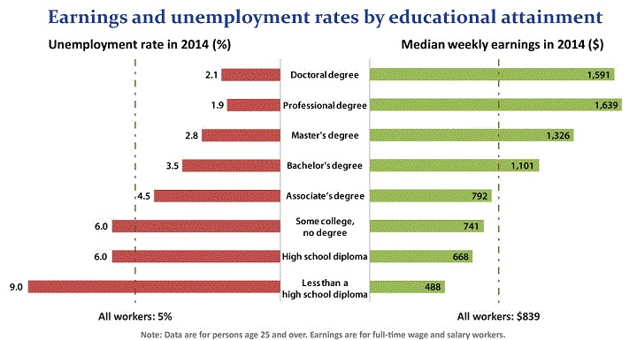
Earnings and Unemployment Rates
by educational attainment
Source: Current Population Survey, Bureau of Labor Statistics
Notes:
When deciding where to go to college, money shouldn’t be the first thing you think about. Yes, college is expensive. But there are ways to pay for it if you plan ahead.
Financial Aid Programs - Financial aid for college refers to specific borrowed, given or earned money that can be found through a variety of sources, including state, federal, institutional, and private financial aid sources. Improve your chances of receiving financial aid by researching your options, planning carefully, and applying early.
529 Savings & Prepaid Tuition Programs - 529s are state-sponsored college funding programs designed to help families save for future college costs. Here in Illinois we have Bright Start®, a college savings plan and College Illinois!^{sm}, a prepaid tuition plan.
Employer Tuition Reimbursement Plans - If you work while you’re in college, your employer may offer an employer tuition reimbursement plan. These types of plans allow your employer to pay for part or all of your tuition. Such plans are available at certain companies, and each company’s policies are different. Contact potential employers to learn about their unique plans.
Tuition Benefits - Some employers offer free part-time tuition as a benefit to their employees. This type of benefit can sometimes be transferred or extended to a dependent.
Tuition Payment Plans - Tuition payment plans provide you with the option to budget your tuition. Plans vary at each college. Some allow you to pay multiple installments over several months. Others require that you pay one lump sum per semester. A possible advantage to most tuition payment plans is that you might not incur the interest and finance charges that come with loans and borrowed money.

Slide 9
Ways to pay for a college education

Slide 10
Know the Options
A number of options are available to families who are concerned about their ability to meet the family share of college costs.
Financial Aid Programs
529 Savings & Prepaid Tuition Programs
Employer Tuition Benefits
Tuition Payment Plans
Know the options…
Notes:
When deciding where to go to college, money shouldn’t be the first thing you think about. Yes, college is expensive. But there are ways to pay for it if you plan ahead.
Financial Aid Programs - Financial aid for college refers to specific borrowed, given or earned money that can be found through a variety of sources, including state, federal, institutional, and private financial aid sources. Improve your chances of receiving financial aid by researching your options, planning carefully, and applying early.
529 Savings & Prepaid Tuition Programs - 529s are state-sponsored college funding programs designed to help families save for future college costs. Here in Illinois we have Bright Start®, a college savings plan and College Illinois!^{sm}, a prepaid tuition plan.
Employer Tuition Reimbursement Plans - If you work while you’re in college, your employer may offer an employer tuition reimbursement plan. These types of plans allow your employer to pay for part or all of your tuition. Such plans are available at certain companies, and each company’s policies are different. Contact potential employers to learn about their unique plans.
Tuition Benefits - Some employers offer free part-time tuition as a benefit to their employees. This type of benefit can sometimes be transferred or extended to a dependent.
Tuition Payment Plans - Tuition payment plans provide you with the option to budget your tuition. Plans vary at each college. Some allow you to pay multiple installments over several months. Others require that you pay one lump sum per semester. A possible advantage to most tuition payment plans is that you might not incur the interest and finance charges that come with loans and borrowed money.

Slide 11
Terms and concepts

Slide 12
Types of Financial Aid
There are many types of financial aid, including:
gift-aid
Grants
Scholarships
Work-Study
Loans
Grants
Scholarships
Work-Study
Loans
self-help
aid
Grants are typically based on financial need while scholarships are generally rewards for grades, athletics, a unique skill or even an specific career interest. Work-study allows students to earn money through a campus-based employment program. Loans can be subsidized or unsubsidized but must be repaid after graduation or dropping below half-time enrollment status.
Notes:
There are two basic types of financial aid: gift-aid and self-help.
Gift Aid is usually awarded in the form of grants and scholarships. It is assistance that generally does not have to be repaid.
Grants are usually awarded on the basis of a family’s financial need or limited ability to meet the costs of college.
Scholarships may be awarded to reward merit such as academic achievement, athletic ability, artistic talent, background, or other attributes you may possess.
Self-Help Aid requires you to take more responsibility and includes work opportunities and loans.
Work-study allows you an opportunity to earn money while you’re in college. The money you earn is usually paid directly to you and it is up to you to manage this money wisely.
Student loans are financial aid that must be repaid and should always be considered as a last resort in paying for college.

Slide 13
Aid Definitions
Grants and Scholarships: Grants and scholarships are generally free sources of educational monies that do not need to be repaid. Students should seek to have as much of their education as possible funded this way.
Need-Aid: Many grants and scholarships are rewarded based solely or in part on a student’s demonstrated financial need, as determined by completion of the FAFSA and at some schools completion of the CSS Profile.
Merit-Aid: Some grants and scholarships are awarded based on a student’s demonstrated academic aptitude. Merit-aid may be awarded on criteria such as high school grades, class rank, or ACT/SAT scores.
Athletics/Extra-Curricular: Some colleges also award scholarships and grants to students participating in certain sports or other extra-curricular activities (e.g., marching band, orchestra, etc.).

Slide 14
Aid Definitions
Loans: Student loans are a type of aid that require the student or parents to take on more responsibility. Loans need to be repaid, with interest, after graduating or dropping below half-time attendance status. To borrow from the U.S. Department of Education, students must complete the FAFSA.
Federal Work-Study: Work-Study is financial aid for students who demonstrate financial need and meet certain eligibility requirements. With Federal Work-Study, students can hold campus jobs and use the income they earn from that job to supplement their living expenses while in college. Money earned through Federal Work Study does not have to be paid back and does not negatively effect a student’s EFC calculations.

Slide 15
Guiding Principles
Financial aid funds are available to make it possible for students to continue their education beyond high school.
Students and parents have the primary responsibility of funding educational costs.
Financial aid is available only to assist in filling the gap between a family’s contribution and a student’s yearly academic expenses.
Eligibility is based on multiple factors.
Schools are required to meet certain standards and have written agreements with the U.S. Department of Education and ISAC in order to offer student aid programs. Federal financial aid can be used at approved colleges, universities, trade schools and technical schools.
The school, as a whole, is responsible for proper administration of financial aid programs.
Notes:
There are a few key principals that guide financial aid policies, particularly federal and state financial aid.
First, financial aid is to help a student and their parents pay for college, but the students and parents have the primary responsibility to paying for college.
Second, financial aid is designed to fill the gap in ability to pay, and is not intended to finance a student’s entire education, unless we are talking about merit scholarships offered by the colleges and universities themselves.
Third, eligibility is based on multiple factors. For need-based federal and state aid, these factors include dependency status, age of the oldest parent, number in the household, and the cost of attendance at the college the student attends, to name a few of the major factors.
Fourth, school must comply with federal and state laws and regulations. An example of this is the Satisfactory Academic Progress requirement; students not making SAP should not be provided federal or state aid.
Fifth and finally, the college or university is responsible for properly administering financial aid programs. The financial aid office staff might be paid by the college, but they are stewards of taxpayer money.

Slide 16
Expected Family Contribution
EFC
Expected Family Contribution
A need analysis formula established by Congress determines a student’s Expected Family Contribution using information reported on the FAFSA.
What? | Why? | Where?
A comparative measure of how much a family can be expected to contribute over the course of an academic year | Used to determine a student’s eligibility for most federal and state assistance | Shown on the Student Aid Report (SAR)
Notes:
OK, I just mentioned the EFC, or Expected Family Contribution. What is the EFC?
To determine your financial need, the U.S. Department of Education uses a formula established by Congress called Federal Methodology. This need analysis formula uses information from the FAFSA to determine the amount that the student and their family combined is expected to contribute towards the student’s college education, which is called the Expected Family Contribution (EFC). Because it is based on family information, a student’s EFC will remain the same regardless of the college they attend.

Slide 17
Financial Need
Cost of
Attendance
(COA)
Expected
Family
Contribution
(EFC)
Financial
Need
-
=
In many cases, financial aid will not cover 100% of a student’s financial need. The student is ultimately responsible for any difference between the cost of attendance and the financial aid offered.
Notes:
COA – EFC = Financial Need
At each college, the financial aid office will calculate financial need by subtracting the EFC from the COA. The EFC will be the same at each college, but the COA will differ from college to college. Keep this in mind:
COA (varies)
EFC (remains constant)
Financial Need (varies by school)
In many cases, the college may not be able to meet 100% of a student’s financial need. The difference between the cost of attendance and the amount of financial aid offered by the college is referred to as the gap, which the student and family will be responsible for paying out-of-pocket.
Financial Need – Financial Aid Award + EFC= Out of Pocket Cost

Slide 18
How the Typical Family Pays for College
Traditional age (18-24) undergraduate students in 2013-2014
Source: How America Pays for College 2014, Sallie Mae
Notes:
COA – EFC = Financial Need
At each college, the financial aid office will calculate financial need by subtracting the EFC from the COA. The EFC will be the same at each college, but the COA will differ from college to college. Keep this in mind:
COA (varies)
EFC (remains constant)
Financial Need (varies by school)
In many cases, the college may not be able to meet 100% of a student’s financial need. The difference between the cost of attendance and the amount of financial aid offered by the college is referred to as the gap, which the student and family will be responsible for paying out-of-pocket.
Financial Need – Financial Aid Award + EFC= Out of Pocket Cost

Slide 19
Government Sources of Financial Aid
Illinois Student Assistance Commission
(ISAC)
U.S. Department of Education
(ED)
www.ISAC.org
www.StudentAid.gov
The federal agency that provides college funding in the form of grant, scholarship, work study, and educational loan programs.
The college access and financial aid agency in the state of Illinois that administers scholarship, grant, prepaid tuition, and student loan repayment/forgiveness programs.
Notes:
COA – EFC = Financial Need
At each college, the financial aid office will calculate financial need by subtracting the EFC from the COA. The EFC will be the same at each college, but the COA will differ from college to college. Keep this in mind:
COA (varies)
EFC (remains constant)
Financial Need (varies by school)
In many cases, the college may not be able to meet 100% of a student’s financial need. The difference between the cost of attendance and the amount of financial aid offered by the college is referred to as the gap, which the student and family will be responsible for paying out-of-pocket.
Financial Need – Financial Aid Award + EFC= Out of Pocket Cost

Slide 20
Illinois Student Assistance Commission
Grant and Scholarship Programs
Program | Acronym | Type of Aid | 2015-2016 Benefit
Monetary Award Program | MAP | Grant; Need-based; Appropriation | Up to $4,720 (est.)
Illinois Veteran Grant | IVG | Grant; Entitlement | Tuition and Mandatory Fees (Public Only)
Illinois National Guard Grant | ING | Grant; Entitlement | Tuition and Mandatory Fees (Public Only)
Grant Program for Dependents of Police, Fire, or Correctional Officers |  | Grant; Appropriation | Tuition and Mandatory Fees at Public Colleges or Equivalent (Any Approved College)
Illinois State Scholars Program | ISSP | Certificate of Achievement, Scholarship, Appropriation | $1,000 (Not funded)
Teacher Programs
Program | Acronym | Type of Aid | 2015-2016 Benefit
Minority Teachers of Illinois Scholarship | MTI | Scholarship; Appropriation | up to $5,000 (est.)
IL Special Ed. Teacher Tuition Waiver | SETTW | Waiver | Tuition and Mandatory Fees (Public Only)
www.isac.org
Notes:
The U.S. Department of Education is the nation’s largest source of student aid.
The Pell Grant is available to undergraduate students and is the largest grant program administered on a federal level. It may be used for any educational expense, such as tuition and fees, room and board, and living expenses. Award amounts are dependent on funding approved by the Federal government and are calculated by the college.
The Iraq and Afghanistan Service Grant is available to t students whose parent or guardian was a member of the U.S. Armed Forces and died as a result of service performed in Iraq or Afghanistan after September 11, 2001.
Teacher Education Assistance for College and Higher Education (TEACH) grants reward undergraduates, post baccalaureate, and graduate level students who are or will be taking course work necessary to become elementary or secondary teacher; recipients must sign an Agreement to Serve saying they will teach full-time in designated teacher shortage areas for 4 years (within 8 years of completing an academic program).
Campus-Based Programs are administered directly by the financial aid office at each participating school. Not all schools participate in all three programs, so check with a school's financial aid office to find out which programs they participate in. How much aid a student can receive from each of these programs depends on financial need, on the amount of other aid received, and on the availability of funds at a particular college. Unlike the Federal Pell Grant Program, which provides funds to every eligible student, the campus-based programs provide a certain amount of funds for each participating school to administer each year. When the money for a program is gone, no more awards can be made from that program for that year. Each school sets its own deadlines for campus-based funds.
The FSEOG gives priority to exceptionally needy students (in lowest EFC order) and Federal Pell Grant recipients. It is available to undergraduate students. The award amount is calculated on the basis of the student's need and availability of funds at the college. The college determines eligibility and students are notified via the financial aid award letter.
To apply for state and federal financial aid programs, the FAFSA must be completed.

Slide 21
U. S. Department of Education
Federal Grant Programs
Program | Acronym | Type of Aid | 2015-2016 Award
Federal Pell Grant |  | Grant; Need-based | up to $5,775
Iraq and Afghanistan Service Grant |  | Grant | up to $5,382
Federal TEACH Grant Program | TEACH | Grant | up to $3,728; total amount may not exceed $16,000.
Campus-Based Programs
Program | Acronym | Type of Aid | 2015-2016 Award
Federal Supplemental Education Opportunity Grant | FSEOG | Grant Exceptional Need | $100-$4,000
Federal Work-Study | FWS | Need-based Employment | no annual minimum or maximum amounts; at least minimum wage
Perkins Loans |  | Need-based Loan | up to $5,500 for undergraduates and up to $8,000 for graduate students
www.studentaid.gov
Notes:
The U.S. Department of Education is the nation’s largest source of student aid.
The Pell Grant is available to undergraduate students and is the largest grant program administered on a federal level. It may be used for any educational expense, such as tuition and fees, room and board, and living expenses. Award amounts are dependent on funding approved by the Federal government and are calculated by the college.
The Iraq and Afghanistan Service Grant is available to t students whose parent or guardian was a member of the U.S. Armed Forces and died as a result of service performed in Iraq or Afghanistan after September 11, 2001.
Teacher Education Assistance for College and Higher Education (TEACH) grants reward undergraduates, post baccalaureate, and graduate level students who are or will be taking course work necessary to become elementary or secondary teacher; recipients must sign an Agreement to Serve saying they will teach full-time in designated teacher shortage areas for 4 years (within 8 years of completing an academic program).
Campus-Based Programs are administered directly by the financial aid office at each participating school. Not all schools participate in all three programs, so check with a school's financial aid office to find out which programs they participate in. How much aid a student can receive from each of these programs depends on financial need, on the amount of other aid received, and on the availability of funds at a particular college. Unlike the Federal Pell Grant Program, which provides funds to every eligible student, the campus-based programs provide a certain amount of funds for each participating school to administer each year. When the money for a program is gone, no more awards can be made from that program for that year. Each school sets its own deadlines for campus-based funds.
The FSEOG gives priority to exceptionally needy students (in lowest EFC order) and Federal Pell Grant recipients. It is available to undergraduate students. The award amount is calculated on the basis of the student's need and availability of funds at the college. The college determines eligibility and students are notified via the financial aid award letter.
To apply for state and federal financial aid programs, the FAFSA must be completed.

Slide 22
The Big Three
Maximum Award Amounts for 2015-2016
Up to $4,720*
Up to $4,000
Up to $5,775
State of Illinois Monetary Award Program (MAP)
Federal Pell Grant
Federal Supplemental Education Opportunity Grant (FSEOG)
Total = $14,495
* Based on best estimates as of publication date. Announced grant awards could increase or decrease throughout the academic year.
Notes:
COA – EFC = Financial Need
At each college, the financial aid office will calculate financial need by subtracting the EFC from the COA. The EFC will be the same at each college, but the COA will differ from college to college. Keep this in mind:
COA (varies)
EFC (remains constant)
Financial Need (varies by school)
In many cases, the college may not be able to meet 100% of a student’s financial need. The difference between the cost of attendance and the amount of financial aid offered by the college is referred to as the gap, which the student and family will be responsible for paying out-of-pocket.
Financial Need – Financial Aid Award + EFC= Out of Pocket Cost

Slide 23
Grant Aid 2013-2014
Source of Aid | Percent of Grants
US Department of Education | 40%
State Government | 8%
Colleges/Universities | 39%
Private/Employer | 13%
Source: Trends in Student Aid 2013, p.15, The College Board, New York, NY,
Notes:
Non federal loans have declined significantly in the last five years. In 2007-08 nonfederal loans made up 25% of student loan borrowing.

Slide 24
Loan Programs
When evaluating loan options, consider the following:
Source
of Loan
Subsidized
vs.
Unsubsidized
Interest
Rate
+
Fees
Repayment
Options
&
Grace
Period
Start by knowing a borrower’s rights and responsibilities.
Notes:
Know the borrowing basics and be sure to research your loan options carefully.
What is a loan?
A loan is a type of “self-help” aid that lets students borrow money from the government, banks or other lending institutions. However, loans must be paid back with added interest. Always borrow conservatively, accepting only the amount of money needed. After all, loans can be a lot of help, but the more money you borrow the more money you will have to pay back with interest.
How are loans awarded?
Know that loans can be awarded based on financial need (subsidized loans) or not on financial need (unsubsidized loans). Loan eligibility will be determined after grants, scholarships and Federal Work-Study programs have been considered.
Types of loans…
As you start to evaluate loan options, keep in mind that there are student loans, parent loans, alternative loans and consolidation loans. Know your options as well as your borrower rights and responsibilities.
Basics you should know…
To ensure proper management of your student debt, know: (1) the source of the loan; (2) whether it is subsidized or unsubsidized; (3) the interest rate; (3) repayment options; and (4) grace periods.

Slide 25
U. S. Department of Education
Federal Loan Programs, 2015-2016
Type
Rate
Amount
Grace
Perkins | Subsidized | 5% Fixed | $5,500 per year | 9 Months
Direct Loans | Subsidized | 4.29% Fixed | $3,500 first-year undergraduate | 6 Months
 | Unsubsidized (Undergraduate) | 4.29% Fixed | $2,000 first-year dependent $6,000 first-year independent | 6 Months
 | Unsubsidized (Graduate) | 5.84% Fixed | $20,500 per year | 6 Months
Direct PLUS (Parent/Graduate) | Credit-based Unsubsidized | 6.84% Fixed | Depends on remaining financial need | Within first 60 days
www.studentaid.gov
Notes:
Know the borrowing basics and be sure to research your loan options carefully.
What is a loan?
A loan is a type of “self-help” aid that lets students borrow money from the government, banks or other lending institutions. However, loans must be paid back with added interest. Always borrow conservatively, accepting only the amount of money needed. After all, loans can be a lot of help, but the more money you borrow the more money you will have to pay back with interest.
How are loans awarded?
Know that loans can be awarded based on financial need (subsidized loans) or not on financial need (unsubsidized loans). Loan eligibility will be determined after grants, scholarships and Federal Work-Study programs have been considered.
Types of loans…
As you start to evaluate loan options, keep in mind that there are student loans, parent loans, alternative loans and consolidation loans. Know your options as well as your borrower rights and responsibilities.
Basics you should know…
To ensure proper management of your student debt, know: (1) the source of the loan; (2) whether it is subsidized or unsubsidized; (3) the interest rate; (3) repayment options; and (4) grace periods.

Slide 26
U. S. Department of Education
Federal Loan Limits, 2015-2016
Year | Dependent Students | Independent Students (and dependent undergraduates whose parents are unable to obtain PLUS Loans)
First-Year Undergraduate Annual Loan Limit | $5,500 – No more than $3,500 subsidized | $9,500 – No more than $3,500 subsidized.
Second-Year Undergraduate Annual Loan Limit | $6,500 – No more than $4,500 subsidized | $10,500 – No more than $4,500 subsidized
Third-Year and Beyond Undergraduate Annual Loan Limit | $7,500 – No more than $5,500 subsidized | $12,500 – No more than $5,500 subsidized
Graduate or Professional Students Annual Loan Limit | Not Applicable (all graduate and professional students are considered independent) | $20,500 (unsubsidized only)
Subsidized and Unsubsidized Aggregate Loan Limit | $31,000 – No more than $23,000 subsidized | $57,500 for undergraduates – No more than $23,000 subsidized $138,000 for graduate or professional students – No more than $65,500 subsidized. (includes loans for undergraduate study)
www.studentaid.gov
Notes:
Know the borrowing basics and be sure to research your loan options carefully.
What is a loan?
A loan is a type of “self-help” aid that lets students borrow money from the government, banks or other lending institutions. However, loans must be paid back with added interest. Always borrow conservatively, accepting only the amount of money needed. After all, loans can be a lot of help, but the more money you borrow the more money you will have to pay back with interest.
How are loans awarded?
Know that loans can be awarded based on financial need (subsidized loans) or not on financial need (unsubsidized loans). Loan eligibility will be determined after grants, scholarships and Federal Work-Study programs have been considered.
Types of loans…
As you start to evaluate loan options, keep in mind that there are student loans, parent loans, alternative loans and consolidation loans. Know your options as well as your borrower rights and responsibilities.
Basics you should know…
To ensure proper management of your student debt, know: (1) the source of the loan; (2) whether it is subsidized or unsubsidized; (3) the interest rate; (3) repayment options; and (4) grace periods.

Slide 27
U. S. Department of Education
Federal Loan Fees, 2015-2016
Loan Type | First Disbursement Date | Loan Fee
Direct Subsidized Loans and Direct Unsubsidized Loans | On or after Dec. 1, 2014 and before Oct. 1, 2015 | 1.073%
 | On or after Oct. 1, 2015 and before Oct. 1, 2016 | 1.068%
Direct PLUS Loans | On or after Dec. 1, 2014 and before Oct. 1, 2015 | 4.292%
 | On or after Oct. 1, 2015 and before Oct. 1, 2016 | 4.272%
Loans first disbursed prior to Dec. 1, 2013, have different loan fees. There are no loan fees for Perkins Loans.
www.studentaid.gov
Notes:
Know the borrowing basics and be sure to research your loan options carefully.
What is a loan?
A loan is a type of “self-help” aid that lets students borrow money from the government, banks or other lending institutions. However, loans must be paid back with added interest. Always borrow conservatively, accepting only the amount of money needed. After all, loans can be a lot of help, but the more money you borrow the more money you will have to pay back with interest.
How are loans awarded?
Know that loans can be awarded based on financial need (subsidized loans) or not on financial need (unsubsidized loans). Loan eligibility will be determined after grants, scholarships and Federal Work-Study programs have been considered.
Types of loans…
As you start to evaluate loan options, keep in mind that there are student loans, parent loans, alternative loans and consolidation loans. Know your options as well as your borrower rights and responsibilities.
Basics you should know…
To ensure proper management of your student debt, know: (1) the source of the loan; (2) whether it is subsidized or unsubsidized; (3) the interest rate; (3) repayment options; and (4) grace periods.

Slide 28
Student Loans 2013-2014
Loan Program | Percent of Student Loans
Direct Subsidized | 24%
Direct Unsubsidized | 49%
Direct Parent PLUS | 9%
Direct Graduate PLUS | 7%
Perkins and Other Federal | 1%
Non-federal Loans (Private and Institutional) | 9%
Source: Trends in Student Aid 2014, p.16, The College Board, New York, NY
Notes:
Non federal loans have declined significantly in the last five years. In 2007-08 nonfederal loans made up 25% of student loan borrowing.

Slide 29
APPLYING FOR FINANCIAL AID

Slide 30
How to Apply
To be considered for student aid, a student must complete all forms required by a college.
Free Application for Federal Student Aid (FAFSA)
Institutional Forms (e.g., scholarship applications)
Other (e.g., CSS Profile)
Note: Communicate with each college to inquire about steps to a complete application.
Notes:
The first step in applying for federal and state financial aid programs is to complete the Free Application for Federal Student Aid (FAFSA). This application, which is available to complete online (preferred method) or in paper format, will use income, assets and other factors to determine the amount you and your family are expected to contribute to your college expenses.
Your eligibility for financial aid will be determined by your and your family’s financial situation, and by filing your application on time. In some instances, colleges may use additional forms. The form used most often in this process (typically private colleges) the CSS/Financial Aid PROFILE, which is administered by the College Scholarship Service (CSS), a division of the College Board organization. Be sure to communicate with each college to inquire about the steps you need to take to ensure that you submit a complete application.

Slide 31
General Eligibility Requirements
Who can get federal and state student aid?
Eligibility for most federal and state aid programs is based on financial need rather than academic achievement.
In addition to a completed FAFSA, a student must:
have a high school diploma or its equivalent
enroll as a regular student in an eligible degree or certificate program
have a valid Social Security Number
make satisfactory academic progress
register for Selective Service, if male 18-25 years old
sign certifying statements on the FAFSA
be a U.S. Citizen or eligible noncitizen
Notes:
To receive aid funds, a student must be qualified to study at the postsecondary level.
A student qualifies if the following apply:
has a high school diploma;
has the recognized equivalent of a high school diploma, such as a general education development or GED certificate;
has completed homeschooling at the secondary level;
has passed a Department approved ability-to-benefit test; or
has satisfactory completed 6 credits of college work that are applicable to a degree or certificate offered by the school.

Slide 32
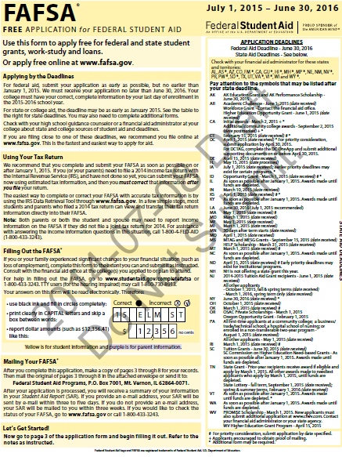
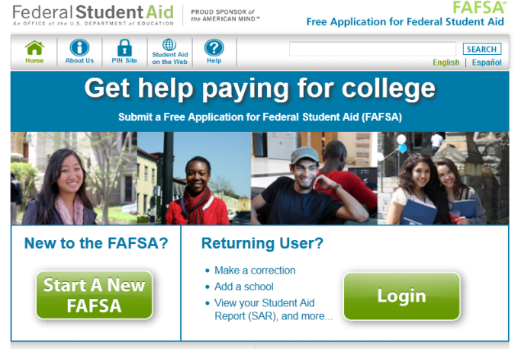
Free Application for Federal Student Aid
What is a FAFSA?
It is the first step in the financial aid process. A FAFSA is used to apply for Illinois scholarships and grants and for federal financial aid such as grants, loans, and work-study (e.g., Pell Grant, MAP Grant). In addition, postsecondary schools use it to award non-federal financial aid. The application is available at no fee, hence the word free in the title.
Three Ways to Access a FAFSA
Paper FAFSA | FAFSA on the Web | .pdf FAFSA
1-800-4-FED-AID | www.FAFSA.gov | www.FAFSA.gov
Notes:
To receive aid funds, a student must be qualified to study at the postsecondary level.
A student qualifies if the following apply:
has a high school diploma;
has the recognized equivalent of a high school diploma, such as a general education development or GED certificate;
has completed homeschooling at the secondary level;
has passed a Department approved ability-to-benefit test; or
has satisfactory completed 6 credits of college work that are applicable to a degree or certificate offered by the school.

Slide 33
Dependency Status
Whose information is required on a FAFSA?
For financial aid purposes, questions on the FAFSA will determine the status of the student.
Status based on FAFSA | Information to be Reported
Dependent | Student Parents
Independent | Student Spouse
Notes:
The questions you answer on the FAFSA will determine whether you are considered a DEPENDENT or INDEPENDENT student. This determination will impact the amount and types of aid for which you will qualify.
For DEPENDENT students, the EFC includes a contribution from the parents’ and student’s income and assets.
For INDEPENDENT students, the EFC is made up of the student’s (and spouse’s, if married) income and assets.
Many people think that dependency is a choice the student can make. This is not true, dependency status is determined by completion of the FAFSA and the answer to key dependency questions.

Slide 34
FSA ID
A new PIN process was instituted May 10, 2015
Previous PIN process was replaced by a Username and Password for Federal Student Aid websites.
Students who filed 2015-2016 FAFSAs before the change will have to transition over to the new format.
Those who file FAFSAs after the change will use the new format from the start.
 | FSA ID Requirements
 | Username
 | Password
 | Uppercase letters Lowercase letters Numbers Special characters
Notes:
The questions you answer on the FAFSA will determine whether you are considered a DEPENDENT or INDEPENDENT student. This determination will impact the amount and types of aid for which you will qualify.
For DEPENDENT students, the EFC includes a contribution from the parents’ and student’s income and assets.
For INDEPENDENT students, the EFC is made up of the student’s (and spouse’s, if married) income and assets.
Many people think that dependency is a choice the student can make. This is not true, dependency status is determined by completion of the FAFSA and the answer to key dependency questions.

Slide 35
When to Apply
Important Dates
2015-2016 Academic Year 2016-2017 Academic Year
FAFSA
Dates vary by college (check with each college)
MAP Grant
As soon as possible after January 1, 2015 (awards made until funds are depleted.*)
Federal Pell Grant
June 30, 2016 (at the end of the academic year)
January 1, 2015 (first date to submit FAFSA)
College
FAFSA
Dates vary by college (check with each college)
MAP Grant
As soon as possible after January 1, 2016 (awards made until funds are depleted.*)
Federal Pell Grant
June 30, 2017 (at the end of the academic year)
January 1, 2016 (first date to submit FAFSA)
College
Initial Suspense Date for 2013-2014 MAP Awards: March 2, 2013; Limited Release Suspense Date: March 2 – 16, 2013
Initial Suspense Date for 2014-2015 MAP Awards: February 28, 2014; Limited Release Suspense Date: February 28-March 5, 2014
Suspense Date for 2015-2016 MAP Awards: February 22, 2015
* Note: In Illinois, grants and dollar amounts are subject to appropriations by the Illinois General Assembly and the Governor.
Notes:
The questions you answer on the FAFSA will determine whether you are considered a DEPENDENT or INDEPENDENT student. This determination will impact the amount and types of aid for which you will qualify.
For DEPENDENT students, the EFC includes a contribution from the parents’ and student’s income and assets.
For INDEPENDENT students, the EFC is made up of the student’s (and spouse’s, if married) income and assets.
Many people think that dependency is a choice the student can make. This is not true, dependency status is determined by completion of the FAFSA and the answer to key dependency questions.

Slide 36
Output Documents
The SAR and ISIR
SAR
Student Aid Report
ISIR
Institutional Student Information Record
After FAFSA processing is completed by the Central Processing System (CPS), a student will receive a Student Aid Report (SAR) that shows:
information originally provided by a student;
the Expected Family Contribution;
results of the eligibility matches;
information about inconsistencies; and
colleges listed on the FAFSA will receive an ISIR.
Notes:
The body of the SAR has been reduced to enable students to determine the status of their FAFSA, their eligibility for a Federal Pell Grant and the next steps in the application process
Students who submit a Spanish FAFSA or a correction in Spanish will receive all communication in Spanish
Notes:
Once students complete their FAFSA, two very important documents are generated, the Student Aid Report and the Institutional Student Information Record. These documents provide the student and the colleges and universities with information from the student’s FAFSA, as well as the Expected Family Contribution. Information on the SAR and the ISIR will also let the schools and the student know if there are any problems with data matches to determine eligibility, such as names not matching, or if there were any inconsistencies or errors that need to be resolved.

Slide 37
College Board: CSS/Financial Aid Profile
In addition to the FAFSA, some institutions may require students to complete the College Board CSS Profile in order to determine eligibility for institutional grants and scholarships.
In Illinois, it was requested by 13 institutions and organizations for the 2015-2016 academic year.
Illinois Institutions that Requested the CSS/Financial Aid Profile for
2015-2016
Bradley University
Illinois Wesleyan University
Joseph Blazek Foundation
Lake Forest College
Lincoln Christian University
Monmouth College
National Merit Scholarship Corp.
Northwestern University
Principia College
Seabury-Western Theological Sem.
Shimer College
University of Chicago
Wheaton College
www.collegeboard.org
Notes:
http://student.collegeboard.org/css-financial-aid-profile

Slide 38
CSS/Financial Aid Profile
Additional Information
Can be completed before the FAFSA and is available beginning October 1st for the following academic year (e.g., Oct. 1, 2015 for 2016-2017 academic year)
A different formula for calculating student need
CANNOT be used to award federal or Illinois financial aid, only used to award institutional or other private aid
Costs $25, plus $16 for each additional report
(students who are from low-income families with limited assets will automatically receive fee waivers)

Slide 39
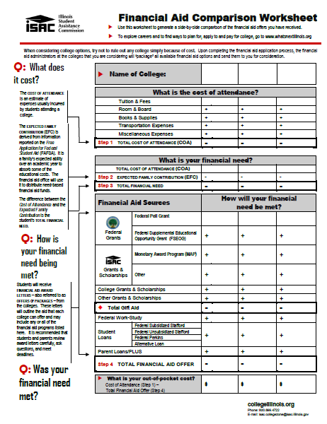
Financial Aid Awards
The financial aid administrator at the college will package all available aid and send an award offer for consideration.
What is the total cost of attendance?
What is the Expected Family Contribution?
What is the out-of-pocket cost?
What is a student’s financial aid eligibility?
What types of financial aid were included?
Was financial need met?
When packaging need-based aid, students must have need and all sources of aid must be considered
New information creates changes (e.g., outside scholarships)
The total of all sources of aid may not exceed Cost of Attendance (COA)
Notes:
Once a student has completed the financial aid application process, the financial aid administrators at each college that the student had their financial aid information sent too on the FAFSA will "package" all available aid options and send an award letter for consideration. Because each college has its own packaging policy, the types of financial aid offered will probably vary from college to college. The financial aid offer may include a combination of financial aid programs from various sources, such as grants, scholarships, work-study and student loans.
When reviewing financial aid award letters, consider the amount of gift aid provided, the amount of loans in the package, and the remaining gap which, along with the EFC, constitutes the out of pocket costs that the student and family will need to come up with to finance a college education.

Slide 40
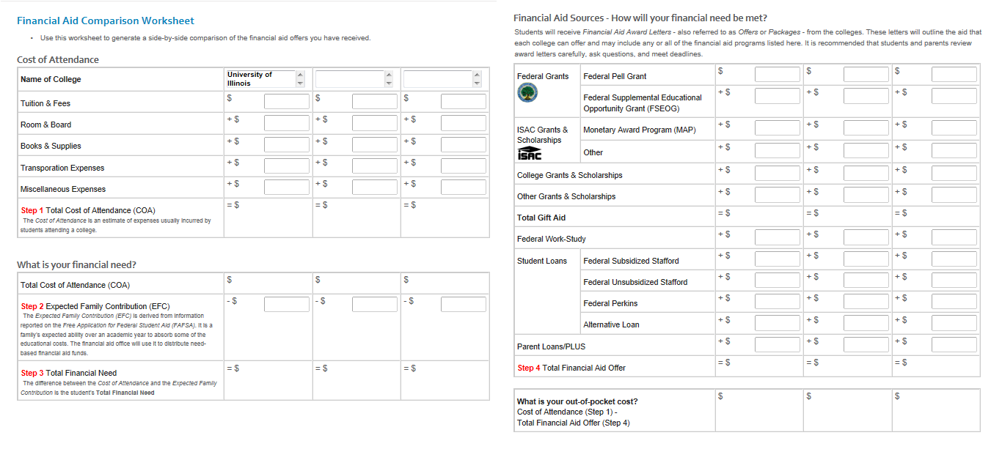
Interactive Award Letter Comparison
Worksheet is now interactive and available for use online
Students can use this worksheet to generate a side-by-side comparison of the financial aid offers they have received.
www.isac.org
Students & Parents → Before College → Making an Informed College Choice → Financial Aid Comparison Worksheet
Notes:
Once a student has completed the financial aid application process, the financial aid administrators at each college that the student had their financial aid information sent too on the FAFSA will "package" all available aid options and send an award letter for consideration. Because each college has its own packaging policy, the types of financial aid offered will probably vary from college to college. The financial aid offer may include a combination of financial aid programs from various sources, such as grants, scholarships, work-study and student loans.
When reviewing financial aid award letters, consider the amount of gift aid provided, the amount of loans in the package, and the remaining gap which, along with the EFC, constitutes the out of pocket costs that the student and family will need to come up with to finance a college education.

Slide 41
Other things to know about applying for aid:
Students must REAPPLY every year
It helps to keep a record and copy of everything that is submitted
Keep track of application DEADLINES
Supplemental applications or forms may be required
A student may be asked to submit documentation for VERIFICATION purposes
Information reported on a FAFSA is confidential and is used ONLY to determine financial aid eligibility
Apply early
Notes:
There are some key things to keep in mind and tell students.
Apply early
Information reported on the FAFSA is confidential and used only to determine financial aid eligibility
Students may be asked to submit documentation to the financial aid office for verification purposes
Supplemental applications or forms may be required
Keep track of application DEADLINES!
Keep a copy of everything you submit
Make sure to reapply for financial aid every year

Slide 42
Disbursement
A student needs to meet the following requirements in order for an award to be disbursed:
⇨Accept the awards
⇨ Submit all paperwork and information required
⇨ Pay past due charges on a student account
⇨ Make arrangements to clear holds set on a student account
⇨ Enroll in classes and meet Satisfactory Academic Progress (SAP) standards
⇨ Complete loan counseling, if the student is a new loan borrower
Note: The method and time of disbursement varies depending on the type of financial aid.
Notes:
Once a student enrolls in a college, financial aid is disbursed. There are a few key steps along the way. First, students must accept the awards, particularly loans. Some paperwork may be required in addition to the FAFSA by the college and university, as well as a Master Promissory Note for loans. In order to keep receiving aid, the student must be making Satisfactory Academic Progress (SAP), which is developed by each college and university but that must show a student making progress towards earning a college degree.
If loans are part of the financial aid package, the student must complete loan counseling.
Student aid can also be delayed or withheld if there are past due charges on the student’s account.
Sometimes, students have holds put on their account. Holds are a way for colleges and universities to make sure that proper documentation is filed and deadlines met. For example, a student who hasn’t met with an academic advisor over a certain period of time could have a hold put on their account.
Finally, financial aid is disbursed in different times. Even if a student receives a Pell Grant, not all the money is paid all at once at the beginning of the year. Students should regularly check on their account to make sure financial aid posts, particularly if there are outside scholarships that the student is expecting.

Slide 43
The Financial Aid Process
From a financial aid administrator’s point of view…
Step 1: Determine Student Eligibility
Step 2: Package Aid
Step 3: Disburse Aid
Step 4:
Deal with Student Departures and Withdrawals
Notes:
To get a high level view of the financial aid offices world, there are four steps in dealing with financial aid for all students. First, they must determine the student’s eligibility, and only then do they package the student for financial assistance. Next, the FAA will disburse aid, and finally will deal with departures and withdrawals of students.

Slide 44
Determine Student Eligibility
Step 1
Student/Parent complete FAFSA
Central Processing System (CPS) processes FAFSA data, calculates EFC, and creates an ISIR and SAR
School reviews ISIR; determines student’s eligibility and need
If student is selected, the school performs verification
If necessary school corrects ISIR data and sends it to CPS for an accurate ISIR
Notes:
(explain process)

Slide 45
Packaging
Step 2
School packages and awards aid
If appropriate, school exercises professional judgment and student is repackaged
If new information about a student becomes available which results in an overaward, repackaging may be necessary
Notes:
(explain process)

Slide 46
Disburse Aid
Step 3
A school credits a student’s account with financial aid funds
If a student received an overpayment, a school adjusts a student’s aid
Steps 1-3 are repeated each award year until a student graduates or withdraws
Notes:
(explain process)

Slide 47
Student Departures
Step 4
Determine the date a student ceased attendance
Must determine a student’s eligibility for a post-withdrawal disbursement
Comply with refund policies and procedures
Prorate the earned and unearned portions of aid based on time spent in attendance

Slide 48
Resources
Get your hands on up-to-date, accurate and trusted sources of information to learn what you need to know.

Slide 49
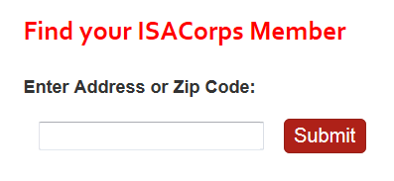
ISACorps
Recent college graduates who serve as near-peer mentors
ISACorps One-on-One Mentoring
One-on-one assistance for students and their families
Career and college exploration
College admission and applications
Financial aid options
Completing the FAFSA
Understanding financial aid award letters
Transitioning to college
ISACorps Presentations and Workshops
The Financial Aid Process
FAFSA Completion Workshops
College Preparation Session
If you are looking to host a specific type of presentation or workshop on the college-going or financial aid process, let us know by filling out the Outreach Request Form in the Counselor area of our website. Home→Counselors→Resources→Outreach Resources
www.isac.org
Students & Parents → Before College → Financial Aid Planning → About the ISACorps

Slide 50
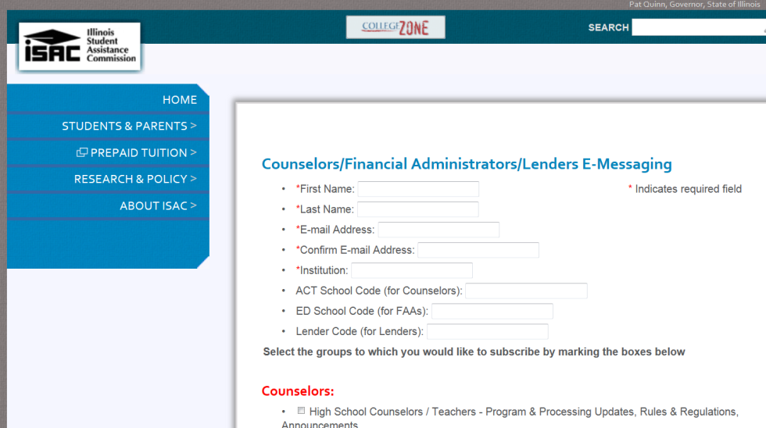
Stay Connected
ISAC’s e-Messaging Service – www.isac.org/emessaging
Notifies you when new information and/or announcements are added to ISAC.org
Summaries of new information, along with links, will be sent to your e-mail
Get Printed Materials
ISAC Printed Materials – www.ISAC.org
FSA Publications Ordering System (FSAPubs) – www.FSAPubs.org

Slide 51
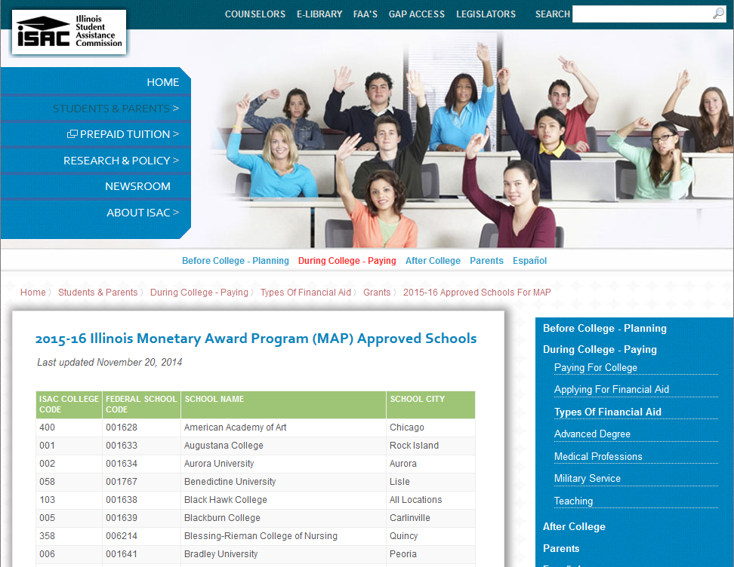
MAP Approved Schools
www.isac.org
Students & Parents → During College → Types of Financial Aid → Grants → 2014-2015 MAP Approved Schools

Slide 52
ISAC Student Portal
Instantly access information on local and national scholarships
Find out chances of acceptance for any college in the country
Search thousands of college profiles
with student reviews, campus videos, financial aid opportunities, and more
Organize college applications and scholarships
www.cappex.com/isac

Slide 53
SALT Standards
Students don’t always understand the impact of their school debt. SALT teaches them to think differently about their finances, empowering them to borrow smart, borrow less, and repay their loans successfully.
SALT was created by the nonprofit American Student Assistance (ASA), who’s been helping students manage their education for 50+ years. SALT Standards offer practical basics and advanced topics such as:
Fundamentals
College Access and Planning
Student Loans
Income and Careers
Money Management
Saving and Investing
Credit and Debt Management
Risk Management
Taxes
www.saltmoney.org/isac

Slide 54
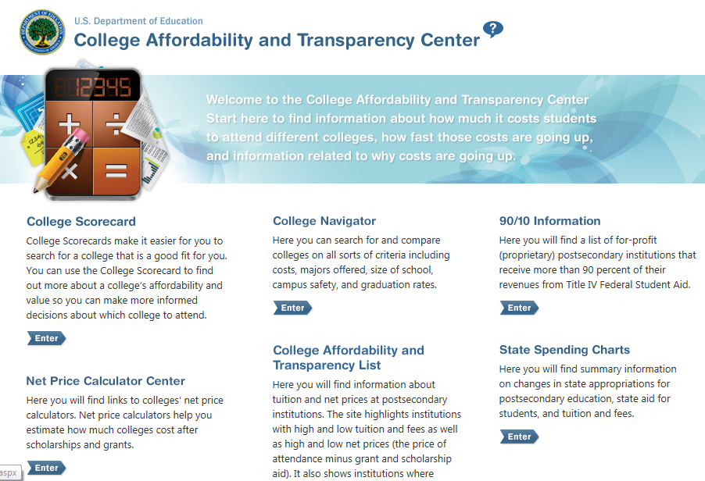
Tools from the Dept. of Education
www.collegecost.ed.gov

Slide 55
College Planning Timeline
www.studentaid.gov/prepare-for-college/checklists

Slide 56
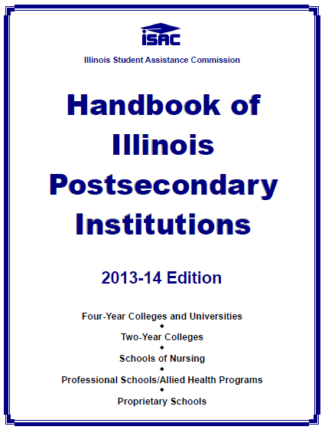
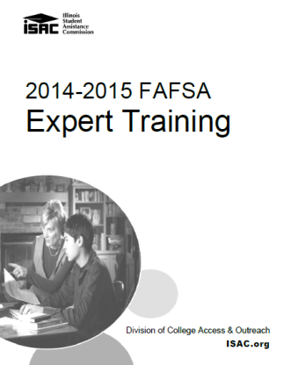
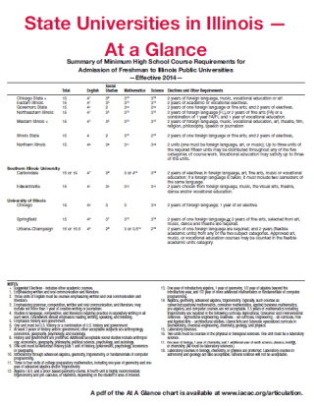
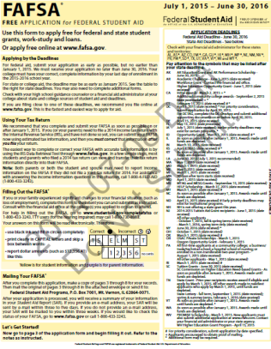
Manuals & Handbooks
Handbook of Illinois Postsecondary Institutions
Up-to-date financial aid and admission information for institutions approved to participate in ISAC's scholarship and grant programs. Source: www.isac.org
FAFSA Expert Guide
A compilations of all documents that are referenced in the FAFSA, including IRS tax forms, a description of the McKinney-Vento Act, and the EFC formula.
Source: Only distributed at ISAC’s Annual Financial Aid Certification Trainings.
Counselors and Mentors Handbook on Federal Student Aid
A guide for those advising students about financial aid for postsecondary education. Source: www.FSAPubs.org
State Universities in Illinois - At a Glance
A summary of minimum high school course requirements for admission of freshman to Illinois public universities.
Source: www.IACAC.org
12 Reasons to Stay in Illinois
An admissions guide for counselors on state universities in Illinois. Source: www.IACAC.org

Slide 57
Trusted Web Sites
Get your hands on up-to-date, accurate and trusted sources of information to learn what you need to know.
FAFSA.gov
StudentAid.gov
ISAC.org
nces.ed.gov/CollegeNavigator

Slide 58
Increase the proportion of Illinois adults with a postsecondary degree or credential to 60 percent by 2025
Follow College Changes Everything
Website: www.collegechangeseverything.org
Facebook: www.facebook.com/collegechangeseverything
Twitter: www.twitter.com/cce_illinois
www.ISAC.org…………………………………….. Illinois Student Assistance Commission
The official web site of the Illinois Student Assistance Commission (ISAC)

