Slide 1
Generation Stressed
Drew Eder. Highland Park High School
Holly Fleischer, Highland Park High School
Benjamin Schwartz, Psy. D. University of Illinois - Chicago

Slide 2
Why spend so much time talking about adolescent stress?
Chicago-area high school trends in student hospitalization
IACAC list serve topic regarding student essay topics during Fall of 2014
Concerns from higher education on emotional health of students entering college
Emotional health has direct correlation to the ability to succeed in the classroom

Slide 4
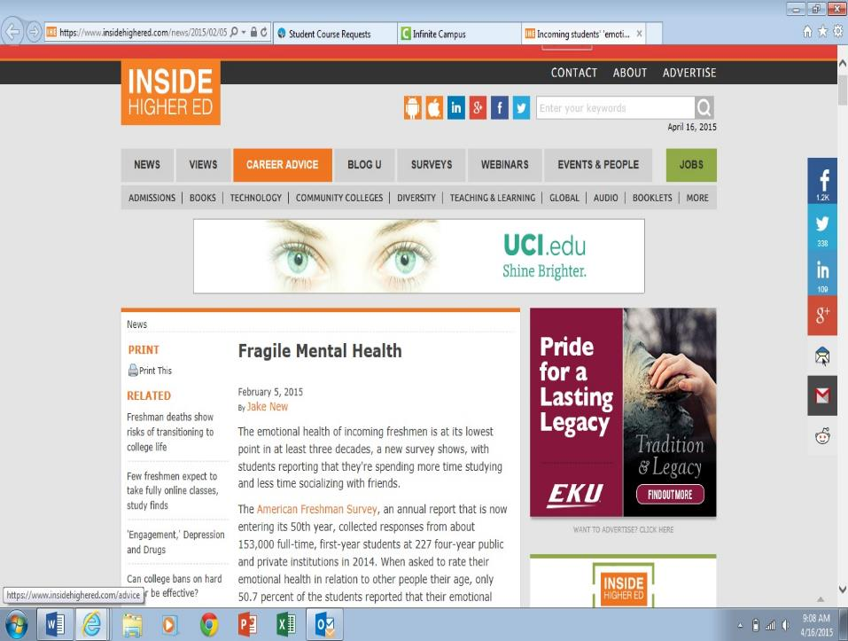

Slide 5
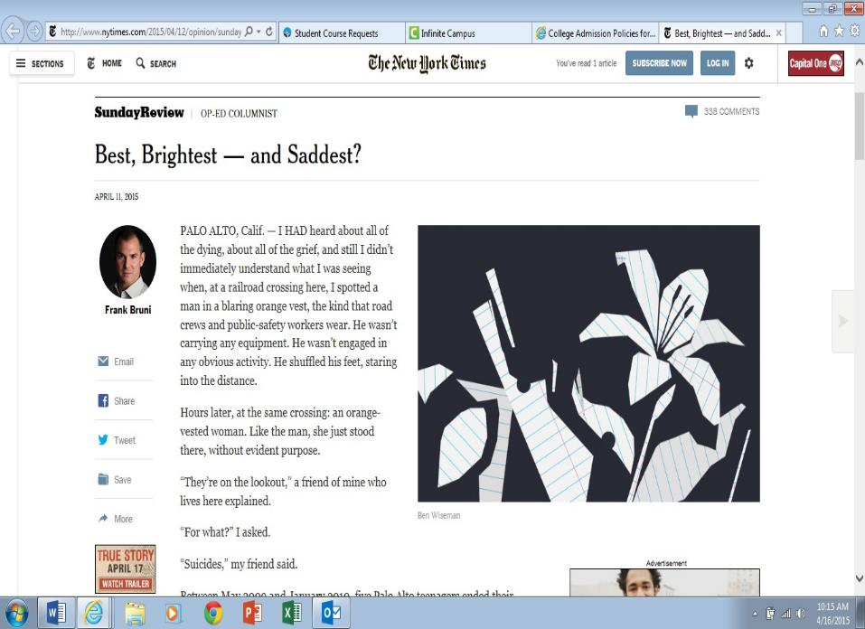

Slide 6
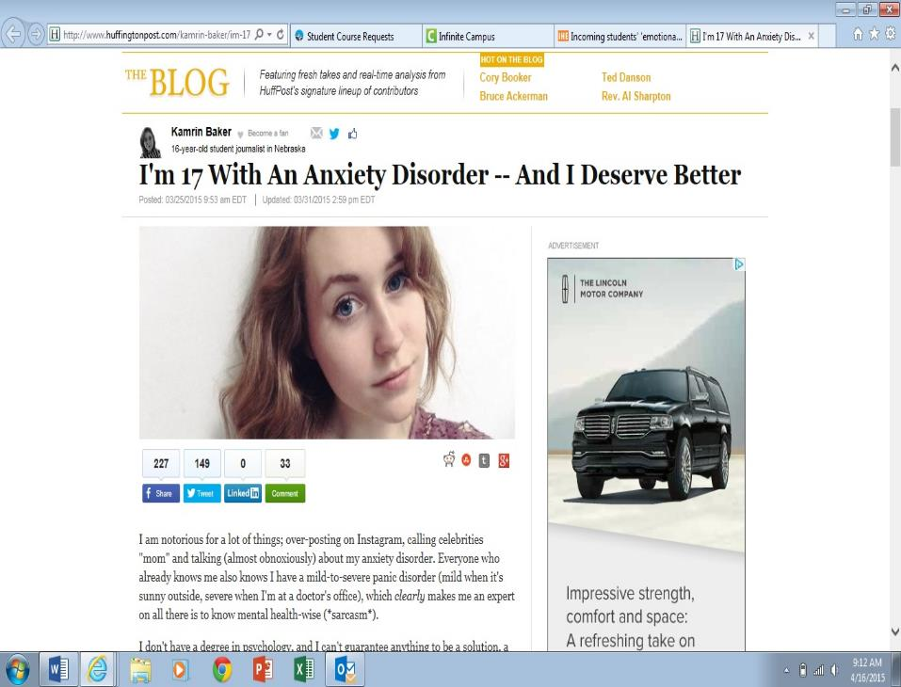

Slide 7
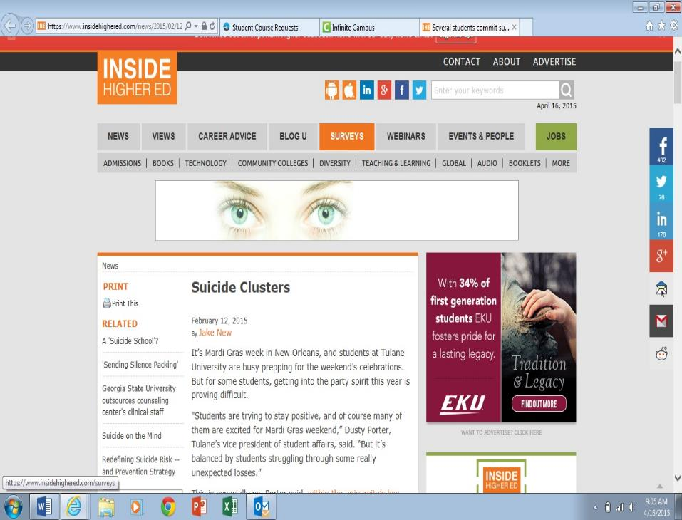

Slide 8
Generation Stressed: A specific look at anxiety
Holly Fleischer

Slide 9
Why Should We Care: Beyond the Humanitarian Argument
According to the 2013 Association for University and College Counseling Center Directors survey of counseling center directors:
70% of directors believe that the # of students with severe psychological problems on their campus has increased in the past year.
Anxiety is the top presenting concern among college students (41.6 percent), followed by depression (36.4 percent) and relationship problems (35.8 percent).
24.5 percent of clients were taking psychotropic medications
21% of counseling center students present with severe mental health concerns, while another 40% present with mild mental health concerns.

Slide 10
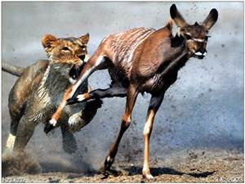
Anxiety and stress is extremely adaptive for survival
Helpful to keep us moving forward (ambition)
Motivator to prepare more
Protective measure
Signals that we need action

Slide 11
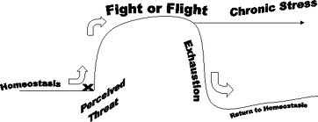
We avoid situations that elicit stress because of the discomfort
When experiencing stress, the amygdala fires that we are in trouble. We then have three possible automatic responses to protect us:
1. Fight the threat
2. Flight
3. Freeze

Slide 12
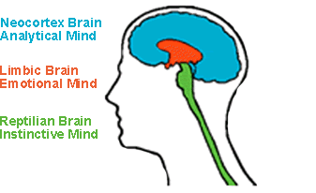
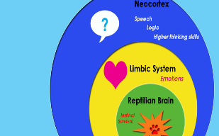
TRIUNE BRAIN THEORY
Reptilian- Instinctual/ heart and lung functioning
Paleopallium- Emotions that click us to act on instinct and lessen thought. When the paleo clicks on, the neocortex will automatically click off because it is incompatible based on the speed of action
Neocortex- Thinking brain that allows us to prepare and plan in a logical fashion
*****Mindfulness helps to reengage the neocortex*****

Slide 13
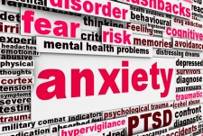
Anxiety Disorders Defined
Anxiety disorders are one of the most common mental health conditions in children and adolescents.
While everyone may have occasional moments of feeling anxious or worried, an anxiety disorder is a medical condition that causes people to feel persistently, uncontrollably worried over an extended period of time.
The disorder may result in significant distress in a number of settings, such as school, peer relationships, and home life
Anxiety may dramatically affect people's lives by limiting their ability to engage in a variety of activities.

Slide 14
Types of Anxiety Disorders
GAD- anxiety that occurs in multiple settings, involving excessive apprehension about a number of situations on most
social phobia or social anxiety - fear of meeting new people or of embarrassing oneself in social situations
selective mutism - persistent failure to speak in specific social situations (despite the physical ability to speak in other situations)
specific phobia - fear of a particular object (spider) or situation (airplane travel)
separation anxiety disorder - fear of separating from home or primary caregiver
panic disorder - unpredictable and repeated panic attacks unrelated to surrounding circumstances
obsessive-compulsive disorder - uncontrollable, repetitive, thoughts and fears, often accompanied by repetitive behaviors intended to prevent the fears from being realized

Slide 15
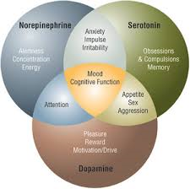
Causes/Risk Factors of Anxiety Disorder
Genetics/Family Dynamics
Biological/Neurological Factors
Developmental Factors
Socio-Economic Status-stress factors
Age-early childhood
Gender-Females
Life experiences/Traumas
Personality-shy, inability to tolerate unknown
Social factors- social alienation
Medical Factors

Slide 16
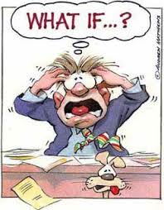
What Does Anxiety look like at Home?
Excessive worry and anxiety
Frequent self-doubt and self-critical comments
Inability to stop the worry despite parental reassurance
Physical problems, including headaches, stomach ache, fatigue, and muscle tensions
Restlessness, feeling "on edge," difficulty concentrating or relaxing, or mind going blank
Irritability, which often increases with increased worry
Sleep problems
Experimentation with alcohol or drugs
Depression or thoughts of not wanting to be alive

Slide 17
How does Anxiety present in high school?
Excessive worry about a variety of matters
Repeated seeking of teacher approval
An inability to explain or stop worries
Difficulty transitioning
Refusal or reluctance to attend school
Avoidance of academic and peer activities
Self-criticism and low self-esteem
Difficulty Concentrating
Co-morbidity (ADHD, depression, learning disorders)
Lower achievement
Over-programming

Slide 18
Socio-Economic Factors- Poverty Maslow’s Hieracrchy of Needs

Slide 19
Socio-Economic Factors-Top 1%
Sense of self is robbed when everything a student does is for the purpose of looking good in the eyes of admissions officers and employers
These students fall apart and develop anxiety disorders and/or depression because they have no authentic sense of who they are or what is important in their lives.
“Preteens from affluent, well-educated families experience the highest rates of depression, substance abuse, anxiety disorders, somatic complaints, and unhappiness of any group of children in this country” (p. 45-46).
“This generation of highly accomplished, college-bound students have been robbed of their independence because they have been raised in a petri dish for one purpose only: to attend an elite college that ensures their and their families’ economic and social status (p. 46-47).
From former Yale professor, William Deresiewiscz in Excellent Sheep: The Miseducation of American Elite and the way to a meaningful life

Slide 20
Developmental Factors
“Parents who persistently fall on the side of intervening for their child, as opposed to supporting their child's attempts to problem solve, interfere with the most important task of childhood and adolescence: the development of a sense of self. Autonomy, what we commonly call independence, along with competence and interpersonal relationships, are considered to be inborn human needs. Their development is central to psychological health. In a supportive and respectful family, children go about the business of forging a "sense of self" by being exposed to, and learning to manage, increasingly complex personal and interpersonal challenges.”
“Both intrusion and overinvolvement prevent the development of the kinds of skills that children need to be successful: the ability to be a self-starter, the willingness to engage in trial-and-error learning, the ability to delay gratification, to tolerate frustration, to show self control, to learn from mistakes and to be a flexible and creative thinker.”
“Psychological development goes awry when children are pressured into valuing the views of others over their own….Working primarily to please others and to gain their approval takes time and energy away from children's real job of figuring out their authentic talents, skills and interests.”

Slide 21
Where your admitted students are on the emotional development scale may prove to be more indicative of success than ACT score and GPA

Slide 22
Implications for college
According to the Center for Collegiate Mental Health pilot study:
The greater students exhibit symptoms of anxiety, the more academic distress they feel
The greater the symptoms, the lower the academic achievement
Students often wait days for a mental health appointment due to budgetary cuts in counseling centers
College centers serve 10 percent of pop.

Slide 23
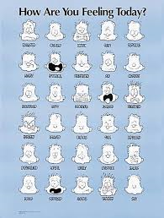
A few suggestions
Yale Center for Emotional Intelligence has found that emotional intelligence can be taught
They suggest offering an Emotions 101 class for all freshmen as part of orientation, seminars, or dorm lives
In classrooms where students learn to recognize, understand, label, express, and regulate their emotions:
they have better relationships and social skills and are more connected to each other and their teachers
they are better at managing conflict
they are more autonomous and show more leadership skills
they perform better in academic subjects (it’s easier to concentrate when they feel better).

Slide 24
A few suggestions continued…
Yale School of Management uses a standardized test of emotional intelligence and a mobile app that teaches emotional skills.
Social Connectedness is the number one protective factor for developing mental illness symptoms.
Parental involvement is understood, but a college student’s confidence and personal agency is undermined when parents intervene on their behalf

Slide 25
Questions we should ask for lasting happiness
Who tells us who we are?
Explore identity development that is not dependent on internet, television, movies, advertising, and college admissions
Where do we want to go with our lives?
What leads us to fulfillment and happiness---passion
How do we want to get there?
The journey is as important as the end goal
Instead of WHAT questions:
What grade did you get?
What team did you make

Slide 26
References
The Association for University and College Counseling Center Directors (2013) The Association for University and College Counseling Center Directors Annual Survey. Aurora, IL: Reetz, D.; Barr, V.; Krylowicz, B.
Strauss, V. (2014, September 28). Why college freshman need to take Emotions 101 Washington Post p. 1-7
Mulligan, M. (2014, November 20) The Three Most important questions you can ask your teenager. Huffington Post, p1-10
Massachusetts General Hospital (2010). What is Anxiety. MA: School Psychiatry Program and Madi Resource Center
Giambrone , A. (2015, March 2). When Mentally Ill students feel alone. The Atlantic p1-6
Welle, C. (2014, January 31). Stress and Anxiety: Scientists Uncover Where Stress Lives in the Brain, Including Causal Mechanism that Produces Worry Medical Daily p.1-10
Levine, M. (2008). The Price of Privilege New York: Harper Collins
Deresiewicz, W. (2014). Excellent Sheep: The Miseducation of the American Elite and the Way to a Meaningful Life. New York: Free Press
Boyle, S. (2015). The Four Gifts of Anxiety: Embrace the Power of Your Anxiety and Transform your life MA: Adams Media

Slide 27
Generation Stressed: Part II Stress, Burnout, Depression and the Student…Assessing College Mental Health Offerings Benjamin Schwartz Psy. D.

Slide 28
Prevalence
The American Freshman: 2014 National Norms (Survey of 150,000 students nationwide)
Self-rated emotional health at an all-time low
9.5% frequently “felt depressed” during past year
5 years prior this number was 6.1%
34.6% “felt overwhelmed” by school and other commitments
5 years prior this number was 27.1%
Why?

Slide 29
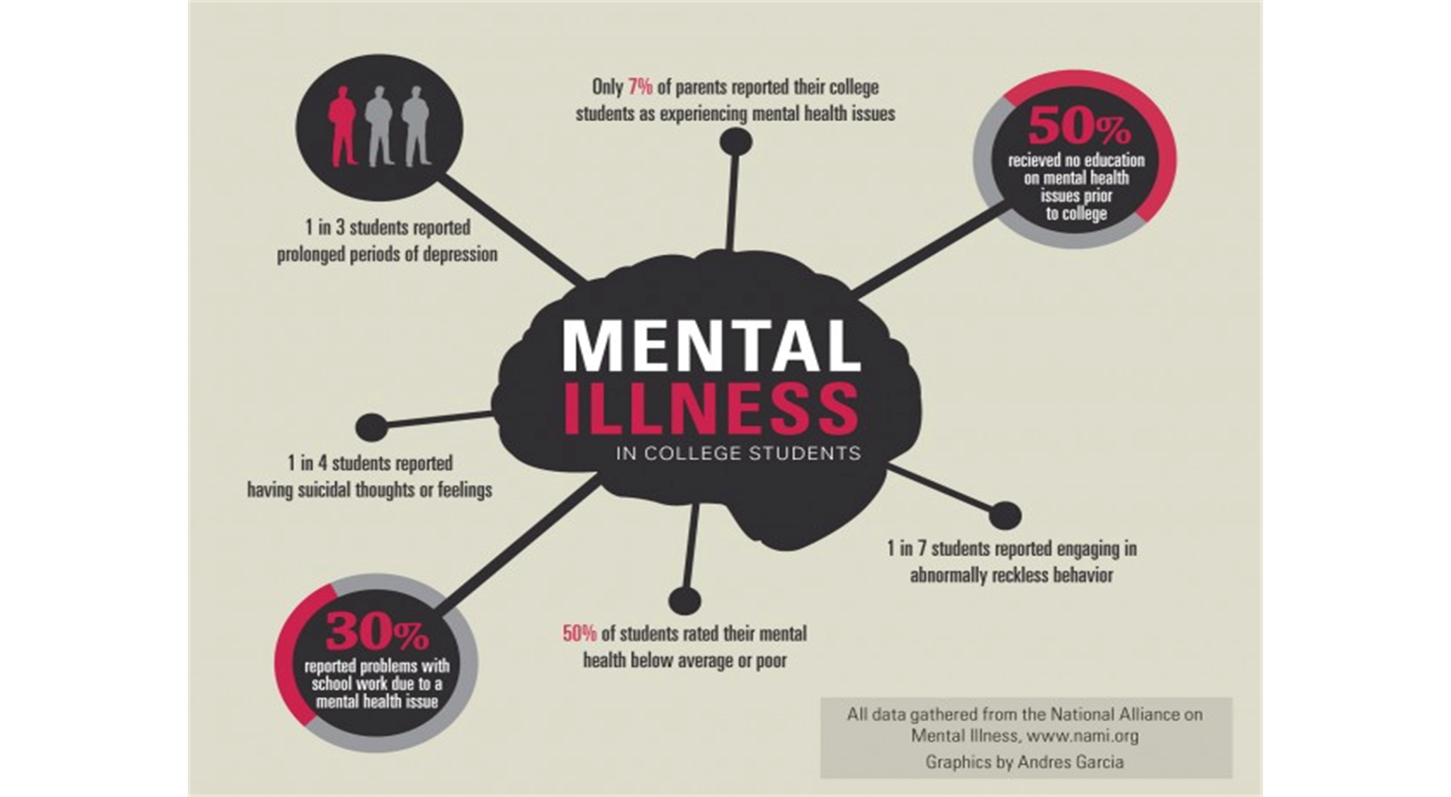

Slide 30
National News
How Colleges Flunk Mental Health
Newsweek, 2/11/15
College Freshman’s Mental Health Hits New Low
CBS News, 2/6/15
When Mentally Ill Students Feel Alone
The Atlantic, 3/2/15
Why are College Students Reporting Record High Levels of Stress?
Time, 1/27/2011

Slide 31
Stress, Burnout, and Depression
Stress
Overengagement
Overreactive
Loss of energy
Problems with concentration & memory
Leads to anxiety
Stress and stressful life events are strongly correlated with academic impairment and prevalence and onset of depression (Aselton, 2012).
Coping counts (active vs passive)

Slide 32
Sources of Stress
Roommate issues
Academic problems
Financial struggles
Career concerns
Pressure from family
Change in sleeping and eating habits
Premorbid coping counts

Slide 33
Stress, Burnout, and Depression
Burnout
Fatigue
Apathy
Disengagement / detachment
Blunted / mental exhaustion
Loss of motivation/hope
Leads to depression
Remits after rest, vacation, or improvements in work environment and life balance

Slide 34
Traits of Someone Likely to Burnout
Idealistic
They have high aspirations for their life and believe that their special talents, knowledge and education will be enough to change the world in some way.
Goal Oriented
They work very hard, often devoting their lives to a certain cause, career, or relationship.
Leaders
They take on more than their share of work and try to motivate others with their ideals and high expectations.
Females
They may try to fulfill a “superwoman” ideal and get over-stressed from the responsibilities of work, children, and home.
(College of Charleston)

Slide 35
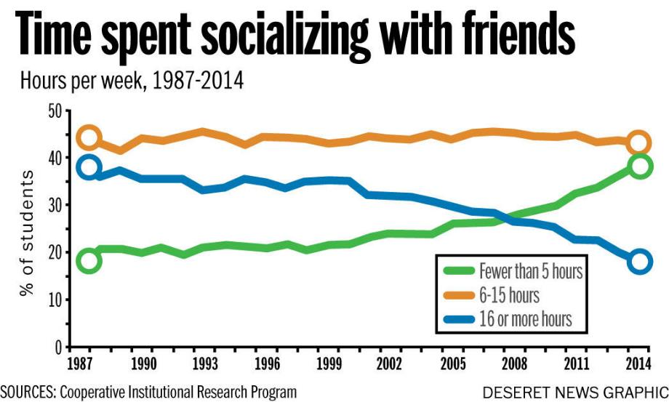

Slide 36
Stress, Burnout, and Depression
Depression
Trouble sleeping
Feelings of guilt
Changes in appetite
Suicidal thoughts
Persistent and pervasive depressed mood and/or loss of interest in doing things you would have previously enjoyed

Slide 37
Clinical Depression
Major Depression vs. Dysthymia
And bipolar disorder (aka manic-depressive)
Clinical depression…
can affect your body, mood, thoughts, and behavior
is not a passing mood, a sign of personal weakness, or condition that can be willed away
Suicidal thoughts, impulses, and behaviors should always be taken seriously
Past attempts, impulsivity, demographics

Slide 38
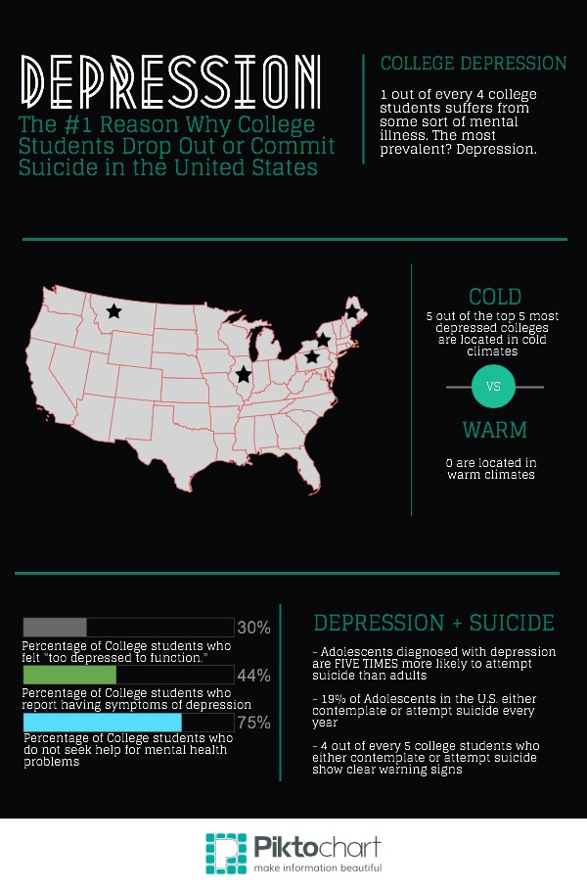

Slide 39
Trends in College Counseling
Severe Psychological Problems > Developmental Concerns or Information
Prevalence and severity
World expecting more of students
Heightened focus on academics over social connection
Diminished Stigma
More campus resources
Increased accessibility to college

Slide 40
Considerations for Advisors & Parents
School Size
Impact on learning environment
1 clinician per 1,000 to 1,500 students
Treatment prior to college
Entering college with more anxiety…stakes raised due to acceptance process
Therapy versus medication
Diversity
Impact on adjustment
i.e. UIC
Social media and its impact
Higher education catching up to mental health needs

Slide 41
How to Support Your Students
Different levels of access
Resident Advisors / Residence Life
Student Affairs
Counseling or Wellness Center (therapy, meds, referrals)
Student Orgs
Cultural Centers
Disability Resource Center
Academic Affairs
Admissions
Advising
Departmental overlap responding to crisis
Balance comes through experience at college

Slide 42
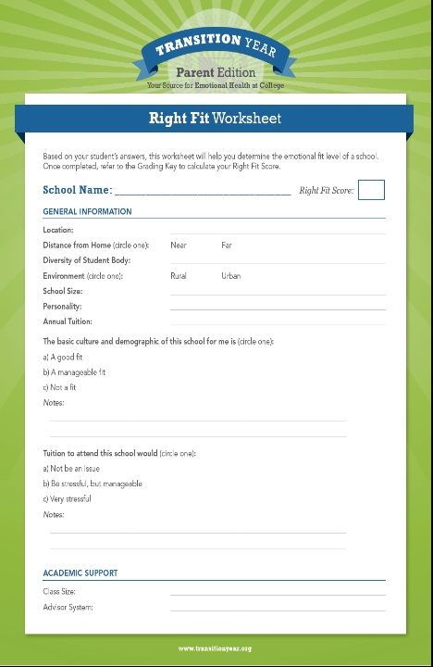
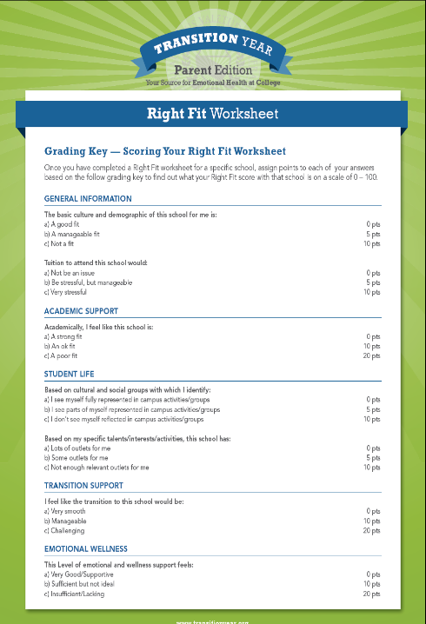

Slide 43
Critical Question
What is the role of higher education in addressing student mental health concerns?

Slide 44
Resources
The JED Foundation
National Alliance on Mental Illness (NAMI)
Transitionyear.org
College Transition Initiative
What to do when college is not the
best time of your life?
By David Leibow
College of the overwhelmed: The campus mental health crisis and what to do about it
By Theresa Foy DiGeronimo

Slide 45
References
American Psychological Association (2011). The State of Mental Health on College Campuses: A Growing Crisis. Retrieved from: http://www.apa.org/about/gr/education/news/2011/college-campuses.aspx.
Aselton, P. (2012). Sources of stress and coping in American college students who have been diagnosed with depression.
College of Charleston Student Health Center. Common Mental Health Topics: Burnout. Journal of Child and Adolescent Psychiatric Nursing, 25, 119-123.
Higher Education Research Institute (2014). The American Freshman: National Norms 2014. Retrieved from http://www.heri.ucla.edu/monographsTheAmericanFreshman2014.pdf. Los Angeles: Higher Education Research Institute
National Institute of Mental Health. (2003). Depression and college students. UC Berkeley, University Health Services, from NIH Publication No. 97-4266; s:uhs/healthed/depresscoll.doc.

