Slide 1
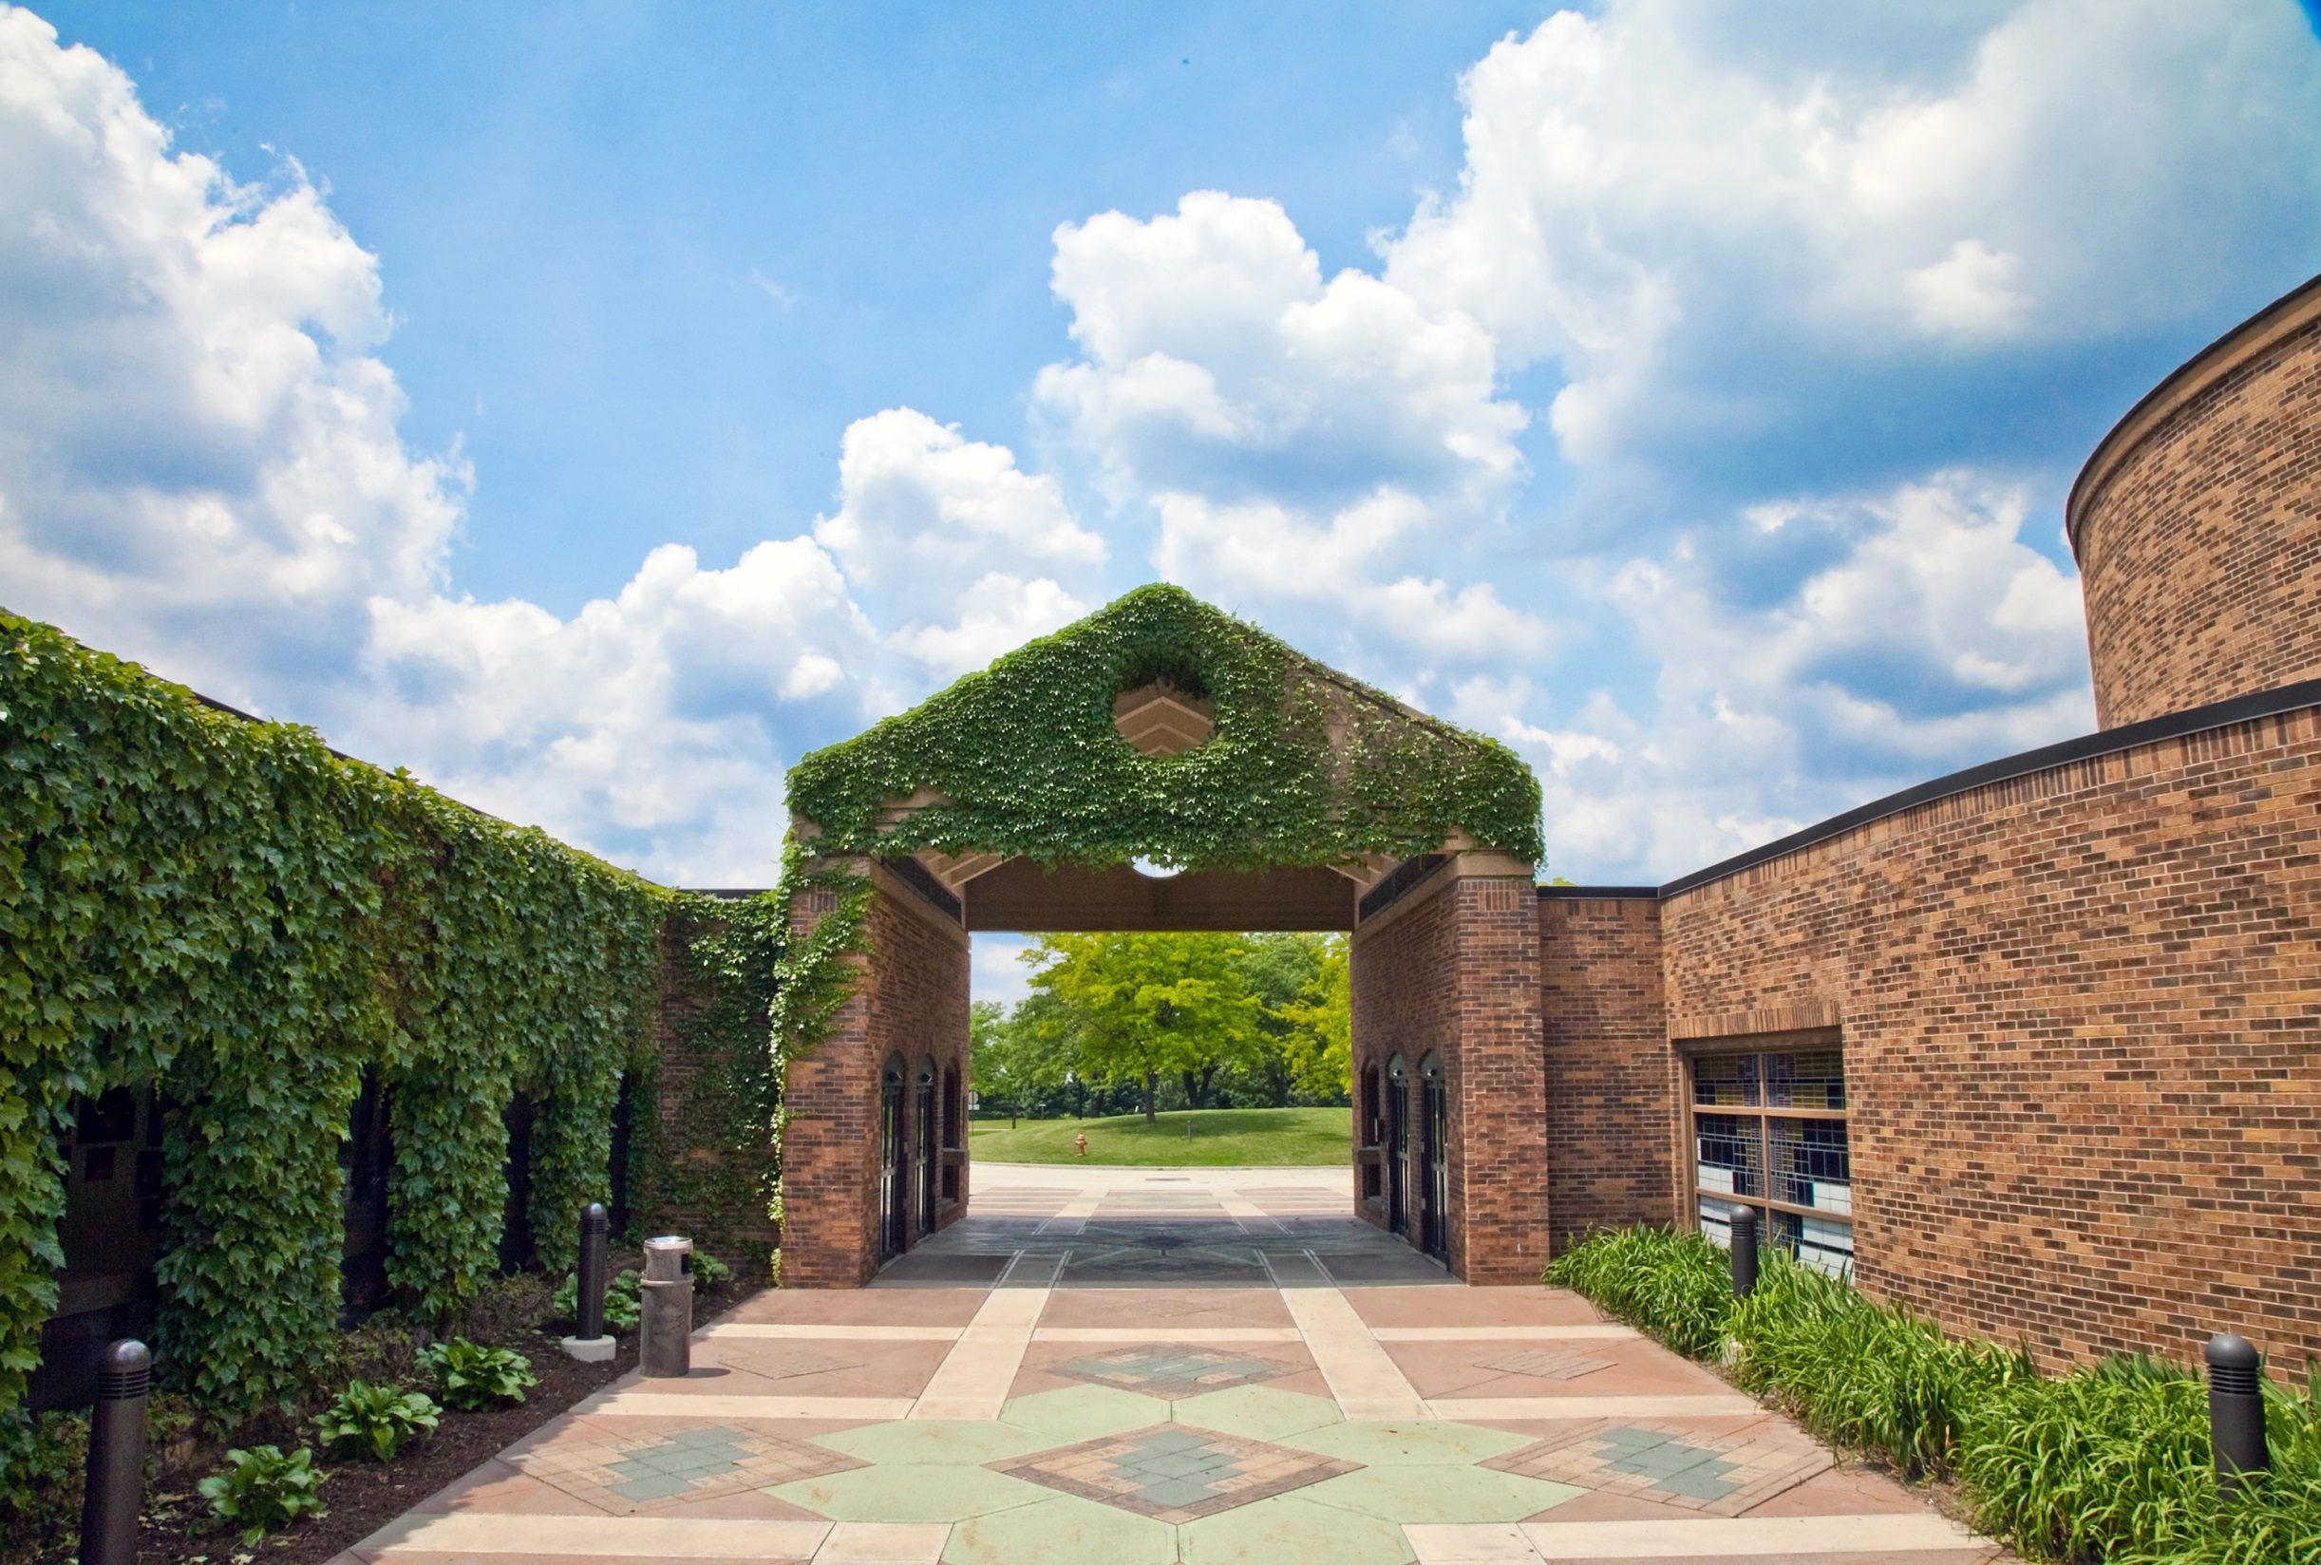
Parkland Pathway to Illinois
Orientation
Parkland Pathway to Illinois: Paving the Road from a Comprehensive Community College to a Research I Land Grant Institution
May 22, 2013

Slide 2
Presenters
Holly Herrera, Coordinator for Transfer Advising, University of Illinois, holly10@illinois.edu
Kristin Smigielski, Associate Director, Undergraduate Admissions, University of Illinois, ksmigiel@illinois.edu

Slide 3
The Institutions

Slide 4
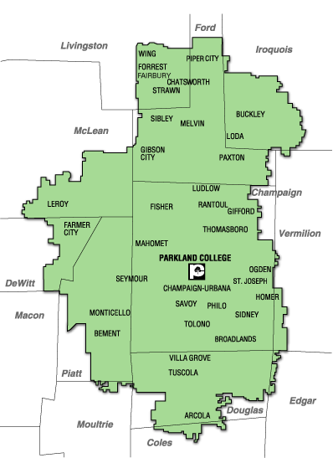
Parkland College
We serve
26 public high schools
Over 66 communities
Over 280,000 residents
Parts of 12 Illinois counties
Comprehensive College
37% full-time
27% ethnic minority
30% AA/AS transfer programs
21% AAS occupational programs
20:1 Student to faculty ratio

Slide 5
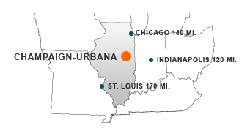
University of Illinois at Urbana-Champaign
Ranked 11th among public universities (USNWR)
3rd most recruited undergrads in the nation (WSJ)
#1 in Big Ten for starting and mid-career salaries
32,579 Undergraduates
17:1 student to faculty ratio
56% Men, 44% Women
29.6% are underrepresented students

Slide 6
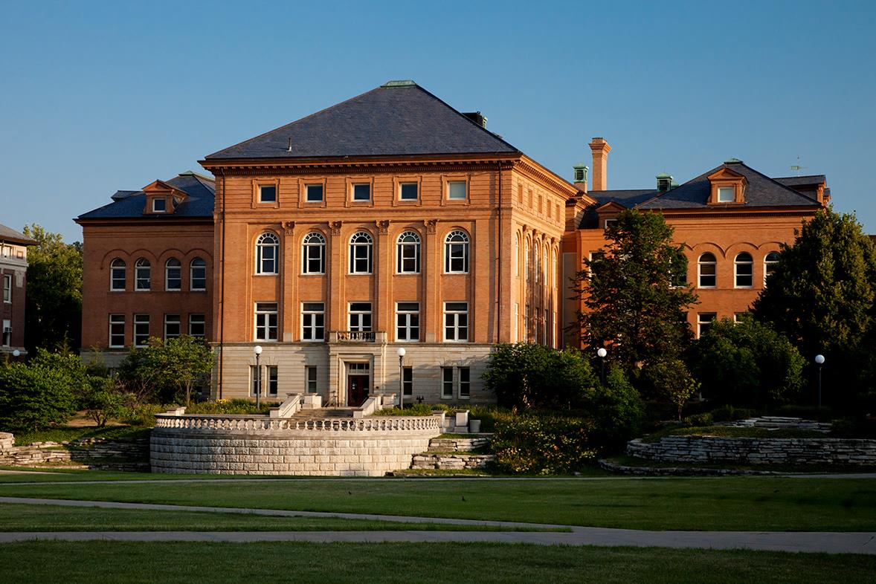
The Program

Slide 7
Program Design
Program Design
Graduates of Illinois high school
Focus on underrepresented students, first generation, low SES and/or Parkland district
All colleges except Business
Selected majors or general admissions
Take Parkland orientation course
Limited change of major

Slide 8
Application Procedures
The following items will need to be submitted to the University of Illinois:
Parkland Pathway to Illinois application
Official college transcripts if applicable
ACT or SAT scores (writing scores are not required)
Parkland Pathway Essay
Parkland College:
Parkland College Application
ACT scores
High school transcript
Complete College Assessments at Parkland College

Slide 9
Program Details
Dual enrollment with Parkland as the primary institution
Guaranteed admission at the University of Illinois (stipulations)
Access to smaller class sizes
Parkland tuition rate at both institutions

Slide 10
Program Details
Access to award winning faculty at both institutions
Opportunity to live on U of I campus
Participate in student clubs at both institutions
Easy-to-access academic/student support
Individualized advising at both institutions

Slide 11
Admission/Continuation Procedures
Parkland
Students are given the PATH designation in DataTel
Illinois
All applicants are given attributes at application
Enrolled students are given attributes designating their tuition rate (in Parkland’s district, out of district and Trustee)
Tuition Waive-downs
Once students apply to transfer, each receives an attribute based on completion status (non-completer or completer).

Slide 12
Policy Summary
Must stay in good standing
Meet with advisors at both institutions at least once per semester
Minimum of 12 semester hours between institutions
No early applications to transfer
Take courses required: www.transferhandbook.illinois.edu

Slide 13
Participation by Cohort
Notes:
Number of applicants/admits/accepts
13

Slide 14
Parkland Pathway Completers
Notes:
14

Slide 15
Parkland Pathway Graduation Rates
Notes:
15

Slide 16
Holly Herrera, holly10@illinois.edu Kristin Smigielski, ksmigiel@illinois.edu
PARKLAND COLLEGE

