Slide 1
Collecting Effective Data in Counseling
Presenters:
Maureen Mohan, Guidance Counselor, York High School
Brian Trainor, Ph.D., Educational Research Methodology, Loyola University-Chicago
Moderator:
Lauren O’Connor, Guidance Counselor, Westmont High School

Slide 2
Questions to be Discussed
How do we make sense of qualitative/anecdotal data?
How can we collect more reliable data?
How can data help us improve our counseling programs and the services we provide to students?

Slide 3
The Qualitative Data Dilemma
As counselors, much of the data we collect is qualitative, anecdotal, or based on non-experimental observation
Qualitative data and anecdotal information is not tidy
How do we present qualitative data as evidence?

Slide 4
Commonly Collected Qualitative Data
Needs assessments (free response questions)
  Example: “What do you need the most help with in school?”
Informational interviews
  Students expressing thoughts and feelings
  Observations of body language or other non-verbal cues
Group behaviors
Genograms (student or counselor-created)
Observations from classroom teachers of student academics and behavior

Slide 5
Using Qualitative Data
Coding—a method of drawing meaning from qualitative data by recognizing patterns and common themes (i.e. establishing codes)
Counselors do this naturally
These patterns and themes may be within a particular student or among a population
Examples?

Slide 6
Using Qualitative Data
Timmy said his parents are getting divorced; in a meeting his teachers mention he is struggling to focus in class and you connect his performance to his family strife in your mind.
You notice many students exhibiting exhaustion or lack of focus. The previous week one of your students mentioned ordering the new Call of Duty. You surmise some of these students’ struggles may be due to little sleep and lots of gaming.
Congratulations, you just coded!

Slide 7
Using Qualitative Data
Administrators and school districts emphasize the need for more data collection and using that data to drive our decisions
It is important to remember this coded information IS real data
Qualitative data can be perceived as “fluff” or dismissed as subjective, but careful presentation of these data can help counselors design and implement interventions

Slide 8
Tips for Presenting Qualitative Data
A simple event sign up can provide useful data and not just “fluff” .
Using a source of technology rather than paper pencil can reflect interesting data later on and determine future needs/trends of the event or program.
Sign up Genius is an online tool that can help with organization of qualitative information from a program sign up– i.e. group interviews, one-on-one student meetings, parent presentation, etc.
  http://www.signupgenius.com/
Sign up Genius can easily organize and group people who are signing up. Create online and e-mail out link to necessary group.
  Could get more complex with creation of sign up, in order to track a trend amongst a certain group.
  Can be easily manipulated
  Can quickly provide info. on students who do not sign up at all, the students who sign up but are absent and the students who show up.
    Provides useful data for a counseling office that never would have existed before in a quantifiable, electronic format.

Slide 9
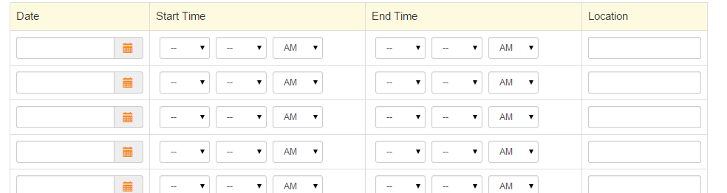
Tips for Presenting Qualitative Data
Example: York Freshman Mentor Program – Interview Sign up
www.signupgenius.com

Slide 10
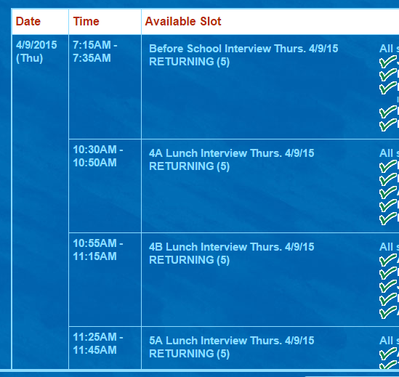
Tips for Presenting Qualitative Data
Sign Up Genius – York Freshman Mentor Interviews

Slide 11
Tips for Presenting Qualitative Data
NVivo software for Windows
  Platform for analyzing unstructured data
  Uses powerful search tools to extract information from coded data
  Unique visualization tools to summarize coded data
  Sharing/disseminating options
  Used by professional researchers, evaluators, professors, educators, etc.
  Analyzes content from interviews, groups, discussions, surveys, audio files, video files, websites, etc.
  Interfaces well with many other programs

Slide 12
Tips for Presenting Qualitative Data
What if your school doesn’t have the time or money to invest in NVivo?
Encourage a culture shift in your department
  Counselors should perceive and describe information gleaned from interviews, conversations, or non-experimental observations as real data
Employ methodological vocabulary to describe action steps and interventions
  Narrative analysis
  Coding
  Ethical inquiry

Slide 13
Tips for Presenting Qualitative Data
Whenever possible, apply a mixed methods approach
Mixed methods approaches provide thick rich descriptions of qualitative data supported by numbers and quantitative data
Improves presentation of qualitative data by including empirical information and reducing the perceived subjectivity
Enhances presentation of quantitative data by providing a context in which to view empirical information and allowing for a more holistic review

Slide 14
Example of Mixed Method Data Presentation
Needs Assessment:
  Students Mental and Emotional Health - need discussed often by York Student Services Department and top priority for our principal.
  *Looking closer at this Need stemmed from 2 data points:
  1. Qualitative data shared from all student services staff. Mainly counselors and social workers, who work often with students struggling with anxiety & depression.
  2. Quantitative Data: Illinois Youth Survey given to 10th and 11th graders in the spring of 2014.

Slide 15
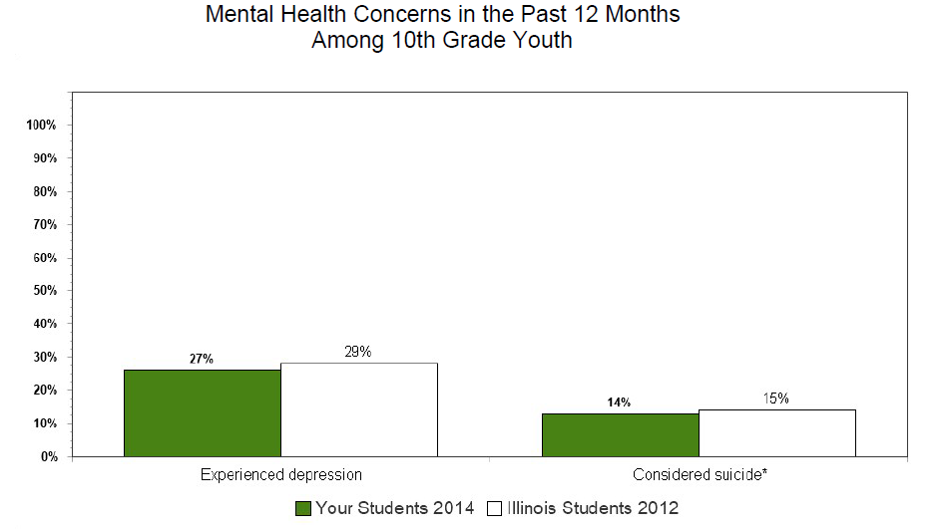
Illinois Youth Survey quantitative data

Slide 16
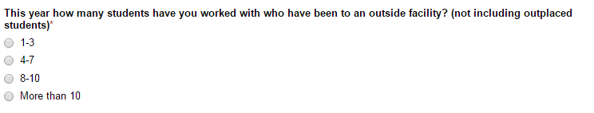
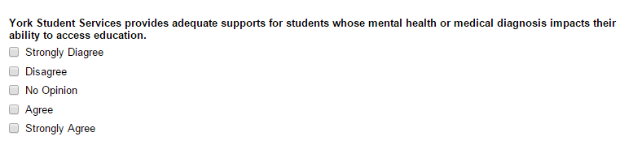

Now what to do with the data?
Use Google forms to create a survey and tap into thoughts of the department on this topic.
Some sample questions:

Slide 17
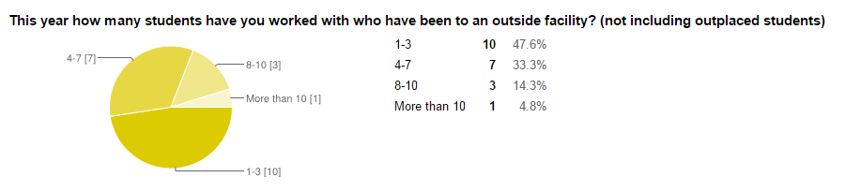
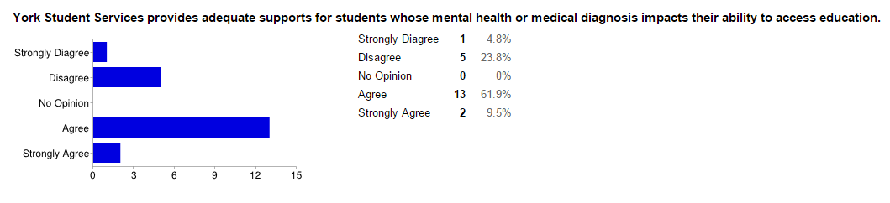
Google forms makes survey responses easy to view!

Slide 18
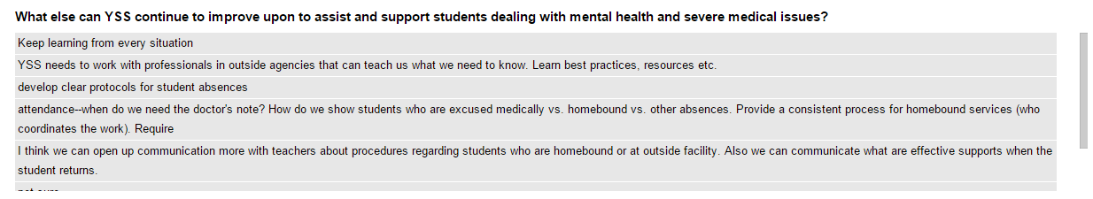
Google Forms: provide qualitative and quantitative date from survey

Slide 19
Survey Monkey
Another good tool to help analyze and present quantitative survey data
Compiles responses for you
Creates tables and presentation materials for you
Easy to use
Semi-free
Microsoft Excel

Slide 20
Commonly Collected Quantitative Data
Graduation rates
Survey data (Likert-scale or multiple choice questions)
Post-secondary plans
Standardized test scores

Slide 21
The Unexpected Dilemma of Quantitative Data
While the primary problem with qualitative data collection is that others may view it as too subjective, the primary problem with quantitative data is that others may place too much faith in it.
How can we ensure our quantitative data is both reliable and valid?
What are some examples of quantitative data used in counseling departments? How are these data used?

Slide 22
Potential Pitfalls of Quantitative Data
Non-Response Bias
  Occurs in statistical surveys when the answers of non-responders differ systematically from those of the responders
  In this case, it is impossible to know what non-responders to a particular survey or assessment would have reported
If students are asked to complete a survey and only 40% respond, the data will likely be skewed to the extreme values
  Students who want to be “nice” and help out
  Students who have specific negative viewpoints to share
  Degree of topic saliency highly correlated with response rate
  The lower the response rate, the higher the probability of non-response bias

Slide 23
Potential Pitfalls of Quantitative Data
Ways to combat non-response bias
Mandatory surveys
  Distributed before or after state-mandated assessments (PSAE, PARCC)
  Required for graduation/senior check-out
    Problems with truthfulness
Predict what non-responders would have answered
  Follow-up interviews/reminders
  Sub-group analysis
  Demographic comparisons

Slide 24
Mandatory Survey
Example: York Senior Check out Survey
Mandatory Participation
Available in Naviance (https://succeed.naviance.com/) prior to senior check-out day, so students have the choice to take it in advance
  Email students through Naviance & cc parents
Set up under Connections tab, survey
If a student does not take on own, required to sit at computer station during check out to complete
  Use this system to lessen gaps/inconsistencies in data

Slide 25
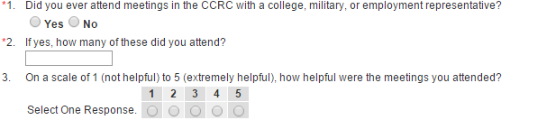
Mandatory Survey
Example: York Senior Check out Survey
Survey allows students to provide feedback on how the CCRC (College & Career Resource Center) was able to meet their needs and the needs of their family.
Students also indicate what their post-high school plans will entail

Slide 26
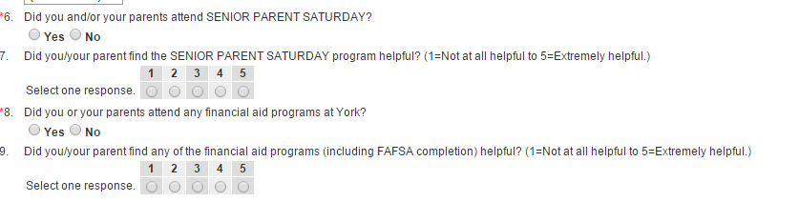
York Senior Check out Survey

Slide 27
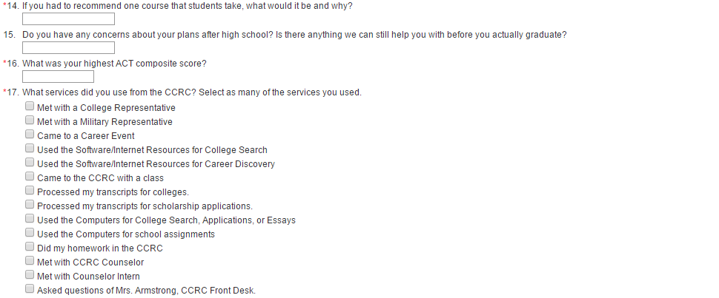
York Senior Check Out Survey

Slide 28
Potential Pitfalls of Quantitative Data
Reliability/Validity checks
  How do we know our surveys or assessments are measuring what they are supposed to measure and will continue to do so over time?
Counselors may ask students throughout high school (i.e. freshman year, junior year) “How certain are you of your plans for after high school? Rate on a scale of 1-5 (one being not confident at all).”
  When we create these questions, they make sense to us. No matter how ideally we feel the question is written, we can never be sure how others will interpret the question.

Slide 29
Potential Pitfalls of Quantitative Data
There are ways to check for reliability/validity of survey instruments
Factor Analysis
IRT Analysis
Can provide a lot of good information about the quality of the instrument
  Is it measuring what you think it is?
  Are people confused or misinterpreting certain questions?

Slide 30
Summary of Quantitative Data
Oftentimes, individuals put a large amount of value on quantitative data
However, quantitative data is just as subjective as qualitative data IF NOT MORE SO
The keys to balancing our data collection, usage, and dissemination in counseling departments include:
  Applying mixed methods approaches
  Whenever possible, controlling for external factors or potential pitfalls
  Understanding that the use of data to drive decisions will always be in some ways a guessing game

Slide 31
Discussion Questions
How does your school and/or department use data?
Does your department use any of the resources shared in this presentation? If so, how do you utilize them with students?
What is one of the biggest challenges your department encounters with data collection? Have you found a workable solution?
Any further quetions?

Slide 32
Questions? Contact us!
Maureen Mohan
mmohan@elmhurst205.org
Brian Trainor
brianptrainor@gmail.com
Lauren O’Connor
loconnor@cusd201.org

