Slide 1
Black Student Leadership Conference
Wendy Biggs –Counselor, Wheaton North High School
Jacqueline Hanson – Counselor, Oak Park River Forest High School
Amy Thompson – Counselor, York High School
Sean Warren-Crouch – Admissions Representative, College of DuPage

Slide 2
How BSLC got Started
Principal of York wanting a college fair for students of color
Counselors understand the time commitment for fairs and the schedules of admissions representatives may not allow for them to come to such a niche fair
Potential to combine with other high schools
When and where could this event be held
Addition of College of DuPage
Currently working on diversifying campus
Additional monies allocated for recruiting African American students

Slide 3
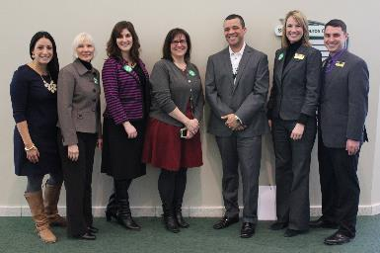
Formation of the Committee – Year 1
Wendy Biggs – Wheaton North High School
Rachel Georgakis – Fenton High School
Jacqueline Hanson – Oak Park River Forest High School
Julie Marlatt – College of DuPage
Lianne Musser – Lyons Township High School
Natalie Rubino – Glenbard West High School
Amy Thompson – York High School
Sean Warren-Crouch – College of DuPage

Slide 4
Goals of the Event

Slide 5
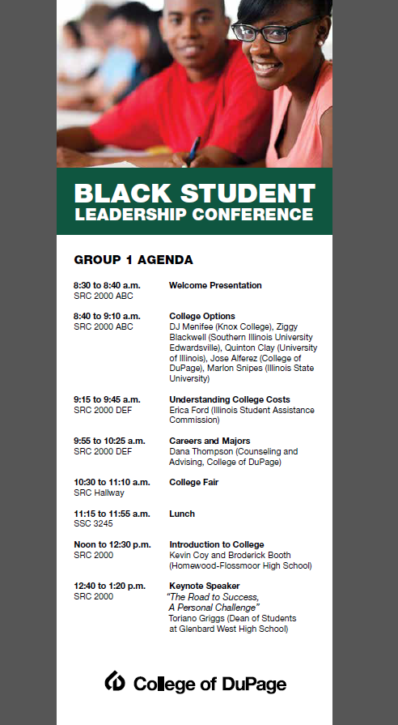
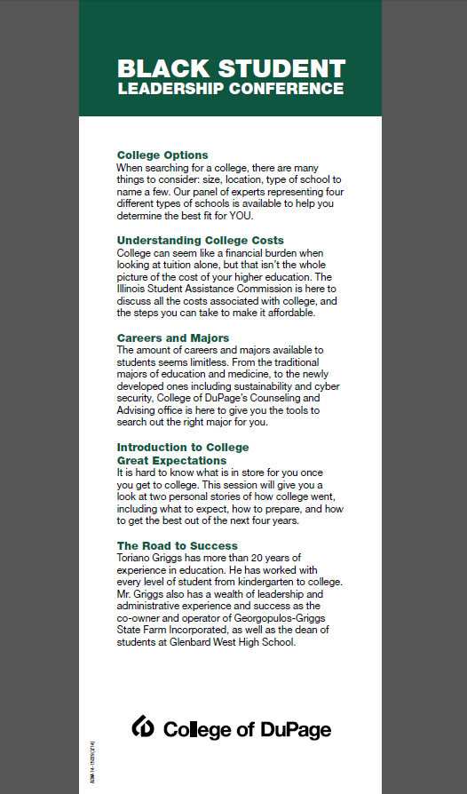
Agenda

Slide 6
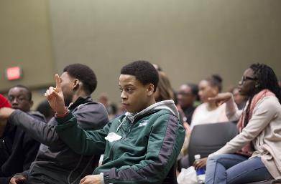
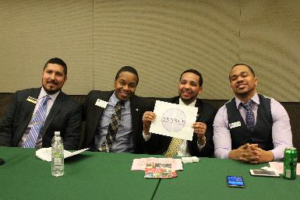
Events of the day: Admissions Representative Panel
Representatives from different types of institutions
Quinton Clay – University of Illinois – Flagship state school
DJ Menifee – Knox College – Small private school
Ziggy Blackwell – SIU Edwardsville – Midsize state school
Jose Alferez – College of DuPage – Community College
Discussed
Admissions criteria
Cost to attend
Diversity
Scholarship Opportunities
General Q&A for students

Slide 7
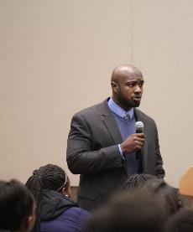
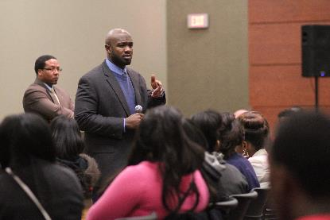
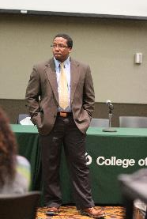
Events of the day: “Introduction to College” Speakers
Kevin Coy- College Counselor at Homewood-Flossmoor High School
Broderick Booth – Guidance Counselor at Homewood-Flossmoor
Gave personal stories of their college experiences
Athletics
Greek life
Scholarships
Grad School
Focus on how to get the most out of college years

Slide 8
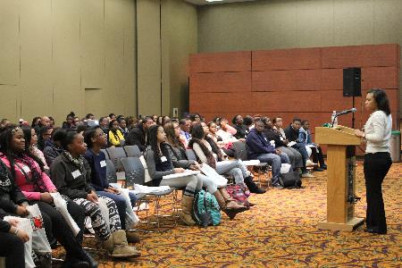
Events for the day: Financial Aid Presentation
Erica Ford from Illinois Student Assistance Commission
Discussed Scholarships, Loans, and Grants in depth
Broke down the FAFSA to make it more understandable
Many students thought college was unattainable for them, this helped make it more of a reality

Slide 9
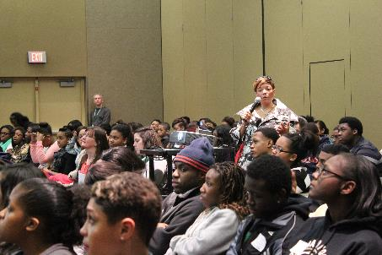
Events for the day: Careers and Majors Presentation
Dana Thompson – Counselor at College of DuPage
Discussed differences between types of degrees and certificates
In-demand jobs
Up and coming career paths
Impact major changes have on students

Slide 10
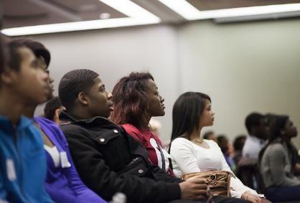
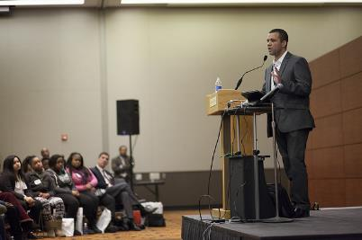
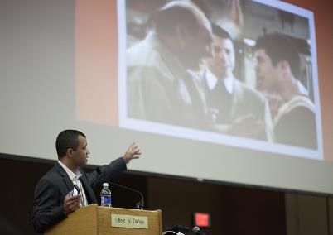
Events of the day: Keynote Speaker – Road to Success
Torriano Griggs – Dean of Students at Glenbard West High School
“The Road to Success – a Personal Challenge”
Success story from someone who came from a disadvantaged background
YouTube clips to emphasize points
Interactive presentation
Phone polling
Real time responses

Slide 11
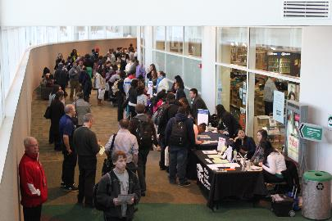
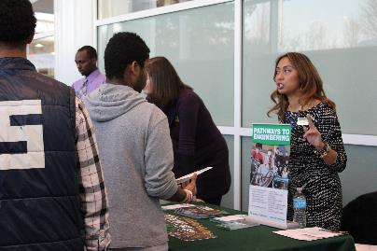
Events of the day: College Fair
39 colleges in attendance
Mainly from Chicagoland area/Illinois State Schools
Bonus for Representatives, got to recruit BSLC students and current COD students
Representatives encouraged to bring minority scholarship information

Slide 12
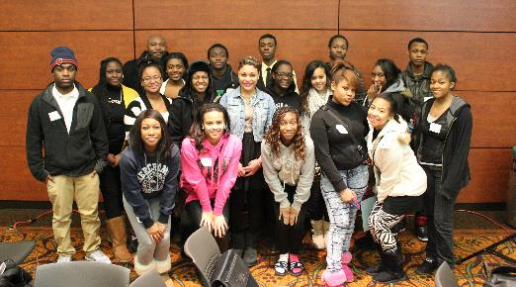
First Event Overall
15 area high schools participated
402 students and 36 chaperones attended
Students from all grade levels were invited, mainly Sophomores through Seniors attended
90% of students felt the program was “Excellent” overall!

Slide 13
Areas of Improvement
College Fair
Students not always interacting with colleges
No HBCU in attendance
Not enough out of state schools
Who is invited to BSLC
Older students concerned that younger students took away from their experience
Some students were immature
Committee makeup
No African American representation
Space
Not enough room to hold everyone for Lunch, had to do shifts that caused issues
Program
Make more interactive, less just sitting

Slide 14
Changes to Second Event
College fair increase
Word got out, more wanted to be involved!
56 colleges, 1 HBCU
Schools that provided minority scholarship information were highlighted in student packet
College Fair Prep
During introduction, expectations during a college fair and sample questions discussed
Students invited
Hand selected by counselors
Dress Code
Juniors only – while this made the event smaller, it had more of an impact on students

Slide 15
Changes to Second Event
Additional Committee Members
Ebony Baker – Counselor at Naperville North High School
David Swope – Interim Director of Center for Diversity and Inclusion at COD
Ranita Dailey – Administrative Assistant of Center for Diversity and Inclusion
Amanda Brzuszkiewicz – Office of High School Partnerships at COD
More interactive program
Engaged the students more
Less distracted/inattentive students

Slide 16
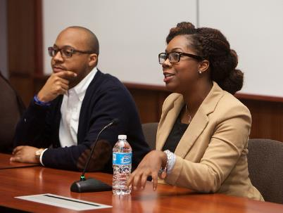
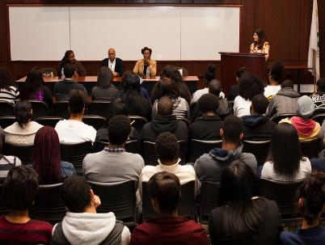
Events of the day Year 2: College Student Panel
3 current college students and recent college graduates
Asa Cain
Tamara Missick
Lateasha Tillman
Students shared their stories and were very BLUNT about things!
Some had received scholarships which was encouraging
One high school student reached out to the committee asking to pass along her contact info to the panelists because their stories “really touched her” and she wanted to keep in contact!

Slide 17
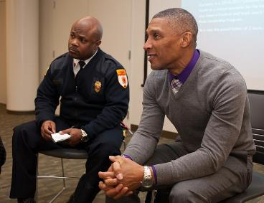
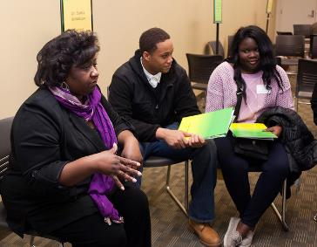
Events of the day Year 2: Career Exploration Express
10 African American professionals from different careers were on hand to discuss education needed and more about their careers
Students could choose up to 4 professionals to speak with in allotted time
Seats were limited at each professional, similar to “Musical Chairs”
Got students moving and learned about a wide variety of careers
Dentist
Engineer
Fire Chief
Architect

Slide 18
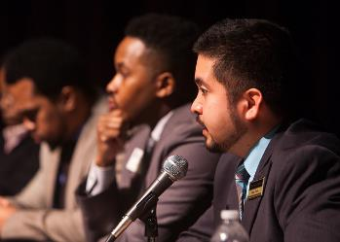
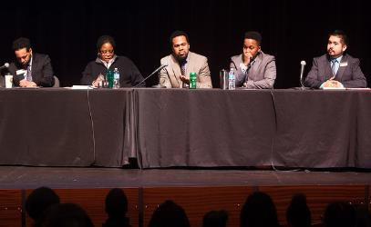
Events of the day Year 2: Admissions Representative Panel
Invited all back from previous year:
Quinton Clay – University of Illinois – Flagship state school
DJ Menifee – Knox College – Small private school
Ziggy Blackwell – Illinois College
Cesar Flores– College of DuPage – Community College
Added
Lisa King – Northern Illinois University Chance Program – Alternative Admission Program

Slide 19
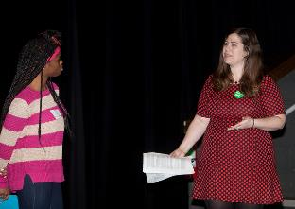
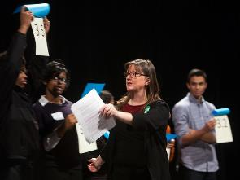
Events of the day Year 2: Mock College Admissions
Adapted from the Great Sorting Game, written by Marylee Hoganson – Available on the NACAC website to download!
10 students selected out of audience
Each given a profile
Lined up in order of GPA
Different criteria moved them back and fourth on the admissions decision
Top 2 were accepted, not necessarily the highest GPA/ACT scores
Showed students the reality of a Holistic Review when determining admissions.

Slide 20
Events of the day Year 2: Keynote Speaker
Broderick Booth from Homewood-Flossmoor was invited back to be our Keynote Speaker
His presentation was at the beginning of the day, to set the tone for the day
Presentation titled “Negative Media Portrayal of Minorities and how the Student can Ensure their Road to Success”
YouTube clips
Personal Story
Really connected with each student

Slide 21
Second Event Overall
16 Schools attended
325 Students. While this was less than last year, this was only Juniors
56 Colleges in Attendance
96% said the program was “Excellent”
Biggest concern of students in attendance (besides more lunch) was they wanted more time for the day!

Slide 22
Tips to start an event of your own.
Partnerships! It can’t be done on your own
Create a committee with representation from all areas involved
Ensure multiple high schools are in attendance
Justifies College Fair representatives times
Guarantees larger turn out for all presenters
Look for grant money…It’s out there, you just need to find it
Invite diversity initiatives to assist and participate

Slide 23
Your turn!
We hope to have provided you a guideline to help you create your own program!
Need help? Let us know! Our contact information can be found on the IACAC App
Thank you for attending the Black Student Leadership Conference Session!

