Slide 1
What’s New with ACT? ACT Profile, ACT Aspire and More
Presented at
Illinois Association for College Admissions Counseling (IACAC)
April 30, 2015
George Schlott
ACT Client Relations Account Executive
george.schlott@act.org
319/321-9698
April Hansen
ACT Client Relations Account Executive
april.hansen@act.org
319/321-9751

Slide 2
What is College and Career Readiness?
Assuring that all students, graduating from high school, are ready for college-level credit-bearing coursework in English, Math, Social Science, and Science without remediation.
Illinois Issues: Higher education faces a Remediation Crisis and a Completion Crisis

Slide 3
ACT College Readiness Benchmarks
ACT Subject-Area Tests | College Course | 3rd Grade Benchmark | 4th Grade Benchmark | 5th Grade Benchmark | 6th Grade Benchmark | 7th Grade Benchmark | 8th Grade Benchmark | 9th Grade Benchmark | 10th Grade Benchmark | ACT
English | English Composition | 413 | 417 | 419 | 420 | 421 | 422 | 426 | 428 | 18
Math | College Algebra | 413 | 416 | 418 | 420 | 422 | 425 | 428 | 432 | 22
Reading | Social Sciences | 415 | 417 | 420 | 421 | 423 | 424 | 425 | 428 | 22
Science | Biology | 418 | 420 | 422 | 423 | 425 | 427 | 430 | 432 | 23
ACT Subject-Area Tests | College Course | The ACT® Benchmark
English | English Composition | 18
Math | College Algebra | 22
Reading | Social Sciences | 22
Science | Biology | 23
ACT Subject-Area Tests | College Course | ACT Explore® Benchmark Grade 8 | ACT Explore® Benchmark Grade 9 | ACT Plan® Benchmark Grade 10 | The ACT® Benchmark
English | English Composition | 13 | 14 | 19 | 18
Math | College Algebra | 17 | 18 | 19 | 22
Reading | Social Sciences | 16 | 17 | 18 | 22
Science | Biology | 18 | 19 | 20 | 23
Note: The Benchmarks are scores on the ACT subject-area tests that represent the level of achievement required for students to have a 50% chance of obtaining a B or higher or about a 75% chance of obtaining a C or higher in corresponding credit-bearing first-year college courses

Slide 4
ACT College & Career Readiness Standards
Mathematics
 | Score Interval | Numbers and Quantity (N) | Algebra (A) | Functions (F) | Geometry (G) | Statistics and Probability (S)
Stamdards | 16-19 | N 301. (NCP 201) Recognize one-digit factors of a number N 302. (NCP 302) Identify a digit’s place value N 303. (GRE 301) Locate rational numbers on the number line Note: A matrix as a representation of data is treated here as a basic table. | AF 301. (BOA 301) Solve routine one-step arithmetic problems using positive rational numbers, such as single-step percent AF 302. (BOA 302) Solve some routine two-step arithmetic problems AF 303. Relate a graph to a situation described qualitatively in terms of familiar properties such as before and after, increasing and decreasing, higher and lower AF 304. Apply a definition of an operation for whole numbers (e.g.,a ◘ b = 3a – b) A 301. (XEI 301) Substitute whole numbers for unknown quantities to evaluate expressions A 302. (XEI 302) Solve one-step equations to get integer or decimal answers A 303. (XEI 303) Combine like terms (e.g., 2x + 5x) | AF 301. (BOA 301) Solve routine one-step arithmetic problems using positive rational numbers, such as single-step percent AF 302. (BOA 302) Solve some routine two-step arithmetic problems AF 303. Relate a graph to a situation described qualitatively in terms of familiar properties such as before and after, increasing and decreasing, higher and lower AF 304. Apply a definition of an operation for whole numbers (e.g.,a ◘ b = 3a – b) F 301. Extend a given pattern by a few terms for patterns that have a constant factor between terms | G 301. (PPF 301) Exhibit some knowledge of the angles associated with parallel lines G 302. (MEA 301) Compute the perimeter of polygons when all side lengths are given G 303. (MEA 302) Compute the area of rectangles when whole number dimensions are given G 304. (GRE 301) Locate points in the first quadrant | S 301. (PSD 301) Calculate the average of a list of numbers S 302. (PSD 302) Calculate the average given the number of data values and the sum of the data values S 303. (PSD 303) Read basic tables and charts S 304. (PSD 304) Extract relevant data from a basic table or chart and use the data in a computation S 305. (PSD 305) Use the relationship between the probability of an event and the probability of its complement
Ideas for Progress | 16-19 | (N) apply elementary number concepts, including identifying patterns pictorially and numerically (e.g., triangular numbers, arithmetic and geometric sequences), ordering integers, and identifying factors of whole numbers (N) recognize, identify, and apply basic properties of real numbers (e.g., commutative, associative, identities) (N) describe the distance between zero and a point on the number line (N) measure and describe, with appropriate units, the distance between two points (N) arrange data into meaningful arrays (N) identify the dimensions of a matrix | (AF) solve routine mathematical problems that involve rates, proportions, and percents (AF) model real-world and mathematical problems that contain verbal and symbolic representations of money (AF) do multistep computations with rational numbers (AF) generate expressions using combinations of symbols and numbers (AF) describe real-world and mathematical problems associated with incremental change by using rate and/or slope language (e.g., feet per second, dollars per hour, change in y over change in x) (A) evaluate algebraic expressions and solve simple equations, using integers (A) multiply two simple monomials (A) apply the distributive property to multiply a simple monomial by a binomial | (F) recognize functions as mappings of an independent variable into a dependent variable (F) distinguish between domain and range (F) use function notation to create equations that model real-world and mathematical problems (F) evaluate polynomial functions that use function notation | (G) describe angles and triangles using mathematical terminology, and apply their properties (G) use angle relationships (e.g., complementary, adjacent, vertical) to find measures of unknown angles (G) sketch and identify the midpoint of a line segment (G) find area and perimeter of triangles and rectangles by substituting given values into standard geometric formulas (G) describe movement in the coordinate plane using positive and negative values | (S) read and interpret data and use appropriate measures of central tendency to find unknown values (S) gather, organize, display, and analyze data in a variety of ways for use in problem solving (S) use a variety of strategies (e.g., fundamental counting principle) to determine possible outcomes for simple events (S) conduct simple probability experiments, and represent results using different displays (e.g., tree diagrams, organized lists)
 | Score Interval | Numbers and Quantity (N) | Algebra (A)
Stamdards | 16-19 | N 301. (NCP 201) Recognize one-digit factors of a number N 302. (NCP 302) Identify a digit’s place value N 303. (GRE 301) Locate rational numbers on the number line Note: A matrix as a representation of data is treated here as a basic table. | AF 301. (BOA 301) Solve routine one-step arithmetic problems using positive rational numbers, such as single-step percent AF 302. (BOA 302) Solve some routine two-step arithmetic problems AF 303. Relate a graph to a situation described qualitatively in terms of familiar properties such as before and after, increasing and decreasing, higher and lower AF 304. Apply a definition of an operation for whole numbers (e.g.,a ◘ b = 3a – b) A 301. (XEI 301) Substitute whole numbers for unknown quantities to evaluate expressions A 302. (XEI 302) Solve one-step equations to get integer or decimal answers A 303. (XEI 303) Combine like terms (e.g., 2x + 5x)
Ideas for Progress | 16-19 | (N) apply elementary number concepts, including identifying patterns pictorially and numerically (e.g., triangular numbers, arithmetic and geometric sequences), ordering integers, and identifying factors of whole numbers (N) recognize, identify, and apply basic properties of real numbers (e.g., commutative, associative, identities) (N) describe the distance between zero and a point on the number line (N) measure and describe, with appropriate units, the distance between two points (N) arrange data into meaningful arrays (N) identify the dimensions of a matrix | (AF) solve routine mathematical problems that involve rates, proportions, and percents (AF) model real-world and mathematical problems that contain verbal and symbolic representations of money (AF) do multistep computations with rational numbers (AF) generate expressions using combinations of symbols and numbers (AF) describe real-world and mathematical problems associated with incremental change by using rate and/or slope language (e.g., feet per second, dollars per hour, change in y over change in x) (A) evaluate algebraic expressions and solve simple equations, using integers (A) multiply two simple monomials (A) apply the distributive property to multiply a simple monomial by a binomial
Statements
that describe
what
students
are likely to
know and
be able to
do...
And statements that
provide suggestions to
progress to a higher level
of achievement

Slide 5
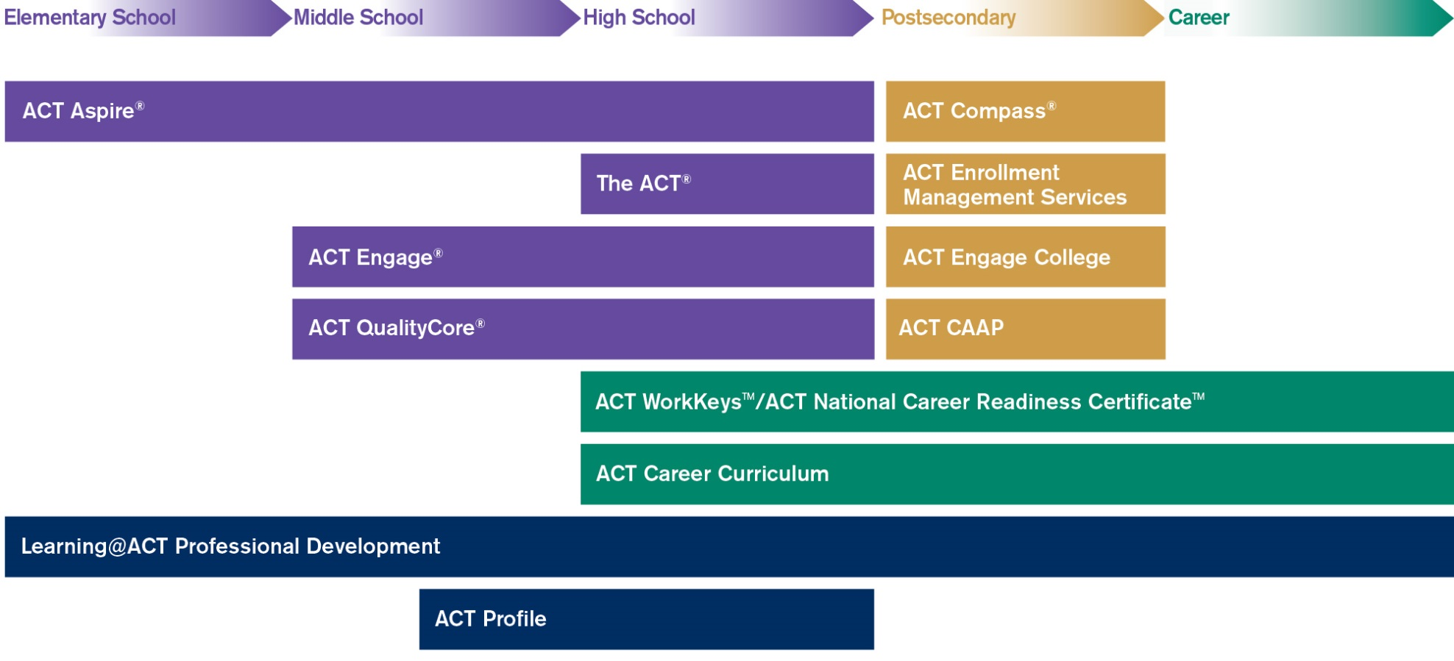
ACT Elementary — Career Continuum

Slide 6
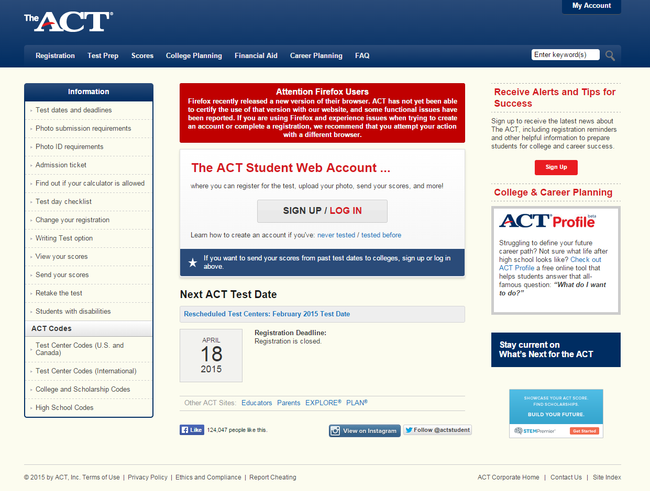
ACT Student Website
www.actstudent.org

Slide 7
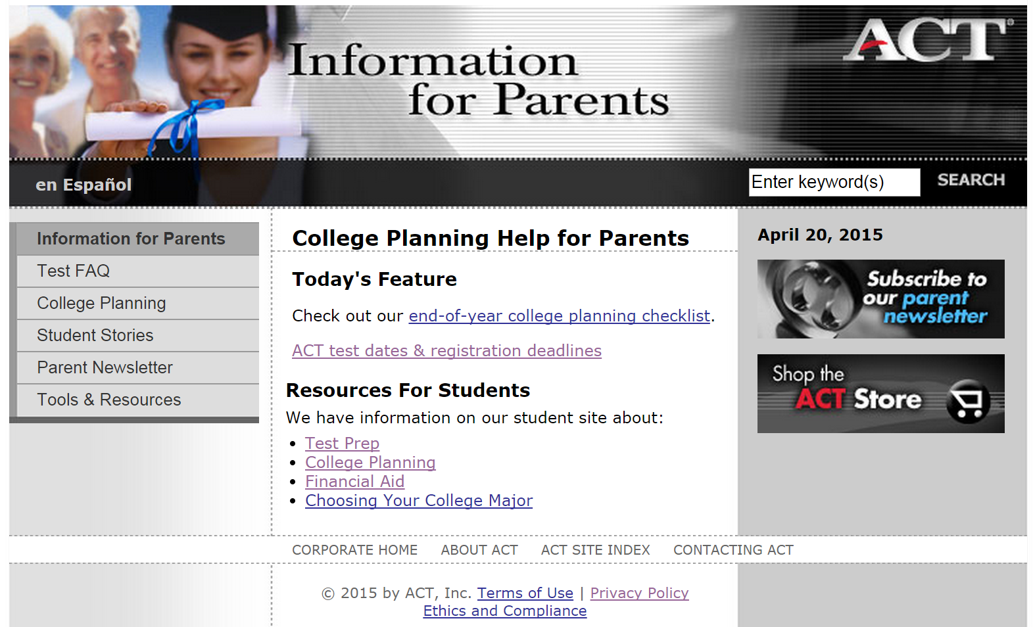
Information for Parents
www.act.org/path/parent/

Slide 8


www.act.org/aap/

Slide 9
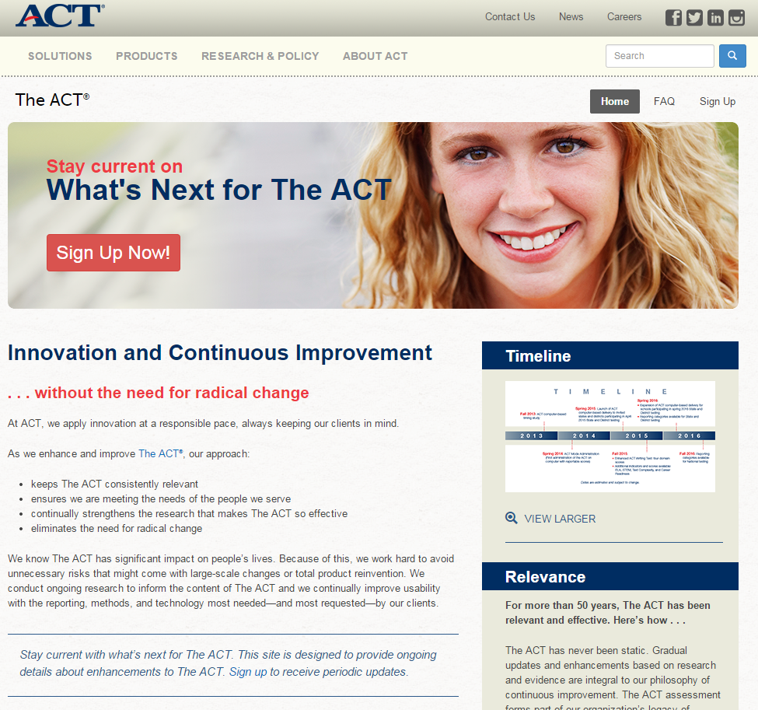
ACT Updates
www.act.org/actnext/

Slide 10
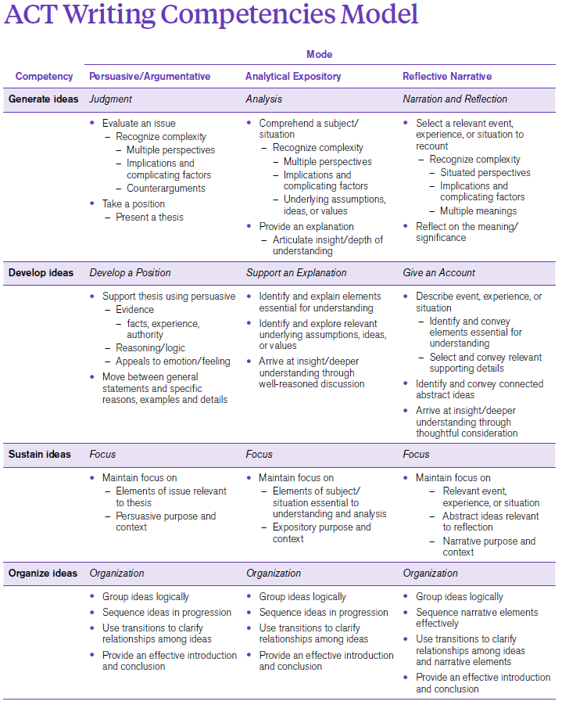
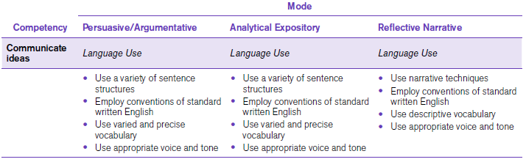
ACT Writing Competency Model
Competency Model
Writing Modes
Persuasive/Argumentative
Analytic Expository
Reflective Narrative
Rubric
Generate Ideas
Develop Ideas
Organize Ideas
Communicate Ideas

Slide 11
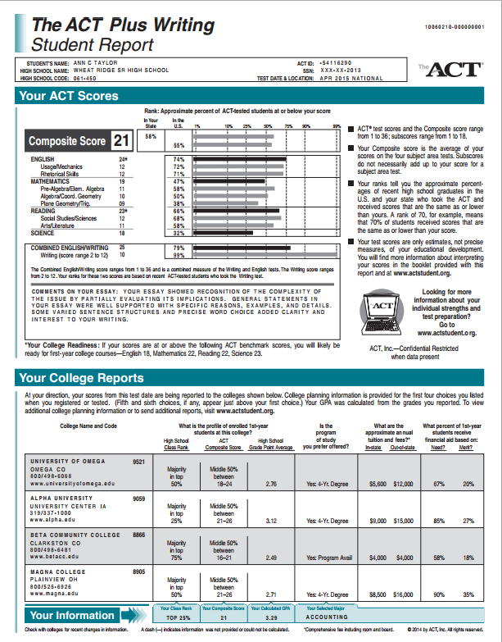
Current Student Score Report
Understand your scores
  www.actstudent.org/scores/understand
Using Your ACT Results
  www.act.org/aap/pdf/Using-Your-ACT-Results.pdf

Slide 12
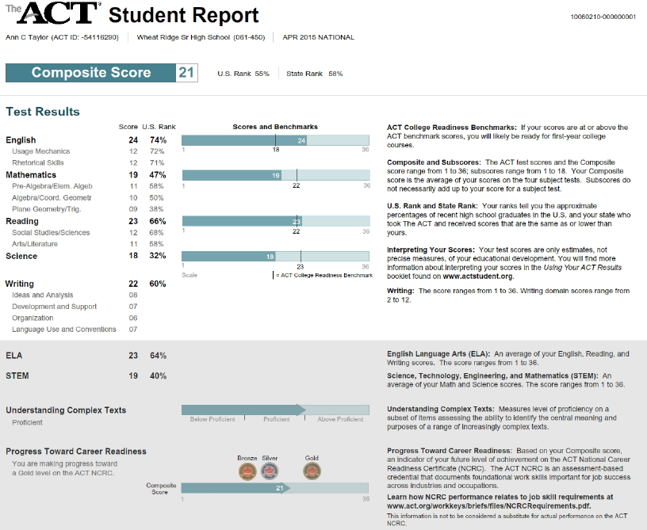
DRAFT

Slide 13
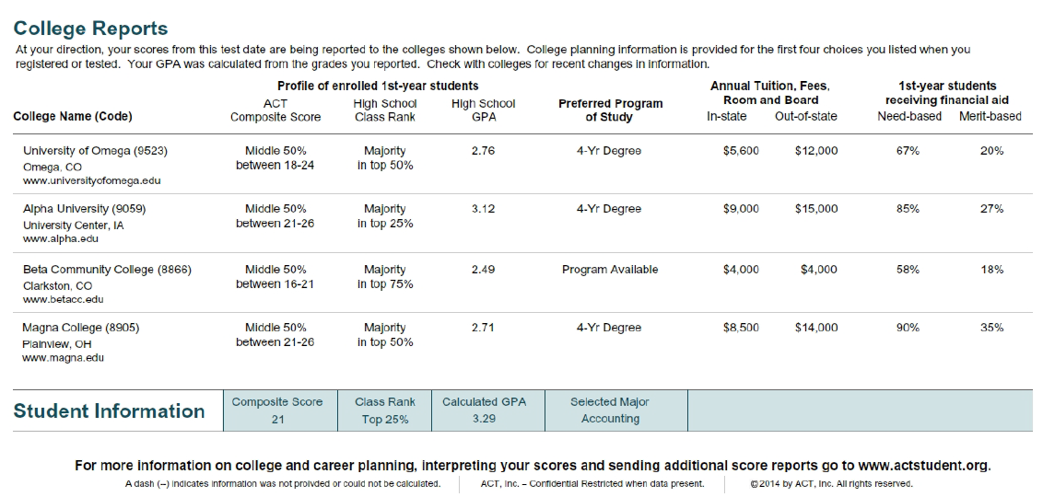
ACT Student Report (continued)
DRAFT

Slide 14
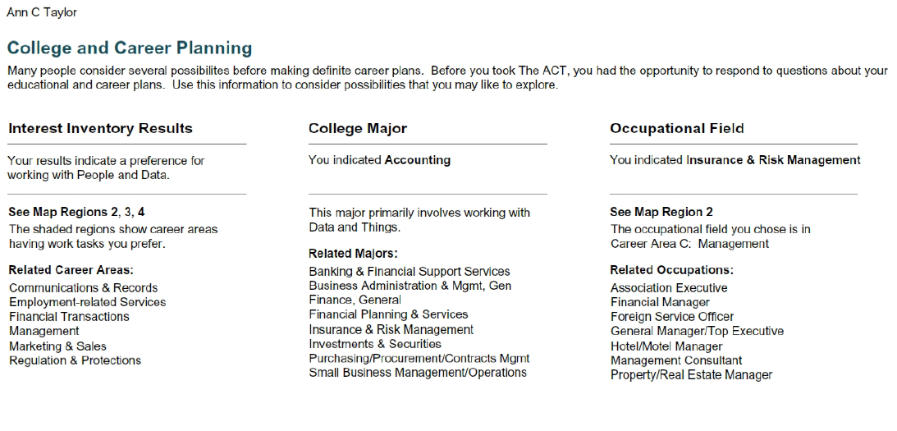
ACT Student Report (continued)
DRAFT

Slide 15
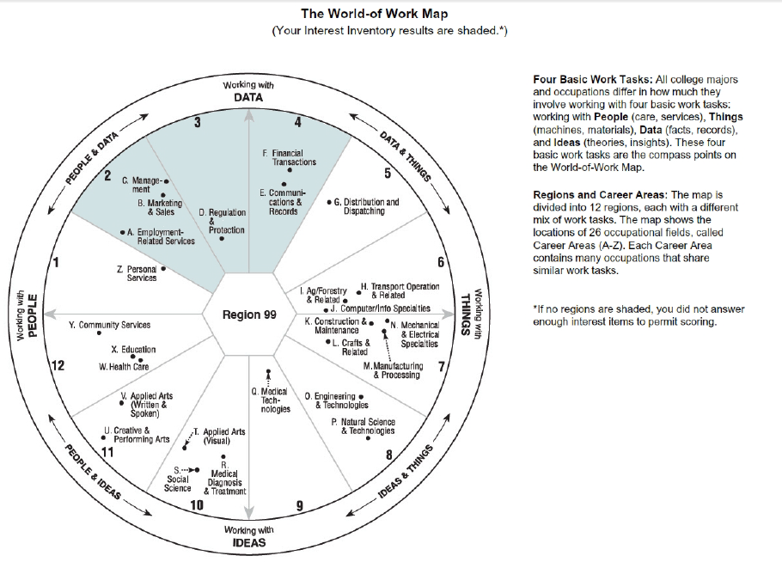
ACT Student Report (continued)
DRAFT

Slide 16
ACT Student Report (continued)
DRAFT

Slide 17

www.discoveractaspire.org

Slide 18
Spring Administration of the ACT Aspire Summative Assessment
  Predictive
  Instructional
  Evaluative
  Predictive
  Instructional
  Evaluative
  Instructional
  Evaluative
  Predictive
  Instructional
  Evaluative
ACT Aspire Periodic -Interim 1
ACT Aspire Periodic -Interim 2
ACT Aspire Periodic -Interim 3
ACT Aspire Summative

Slide 19
ACT Aspire Summative Assessment
Summative Timing in Minutes
Grade | English | Math | Reading | Science | Writing
3 | 30 | 55 | 60 | 55 | 30
4 | 30 | 55 | 60 | 55 | 30
5 | 30 | 55 | 60 | 55 | 30
6 | 35 | 60 | 60 | 55 | 30
7 | 35 | 60 | 60 | 55 | 30
8 | 35 | 65 | 60 | 55 | 30
Early HS | 40 | 65 | 60 | 55 | 30

Slide 20
ACT Aspire Periodic – Interim & Classroom
ACT Aspire Classroom Assessments
ACT Aspire Interim Assessments
Assessments: | 5 Classroom Assessments, per grade, and per content area
Format: | Fixed-format, computer-based, multiple choice
Grades: | 3 through 8
Content Areas: | English, math, reading, and science
Duration: | 15 to 20 minutes
Available Feedback: | Immediate, computer-based analysis and reporting
Configuration: | Each five-item Assessment is mapped to 2 Standards
Reports: | Student/Parent; Teacher/Group; Item Response/Analysis
Assessments: | 3 Interim Assessments, per grade, and per content area
Format: | Fixed-format, computer-based, multiple choice
Grades: | 3 through 10
Content Areas: | English, math, reading, and science
Duration: | 45 minutes or less
Available Feedback: | Immediate, computer-based analysis and reporting
Reports: | Student/Parent; Teacher/Group; School/District; Item Response/Analysis
http://discoveractaspire.org

Slide 21
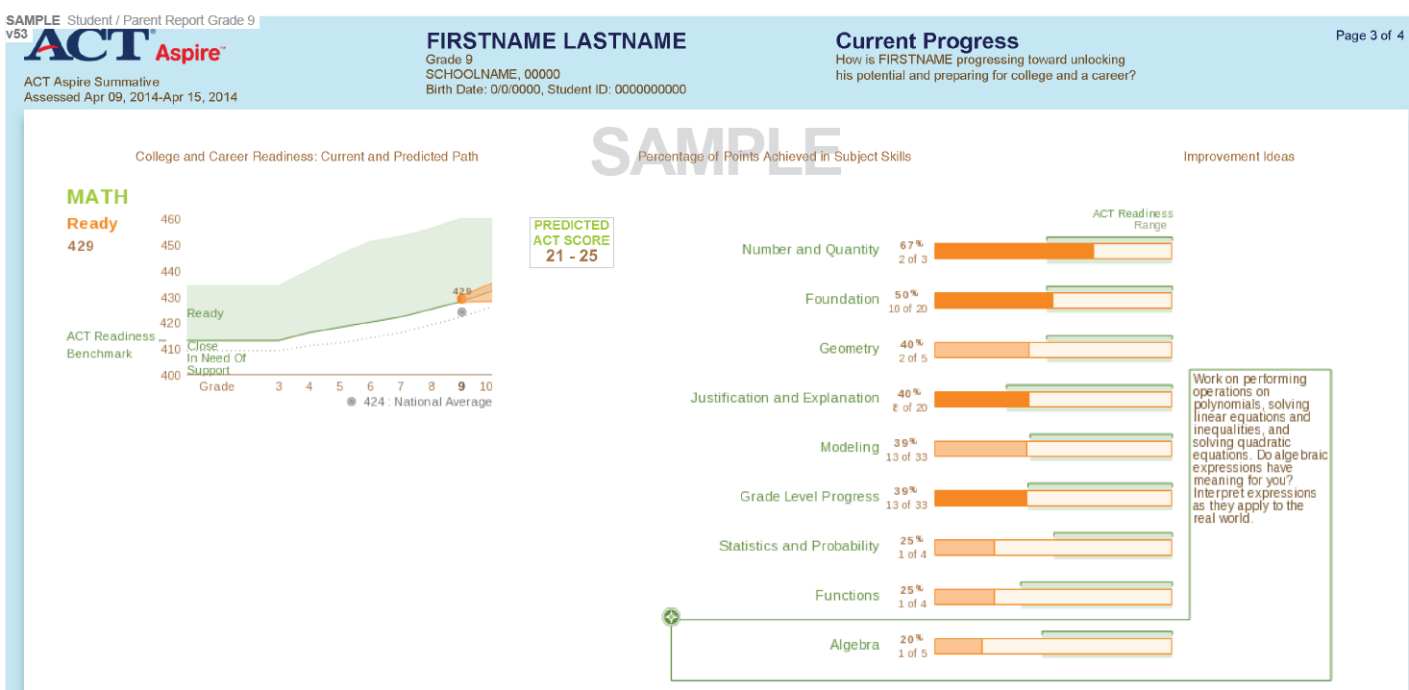
ACT Aspire Summative Reporting - ISR

Slide 22
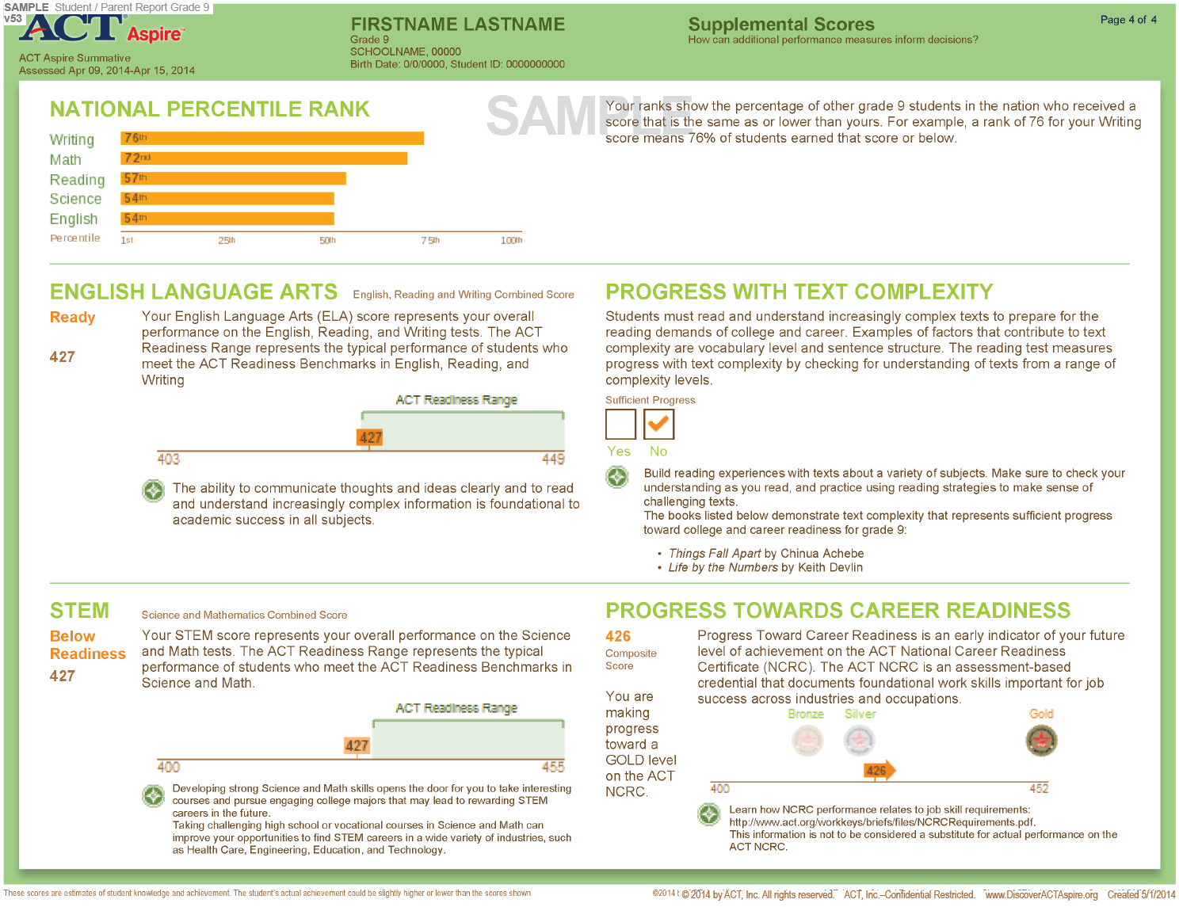
ACT Aspire Summative Reporting - ISR

Slide 23
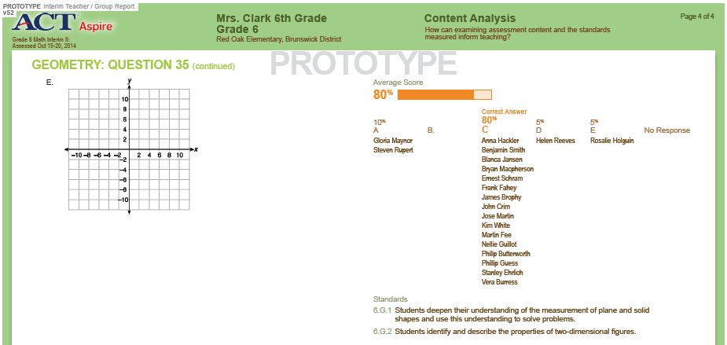
ACT Aspire – Interim Assessments

Slide 24

www.actprofile.org/

Slide 25

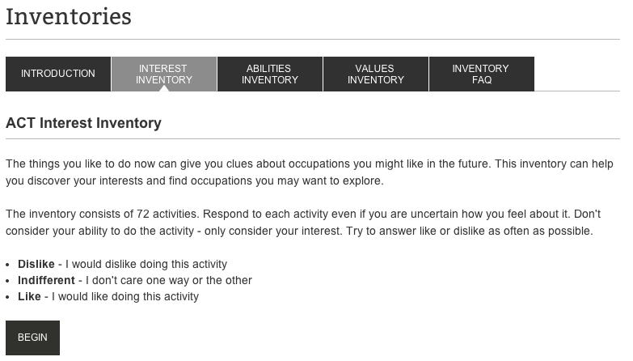
Interest Inventory

Slide 26
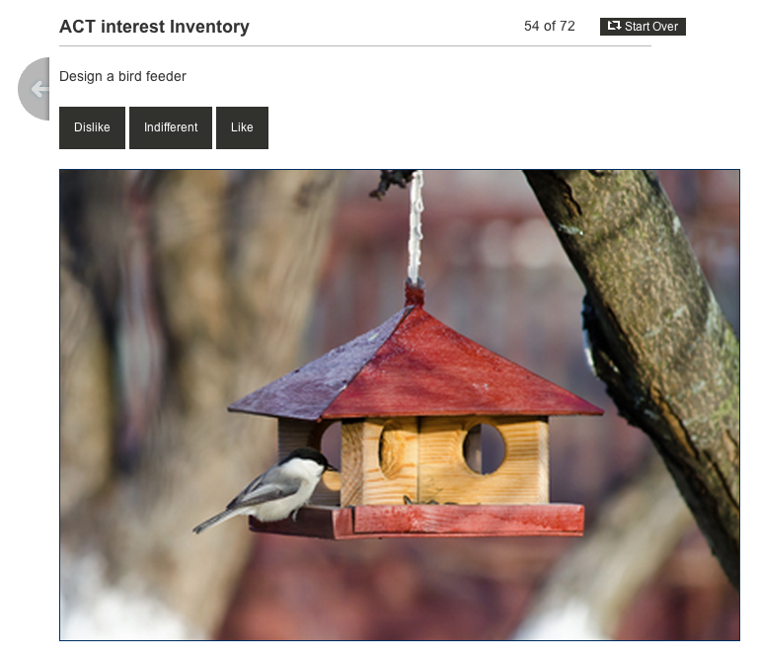
Interest Inventory

Slide 27
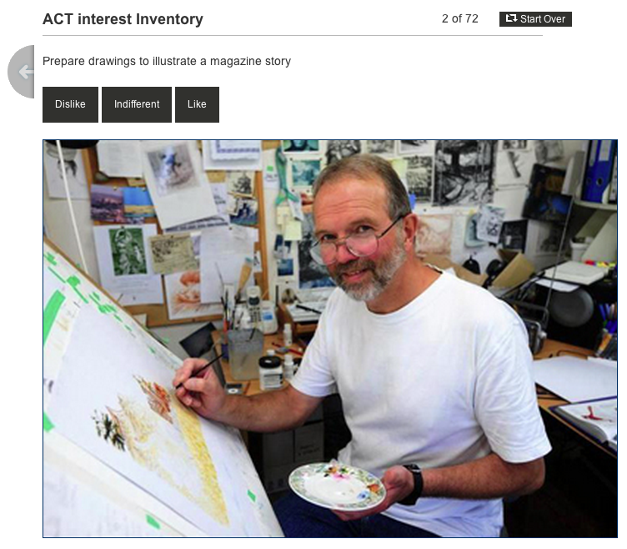
Interest Inventory
27

Slide 28
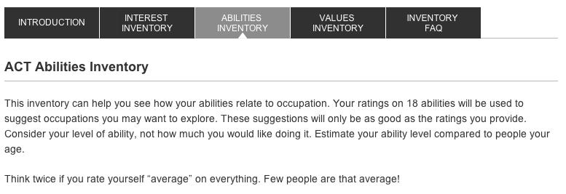
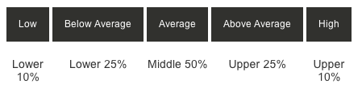
Abilities Inventory

Slide 29
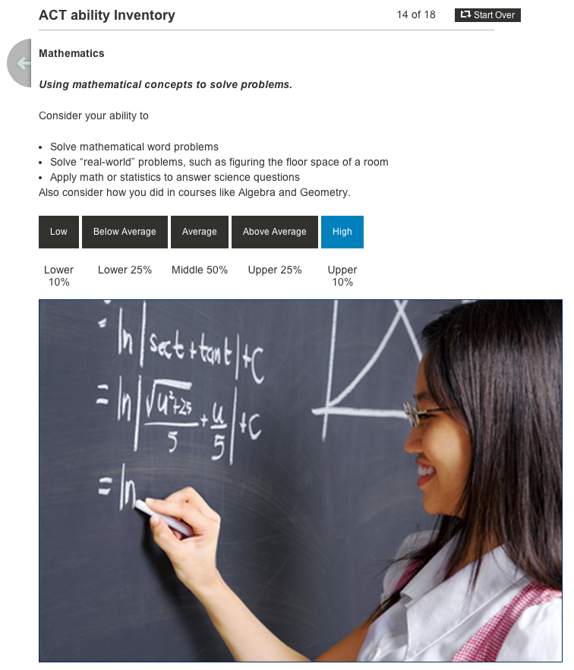
Abilities Inventory

Slide 30
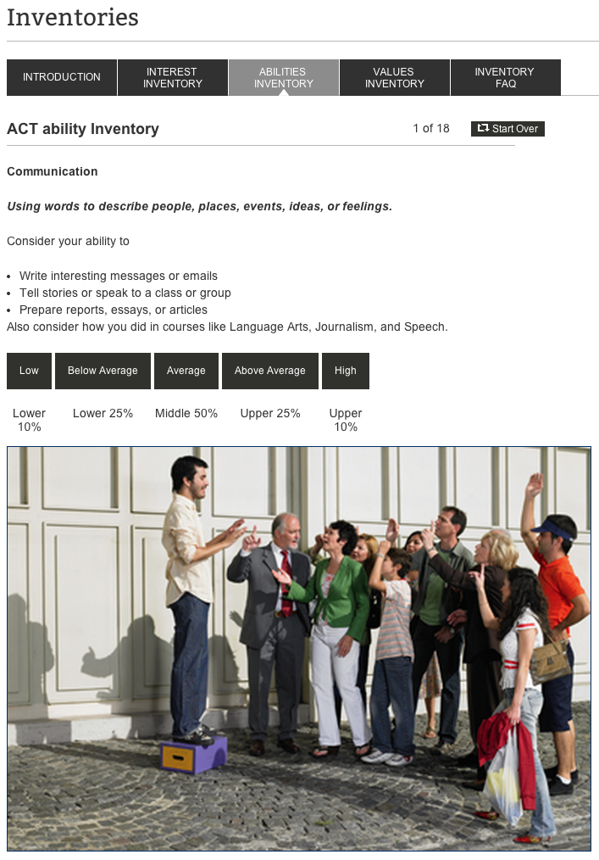
Abilities Inventories
30

Slide 31
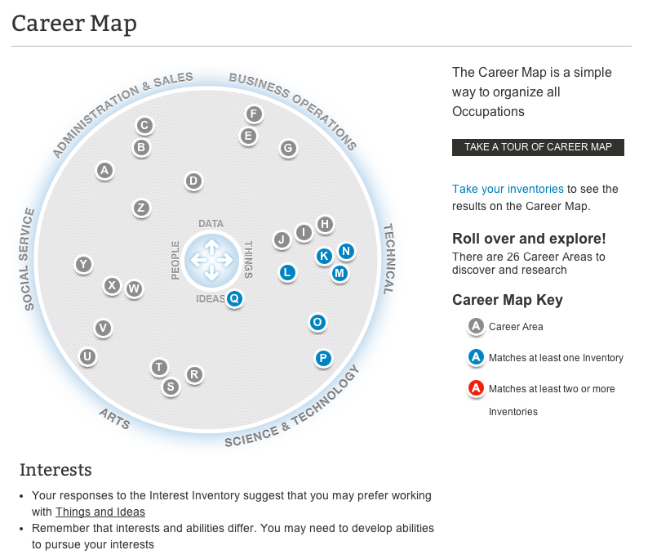
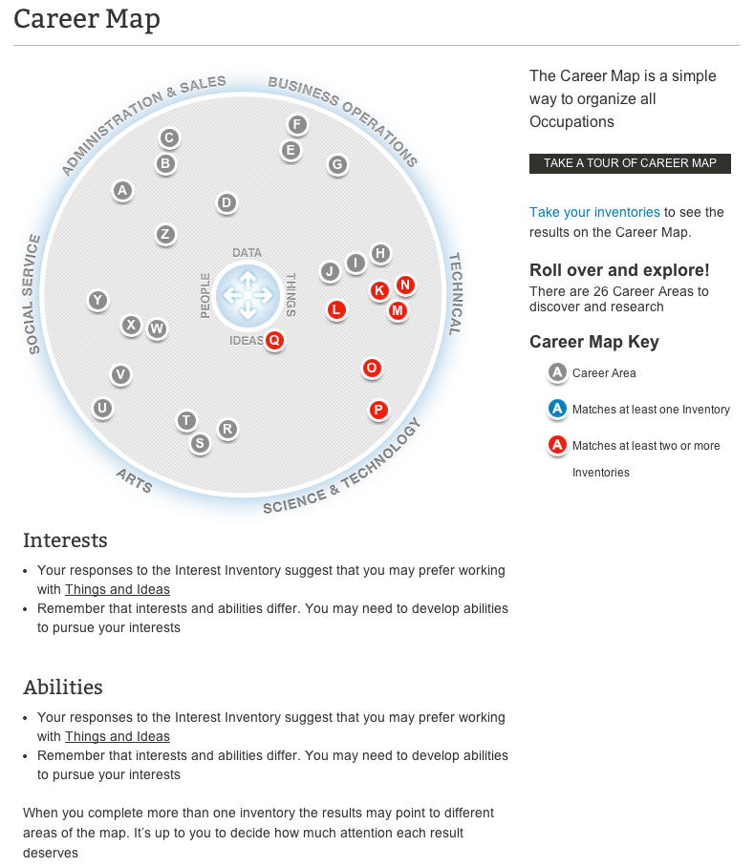
Career Map
31

Slide 32
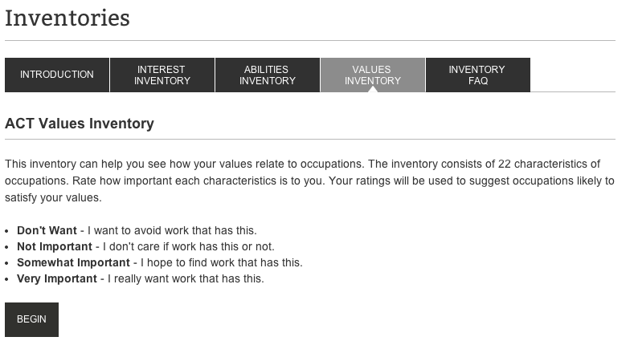
Values Inventory

Slide 33
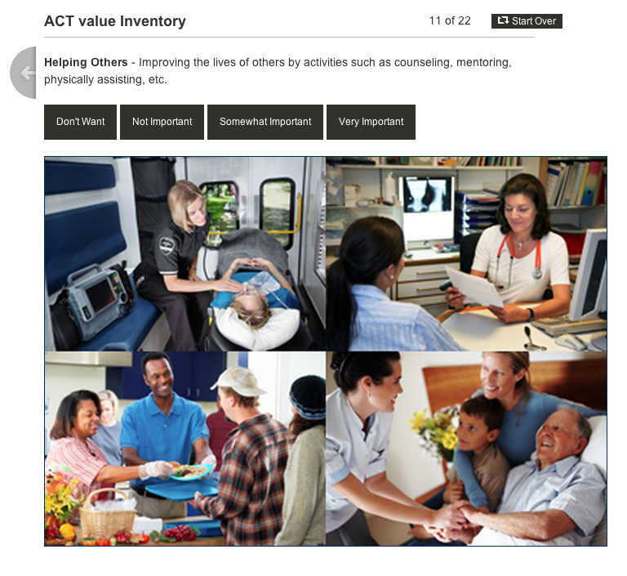
Values Inventory

Slide 34
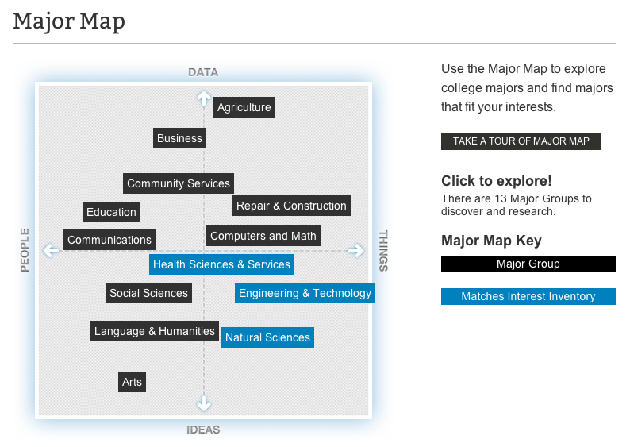
Major Map
34

Slide 35

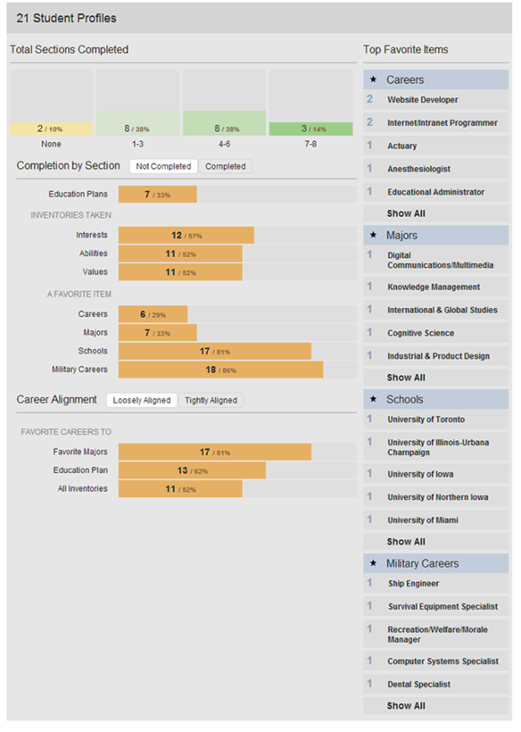
Counselor Dashboards
Identify interest areas
Spot potential challenges or gaps in plans
Remind students to complete critical tasks
Share relevant resources and information

Slide 36
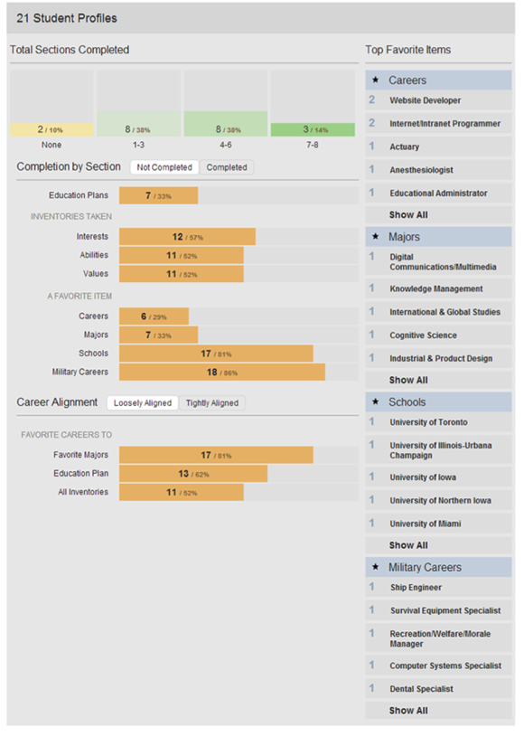
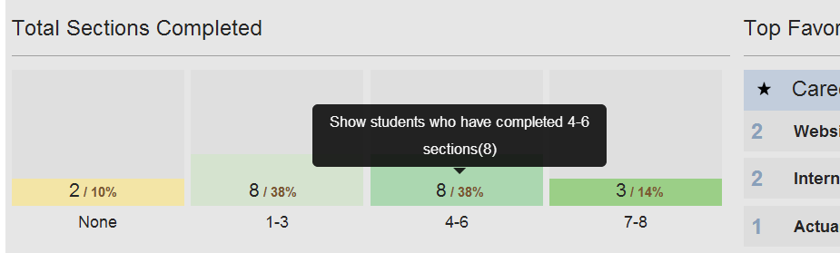
Counselor Dashboards

Slide 37
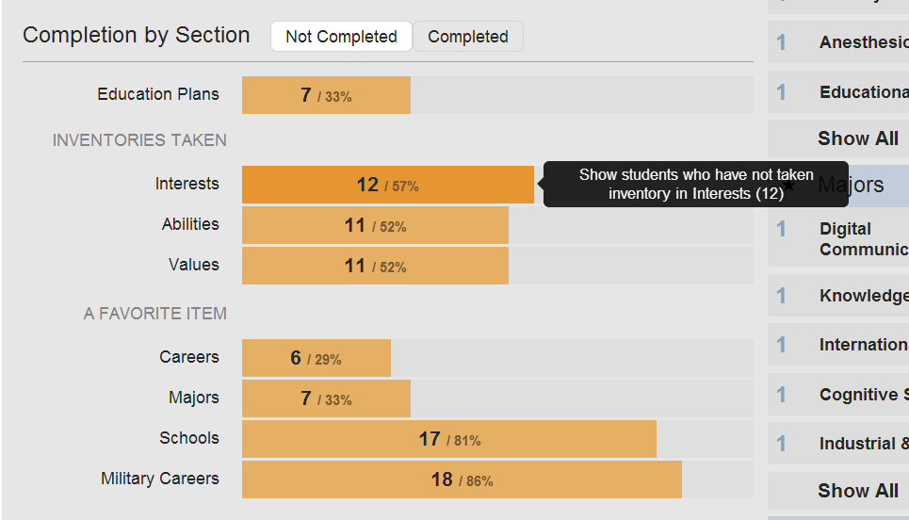
Counselor Dashboards

Slide 38
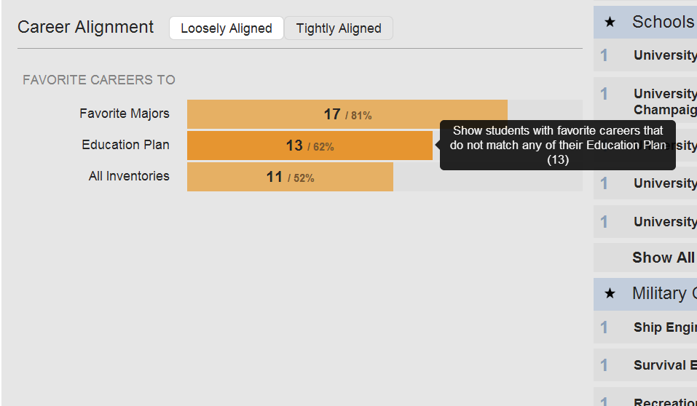
Counselor Dashboards

Slide 39
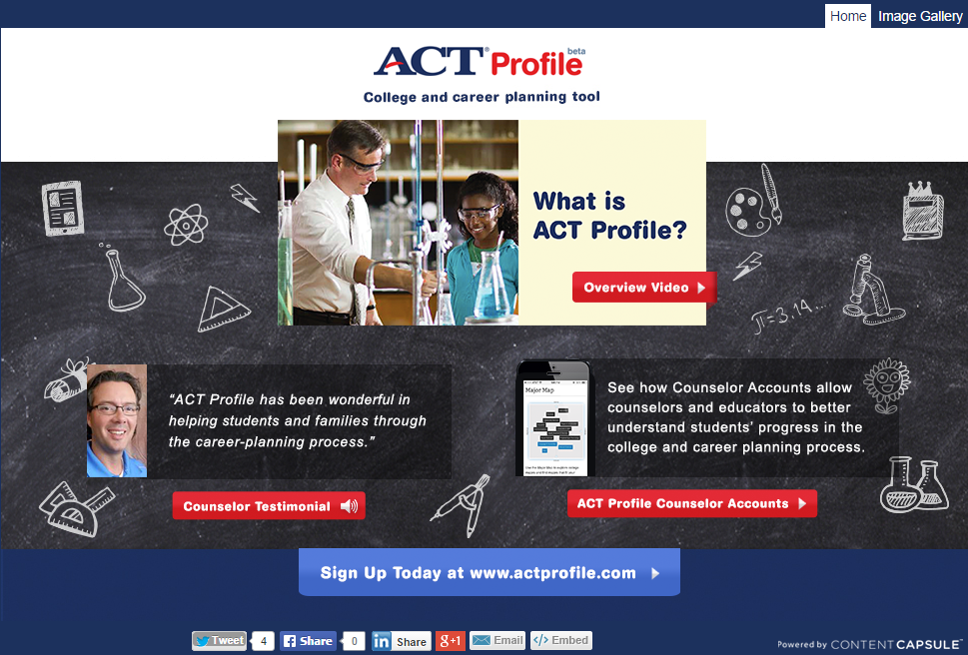
Register Today
www.actprofile.org/counselors/

Slide 40


www.act.org/engage/

Slide 41
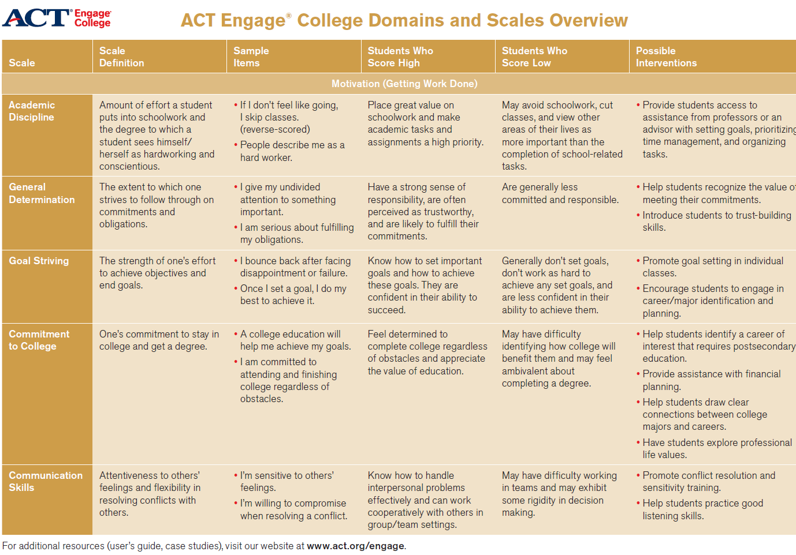
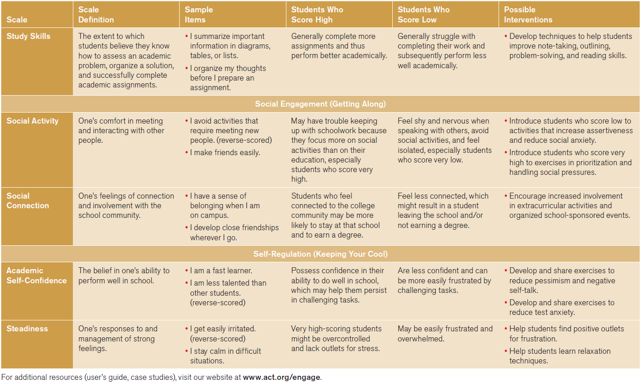
ACT Engage

Slide 42


www.act.org/qualitycore/

Slide 43


www.act.org/workkeys/

Slide 44



www.act.org/keytrain/

Slide 45


Introducing
A suite of product training and professional development events designed with
K–12 educators in mind
www.act.org/learning-at-act/

Slide 46
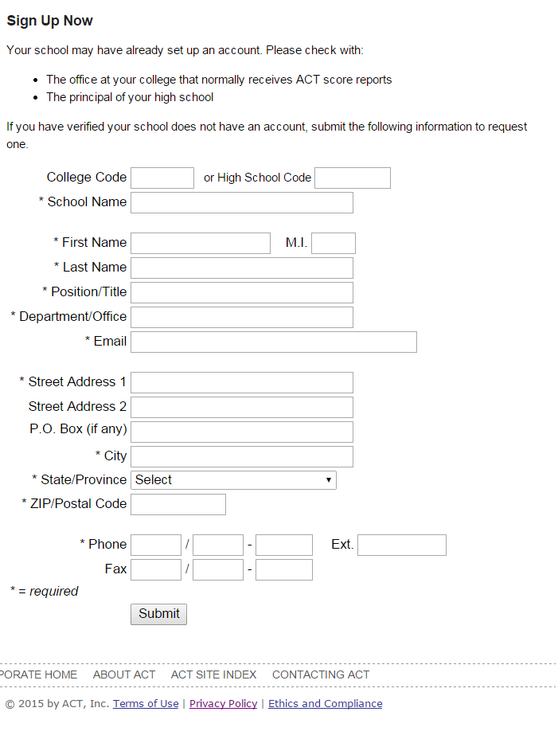
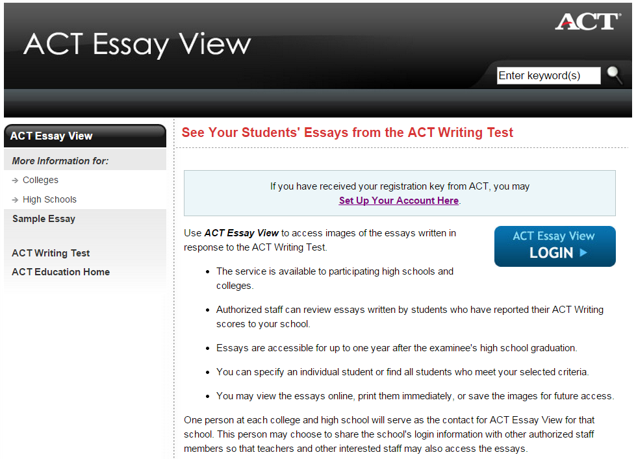
ACT EassyView
www.act.org/essayview

Slide 47
Illinois ACT Client Relations Contacts:
George Schlott
ACT Client Relations Account Executive
george.schlott@act.org
319/321-9698
April Hansen
Counties: McLean, Woodford
ACT Client Relations Account Executive
april.hansen@act.org
319/321-9751

