Slide 1
Transfer Recruitment: Thinking outside the box of the typical college fair IACAC Conference 2015
Brittany Burton
Transfer Specialist
Purdue University, Calumet
April Ponte
Senior Admissions Counselor
University of Illinois, Urbana-Champaign
“The transfer student population is trending”

Slide 2
Purdue University Calumet
“The transfer student population is trending”

Slide 3
Transfer Recruitment – Why it Matters
Approx. 1/3 of the 2.8 million students who began their posts​secondary education in the fall of 2006, transferred at least once before earning any degree (National Student Clearinghouse, 2012).​ This figure includes all instances of transfer and mobility whether it was a temporary (summer courses) or longer term shift.
More than 70,000 international students are currently enrolled at one of the nation’s community colleges, many of whom aspire to transfer to a 4-year school to complete their undergraduate degrees (Institute of International Education).
2
4
Stats & Visuals provided by NACAC
“The transfer student population is trending”

Slide 4
Transfer Recruitment – Why it Matters
Approximately three quarters of transfer students enrolled in public two-year and four-year institutions transfer to an institution in-state (About 78 percent for two-year publics, 75 percent for four-year publics).​
* (Statistics and Visuals have been provided by NACAC )
Typically 50-80 percent of first-time community college students indicate a desire to transfer and earn a higher degree.
3/4
Nearly half of all undergraduates are enrolled​ in community colleges.
“The transfer student population is trending”

Slide 5
Necessary Measures
“The transfer student population is trending”
Evaluate & Review the current processes, structures and policies involving transfer student enrollment and academic success
What kind of transfer population will your recruit ( traditional or non traditional students)
Are their the appropriate measures to help them succeed (Orientation, Advising, Activities, Clubs, etc.)
Collaborate with other units on campus to make sure the campus is prepared to work with an increase of transfer student population.
Faculty and Staff Concerns
Transferability of credits & Time are important for a successful completion of a baccalaureate degree. Monaghan and Attewell (2014), found that “students who have all or almost all their credits transferred have an odds of graduation more than 2.5 times greater than students with less than half their credits transferred.” It is important to inform students how their credits will transfer so students can make the best decisions for where and which program to transfer into.

Slide 6
Transfer Student Services
Career Outlook
Our Team
Associate Director
Transfer Specialist
Credential Analyst
Coordinator for Academic Partnerships
Evaluation of Coursework
Support
Building Articulations
Increase in transfer enrollment since our team has been formed.
Location – Accessible for transfer students to meet
Creating Transfer Guides
“The transfer student population is trending”

Slide 7
PUC Transfer Stats
Fall 14 Class 375, 31% total students admitted and enrolled
Majority of our student population transfer from local community college partner Ivy Tech Community College.
Online Nursing Cohort – 172 total students (with total enrollment, 39% of our incoming student body are transfers.
Average GPA is 3.0 for transfer students
“The transfer student population is trending”

Slide 8
On Campus
One on One Pre-advising
Instant Decision Day
Open House
Community College Luncheons
Invited Group Visits
“The transfer student population is trending”

Slide 9
Off Campus
*College Fairs
* Table Visits
* Classrooms Visits
* Invited by Faculty
* Specific Major or General
* Connecting with Transfer staff to build relationships
*Marketing – Scholarships, Presentation of Social Media, Bill Boards, Newspapers, Webpage, Radio, etc.
“The transfer student population is trending”

Slide 10
Upcoming
Workshops for Targeted Populations
Reverse Transfer Agreement with Partners
Continuing new Articulations with Partners
Scholarship Breakfast
Creating a Transfer Student Workshop
Student Faculty Interaction
Redesigning our Transfer Webpage
“The transfer student population is trending”

Slide 11
University of Illinois at Urbana Champaign
“The transfer student population is trending”

Slide 12
Our Transfer Population
~4900 applications (28% increase since 2009)
~1350 expected each fall
-Yield is 66%
-Retention rate for transfers is around 91%
-Average GPA after first semester at Illinois is 3.3
-50% from community colleges in IL and 50% from other institutions
-75% of enrolled transfers are from IL
“The transfer student population is trending”

Slide 13
History of Transfer Recruitment
Then…
-Transfer Coordinator Role
-One on-campus event for transfers and counselors
-College Fairs
-One Course Articulator
And Now…
-3 staff members dedicated to transfer recruitment
-Several on-campus events offered throughout the year
-College Fairs, Receptions, and Coffee Talks
-4 person course articulation staff
“The transfer student population is trending”

Slide 14
Off-campus Transfer Events
University of Illinois at Urbana-Champaign
“The transfer student population is trending”

Slide 15
Transfer Receptions
-Informal setting
-Presentation and student panel (if transfer students are available)
-Free food for students and parents
-Low cost for us
-30-40 people total in attendance
“The transfer student population is trending”

Slide 16
Coffee Talks
-Coffee Shops or Community College Setting
-One-on-one interaction with student
-25 minutes appointments
-Free coffee for student (low cost for us)
-10-12 appointments on average
“The transfer student population is trending”

Slide 17
Classroom Visits done by colleges
-Visit specific classes to promote a major
-Need approval from instructor
-Present brief info for about 10 minutes at the beginning of class
-Many colleges on our campus have started to recruit using this model
“The transfer student population is trending”

Slide 18
On-campus Transfer Events
University of Illinois at Urbana-Champaign
“The transfer student population is trending”

Slide 19
Transfer Visit Opportunities
-Transfer Information Sessions
-Group Visit opportunities
-Transfer Orange and Blue Days
-Admitted Transfer Days
-Transfer VIP Visit
“The transfer student population is trending”

Slide 20
Community College Counselor Outreach
“The transfer student population is trending”

Slide 21
Community College Advisory Board
-Established 2011-2012
-10 community college counselors from IL
-Meals and expenses are covered
What we are trying to achieve
Educate them on campus and transfer admissions
Expose them to our campus
Receive feedback on our current process
Discuss new ideas/changes we have
Listen to the board’s ideas
“The transfer student population is trending”

Slide 22
Typical CCAB Agenda
-Two-day event
-Starts with lunch on first day
-1:00-4:00 pm meeting with various people from the Admissions Office
-Dinner at local restaurant
-Breakfast on Day #2
-Morning meetings with other campus units
-Noon departure for home
“The transfer student population is trending”

Slide 23
Transfer Articulation Day
-One-day event in the fall for all community college counselors
-Typical attendance ~60 counselors
Agenda includes:
Admissions presentation
Updates from all 10 academic communities
Student panel/updates from other campus units
“The transfer student population is trending”

Slide 24
Community College Counselor Website
-Implemented Fall 2012
-Password is mailed in September to one contact at the college
-Provides counselors application numbers
-Able to view decisions
-Access to special forms
-Includes important dates and deadlines
“The transfer student population is trending”

Slide 25
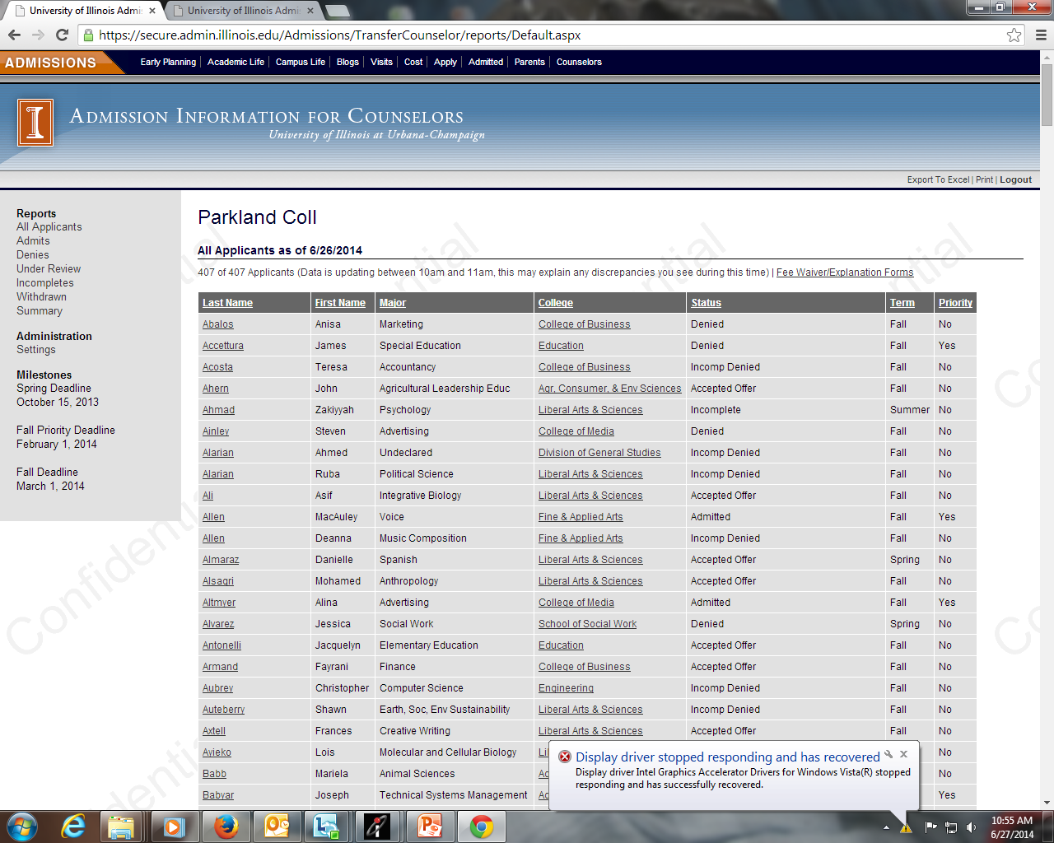

Slide 26
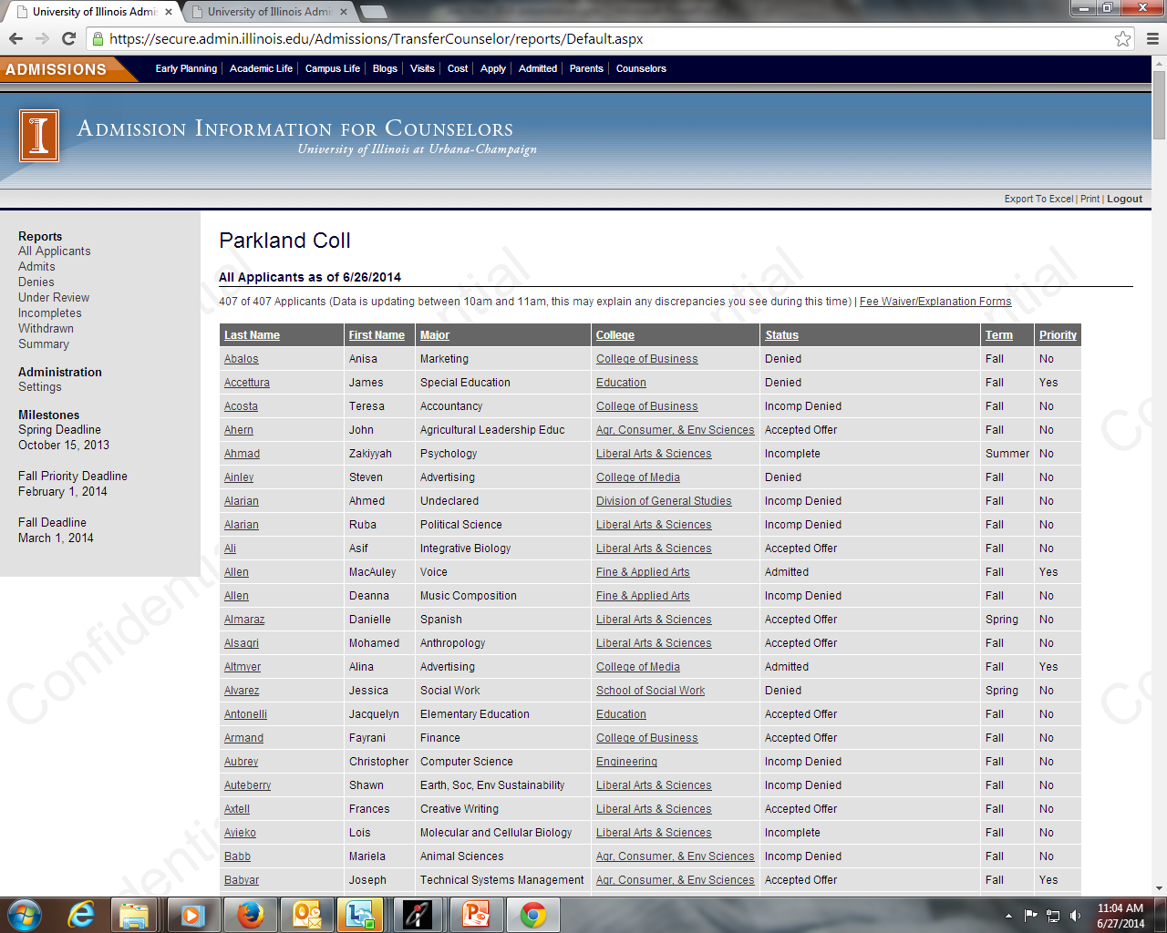

Slide 27
Communication
Transfer Emails sent through CRM
Transfer First Email http://admissions.illinois.edu/emails/campaign_transfer_yesMyIllini.html
Academic Interest email
Apply Now email
Admit email
Accept email
Registration email
“The transfer student population is trending”

Slide 28
Communication con’t
-Letter to previously admitted freshman (from NSCH)
-Letter to Honors program coordinators
-Notice of Admission Letter, evaluation and brochure
-Transfer Blogs
-Transfer Facebook page
-Illinois Near You page
“The transfer student population is trending”

Slide 29
What’s Next?
-Provide individualized visits for high ability transfers as yield activity
-More in-depth Transfer campaign during application and/or yield process
-Continue to work on strengthening community college partnerships
“The transfer student population is trending”

Slide 30
Thank you for attending!
Brittany Burton
Brittany.Burton@purduecal.edu
April Ponte
aaponte2@illinois.edu
“The transfer student population is trending”

