Slide 1
National Association for College Admission Counseling
Statement of Principles of Good Practice
(SPGP)
IACAC Annual Conference
April 30, 2015

Slide 2
Statement of Principles of Good Practice
NACAC’s Statement of Principles of Good Practice brings focus to principled conduct among colleges and universities, high school and independent counselors in the recruitment of students and their transition to postsecondary education.
“Philosophy of Doing the Right Thing!”

Slide 3
SPGP includes
Core Values
Member Conventions
Mandatory Statements
Interpretations of Mandatory Practices
Best Practices
Education, Monitoring Procedures and Penalties

Slide 4
Why are these important?
It is a code of conduct created to ensure equity and fairness in the college admissions process.
It is a document that promotes responsibility and integrity on the part of individuals who are engaged in college counseling.
It is a document that strives to “level the playing field” among all types of educational institutions.
It is a document that protects the best interests of students.

Slide 5
Purpose of the National and Affiliate Admission Practices Committees
Educate admission and counseling professionals and their institutions regarding ethical college admission standards adopted and promoted by NACAC.
Assist them in fully integrating policies and procedures into their practices.
Review, formulate and recommend changes to the Statement of Principles of Good Practice and the Education, Monitoring Procedures and Penalties policies, annually.
Monitor compliance with the SPGP.
Promote the adoption of ethical admission standards by non-members within the profession and promote awareness of these practices among affected publics.

Slide 6
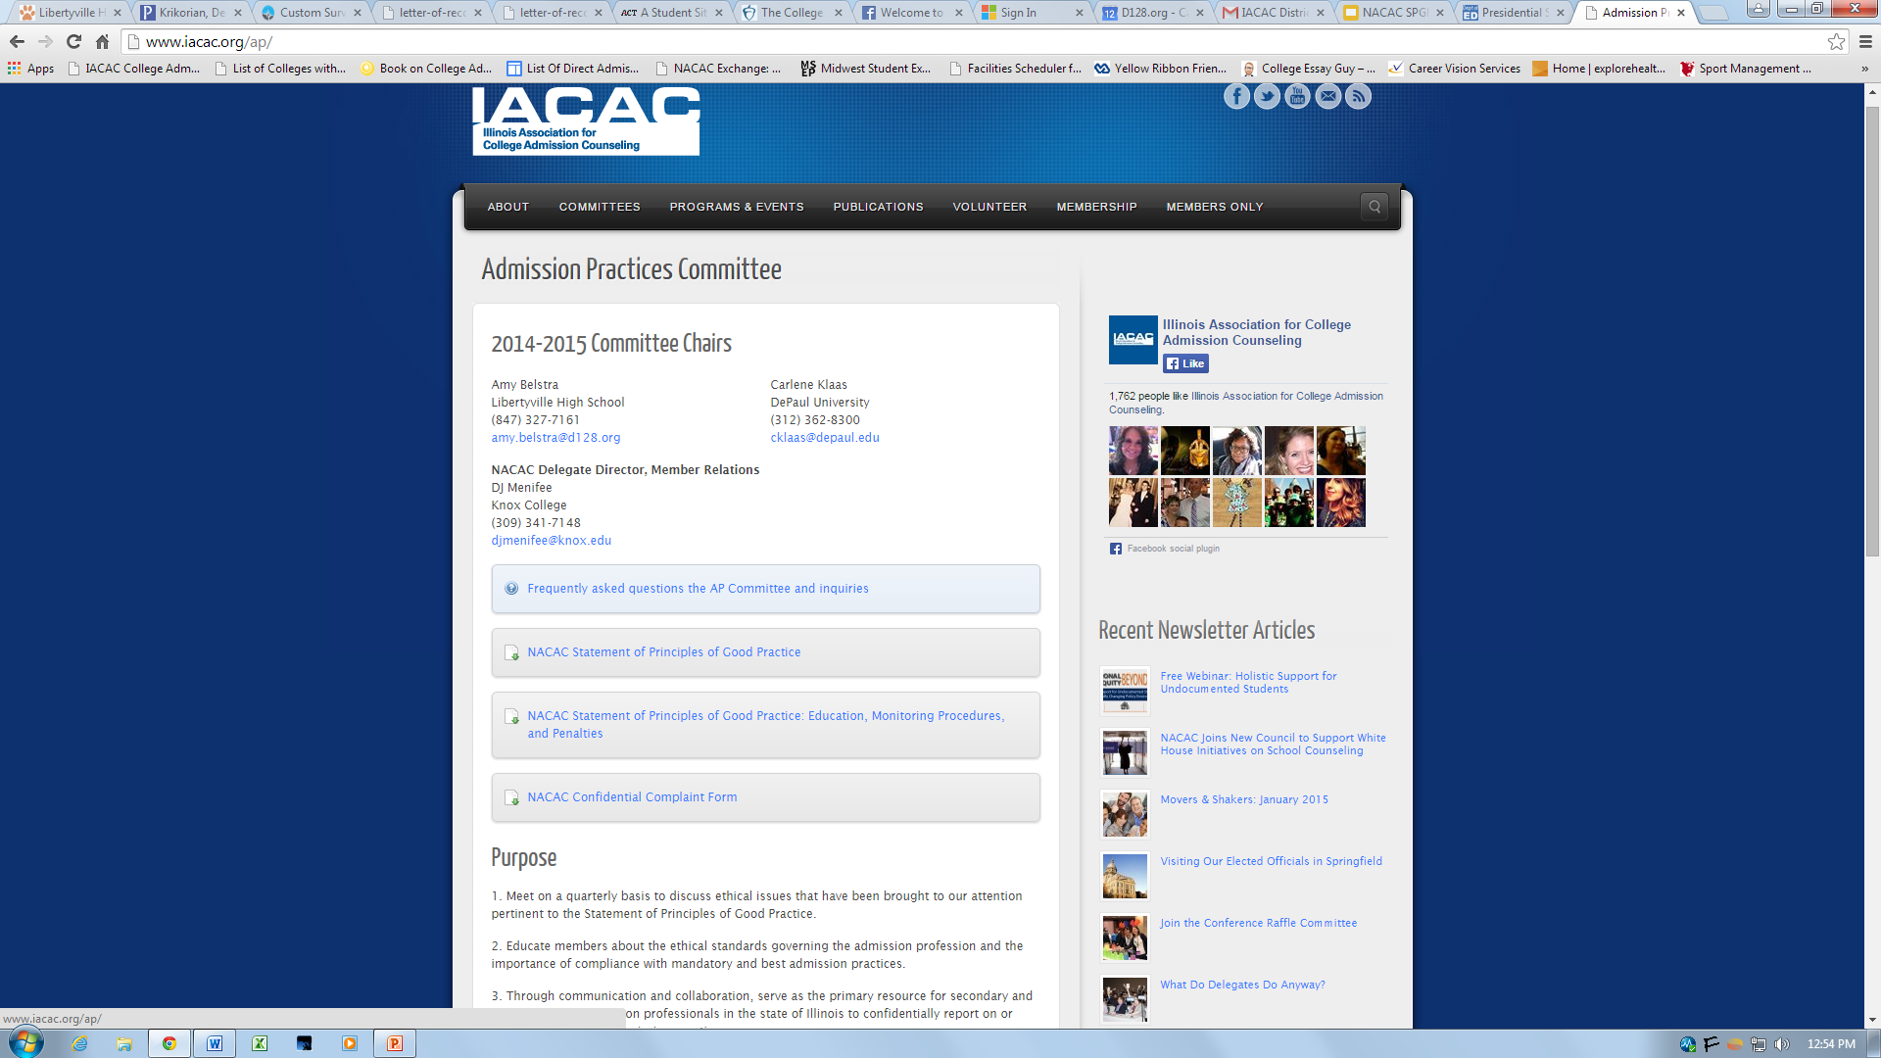

Slide 7
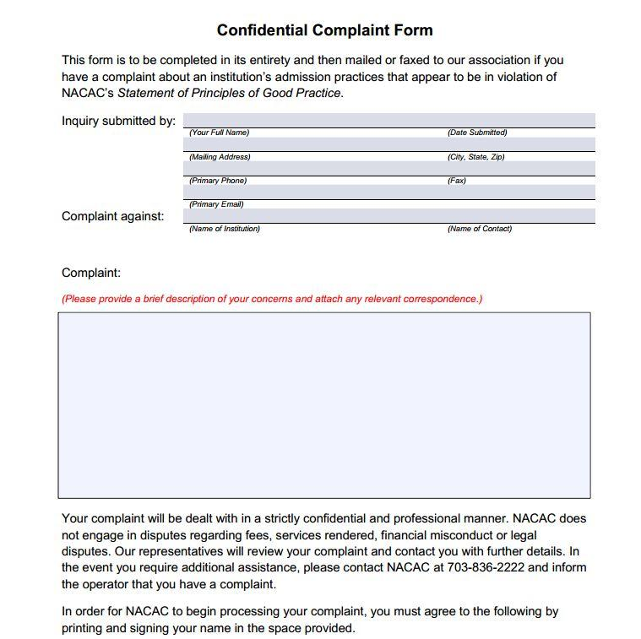

Slide 8
Profile of Complaints Filed
Trends in complaints observed in recent years are the following:
Earlier application deadlines (pre October 15)
May 1 - National Candidates Reply Date (earlier deadlines, including housing, scholarships and special programs)
Recruiting students enrolled at four-year institutions (transfer recruitment)
Wait list issues
Disparaging comparisons

Slide 9
Case Study 1:
Candidate’s Reply Date
Your senior year will be busy, so start early on your application to Eager Beaver State College! Submit an application by July 31, and we’ll waive your application fee of $50.
Is this ethical?

Slide 10
Case Study 1
SPGP Mandatory Principle II.B.12. – All post secondary members agree they will:
not establish any application deadlines for first-year candidates for fall admission prior to October 15 and will give equal consideration to all applications received by that date.
a. Colleges and universities may welcome the initiation of applications from first-year students prior to the notification date and earliest application deadlines. Any incentives offered, including but not limited to application fee waivers, essay waivers, scholarships, housing, etc., must be honored at least through October 15;

Slide 11
Case Study 2:
Future Admission
I hope this note finds you doing well and enjoying college. If things have not turned out as you expected, we encourage you to apply as a transfer student to Second Chance University.
Is this ethical?

Slide 12
Case Study 2
SPGP Mandatory Principle II.A.2. – All post secondary members agree they will:
not knowingly recruit students who are enrolled or registered or have initiated deferred admission, declared their intent or submitted contractual deposits to other institutions, unless the students initiate inquiries themselves or unless cooperation is sought from institutions that provide transfer programs.

Slide 13
Case Study 3:
It is my pleasure to congratulate you on your admission to Awesome State University. To accept this offer of admission and begin the enrollment process, please respond to this offer within 30 days.
Is this ethical?

Slide 14
Case Study 3
SPGP Principle II.B.3. - All post secondary members agree they will:
permit first-year candidates for fall admission to choose among offers of admission and institutionally-affiliated financial aid and scholarships until May 1 and state this deadline explicitly in their offers of admission;
II.B.3.C colleges will neither retract nor adversely alter their offers of admission and/or financial aid prior to May 1 for candidates who choose not to reply until that date, nor will they state or imply that candidates might incur such a penalty by waiting until May 1 (including time zone) to submit an enrollment deposit;

Slide 15
Case Study 4:
Congratulations on your offer of admission to Spectacular University! I am pleased to inform you that your application has been directly admitted to both the undergraduate program as well as our School of Medicine. Your deadline to confirm your direct admission is March 1.
Did Spectacular University commit a violation?

Slide 16
Case Study 4
SPGP Principle II.B.3.d – All postsecondary members agree they will:
II.B.3.d. the May 1 deadline also applies to any academic major or special program to which the candidate has been offered admission. Examples of special programs can include, but are not limited to, honors programs, dual-enrollment master’s, or professional-degree programs;

Slide 17
Case Study 5:
Candidate’s Reply Date
University of Western Southeastern State (UWSS) offers admission to a student, and tells the student that they have until May 1st to accept their offer of admission by sending a deposit.
The student then receives a letter from the Office of Financial Aid, offering a scholarship of $10,000. However, the student must let UWSS know if she will accept the scholarship by March 15, allowing another student to be offered the scholarship if she declines.
Is this ethical?

Slide 18
Case Study 5
SPGP Mandatory Principle II.B.3. – All post secondary members agree they will:
Permit accepted students to choose among offers of admission and institutionally affiliated financial aid and scholarships until May 1 and will state this deadline explicitly in their offers of admission.
SPGP Principle II.B.5. - All post secondary members agree they will:
Work with their institutions’ senior administrative officers to ensure institutionally affiliated financial aid and scholarship offers and housing options are not used to manipulate commitments prior to May 1.

Slide 19
Case Study 6:
A student at Ambitious College Prep comes to his college counselor in late September to get a signature for his Restrictive Early Action Agreement. The application is to his “dream” school, Prestigious College (PC), with a Nov. 1 deadline. The student will hear back in mid-December from PC.
In late October, the student asks the counselor to sign an Early Decision agreement to his “top realistic” choice, Great College (GC). GC’s deadline is December 1 and the student will hear back by January 1.
Is this allowed?

Slide 20
Case Study 6
SPGP Mandatory Principle III.B.3. – Counseling members agree they will:
sign only one pending Early Decision or Restricted Early Action agreement, when applicable, for any student.

Slide 21
Case Study 7:
A parent comes to the guidance counselor at Everyday High School with the simple request, “Can you help?” She explains, her son Aspiring Athlete received a “D” his freshman year in Math 9. He re-took the course during the summer and received a B. She now wonders, can the school just list the B or average the courses together to only list a C? She is worried college coaches might be confused or will no longer be interested in recruiting her son. The counselor happily explains, “Don’t worry. In a case like this, we routinely delete out the old grade and only list the higher grade.” The parent is pleasantly surprised to hear this policy as she had checked the school website and profile on-line and not seen it described.
Is this ethical?

Slide 22
Case Study 7
SPGP Mandatory Principle I.B.8. – All members agree that they will:
provide in a timely manner, accurate, legible, and complete transcripts for all students for admission or scholarships.
A complete transcript includes all attempted courses. However, when school and/or district policy prohibits the inclusion of all coursework, the transcript or school profile must state the institutional policies on recording repeated courses and indicate whether grades from all courses attempted are included in the cumulative GPA calculation.

Slide 23
Case Study 8:
When the counseling staff at Independent Prep is updating their school profile for next year, the Head of School requests they exclude the test scores of their international students as well as any students applying to test optional colleges.
Is this ethical?

Slide 24
Case Study 8
SPGP Mandatory Principle III.B.7. – All counseling members agree they will:
report on all students within a distinct class (freshman, sophomore, junior, and senior) and subgroups, including non-native speakers, in the reporting of standardized test scores.

Slide 25
Case Study 9:
Future Admission
A student applies to Most Popular University (MPU), and is dying to get in. As a backup, this student applies to a Less Popular But Still Good College (LPBSGC).
MPU offers admission, but not until the Spring semester, because they are full for the Fall. The student is admitted to LPBSGC. The student enrolls at LPBSGC for one semester, but then moves on to MPU.
Is this ethical?

Slide 26
Case Study 9
Concerns/potential issues:
Double deposit??
Impact on retention and graduation rates
Financial aid not available to non-degree seeking students
Is this recruiting students from another university?

Slide 27
Case Study 10:
Indicating Preferences
A student applies via Early Action to Mighty Midwestern University (MMU). In her letter of acceptance, MMU includes a survey that asks questions about her likes and dislikes. This includes a question about what other schools she has applied to and another asking her to rank order those schools.
Is this ethical?

Slide 28
Case Study 10
SPGP Principle II.B.2. - All post secondary members agree they will:
not require or ask candidates or the secondary schools to indicate the order of the candidates’ college or university preferences, except under Early Decision.

Slide 29
Case Study 10
Findings:
The big question here was “What is a candidate?”
MMU argued that admitted students are not candidates. After considerable discussion, the Committee disagreed.
The idea of this principle is that students should not be pressured to rank schools, either before being admitted or before sending a commitment.

Slide 30
Case Study 11:
Puny Endowment College (PEC) offered a decent financial package, and the student deposited. When withdrawing his application from Humungous Endowment College (HEC), they proceeded to offer about $14,000 in extra aid. Student called PEC to see if they would match this, but they had no additional scholarship money available. Given this large difference in cost, the student decided to ultimately enroll at HEC.
Did HEC commit a violation?

Slide 31
Case Study 11
SPGP Principle II.B.10. – All postsecondary members agree they will:
not knowingly offer financial aid packages to students who are committed to attend other institutions, unless the students initiate such inquiries. Athletic scholarships, which adhere to nationally-established signing periods, are a recognized exception to this provision.

Slide 32
Case Study 12:
Following the May 1 deadline, Low Deposit University (LDU) found that their enrollment commitments were down about 30%.
Facing budget cuts, LDU made calls to students who had been accepted but had decided to go elsewhere. In some cases, they even offered additional aid to influence a commitment.
Did LDU commit a violation?

Slide 33
Case Study 12
SPGP Mandatory Principle II.A.2. - All postsecondary members agree they will:
not knowingly recruit students who are enrolled, registered, have initiated deferred admission, or have declared their intent, or submitted contractual deposits to other institutions unless the students initiate inquiries themselves or unless cooperation is sought from institutions that provide transfer programs.
SPGP Mandatory Principle II.B.10. – All postsecondary members agree they will:
not knowingly offer financial aid packages to students who are committed to attend other institutions, unless the students initiate such inquiries. Athletic scholarships, which adhere to nationally-established signing periods, are a recognized exception to this provision.

Slide 34
TRENDS to MONITOR
Mid-year admission for first year students
30 day expected response rather than May 1
Proposed use of families’ prior year income (prior prior year)
Growing pressure to use institutional incentives related to student athletes, diversity goals, donors, admits on the spot or admits promised by others outside of the admission operation
Providing an honest and complete transcript representing all of a student’s work
“Poaching” or recruiting students already enrolled, to transfer from another institution

Slide 35
Questions and Answers
What issues have you encountered??
Any issues with high schools??

Slide 36
Thank you!

