Slide 1
Tools for College Financial Planning C-23
Jerry Cebrzynski, Lake Forest College
Ann LePage, Glenbrook South High School
Kathy Facenda, Sallie Mae
April 29, 2015

Slide 2
Today’s Objectives
Recognize the real cost of higher education today and how colleges present pricing for families
Learn how high schools can help their students search for college funding, navigate the financial aid process and evaluate options
Review how families can use available tools to plan early for college costs

Slide 3
The Real Cost of Higher Education

Slide 4
Sticker Price?
82% of all full-time, first-time (FTFT) undergraduate students receive some form of financial aid
92% at private colleges; 76% at public institutions
In 2013-2014 undergraduates received an average of $15,000 in aid from all sources
53% of all funds awarded to undergraduates were from a scholarship or grant
SOURCE: The College Board, Trends in Student Aid

Slide 5
The Real Cost of Higher Education
Net Price Calculator
Common Financial Aid Award Letter
College Scorecard/Ratings

Slide 6
Net Price Calculators
Online, College-specific estimator
Average grant/scholarship available to a family
Average student loan and work-study eligibility
Estimated award is not a promise, a guarantee, or an actual aid offer

Slide 7
Net Price Calculator
318 College sample (Public, Private, Doctoral, Baccalaureate)
Current aid policies cancel out public vs. private prices differences for middle to lower income families
On average, the net price calculated is 55% of the published price, with some differences for public (60–80%) and private (50–60%) universities
SOURCE: The College Board, Trends in Student Aid

Slide 8
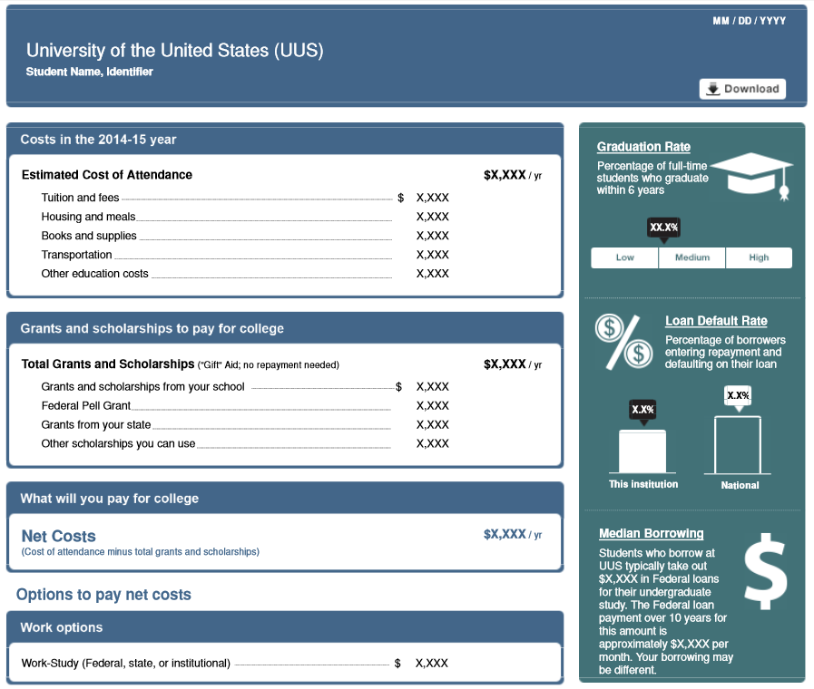

Slide 9
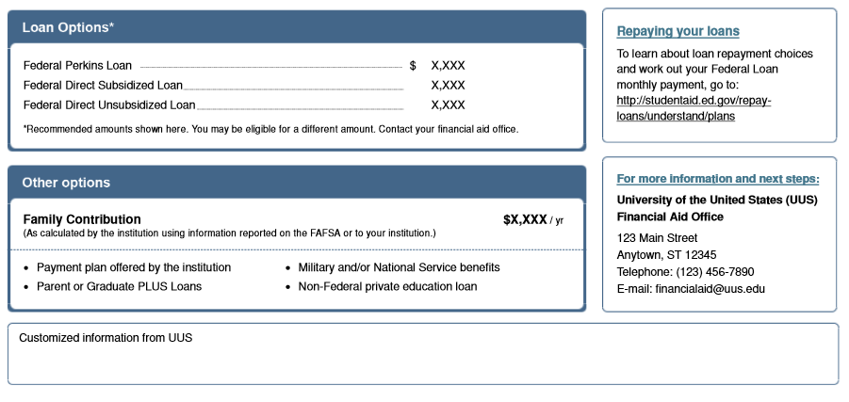

Slide 10
Decoding the Award Letter
Direct costs vs. Indirect costs
Net Price
Gift aid vs. self-help
Renewal requirements
Consumer disclosures

Slide 11
College Scorecard
What does it typically cost to attend?
What percentage of students graduate?
Are students able to repay their loans after they graduate?
What is the typical amount borrowed for a student’s undergraduate study?
What kinds of jobs do students have when they graduate?
Notes:
Data provided on the scorecard includes type of institution (can you receive degrees or certificates) and enrollment.
Data for the first four questions are provided so that students/parents can compare costs, graduation rates, and loan repayment and default rates. Data for the last question is not provided; instead students are asked to contact the institution to learn more about how many graduates get jobs.
College Scorecard has been designed by the U.S. Department of Education to provide better information to students and parents about college affordability and value.

Slide 12
College Ratings System
Hot off the press…..
  $4 Million set aside for USDE to develop ratings system/website
  Compatible with smartphones
  Users can share searches by email and on social media
  Colleges will have opportunity verify data on site and provide narrative
  Sept. 1 release date

Slide 13
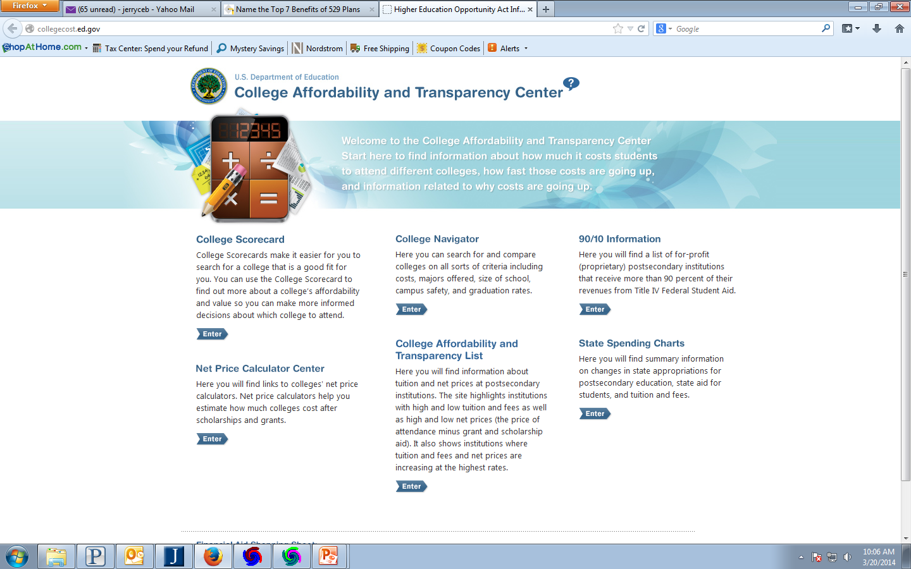
Collegecost.ed.gov

Slide 14

What Can the High School Do To Help?
Continue to assess the needs of your community
Notes:
Evolution:
97% College going rate –
20% free/reduced lunch
Increased population of First Generation College
Increased number of households where English is not the first language
Therefore an increased need for programming and support around financial aid for college

Slide 15
Getting Families Ready for the Financial Realities of College
Parent Education
Sophomore Year: College Info Night
  - Define terminology and introduce concepts
  Junior Year: Finding the Fit: Financially
  - Financial aid basics, timelines, etc.
  Counseling Strategy: Spread of schools including academic, geographic, and financial safety
Notes:
Sophomore Program – Introduces parents to Naviance, Guidance Curriculum, Transcript, Testing, and Financial Aid basics
Junior Program - Utilize Financial Aid Professionals from local colleges , IACAC Speakers Bureau, ISAC Corp

Slide 16
Helping Seniors
Senior College Finance Night – early January
The Financial Aid Process
Completing the financial aid forms
  FAFSA and CSS Profile
Alternative Strategies for Affording College
  Need-based/Merit based aid
  Federal methodology vs Institutional methodology
  Loans

Slide 17
Helping Seniors
FAFSA Completion Night
  ISAC Corp
  Financial Aid Professionals
  Counselors with ISAC Expert Training Certification
  Interpreters (Spanish/Korean languages)
Notes:
Be sure to schedule this early enough for full MAP access
Interpreters do not have to have financial aid expertise
Publish information on website, mailings, and flyers regarding material needed to complete the FAFSA
Use school computer labs
Annual Financial Aid Certification Program and Professional Development (see ISAC Website- Outreach training)

Slide 18
Helping Seniors
FAFSA Fridays
Held in the College Career Center every Friday in February
Staffed by ISAC Corp Member
Students and Families schedule a 45 minute appointment in advance

Slide 19
Helping Seniors
Additional Resources
Individual appointments with the College Counselor to compare/interpret financial aid offers from colleges
College Career Center Website with links to important financial aid websites
List scholarships in Naviance
Local Scholarship Application (survey in Naviance)
Google Hangouts
Notes:
We use Google Hangouts to record all our evening programs and then they are available to post on the website for families who were unable to attend the programs.

Slide 20
Sallie Mae’s How America Pays for College Study and Insights into the College Financial Planning Process

Slide 21


College-Ready?
How America Pays for College 2014 Findings
Why helping families become college-ready planners is important

Slide 22
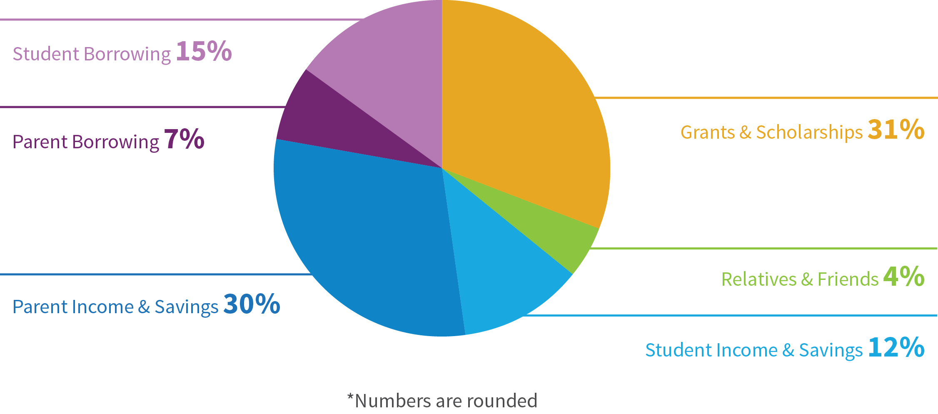
Why is it important to plan for college costs?
How America Pays for College 2014 Findings
Average spent on 4-year public college: $21,072
Average spent on 4-year private college: $34,855
Source: How America Pays for College 2014.

Slide 23
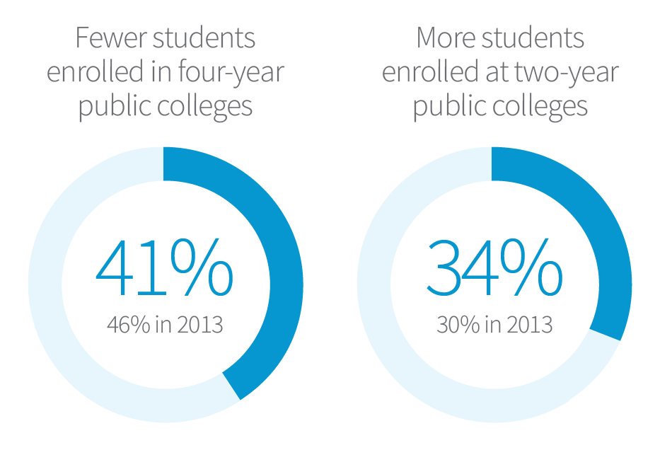
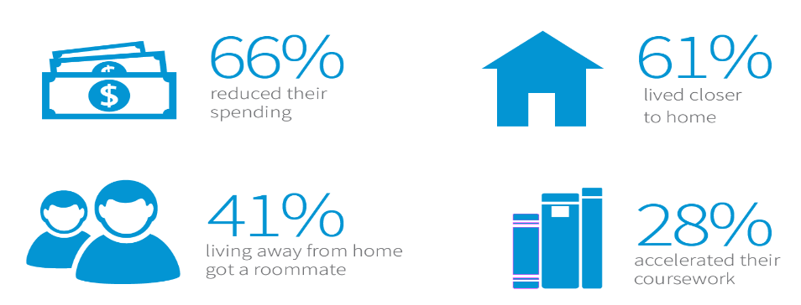

Choices that Non-planners Make to Pay for College
How America Pays for College 2014 Findings
It’s more than just tuition costs. The biggest unexpected expenses:
Source: How America Pays for College 2014.

Slide 24
Tools to Help with College Financial Planning

Slide 25
Mobile Device Usage and Web Preferences
College Financial Planning Tools
90% of seniors and 80% of parents have access to a mobile device
62% of students and 51% of parents prefer web-based resources for learning about colleges
71% of seniors and 45% of parents have looked at college websites on their mobile devices
47% of students and 29% of parents have researched scholarships online or used a college cost calculator
Source: 2014 E-Expectations Report sponsored by Noel-Levitz, OmniUpdate, CollegeWeekLive, and NRCCUA

Slide 26
Best Practices When Promoting Mobile Apps
College Financial Planning Tools
Look for mobile apps that offer:
  Free access
  The ability to compare and rate colleges
    Look for apps that allow students to keep track of potential schools and rate them based on cost, distance from home and how likely they are to be accepted
  Comprehensive checklists and timelines
    Look for apps that help students stay on top of transcript requests, letters of recommendations, and essays
  The ability to keep track of deadlines
  SAT and ACT Test prep
  Guidance on the financial aid process
    Look for apps that help students to set savings goals, look for scholarships, and explore borrowing options
    Look for apps that provide information on completing the FAFSA
  The ability to store academic and extra-curricular accomplishments
  Interactive tools and calculators that help students estimate college costs, the value of future savings or monthly student loan payment amounts.

Slide 27
Best Practices When Promoting College Planning Calculators
Look for calculators that offer:
  FREE access
  The ability to save and edit profile information
  Responsive design (mobile-friendly)
  Accurate cost of attendance data
  The ability to create a financial plan using national average data or actual data entered by the user
  The ability to include income, savings, scholarships, grants and borrowing when building a financial plan
  Printable or downloadable versions of the financial plan
  Student loan affordability guidance, including estimated monthly student loan payments

Slide 28
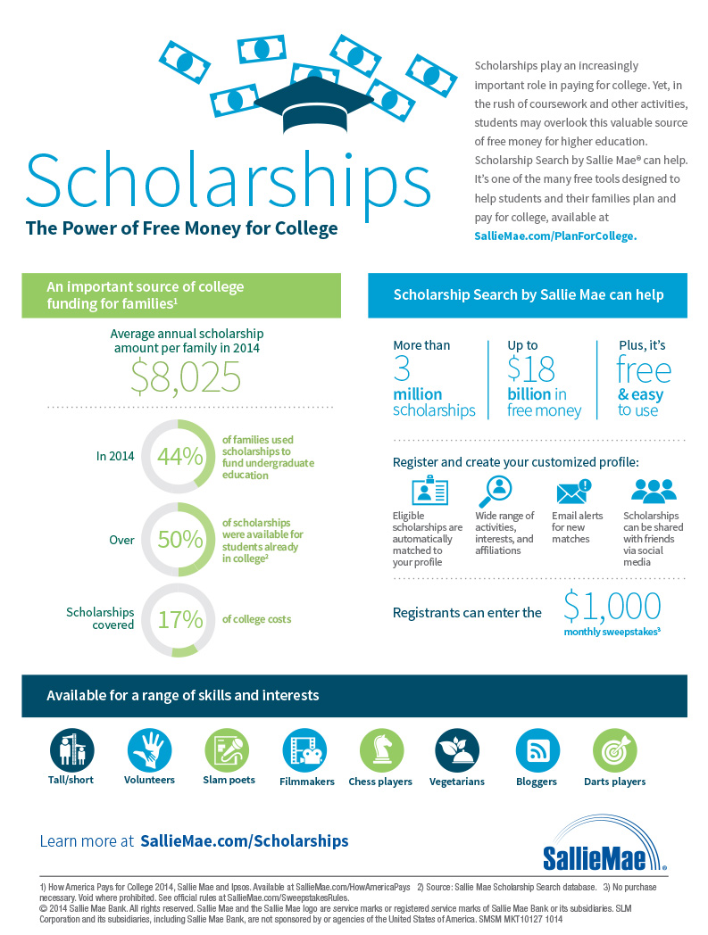
Scholarships Play An Increasingly Important Role In Paying For College
College Financial Planning Tools
How America Pays for College 2014, Sallie Mae and Ipsos. Available at SallieMae.com/HowAmericaPays
Source: Sallie Mae Scholarship Search database.

Slide 29
Scholarship Resources
College Financial Planning Tools
There are many resources for scholarships:
  Local or community-based scholarships
  Federal and state agencies
  College-specific scholarships offered by the colleges your students are interested in attending
  Religious organizations
  Employers
  Libraries
  Private organizations or major companies
  Online search engines that aggregate scholarship offerings and allow users to be matched to scholarships based a personal profile

Slide 30
Promoting Scholarships to Your Students
College Financial Planning Tools
Add scholarship information and links to the Counseling section of your website
Host a Scholarships brown bag lunch
  Invite previous scholarship winners to talk about their search and application experiences
Host a Scholarship Essay writing workshop
Partner with community-based organizations to send mailings or emails about scholarships
Leverage school communications regularly sent to students
Publish a Scholarships article in the school newspaper

Slide 31
School Newspaper Scholarship Promotion
College Financial Planning Tools
ISU Scholarship Finder
Many programs here and in the Financial Aid office offer dozens of scholarships for students. It can take a while to find one that fits you, but it is worth it to search through the website. You can use the Scholarship Finder tool to look up different names of scholarships or use key words to find what you are looking for. For example, if you are a Spanish major, type “Spanish” in the search finder and options will pop up. There is also a list of off-campus scholarships for different categories like ethnicity/diversity, women, transfer and religious.
http://www.videtteonline.com/index.php/2015/04/08/where-to-search-for-scholarships/

Slide 32
Questions

