Slide 1
High School Career Exploration:
Questions, Theory, and Best Practice
Presenters:
Camille Helkowski Susan Thorngren
Associate Director of Advising and Education Career Counselor
Career Development Center Coordinator of Career Development Program
Loyola University Chicago Coordinator of Senior Project
New Trier High School
Moderator: Matt Sheahan, Counselor, East Aurora High School

Slide 2
Question: What do you wanna be when you grow up?
  “You should know what you want your major to be before you apply to college.”
  “Students need to a choose a career, so that they can choose a major, and then use that to choose their college. This is the model we want to adopt.”
  “If you don’t know what you’re going to major in, you should go to a community college for the first two years. It would be a waste of time to go to a four year school”
  “You should just start at a community college to get your Gen Eds out of the way”
  “You should study something practical, like engineering. You can’t get a job with a degree in the humanities.”

Slide 3
Values Placed on Post-Secondary Pursuits
  College < Career
  Core/Gen Ed < Major
  Broad/Theoretical Majors < Vocational/Applied Majors

Slide 4
Emphasis on Vocational Majors
“While companies may complain young workers aren’t getting the right degrees, students are actually increasingly pursuing vocational majors that they hope employers will like. Business majors, for instance, outnumber liberal arts majors by as much as seven to one, depending on the definitions used. And since 2001, science, technology, engineering and math (STEM) degrees have increased at a rate equal to or greater than the overall increase in bachelor degrees being awarded.” (Capelli, 2014)

Slide 5
Liberal Arts Education as Career Preparation
“A broad general education helps foster critical thinking and creativity. Exposure to a variety of fields produces synergy and cross fertilization. Yes, science and technology are crucial components of this education, but so are English and philosophy. No matter how strong your math and science skills are, you still need to know how to learn, think and even write.” (Zakaria, 2015)
“Most employers are looking for transferable skills — the ability to problem solve, work in teams, write and communicate, and think critically, says Ms. Collier of SUNY New Paltz. These can be developed in any liberal arts discipline. It makes no sense, she says, to “suffer through a major” because you think it will lead to employment. “We tell students, ‘Find a major that makes you intellectually engaged, that expands your brain and deepens your understanding of the world.’ ” (Capuzzi Simon, 2012)

Slide 6
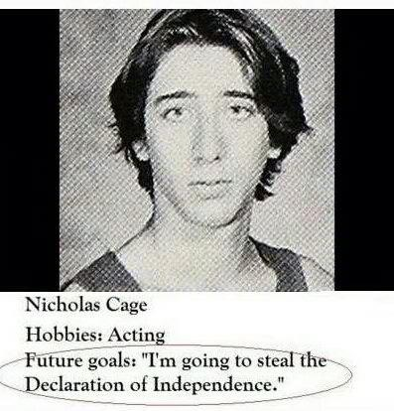
The Explorer
  An estimated 80% of college bound students have yet to choose a major (Ronan, 2005)
  An estimated 20 -50% enter college “undecided” (Freedman, 2013)
  50% of those students that declare a major, change their major, in many cases as often as 2 or 3 times (Ronan, 2005)

Slide 7

                Question: Do these numbers reflect the failure of career education at the secondary level or do they point to the futility of expecting adolescents make informed decisions about their future? Neither? Both?
A 2008 study concluded “that students are choosing major based on influence and assumption rather than through an understanding of their own personal goals and values.” (Freedman, 2013)
ACT reports that based on the 2013 administration of the exam, only 36% of students indicated a major choice that was a “good fit” based on the ACT Interest Inventory completed when registering for the test. (www.act.org/newsroom)
From the Princeton Review:
How important is your major?
Unlike tarot cards, the major you choose will neither predict nor guarantee your future. Many graduates find jobs that have nothing to do with what they studied in college.
www.princetonreview.com/college-advice/college-majors

Slide 8
Question: In the current job climate, does any of this matter anyway?
The average American will have nearly 12 different jobs by the time they are 50! (Bureau of Labor Statistics, www.bls.gov)
Estimates suggest that Americans will have between 3 -7 different careers, with 7 being the number most commonly cited (although not statistically verified) (Bialik, 2010)
“Shorter job tenure is associated with a new era of insecurity, volatility, and risk. It's part of the same employment picture as the increase in part-time, freelance, and contract work; mass layoffs and buyouts; and "creative destruction" within industries.” -Anya Kamenetz, The Four Year Career

Slide 9


And then there is this . . .

Slide 10

Question: Are high school students developmentally capable of making decisions regarding major and career?
The Prefrontal Cortex is “involved in things like planning and strategizing and organizing, initiating attention and stopping and starting and shifting attention. It's a part of the brain that most separates man from beast, if you will. That is the part of the brain that has changed most in our human evolution, and a part of the brain that allows us to conduct philosophy and to think about thinking and to think about our place in the universe. ...
I think that [in the teen years, this] part of the brain that is helping organization, planning and strategizing is not done being built yet ... [It's] not that the teens are stupid or incapable of [things]. It's sort of unfair to expect them to have adult levels of organizational skills or decision making before their brain is finished being built.”
-Jay Giedd, Frontline, Inside the Teen Brain
www.pbs.org/wgbh/pages/frontline/shows/teenbrain/interviews/giedd.html

Slide 11
Young Adult Development
Two Theories to Consider

Slide 12
James Marcia and Identity Status
Identity Status depicts a particular developmental position held by an individual regarding:
  willingness to explore and to commit to vocation (what work will I do)
  values (what do I believe – especially regarding religion and politics).

Slide 13
Marcia’s Theory
 | Exploration | Commitment
Identity Achievement | YES | YES
Moratorium | YES | NO
Identity Foreclosure | NO | YES
Identity Diffusion | NO | NO

Slide 14
Baxter Magolda’s
Four Stages of Knowing
Stage 1: Absolute Knowing:
  Knowledge is certain and absolute; answers exist in all areas
  Passive learners who expect an authority to transfer truths to them
Stage 2: Transitional Knowing:
  Beginning to question the certainty of knowledge and the authorities who convey it
  Recognition of gray areas, multiple perspectives, and contradictions

Slide 15
Stage 3: Independent Knowing
  Knowledge is viewed as uncertain; few absolute truths
  Individuals begin to view their opinions as equally valid as someone in authority; however, opinions are often held without evidence, causing conflict
Stage 4: Contextual Knowing
  Knowledge is mostly uncertain; however, some claims are better than others, based on evidence
  Ability to compare different perspectives and integrate new and existing knowledge.

Slide 16
Predominant Ways of Knowing by Year in College

Slide 17
Question: Is college the best way to address career preparation, particularly for first generation and/or low income students? If your school does not have a college-going culture is it incumbent on counselors to promote college, or is it more responsible to focus on career tracks that do not require a college degree?
“Low SES seems to be related to lowered aspirations. It may also be related to the tendency to underestimate their ability to act on their values and an overall malaise because poor people may have the perception that they have little control over their lives.” (Brown, 2002)
“A belief of low competency or in negative outcomes will lead people to avoid certain activities. Goals are formed based on experiences and their perceived outcomes in different activities . . . a process in constant flux through adolescence. After this time, vocational interests typically stabilize and do not change unless new exposures occur.” (Gibbons & Shoffner, 2004)
Career Technical Education (CTE) coursework:
  “Offering students the option of starting preparation for their chosen occupation during upper-secondary school tends to increase school attendance of 15–19 year olds and improve labor market outcomes of high school graduates whether or not they enter and complete a post-secondary education.” (Bishop & Mane, 2004)

Slide 18
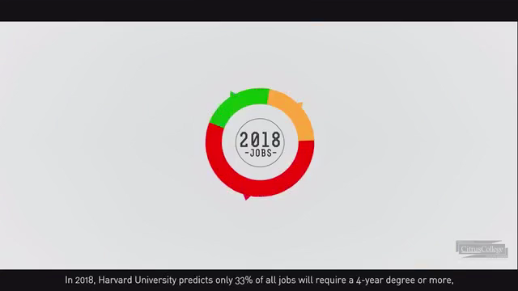
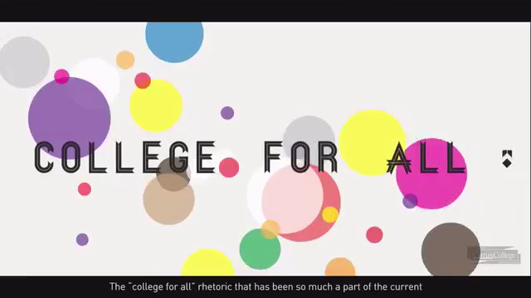
Success in the New Economy
https://vimeo.com/67277269

Slide 19
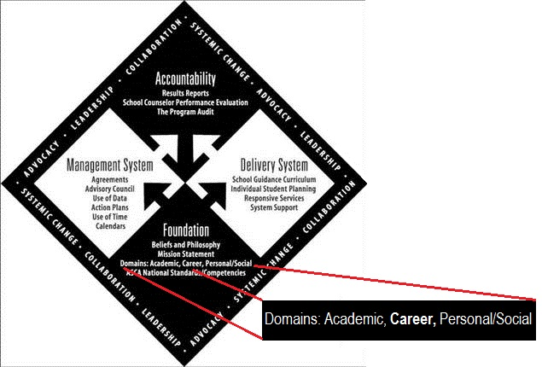
Question: Why is career exploration important at the secondary level?
ASCA Model
The focus of academic and career planning is threefold: to help students acquire the skills to achieve academic success, to make connections between school and life experiences and to acquire knowledge and skills to be college and career ready upon high school graduation. ASCA recognizes that college and career readiness is exemplified by students who are prepared for any post-secondary experience without the need for remediation and that all students possess the skills and knowledge needed to qualify for and succeed in their chosen field.
(ASCA, 2013)

Slide 20
. . . But how?
“Students do seem to benefit, both vocationally and academically, from participation in career courses. In particular, they seem to increase their knowledge of careers and their ability to make career-related decisions. Yet, the research overall does not help us in determining the optimum content of or method of delivery of career guidance. “ (Hughes & Karp, 2004)

Slide 21
Career Counseling
THEORY IN PRACTICE AT THE SECONDARY SCHOOL 1998-2015
NEW TRIER HIGH SCHOOL

Slide 22
History of New Trier Career Counseling
      Program created in 1998 based on my experience…
            14 years with NT students—teacher, advisor, coach and club sponsor
            10 years working as a volunteer youth group leader with both
            high school and college students
            graduate work in counseling and higher education
            graduate assistantship in career counseling working with
            college students and adults

Slide 23
Question: What do you want to be when you grow up?
    New Trier’s model…
    individual counseling not career courses
    offers a plan for students to start the process
    focuses on the student interested in exploring their own potential careers
    counseling based on identifying:
    academic strengths, personal interests and values
    provides self-analysis, career exploration and educational goal setting

Slide 24
The Explorer-
Question: Do these numbers reflect the failure of career education at the secondary level or do they point to the futility of expecting adolescents to make informed decisions about their future? Neither? Both?
Failure? How many schools in the US are offering guidance based career counseling?
Are the “informed decisions” really based on self-analysis with counseling and factual information about the careers of interest?
Are the 50% of students who change their major ever seeking career counseling, using their campus career services or making a plan to choose a major based on an actual method?

Slide 25
Question: In the current job climate, does any of this matter anyway?
Career changes: various paid and volunteer work experiences, age related interest, opportunities, new markets, technology, etc.,…
Teaching a decision-making process: students are able to return to the process of choosing a career

Slide 26
Question: Are high school students developmentally capable of making decisions regarding major and career?
Students with high school career counseling and/or career related experiences…
          Olivia -class of 2011
          Harley -class of 2013
          Elin -class of 2010
          Max -class 2009
          Glenna -class of 2012

Slide 27
Question: Is college the best way to address career preparation, particularly for first generation and/or low income students? If your school does not have a college-going culture is it incumbent on counselors to promote college, or is it more responsible to focus on career tracks that do not require a college degree?
Individual student variables:
          Financial status-SES
          Cultural expectations (parents)
          Aptitude and academic strengths
          Emerging careers/expected growth
          Work-life balance

Slide 28
Question: Why is career exploration important at the secondary level?
Fewer college students changing their major if they had more successful career exploration at the secondary level?
Allows the student (and the parents) to create a plan for various career experiences while in high school.
Economical: first career choice based on a plan with exploration and experience.

Slide 29
Changing the perception of career counseling at the secondary level.
  Not a test or battery of assessments
  Individual counseling vs. career courses
  Student is not forced to choose a college major or technical occupation while in high school
  Best choices for student, not driven by economic needs
  Process that is revisited throughout life
  Previously not existed successfully at the secondary level

