Slide 1
Summer Workshop EXTRAVAGANZA
IACAC Annual Conference 2015

Slide 2
Summer Workshop EXTRAVAGANZA
Jill Cervantes, New Trier High School
Nicole Repa, Lakes Community High School
Rachel Georgakis, Fenton High School
Brian La Porte, Naperville North High School

Slide 3
Essay Seminar and Common App Workshop
Jill Cervantes, New Trier High School

Slide 4
Essay Seminars
Why?
84% of our students apply via the Common App
Similar numbers applying to non-CA schools also requiring essays
Encourage students to work proactively!
427 participants in 2014

Slide 5
Essay Seminars
Curriculum and Structure
1 hour 15 minutes sessions throughout the summer
13 dates, 8 of which parallel the CA Workshops
Students attend ONE
Addresses differences between writing for class and writing for college apps
Allows us to be clear and consistent

Slide 6
Essay Seminars
Topics covered:
Purpose of the essays
Audience
Process: collecting topics, brainstorming, editing
Content, tone, appropriateness of either
Do’s and Don’ts

Slide 7
Essay Seminars
Follow-up
Schedule a meeting with your PHSC for two weeks later
Handouts:
Essay topics
Power point
Brainstorming exercise

Slide 8
Common App Workshop
Why?
Over 1000 in our senior class, 84% of which submit a common app
Pre-empt errors we often see
Head off common questions
Free up time to shift our work to other areas in the fall

Slide 9
Common App Workshop
Curriculum and Structure
8 sessions over 4 days, students attend ONE
Computer lab with a projection screen
Project CA website and hand walk them through a fictitious account
CA site has helpful, short instructional videos that can be shown if time and room set-up allow
Ideally one person leading and one floating to answer questions

Slide 10
Costs
Our staff folds it into our already required summer hours
Group instruction vs. individual meetings, trade-offs are worth it
Provide handouts for the Essay Seminar and optional CA Workshop data cheat-sheet

Slide 11
Boot Camp
Nicole Repa, Lake High School

Slide 12
Lakes Community H.S. Lake Villa, IL
Population: 1465
Class of 2015: 383
ACT mid 50% 20-27; Top 25% 27-35
Post secondary plans: 94% (58% 4 year; 36% 2 year)
981 applications to 224 schools
Attending 92 different schools in 24 different states
Notes:
Who are we? 50 miles north of Chicago in Lake County. Up near Antioch, Grayslake, Lake Forest, Libertyville.

Slide 13
Why Boot Camp?
Insufficient time during school day
Wide range of students
Give time outside the school year
Notes:
40 minutes in Fall and Spring to address juniors and work through the college process, procedures, information and the use of Naviance.
Wide range academically, motivation (how and when to get started), knowledge of the process, knowledge of resources.

Slide 14
Implementation of Boot Camp
Registration form available during summer school registration
$25 per student; waived for students with reduced fees
Announcements, email blasts to students and parents
Scheduling around other camps and activities
Notes:
$25 dollars pays for binders for students, thank you gift cards for speakers and facilitators hourly costs.
Parents signed students up without students knowing.
Band and sport camps. Have 2 dates in separate weeks to accommodate camps and vacations. One morning/afternoon session. Coordinate with in house tech facilities issues.

Slide 15
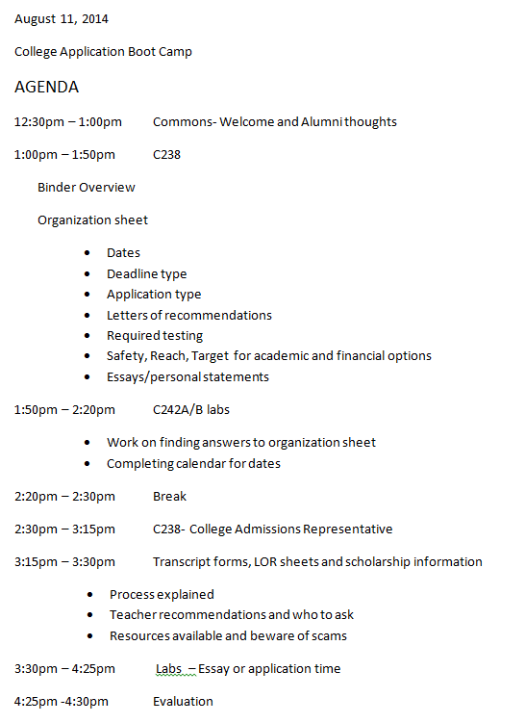
Agenda of Boot Camp
Notes:
Binder overview included individual transcript and tabbed sections of 1. monthly calendar, 2. tab to list all awards and personal achievements, 3. resources and information about essays and personal statements including “Evaluate Yourself Questionnaire” 4. Testing information including dates for ACT/SAT community college proficiency test and AP 5. In house directions about the process including sending ACT score report, transcript and letter of rec requests 6. Financial aid informtion including FAFSA and net price calculator 7. Glossary of terms 8. Additional information – college visits, wait listed, careers, shopping lists

Slide 16
Organization Sheet
Notes:
Lab time spent researching an organizing self. Info gathering. Students reported this was the most helpful sheet.

Slide 17
Student Feedback
Earlier dates in summer to begin the process
Forced fun
Appreciated binder to organize self and use as resource
Hearing message from college reps
Helpful information regardless of where applying

Slide 18
College Boot Camp
Rachel Georgakis, Fenton High School

Slide 19
Fenton High School Population
Over 50% are First Gen
Over 55% participate in FFRLP
Over 60% of students who file the FAFSA are PELL Eligible
42% start at a 4 year institution
45% start at a 2 year institution
52% Latino

Slide 20
Purpose of College Boot Camp
Help first generation and underrepresented college bound students with the college application process

Slide 21
College Boot Camp Logistics
First gen and other underrepresented students with a 3.0 and above are invited to apply
3 days in August from 9am-3pm at FHS
Free to students, Includes lunch and transportation to college campuses
Led by 3-4 FHS counselors, regional representatives, and financial aid professionals

Slide 22
College Boot Camp Sessions
Pre/Post Test
Finding Your Fit
College Fairs, Campus Visits, College Reps
Financial Aid
Naviance
Personal Statement
Common App and Application Workshop
Campus Visit
Mock Admissions (new for 2015)
Parent Workshop/Reception (future)

Slide 23
College & Career Readiness Workshop
Brian La Porte, Naperville North High School

Slide 24
General Course Information
Monday through Thursday (2 weeks)
8:00am – 11:00am
Cost: $50/student
Does NOT count for credit / Does NOT appear on transcript
Classes capped at 15-20 students

Slide 25
Course Outline
Monday : Career Research (CareerCruising)
Tuesday: College Research (Naviance)
Wednesday: Soft Skills / Interviewing Skills
Thursday: Presentations (Mock Interviews)
Friday: Wrap-up / Evaluations (No Class)

Slide 26
Monday Overview
Overview CareerCruising
Career Matchmaker
Students complete Matchmaker, My Skills, & Education level
Students select 3 careers to research
Students narrow search to 1 career
Students research salary, job outlook, typical day, etc.
Students find 3-5 colleges that offer programs for intended career

Slide 27
Tuesday Overview
Review CareerCruising
Overview Naviance
Students add schools from Day 1 to “Colleges I’m Thinking About”
Students research colleges & their offerings
Students research average GPA/ACT, tuition, application type/deadline
Students narrow focus to 1 college that best fits their needs/wants

Slide 28
Wednesday Overview
Review Naviance
Overview Soft Skills
Start with ice breaker
Explain what are “soft skills”
Teamwork, Communication, Problem Solving, Time Management & Leadership

Slide 29
Wednesday Overview (Cont’d)
Overview Soft Skills
Interview Skills/ Etiquette
“Bad Interview” Video
Additional Ice Breaker
Thank You Note Writing
Resume Writing (time permitting)

Slide 30
Thursday Overview
Review Soft Skills
Overview Mock Interviews / Peer Review Process
Conduct individual mock interviews
5-7 minutes each
Students discuss College & Career options
Peers & Interviewers (Counselors) will evaluate
Student Evaluation of Workshop

Slide 31
Friday Overview
Wrap-Up / Evaluations
No Student Attendance
Gather all peer evaluations
Create packet (including resources)
Emailed home to student & parents

Slide 32
Helpful Suggestions
Add “Non-refundable” clause
Create “workbook” to keep papers together
Add ice breakers / “fun” activities to the first 2 days
Let students bring snacks (or provide them)
Make sure you have back-up computer options
Awareness of student needs (IEP, 504, FRL, ESL)

Slide 33
Helpful Suggestions
Order all copies well in advance
Consider college rep to present on Day 2
Consider college/industry professionals to conduct Mock Int.
Consider alternate room for interviews (if using Computer Lab)

Slide 34
Questions?
This presentation & handouts from the various summer workshops discussed today will be available on the IACAC website after the conference.

