Slide 1
If your student wants to be a doctor, KNOW this!
Sunny Nakae, MSW, PhD
Loyola University Chicago Stritch School of Medicine

Slide 2
Overview
Outline the progression of education and training
Cover the basics of preparation
Discuss characteristics of well-prepared, competitive applicants to medicine
Discuss navigating college and premed
Debunk myths and issue precautions
Questions

Slide 3
The journey into medicine
Becoming more flexible
Encouraging of diversity in a broad sense
  Experiences, skills, personal characteristics, courses of study, etc.
Has numbers that determine consideration, but not necessarily admission
Requires persistence, dedication, and support
Can be a ‘choose your own adventure’ if done right!

Slide 4
Premed Preparation
GPA Science GPA | MCAT score | Medical exposure | Leadership
Interpersonal skills | Research experience | Community service & evidence of altruism | Civic and campus engagement
Letters of recommendation | Professionalism | Writing skills | Academic skills (study skills, learning tools)

Slide 5
How it is advertised
High school
undergrad
Medical school
residency
fellowship
practice

Slide 6
What it really can look like
High school
undergrad
Volunteer for TFA
Post bacc classes
Career pursuit
Master’s program
fellowship
Stopping out for family
practice
research
Medical school
Time off
residency

Slide 7
Components
Undergraduate degree (4-6 years)**
Medical school (4 years)
Residency (3-7 years)
Fellowship (1-4 years)
** BA/BS- MD programs offer options for completing both degrees in 6-8 years, depending on the program. Students are essentially conditionally accepted to medical school out of high school

Slide 8
Time line
MCAT
Apply/matriculate
Boards M2 & M3 summer
Apply for residency M4 year
Match/graduate
Boards residency year 1 = fully licensed doctor
Graduate residency = full practice (specialty boards option)
Fellowship + additional boards

Slide 9
College choice
If a student is headed toward professional school, how does that affect their initial undergraduate college choice?
Pause for research slides!

Slide 10
Choosing the right college
Size
Selectivity
Public/private
Research intensive
Size of surrounding community
Enrichment opportunities
Curriculum
Campus community/support
Rigor

Slide 11
Bottom Line
Choose a school where you will THRIVE
  Personally
  Socially
  Pre-professionally
  Academically

Slide 12
A note about community college
Medical schools have different approaches to applicants who have attended CC
If a CC is the best option for a student, it’s okay, BUT
Ensure the student has a transfer plan and time line
Ensure the student takes some prereqs at a four-year school
Understand that earning a BS degree is less likely if a student attends a CC

Slide 13
Premed advisers
Do NOT choose a school based on the premed advising ‘record’ of success
Many advisers act more like gatekeepers than facilitators
Advising varies from a full time dedicated adviser with a program budget to a professor assigned to keep track of students however they see fit
Students can get access to ALL information advisers have through the AAMC
Students do NOT need adviser endorsement to apply or to submit letters of recommendation, but…

Slide 14
Premed advisers
Caution: YOU must take charge of your preparation and may not have a solid advisor upon which to rely. Seek alternatives.
You may disagree with your adviser (this is allowed) and you should seek alternative advice if necessary
Some advisers are discouraging and negative – if you encounter a supremely unhelpful adviser, walk away from the adviser, not medicine!
Typical advisers use ‘one size fits all’ but excellent advisers are like tree farmers. ☺

Slide 15
Premed requirements
Subject to change, but haven’t in the last 100 years
1 year of biology
1 year of general chemistry w/ labs
1 year of organic chemistry w/ labs
1 year of physics w/ labs
Usually calculus is a prereq for physics
Can include: statistics, biochemistry, diversity/social justice courses, medical terminology, etc – vary slightly by school
Some schools ‘require’ and some ‘recommend’

Slide 16
Science Courses
No science courses above beginner/introductory level freshman year. (maybe none at all)
Regardless of how prepared you are
Take the most difficult science courses latter half of sophomore year and beyond.
Protect the GPA!!
“W”s are bad. Given the dilemma, a “W” is always better than a D or an F.

Slide 17
GPA basics
The GPA will not get you in, but it will keep you out
Make sure you understand rules about withdrawing/dropping classes
Learn how to calibrate and predict performance
Think about classes over 4 years including summers
Do not take more than two science or math at a time, especially in the first two years
Again, protect your GPA – it’s a key that unlocks the door of consideration

Slide 18
GPA rules
Every class you have ever taken for college credit is calculated into the GPA for applicants to medical school
  Includes concurrent enrollment
  Includes any repeated courses (grades are averaged in, not replaced – so REPEATING CLASSES WILL NOT FIX A LOW GPA)
  Includes coursework at colleges where no degree was earned
  Pass fail, AP credits, or audited classes are not calculated into the gpa

Slide 19
Science courses
Utilize the summer to ease the load of simultaneous difficult classes (even at universities closer to home if it makes sense)
Understand that counting toward premed and counting toward degree don’t necessarily have to overlap
Understand that most schools’ premed “tracks” are ANTIQUATED and far from ideal for any student, but first generation college students, students with high financial need, or underrepresented minority students should be exceptionally careful.

Slide 20
Why wait for science classes?
You have two years of general education requirements anyway
You will want the content fresh for MCAT. Taking classes too early potentially means less effective learning/performance.
You need letters from professors in science areas, therefore they want to perform well in those classes and have professors remember them and endorse them.

Slide 21
Why wait for science classes?
Students who underperform in science classes in the first two years of college change their career aspirations more often and more drastically.
The pace of science courses in college is intense, therefore you need to be well established as a student before you take science courses
  Academic calibration and self knowledge
  Additional academic success skills
  Resource savvy (supermall example)

Slide 22
Questions about premed coursework – what counts?
What about AP credits?
What about online courses?
What about concurrent enrollment courses?
Are they flexible? What can be substituted?
Are there other requirements besides the general science ones?
What happens if you don’t have every class?

Slide 23
Activities
Begin pursuits with passion
  Don’t play the premed game – “I’ll only do this if it helps me application for med school.”
  Be engaged in the moment → Significant Learning
You should choose a major you LOVE, doesn’t have to be science!
Select extra-curriculars based on interest, not medical school relevance
Think about having a ‘hook’ in the application that will help you stand out
Seek personal growth and community impact. Get outside comfort zone.
Log your activities as you go
Activities/achievements from HS do not belong on your med school application
Medical experience is important, but don’t feel boxed in by it

Slide 24
Usual Selection Process
AMCAS Application
Supplemental Application
Interviews
Applicants Offered Acceptance
Decision based on
Academic readiness:
MCAT,
GPA
Life experiences:
AMCAS experience section and related letters of support
Personal Qualities
Essays
Letters of support
Interviews
final decision

Slide 25

What do Med Schools Look For?
Not This!
The Holistic Review Project
  Definition: a flexible, individualized way of assessing an applicant’s capabilities by which balanced consideration is given to experiences, attributes, and academic metrics and, when considered in combination, how the individual might contribute value as a medical student and physician. ~ https://www.aamc.org/initiatives/holisticreview/.

Slide 26
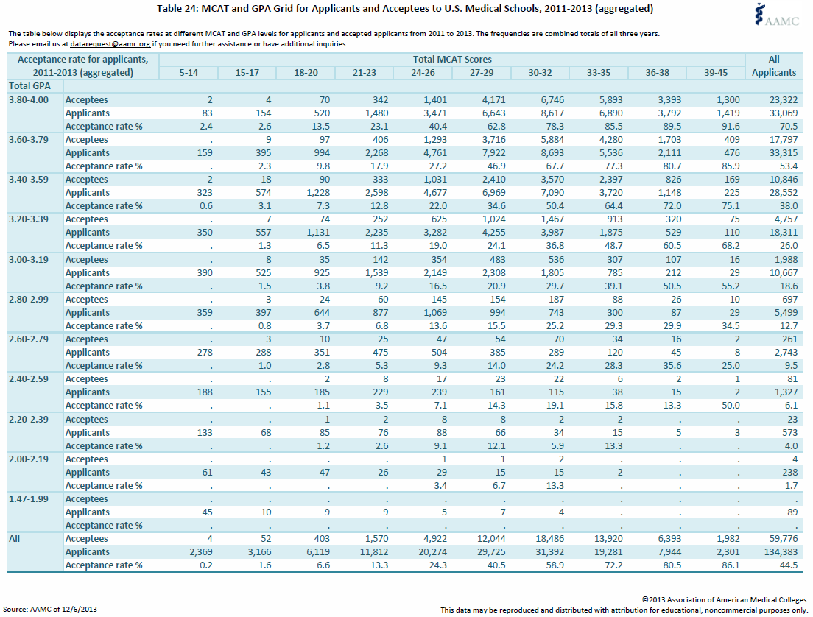

Slide 27
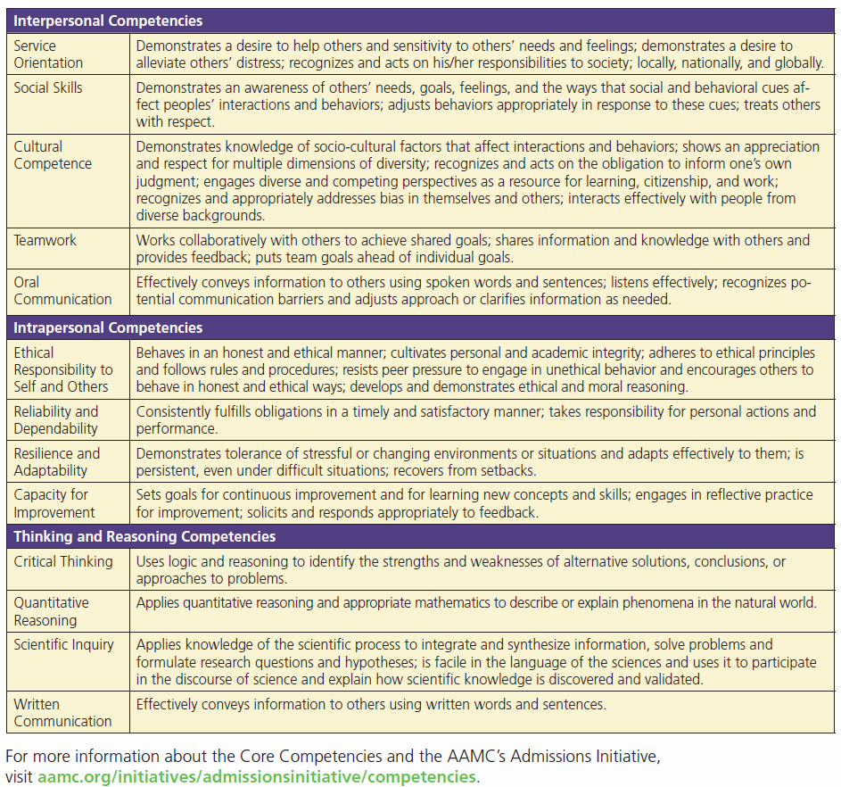
What do Med Schools Look For?

Slide 28
Professionalism
Phone skills!
Correspondent etiquette: email, text, and social media
Interpersonal skills (how to network, how to mingle)
Time management
Professional presentation using contextual cues
Hierarchy & seniority
Finding authenticity within professional norms

Slide 29
Cautions/Notes
Off shore MD programs (non-LCME accredited schools)
International medical schools (non-US, non-LCME)
Doctor of Osteopathy (DO) Schools
Proprietary advising services & consultants
MCAT changes in 2015 & Test Prep
Pre-Health DREAMers. DACA students can apply! (ask me)
A few significant longitudinal pursuits vs. more experiences with shorter durations
Grade shopping
Being a cookie cutter applicant
Social Media & BEWARE OF BLOGS!!!

Slide 30

Resources from AAMC
https://www.aamc.org/data/facts/
AAMC Publications: Roadmap to Diversity
OFFICIAL GUIDES:
  MCAT
  Medical School Admissions
  MSAR Medical School Admission Requirements
Summer enrichment programs for HS Students
  https://services.aamc.org/summerprograms/
  Aspiringdocs

Slide 31
Contact Information
Sunny Nakae
  snakae@luc.edu
  @drnakae
  @stritchadmit
  Facebook.com/stritchmedicine

