Slide 1
3 or 30?
Moderator: Rebecca McWhorter
Presenters: Jennifer Coomer
Rob Walton
Stephanie Levenson
Audience: Post-Secondary

Slide 2
Jennifer Coomer
B.S., Murray State University
M.B.A., Murray State University
Admission Counselor /Coordinator for New Student Programs, Southern Illinois University Edwardsville
3 years experience in Admissions

Slide 3
Rob Walton
B.A., Clarke College
M.B.A., Elmhurst College
Senior Assistant Director of Admission, Northwestern University
11 years experience in Admission(s)

Slide 4
Stephanie Levenson
B.A., University of Illinois, Urbana-Champaign
M.Ed., Loyola University Chicago
Associate Dean/Director of Admission, Elmhurst College
16 years experience in Admissions

Slide 5
Objectives of “3 or 30?” presentation
Strategies to guide admission professionals in making the transition from ‘job’ to ‘career’
Early years as admission professional
Middle managers
Seasoned admission professional

Slide 6
Early Years: You’re Hired! Now What?
Study training manual
Learn how your office works
Find a mentor within your office
Meet with colleagues from other offices
Determine how to more efficiently do your job
Learn to manage your time in the office as well as out of the office

Slide 7
Early Years: Discover the “perks” of the profession
Travel to new locations – everyday is an adventure!
No “typical” day in admissions!
Hotel rewards
Credit cards with points

Slide 8
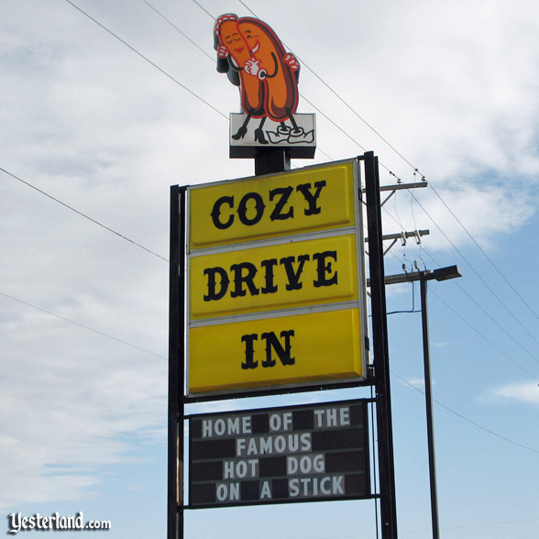
Early Years: Finding your “ideal” travel territory – or just one you really enjoy!
Ask for what you want
Learn interesting facts about your territory
Ask for restaurant recommendations
Request Visitor’s Guide for territory
Stay connected while on the road

Slide 9
Early Years: Finding balance in your life
Try not to overextend if pursuing a graduate degree while working a full-time job
Know when to keep working and when to go home at night
Embrace alone and social time while traveling
Take a day off for yourself and do something you enjoy!

Slide 10
Early Years: Find your “niche”
Learn about other opportunities within your office
Take on additional duties to learn about other areas
Serve on committees within your office and the university
Find out where your passion lies!

Slide 11
Early Years: Get Connected!

Slide 12
Early Years: Get Connected even more!
District Seminars
IACAC/other states conferences
NACAC
IACAC Mentor/Mentee program
Join a committee(s)
Establish rapport with H.S. counselors

Slide 13
Middle Managers: Transitioning
Make yourself marketable
Active in IACAC and NACAC
Get to know how other institutions operate
Ask questions and listen
Stay relevant
Always meet new people
Make every year new and different
Adding roles
Be accessible

Slide 14
Middle Managers: Up or out or over?
Know when it’s time to make a move
Moving up at your institution
Sometimes you have to ask
Usually, the work comes first
Changing places?
Is what you want to do not available at your current place?
Is the grass really greener?

Slide 15
Middle Managers: Always ask questions
Both at current employer and amongst friends elsewhere, know what is going on
Understand where you are in the bigger picture
How far up the ladder do you want to go?

Slide 16
Seasoned Professional Years
Keeping Yourself Engaged
Strategies for Retaining Staff and Promoting Transition from Job to Career

Slide 17
Seasoned professional years
Continue to define role on your campus
Accept and manage an ever changing job description/role
Connect with colleagues from other institutions
Connect with others on your campus
Find opportunities to enhance skill set
IACAC
Collegeboard
Enrollment Leadership Academy
Campus committees

Slide 18
Seasoned professional years
Never forget where you began
To the best of your ability, keep admission counseling skills sharp
Earn “street-cred” whenever possible
Role model behavior you expect of your staff
Never lose your sense of humor
There is always more to learn, you don’t know everything-don’t forget that

Slide 19
When the boss says that they can give the info session if needed… thank you admissionsproblems.tumblr.com!

Slide 20
Staff Retention Strategies to Promote Job to Career
You don’t have to treat everyone equally, but you should treat everyone fairly
Assign projects strategically
Provide or encourage opportunities outside of your office for investment in higher education
Habitat for Humanity, Leadershape, First-Year Seminar, Club Advisor

Slide 21
Staff Retention Strategies to Promote Job to Career
Provide flexibility for graduate school (when possible)
Encourage participation in professional organizations (Hello, IACAC)!
Listen
Give your staff opportunity(ies) to implement and evaluate an idea of their own
Help prepare staff for their next role

Slide 22
Wrap Up
Several strategies that admission professionals can use at each stage in their career to stay engaged
No handouts were given today in an effort to go green!
However, if you give us a business card, we will electronically send you the PowerPoint presentation.
If you have additional questions, please feel free to email us at:
slevenson@elmhurst.edu
Robert-walton@northwestern.edu
jecoome@siue.edu

Slide 23
Questions?
Thank you!

