Slide 1
ISAC Update and Nuts & Bolts of Financial Aid
IACAC May 1st 2013

Slide 2
Illinois Student Assistance Commission
Mission Statement:
Making college affordable and accessible for Illinois students.
Monetary Award Program
Over $370M given annually—dependent on state appropriation
Approximately 150K students receive award
Early suspension date in 2013—March 2nd
Approximately 100K more students qualify but apply after suspension date
Persistence and Completion as important as access
“Return on investment”
Economic benefits to state

Slide 3
College Application Month
National Campaign sponsored by American Council on Education
24 states and DC participated in 2012
First-generation and/or low-income students that apply late or not at all
Inaugural campaign in Illinois fall 2012
33 high schools participated
Nearly 2,000 students participated
Volunteers assist with workshops
2013 campaign
Going from one week to a month: October
Open to any high school interested in participating
Implementation Guide available at www.collegechangeseverything.com/appmonth

Slide 4
Transcript Exchange
ISAC & ISBE Collaboration
Over 230 high schools are live in Illinois
Over 84,000 transcripts have been sent electronically
96 colleges in Illinois are set up as receivers
All public universities
35 community colleges
Numerous private colleges
Free for students to send electronically to approved colleges
Any MAP-approved college
Any college that is a receiver in a MHEC state (www.mhec.org)
No cost to high school or to college

Slide 5
FAFSA Completion Initiative
Began with Chicago Public Schools with 2007 graduation class
Financing college is perceived as an obstacle to going to college
Went from 57.5% completion rate to 77.6% (2012 graduation class)
Successful due to buy-in from top administration to counselor level
Program encompasses 268 high schools
115 individual high schools
6 school districts that encompass 153 high schools
Research agreement between ISAC and school/district
No cost to school
ISACorps members can assist with FAFSA completion workshops
Students in Illinois have qualified for nearly $1.6B in PELL & MAP grants as a result of FAFSA completion rate through April

Slide 6
B4 College Alert
Mobile App
Students will be sent alerts about college readiness events
FAFSA completion alerts are sent based on student information
YouTube video available on ISAC’s website: www.isac.org
Available for Android and iPhone

Slide 7
The Nuts and Bolts of Financial Aid
Objectives
By the end of this session, participants will be able to:
introduce students to financial aid terms and concepts;
outline the process of: (1) establishing eligibility for state and federal aid programs; (2) packaging of awards; (3) disbursing aid; and (4) handling student enrollment withdrawals; and
identify trusted sources of information.
Activities
Illinois Trends in College Cost
Resources
Terms and Concepts
The Financial Aid Process
Notes:
Goals:
Learn financial aid terms and concepts.
Gain high level understanding of financial aid process and eligibility.
Sample
Thank you for attending ISAC’s Financial Aid Certification. At the end of this presentation you should know the basics of how financial aid works, feel more familiar with the terminology in financial aid, and have a firm understanding of major state and federal aid programs and how money is disbursed to students.

Slide 8
Anticipate Questions
There are lots of things to think about and many questions to ask.
How much will it cost?
Can I afford college?
What is financial aid?
What is the FAFSA?
When and how do I apply?
Where can I get help?
Know the answers…
Notes:
Know the key questions to ask.
As you start planning to go to college, you and your family may have questions such as: How much will it cost? Can I afford it? and Where do I go for help? To assist you in finding the answers to these questions, you first need to learn some of the basics.

Slide 9
Education and Unemployment
Unemployment Rate, Age 25+, December 2010
National Average
9.4%
Note: Data are averages for persons 25 and over.
Source: Bureau of Labor Statistics, Current Population Survey (December 2010)
Notes:
Of course, even as education is expensive, it is clearly beneficial in terms of finding a job. Looking at the unemployment rate for those age 25 and over, unemployment for those holding a four-year degree or more is less than one third the unemployment level for those who have less than a high school education, and is significantly below the average unemployment rate.

Slide 10
Education Pays
Median Weekly Earnings, Age 25+, December 2012
National Average
$823
Note: Data are averages for persons 25 and over.
Source: Bureau of Labor Statistics, Current Population Survey (December 2012)
Notes:
Perhaps even more important, those who earn college degrees make more money. Those earning a college degree make a few hundred dollars more per week than the average, and several hundred dollars more per week than high school graduates.

Slide 11
Terms and concepts

Slide 12
Types of Financial Aid
There are many types of financial aid, including:
gift-aid
Grants
Scholarships
Work-Study
Loans
self-help
aid
Grants are typically based on financial need while scholarships are generally rewards for grades, athletics, a unique skill or even an specific career interest. Work-study allows students to earn money through a campus-based employment program. Loans can be subsidized or unsubsidized but must be repaid after graduation or dropping below half-time enrollment status.
Notes:
There are two basic types of financial aid: gift-aid and self-help.
Gift Aid is usually awarded in the form of grants and scholarships. It is assistance that generally does not have to be repaid.
Grants are usually awarded on the basis of a family’s financial need or limited ability to meet the costs of college.
Scholarships may be awarded to reward merit such as academic achievement, athletic ability, artistic talent, background, or other attributes you may possess.
Self-Help Aid requires you to take more responsibility and includes work opportunities and loans.
Work-study allows you an opportunity to earn money while you’re in college. The money you earn is usually paid directly to you and it is up to you to manage this money wisely.
Student loans are financial aid that must be repaid and should always be considered as a last resort in paying for college.

Slide 13
Sources of Financial Aid
Financial aid comes from a variety of sources.
federal
government
state
government
college
(institutional aid)
outside/
private
sources
The federal government is the largest source of financial aid for students, with colleges and universities providing the second largest source of financial aid for students.
Notes:
Financial aid comes from a variety of sources.
Federal Government - Federal financial aid programs are administered by the U.S. Department of Education.
State Government - In Illinois, state and some federal financial aid is administered by the Illinois Student Assistance Commission (ISAC).
Colleges and Universities - Colleges, universities and other higher education institutions also offer financial aid assistance to their students. The financial aid office on campus is the best place to inquire about institutional financial aid options.
Private Sources - Many agencies, associations, corporations, and civic, religious and philanthropic groups award scholarships to college students. To access these private funds, different eligibility requirements, award amounts, application forms and deadlines apply. Be sure to research them carefully.

Slide 14
Financial Aid Funding
Entitlement Program
Appropriation
Waiver
Program in which all eligible applicants will receive the benefit.
Public funds set aside for a specific program.
Ex. Illinois Special Education Teacher Tuition Waiver
Gift assistance that in most cases is awarded based on a student’s field of study and/or employment status.
Ex. Illinois Veterans Grant
Ex. MAP Grant
Notes:
There are three basic types of funding for state and federal financial aid. Entitlement programs, which we have heard much about in the news, are programs where the beneficiary is guaranteed to receive the benefit if they qualify. The Illinois Veterans Grant is one such entitlement. If the student meets the requirements, they will absolutely receive the grant.
There are also many programs that are funded by an appropriation. An appropriation is simply a finite amount of money to pay for a program or benefit, and when the money runs out, no more can be spent. The MAP Grant is funded by appropriation. No matter how many people qualify, money can only be awarded to students until all funds appropriated by the legislature have been spent. Imagine a pot of money with quarters in it. Everyone who comes by is allowed to take a quarter, but once all the quarters are gone, no matter how many more people come by wanting a quarter, when the pot is empty that’s it.
Finally, some financial aid programs are waivers. A tuition waver is assistance that excepts a person from paying for their program. The Illinois Special Education Teacher Tuition Waiver works like this, as long as the student meets the criteria, the student is exempt from paying qualifying tuition and fees.

Slide 15
Illinois Student Assistance Commission
Grant and Scholarship Programs
Program | Acronym | Type of Aid | 2012-2013 Benefit
Monetary Award Program | MAP | Grant; Need-based; Appropriation | up to $4,720
Silas Purnell IL Incentive for Access | IIA | Grant; Need-based; Appropriation | up to $1,000 (Not funded)
Illinois Veteran Grant | IVG | Grant; Entitlement | maximum 12 units per term, up to 120 units cumulative
Illinois National Guard Grant | ING | Grant; Entitlement | maximum 12 units per term, up to 120 units cumulative
Grant Program for Dependents of Police, Fire, or Correctional Officers |  | Grant; Appropriation | up to 8 semesters or 12 quarters
Bonus Incentive Grant (BIG) Program | BIG | Grant; Appropriation | $40 to $440 (Not funded)
Illinois State Scholars Program | ISSP | Certificate of Achievement, Scholarship, Appropriation | $1,000 (Not funded)
Merit Recognition Scholarship | MRS | Scholarship; Merit-Based; Appropriation | $1,000 (Not funded)
Teacher Programs
Program | Acronym | Type of Aid | 2012-2013 Benefit
Minority Teachers of Illinois Scholarship | MTI | Scholarship; Appropriation | up to $5,000
IL Special Ed. Teacher Tuition Waiver | SETTW | Waiver | up to 4 yrs
Notes:
ISAC administers financial aid programs for residents of Illinois. Learn about them to decide which ones are best for you.
The Monetary Award Program is one of the largest state programs in the country. It provides assistance to students demonstrating financial need and applies toward tuition and mandatory fees for undergraduate students at approved Illinois degree-granting institutions. A FAFSA must be submitted for consideration. Students may qualify for up to 135 MAP Paid Credit Hours of which no more than 75 MAP Paid Credit Hours may be used while enrolled at the freshman or sophomore level. Subject to appropriation of funds.
The Silas Purnell Illinois Incentive for Access Program provides assistance to students who have a limited ability to pay for college. A qualified applicant with an EFC of $0 (zero) may receive one grant, subject to appropriation. Recipients must be enrolled on at least a half-time basis and be at the freshman level.
The IVG Program is an entitlement program awarded to eligible applicants regardless of the funding level. It pays eligible tuition and mandatory fees at Illinois public colleges or community colleges. Qualified veterans may receive benefits at the undergraduate or graduate level for the equivalent of four academic years of full-time enrollment, up to 120 eligibility units.
The ING Program is an entitlement program awarded to eligible recipients regardless of the funding level. It pays tuition and eligible fees at all Illinois public universities or public community colleges for undergraduate or graduate enrollment. Recipients may accumulate up to 120 eligibility units. There is no minimum enrollment requirement and non-credit courses are eligible. The program can be used for undergrad and graduate education.
Grants for Dependent of Police, Fire and Correctional Officers - If a correctional officer employed by the Illinois Department of Corrections in a security position or an Illinois police or fire officer is killed or sustains an injury resulting in a permanent disability (at least 90%) in the line of duty, the officer’s spouse and children may receive grant assistance toward tuition and mandatory fees. It may be used for an equivalent of 8 semesters or 12 quarters of undergraduate or graduate enrollment.
The BIG Program provides a financial incentive to encourage the use of Illinois College Savings Bond proceeds from matured bonds at Illinois colleges and universities.
The Illinois State Scholars Program provides a certificate of achievement to students who rank in the top 10% of all seniors in the state. There is no scholarship associated with this program currently. Similarly, the Merit Recognition Scholarship is also currently unfunded.
The MTI Scholarship Program encourages academically talented minority students to pursue careers as teachers at nonprofit Illinois schools. It awards up to $5,000 per academic year for a maximum of 8 semesters or 12 quarters of assistance. Recipients must sign an agreement promising to start teaching within one year for each year of scholarship assistance received. If the teaching obligation is not fulfilled, the scholarship converts to a loan at a 5% interest rate.
Illinois SETTW exempts recipients from the payment of tuition and mandatory fees for up to four calendar years at any one of the 12 public four-year colleges in Illinois. It encourages current teachers (not certified in a special education discipline) and academically talented students to pursue careers at nonprofit Illinois public, private or parochial preschool, elementary or secondary school teachers in any area of Special Education.

Slide 16
U. S. Department of Education
Federal Grant Programs
Program | Acronym | Type of Aid | 2012-2013 Award
Federal Pell Grant |  | Grant; Need-based | up to $5,550
Iraq and Afghanistan Service Grant |  | Grant | up to $5,550
Federal TEACH Grant Program | TEACH | Grant | up to $4,000 a yr; total amount may not exceed $16,000.
Campus-Based Programs
Program | Acronym | Type of Aid | 2012-2013 Award
Federal Supplemental Education Opportunity Grant | FSEOG | Grant Exceptional Need | $100-$4,000
Federal Work-Study | FWS | Need-based Employment | no annual minimum or maximum amounts; at least minimum wage
Perkins Loans |  | Need-based Loan | up to $5,500 for undergraduates and up to $8,000 for graduate students
Notes:
The U.S. Department of Education is the nation’s largest source of student aid.
The Pell Grant is available to undergraduate students and is the largest grant program administered on a federal level. It may be used for any educational expense, such as tuition and fees, room and board, and living expenses. Award amounts are dependent on funding approved by the Federal government and are calculated by the college.
The Iraq and Afghanistan Service Grant is available to t students whose parent or guardian was a member of the U.S. Armed Forces and died as a result of service performed in Iraq or Afghanistan after September 11, 2001.
Teacher Education Assistance for College and Higher Education (TEACH) grants reward undergraduates, post baccalaureate, and graduate level students who are or will be taking course work necessary to become elementary or secondary teacher; recipients must sign an Agreement to Serve saying they will teach full-time in designated teacher shortage areas for 4 years (within 8 years of completing an academic program).
Campus-Based Programs are administered directly by the financial aid office at each participating school. Not all schools participate in all three programs, so check with a school's financial aid office to find out which programs they participate in. How much aid a student can receive from each of these programs depends on financial need, on the amount of other aid received, and on the availability of funds at a particular college. Unlike the Federal Pell Grant Program, which provides funds to every eligible student, the campus-based programs provide a certain amount of funds for each participating school to administer each year. When the money for a program is gone, no more awards can be made from that program for that year. Each school sets its own deadlines for campus-based funds.
The FSEOG gives priority to exceptionally needy students (in lowest EFC order) and Federal Pell Grant recipients. It is available to undergraduate students. The award amount is calculated on the basis of the student's need and availability of funds at the college. The college determines eligibility and students are notified via the financial aid award letter.
To apply for state and federal financial aid programs, the FAFSA must be completed.

Slide 17
The Big Three
Maximum Award Amounts for 2012-13
Up to $4,720*
Up to $5,550
Up to $4,000
State of Illinois Monetary Award Program (MAP)
Federal Pell Grant
Federal Supplemental Education Opportunity Grant (FSEOG)
Total = $14,270
* Based on funding as of publication date. Announced grant awards could increase or decrease throughout the academic year.
Notes:
The Free Application for Federal Student Aid (FAFSA) is required to determine a student’s eligibility for federal and state grants as well as student loans, and other types of aid that are administered by the college or university. By completing a FAFSA, students are considered and may qualify for some or all of the following need-based grants: Pell, FSEOG, and MAP.

Slide 18
Loan Programs
When evaluating loan options, consider the following:
Source
of Loan
Subsidized
vs.
Unsubsidized
Interest
Rate
+
Fees
Repayment
Options
&
Grace
Period
Start by knowing a student’s rights and responsibilities.
Notes:
Know the borrowing basics and be sure to research your loan options carefully.
What is a loan?
A loan is a type of “self-help” aid that lets students borrow money from the government, banks or other lending institutions. However, loans must be paid back with added interest. Always borrow conservatively, accepting only the amount of money needed. After all, loans can be a lot of help, but the more money you borrow the more money you will have to pay back with interest.
How are loans awarded?
Know that loans can be awarded based on financial need (subsidized loans) or not on financial need (unsubsidized loans). Loan eligibility will be determined after grants, scholarships and Federal Work-Study programs have been considered.
Types of loans…
As you start to evaluate loan options, keep in mind that there are student loans, parent loans, alternative loans and consolidation loans. Know your options as well as your borrower rights and responsibilities.
Basics you should know…
To ensure proper management of your student debt, know: (1) the source of the loan; (2) whether it is subsidized or unsubsidized; (3) the interest rate; (3) repayment options; and (4) grace periods.

Slide 19
U. S. Department of Education
Federal Loan Programs, 2012-13
Type
Rate
Amount
Grace
Perkins | Subsidized (need-based) | 5% Fixed | $5,500 per year | 9 Months
Stafford* (2012-2013) | Subsidized (need-based) | 3.4% Fixed | $3,500 first-year undergraduate | 6 Months
 | Unsubsidized (not need-based) | 6.8% fixed | $2,000 first-year for dependents, $6,000 for independents first-year undergraduate | 6 Months
PLUS Graduate PLUS | Credit-based Unsubsidized | 7.9% fixed | Depends on remaining financial need. | Within first 60 days
*Note: New Unsubsidized Stafford Loans for graduate students have a fixed interest rate of 6.8% through the 2012-2013 academic year.
Notes:
Borrow responsibly! Both you and your parents can borrow from a variety of loan programs to help with your educational expenses. These funds require repayment, usually with interest.
The Perkins Loan is a subsidized loan. This means that the federal government pays the interest while you are in school at least half-time, and for 9 months after you separate from the school. The interest rate is 5% and a 10-year repayment period applies. The college acts as the lender and uses a limited pool of funds.
The Federal Stafford Loan program allows students to borrow money with low interest for educational expenses. There are two types of Federal Stafford Loans available: subsidized and unsubsidized.
Federal PLUS Loans allow parents to borrow on behalf of their dependent undergraduate students, or graduate and professional students to borrow on their own behalf.
Take note that federal student loans generally have the lowest interest rates and fees and the greatest repayment flexibility.
Note: Graduate students are no longer eligible for Federal Subsidized loans (beginning July 1, 2012).

Slide 20
How to Apply
To be considered for student aid, a student must complete all forms required by a college.
Free Application for Federal Student Aid (FAFSA)
Institutional Forms
Other
Note: Communicate with each college to inquire about steps to a complete application.
Notes:
The first step in applying for federal and state financial aid programs is to complete the Free Application for Federal Student Aid (FAFSA). This application, which is available to complete online (preferred method) or in paper format, will use income, assets and other factors to determine the amount you and your family are expected to contribute to your college expenses.
Your eligibility for financial aid will be determined by your and your family’s financial situation, and by filing your application on time. In some instances, colleges may use additional forms. The form used most often in this process (typically private colleges) the CSS/Financial Aid PROFILE, which is administered by the College Scholarship Service (CSS), a division of the College Board organization. Be sure to communicate with each college to inquire about the steps you need to take to ensure that you submit a complete application.

Slide 21
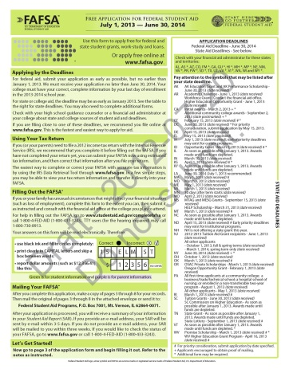
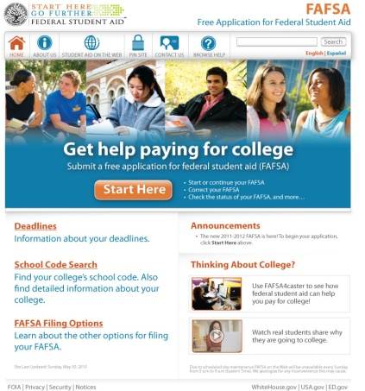
Free Application for Federal Student Aid
What is a FAFSA?
It is the first step in the financial aid process. A FAFSA is used to apply for Illinois scholarships and grants and for federal student financial aid such as grants, loans and work-study (e.g. Pell Grant, MAP Grant). In addition, postsecondary schools use it to award non-federal financial aid. The application is available to students at no fee.
Three Ways to Access a FAFSA
Over 98% of FAFSAs completed online!
Paper FAFSA | FAFSA on the Web | .pdf FAFSA
1-800-4-FED-AID | www.FAFSA.gov | www.FAFSA.gov
Notes:
The FAFSA is the form that must be completed to determining eligibility for Federal and State financial aid programs. You can think of the FAFSA as the first step in determining eligibility for federal and state need-based aid. This includes the Pell and MAP Grants, the Federal Supplemental Education Opportunity Grant, and the Illinois Incentive for Access program, as well as federal work-study and even federal student loans, which have the lowest interest rates for students.
You can complete the FAFSA on the Web at www.fafsa.gov or in paper form. Students can also access a pdf FAFSA by going to www.fafsa.gov
Also, pay special attention to the web address when going online. Many students go to FAFSA.com, which charges a fee to submit the form, rather than FAFSA.gov. Since this is the Free Application for Federal Student Aid, we don’t want any students paying to complete the form.
By the way, if you file the FAFSA on the Web, you can list as many as ten colleges. This means that you can designate up to ten schools to have information sent to them. Only four colleges can be listed on the paper FAFSA.

Slide 22
Personal Identification Number (PIN)
A PIN, along with other identifiers, gives Internet access to information on the Federal Student Aid systems.
Serves as an electronic signature and provides access to personal records
Go to www.pin.ed.gov
Option 1: Create a four-digit PIN
Option 2: Have the site create PIN
PIN is conditional until relevant information is verified with the Social Security Administration (1-3 days)
PIN will not expire at the end of the year
Parents and students need separate PINs to use the FAFSA on the Web
 | PIN Checklist
 | Social Security Number
 | Last Name
 | First Name
 | Middle Initial
 | Date of Birth
 | Address
 | e-Mail address (optional)
Notes:
Filing your FAFSA electronically requires a Personal Identification Number (PIN) to serve as an electronic signature, which can be obtained online at www.pin.ed.gov. A student and a parent each need their own individual PIN.

Slide 23
When to Apply
Important Dates:
2013-2014 Academic Year 2014-2015 Academic Year
FAFSA
Dates vary by college (Check with each college)
MAP Grant
As soon as possible after January 1, 2013. Awards made until funds are depleted.*
Federal Pell Grant
June 30, 2014 (at the end of the academic year)
January 1, 2012 (First date to submit FAFSA)
College
FAFSA
Dates vary by college (Check with each college)
MAP Grant
As soon as possible after January 1, 2014. Awards made until funds are depleted.*
Federal Pell Grant
June 30, 2015 (at the end of the academic year)
January 1, 2013 (First date to submit FAFSA)
College
* Note: In Illinois, grants and dollar amounts are subject to appropriations by the Illinois General Assembly and the Governor.
Notes:
Maximize on your financial aid eligibility by applying early and meeting deadlines. These deadlines apply to the Monetary Award Program (MAP) Grant and the Federal Pell Grant. Remember that the college’s deadlines are also very important and will often be earlier. Last year the MAP Grant cutoff date was in March, so complete your FAFSA ASAP.

Slide 24
General Eligibility Requirements
Who can get federal and state student aid?
Eligibility for most federal and state aid programs is based on financial need rather than academic achievement.
In addition to a completed FAFSA, a student must:
have a high school diploma or its equivalent
enroll as a regular student in an eligible degree or certificate program
have a valid Social Security Number
make satisfactory academic progress
register for Selective Service, if male 18-25 years old
sign certifying statements on the FAFSA
Notes:
To receive aid funds, a student must be qualified to study at the postsecondary level.
A student qualifies if the following apply:
has a high school diploma;
has the recognized equivalent of a high school diploma, such as a general education development or GED certificate;
has completed homeschooling at the secondary level;
has passed a Department approved ability-to-benefit test; or
has satisfactory completed 6 credits of college work that are applicable to a degree or certificate offered by the school.

Slide 25
Dependency Status
Whose information is required on a FAFSA?
For financial aid purposes, questions on the FAFSA will determine the status of the student.
Status based on FAFSA | Report income and assets
Dependent | Parents Student
Independent | Student Spouse
Notes:
The questions you answer on the FAFSA will determine whether you are considered a DEPENDENT or INDEPENDENT student. This determination will impact the amount and types of aid for which you will qualify.
For DEPENDENT students, the EFC includes a contribution from the parents’ and student’s income and assets.
For INDEPENDENT students, the EFC is made up of the student’s (and spouse’s, if married) income and assets.
Many people think that dependency is a choice the student can make. This is not true, dependency status is determined by completion of the FAFSA and the answer to key dependency questions.

Slide 26
Output Documents
The SAR and ISIR
SAR
Student Aid Report
ISIR
Institutional Student Information Record
After FAFSA processing is complete, a students will receive an output document or record that shows:
information originally provided by a student;
the Expected Family Contribution;
results of the eligibility matches; and
information about inconsistencies
Notes:
The body of the SAR has been reduced to enable students to determine the status of their FAFSA, their eligibility for a Federal Pell Grant and the next steps in the application process
Students who submit a Spanish FAFSA or a correction in Spanish will receive all communication in Spanish
Notes:
Once students complete their FAFSA, two very important documents are generated, the Student Aid Report and the Institutional Student Information Record. These documents provide the student and the colleges and universities with information from the student’s FAFSA, as well as the Expected Family Contribution. Information on the SAR and the ISIR will also let the schools and the student know if there are any problems with data matches to determine eligibility, such as names not matching, or if there were any inconsistencies or errors that need to be resolved.

Slide 27
Expected Family Contribution
EFC
Expected Family Contribution
A need analysis formula established by Congress determines a student’s Expected Family Contribution; using information reported on the FAFSA.
What? | Why? | Where?
A comparative measure of how much a family can be expected to contribute over the course of an academic year | Used to determine a student’s eligibility for most federal and state assistance | Shown on the Student Aid Report (SAR)
Notes:
OK, I just mentioned the EFC, or Expected Family Contribution. What is the EFC?
To determine your financial need, the U.S. Department of Education uses a formula established by Congress called Federal Methodology. This need analysis formula uses information from the FAFSA to determine the amount that the student and their family combined is expected to contribute towards the student’s college education, which is called the Expected Family Contribution (EFC). Because it is based on family information, a student’s EFC will remain the same regardless of the college they attend.

Slide 28
What are the costs?
Each college determines the Cost of Attendance at their institution. Some academic majors/programs may have a different Cost of Attendance at the same university.
Tuition & Fees
Direct
expenses
Room & Board
Direct/Indirect expenses
Transportation
Indirect
expenses
Books & Supplies
+
Miscellaneous Living Expenses
Cost of Attendance (COA)
Notes:
The staff in the financial aid office of the college(s) that your are considering will establish a Cost of Attendance (COA), which is an estimate of expenses that are usually incurred by students attending college. Common COA elements include things like tuition, fees, living expense (room and board), books and supplies, and transportation.
Your COA will differ from college to college. In part, this is true because there are different types of colleges, programs they offer, and your preferred living arrangements.

Slide 29
Financial Need
Cost of
Attendance
(COA)
Expected
Family
Contribution
(EFC)
Financial
Need
-
=
Notes:
COA – EFC = Financial Need
At each college, the financial aid office will calculate financial need by subtracting the EFC from the COA. The EFC will be the same at each college, but the COA will differ from college to college. Keep this in mind:
COA (varies)
EFC (remains constant)
Financial Need (varies by school)
In many cases, the college may not be able to meet 100% of a student’s financial need. The difference between the cost of attendance and the amount of financial aid offered by the college is referred to as the gap, which the student and family will be responsible for paying out-of-pocket.
Financial Need – Financial Aid Award + EFC= Out of Pocket Cost

Slide 30
To Determine Financial Need
Examples
Financial
Need
COA
EFC
College
A
$10,000
$3,000
$7,000
-
=
College
B
$20,000
$3,000
$17,000
-
=
College
C
$35,000
$3,000
$32,000
-
=
Notes:
The examples on the screen show how financial need is calculated and how it will vary from college to college based on COA. Remember the EFC will be the same at each college but the COA will be different. As a result financial need will be different at each college and university.

Slide 31
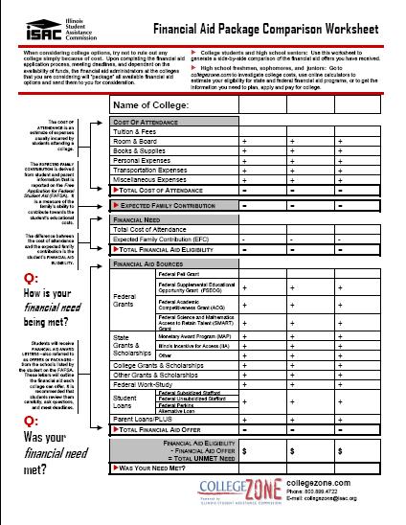
Financial Aid Awards
The financial aid administrator at the college will package all available aid and send an award offer for consideration.
Goal: To meet a student’s need.
New information creates changes.
When packaging need based-aid, students must have need and all sources of aid must be considered.
The total of all sources of aid may not exceed cost of attendance (COA).
What is the total cost of attendance? | What is the Expected Family Contribution?
What is a student’s financial aid eligibility? | What types of financial aid are included?
Was financial need met? | What is the out-of-pocket cost?
Notes:
Once a student has completed the financial aid application process, the financial aid administrators at each college that the student had their financial aid information sent too on the FAFSA will "package" all available aid options and send an award letter for consideration. Because each college has its own packaging policy, the types of financial aid offered will probably vary from college to college. The financial aid offer may include a combination of financial aid programs from various sources, such as grants, scholarships, work-study and student loans.
When reviewing financial aid award letters, consider the amount of gift aid provided, the amount of loans in the package, and the remaining gap which, along with the EFC, constitutes the out of pocket costs that the student and family will need to come up with to finance a college education.

Slide 32
Other things to know about applying for financial aid:
Apply early!
Information reported on a FAFSA is confidential and is used ONLY to determine financial aid eligibility.
A student may be asked to submit documentation to the financial aid office for verification purposes.
Supplemental applications or forms may be required.
Keep track of application DEADLINES!
It helps to keep a record of everything that is submitted.
A student must reapply every year.
Notes:
There are some key things to keep in mind and tell students.
Apply early
Information reported on the FAFSA is confidential and used only to determine financial aid eligibility
Students may be asked to submit documentation to the financial aid office for verification purposes
Supplemental applications or forms may be required
Keep track of application DEADLINES!
Keep a copy of everything you submit
Make sure to reapply for financial aid every year

Slide 33
Disbursement
A student needs to meet the following requirements in order for an award to be disbursed:
⇨Accept the awards
⇨ Submit all paperwork and information required
⇨ Complete pre-loan counseling (entrance counseling) if the student is a new loan borrower
⇨ Pay past due charges on a student account
⇨ Make arrangements to clear holds set on a student account
⇨ The method and time of disbursement varies depending on the type of financial aid
⇨ Enroll in classes and meet Satisfactory Academic Progress (SAP) standards
Notes:
Once a student enrolls in a college, financial aid is disbursed. There are a few key steps along the way. First, students must accept the awards, particularly loans. Some paperwork may be required in addition to the FAFSA by the college and university, as well as a Master Promissory Note for loans. In order to keep receiving aid, the student must be making Satisfactory Academic Progress (SAP), which is developed by each college and university but that must show a student making progress towards earning a college degree.
If loans are part of the financial aid package, the student must complete loan counseling.
Student aid can also be delayed or withheld if there are past due charges on the student’s account.
Sometimes, students have holds put on their account. Holds are a way for colleges and universities to make sure that proper documentation is filed and deadlines met. For example, a student who hasn’t met with an academic advisor over a certain period of time could have a hold put on their account.
Finally, financial aid is disbursed in different times. Even if a student receives a Pell Grant, not all the money is paid all at once at the beginning of the year. Students should regularly check on their account to make sure financial aid posts, particularly if there are outside scholarships that the student is expecting.

Slide 34
The Financial Aid Process

Slide 35
Guiding Principles
Financial aid funds are available to make it possible for students to continue their education beyond high school.
Students and parents have the primary responsibility of funding educational costs.
Financial aid is available only to assist in filling the gap between a family’s contribution and a student’s yearly academic expenses.
Eligibility is based on multiple factors.
Schools are required to meet certain standards and have written agreements with the U.S. Department of Education and ISAC in order to offer student aid programs. Federal financial aid can be used at approved colleges, universities, trade schools and technical schools.
The school, as a whole, is responsible for proper administration of financial aid programs.
Notes:
There are a few key principals that guide financial aid policies, particularly federal and state financial aid.
First, financial aid is to help a student and their parents pay for college, but the students and parents have the primary responsibility to paying for college.
Second, financial aid is designed to fill the gap in ability to pay, and is not intended to finance a student’s entire education, unless we are talking about merit scholarships offered by the colleges and universities themselves.
Third, eligibility is based on multiple factors. For need-based federal and state aid, these factors include dependency status, age of the oldest parent, number in the household, and the cost of attendance at the college the student attends, to name a few of the major factors.
Fourth, school must comply with federal and state laws and regulations. An example of this is the Satisfactory Academic Progress requirement; students not making SAP should not be provided federal or state aid.
Fifth and finally, the college or university is responsible for properly administering financial aid programs. The financial aid office staff might be paid by the college, but they are stewards of taxpayer money.

Slide 36
The Process
From a financial aid administrator’s point of view…
Step 1: Determine Student Eligibility
Step 2: Package Aid
Step 3: Disburse Aid
Step 4:
Deal with Student Departures and Withdrawals
Notes:
To get a high level view of the financial aid offices world, there are four steps in dealing with financial aid for all students. First, they must determine the student’s eligibility, and only then do they package the student for financial assistance. Next, the FAA will disburse aid, and finally will deal with departures and withdrawals of students.

Slide 37
Resources
Get your hands on up-to-date, accurate and trusted sources of information to learn what you need to know.

Slide 38
Trusted Web Sites
Get your hands on up-to-date, accurate and trusted sources of information to learn what you need to know.
PIN.ed.gov
FAFSA.gov
StudentAid.gov
ISAC.org
nces.ed.gov/CollegeNavigator
Notes:
At ISAC, we are committed to making college accessible and affordable for all Illinois students.
Take advantage of the information and interactive tools that are available – at no cost – at isac.org .


Slide 39
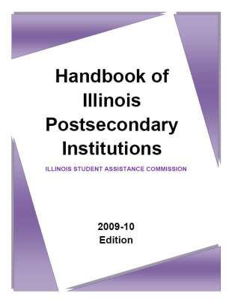
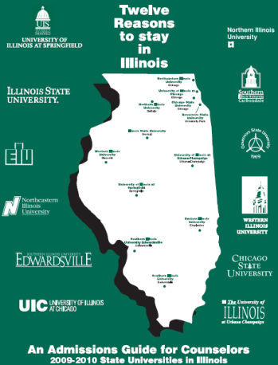
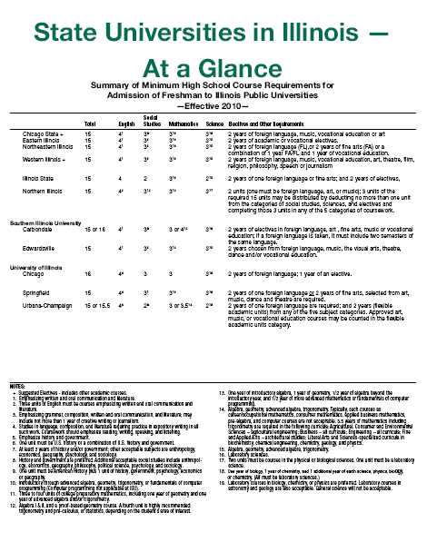
Manuals & Handbooks
Handbook of Illinois Postsecondary Institutions
Up-to-date financial aid and admission information for institutions approved to participate in ISAC's scholarship and grant programs. Source: www.isac.org
FAFSA Expert Guide
A compilations of all documents that are referenced in the FAFSA, including IRS tax forms, a description of the McKinney-Vento Act, and the EFC formula. Source: Only distributed at ISAC’s Financial Aid Certification Trainings.
Counselors and Mentors Handbook on Federal Student Aid
A guide for those advising students about financial aid for postsecondary education. Source: www.FSAPubs.org
State Universities in Illinois - At a Glance
A summary of minimum high school course requirements for admission of freshman to Illinois public universities. Source: www.IACAC.org
12 Reasons to Stay in Illinois
An admissions guide for counselors on state universities in Illinois. Source: www.IACAC.org

Slide 40
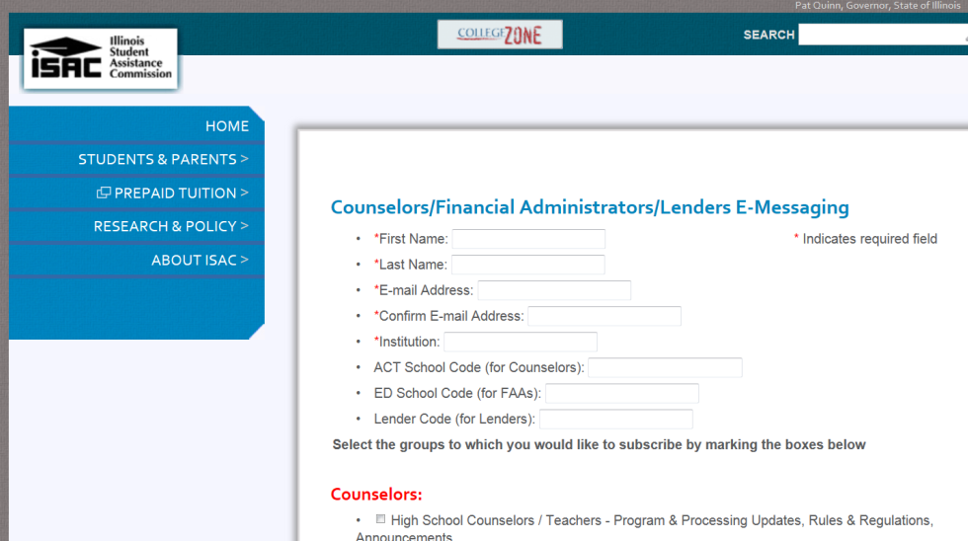
Stay Connected
ISAC’s e-Messaging Service
Notifies you when new information and/or announcements are added to College Illinois
Summaries of new information, along with links, will be sent to your e-mail
Get Printed Materials
ISAC Printed Materials – www.ISAC.org
FSA Publications Ordering System (FSAPubs) – www.FSAPubs.org
Notes:
Finally, to stay in touch with ISAC and learn about financial aid deadlines and training opportunities, please sign up for ISAC’s e-messaging service.

Slide 41
Increase the proportion of Illinois adults with a postsecondary degree or credential to 60 percent by 2025
Follow College Changes Everything
Website: collegechangeseverything.org
Facebook: facebook.com/collegechangeseverything
Twitter: twitter.com/cce_illinois

