Slide 1
Better Essays In Less Time
Illinois Association for
College Admission Counseling
May 1, 2013
Notes:
Better Essays in Less Time
Resources available at http://wowwritingworkshop.com/resources/for-counselors-teachers/
You know how to recognize a strong college application essay. You know when a story needs more detail, when the writing is unfocused or missing the student’s voice. And you certainly know when he or she has gotten too much help.
What if you could avoid these problems from the beginning? What if your students came to you with stronger first drafts? What if they felt confident about their stories and their abilities as writers?
What if their essays didn’t take so much of your time?
In this dynamic, interactive workshop, Wow Writing Workshop’s founders will share what they have learned from decades guiding students through the writing process. From brainstorming ideas to essay reviews, the Wow Method teaches students to ask the right questions, and shows counselors, parents, consultants and others how to read essay drafts with a writer’s eye, not an editor’s red pen.
Participants will leave the session with straightforward writing exercises, valuable tips and proven time-savers, along with online resources for students and parents.

Slide 2
Susan Knoppow Kim Lifton
Notes:
We are writers and teachers who cares passionately about students and the writing process.

Slide 3
Notes:
Let’s say the Common Application, instead of revising its personal statement questions, decided that every student should send a representative sample of homemade soup. “Send me a taste of soup that represents you.”

Slide 4
Notes:
Who has ever read an essay and thought:
Not enough of you in here
Too generic
Trying too hard
Show, don’t tell
Be more specific
It’s kind of boring
I’ve read this essay before – last year, and the year before, and the year before that

Slide 5
Notes:
What doesn’t work:
Pointing out errors
Sharing the best examples without context
What does work:
We need to teach them HOW to approach the task in the first place – before they dive in and try to complete it
We need to teach them HOW to overcome these obstacles.
We need to teach them HOW to build the soup from the bottom up… how to make the stock, how to add the seasoning, when to taste and check.

Slide 6
Counselors and Teachers
ARE
Mentors
and
Reviewers
ARE NOT
Experts
and
Editors
Independence & confidence
Not perfection
Notes:
Counselors and teachers can do the most as mentors/reviewers; not experts/editors
Encourage student independence and confidence
Consider the audience – college admission counselors
Your audience does not demand perfection
They are looking for an honest representation of who the student is

Slide 7
Your Story
Your Voice
Your Words
Notes:
I’m going to talk today about how to get beyond those statements.
We operate on three key principles:
Your Story
Your Voice
Your Words

Slide 8
Your Story
Your Voice
Your Words
Notes:
Let’s focus first on YOUR STORY.

Slide 9
Rice University
“Students think it has to be a discussion of their most traumatic experiences. If you have a relatively peaceful existence, that is fine.”
Tamara Siler, Senior Associate Director for Admission
Notes:
This and other key quotes are available at http://wowwritingworkshop.com/resources/for-counselors-teachers/

Slide 10
Your Story
ASK THIS
What do I want readers to know about me that they don’t already know?
NOT THIS
What should I write?
or
What do they want to hear?
Notes:
Ask the right question

Slide 11
Your Story
Be careful with sample essays
Do share sample lines, descriptions, details
Notes:
Even though we are focusing on the individual, students still ask for examples.
Be careful – they can become a crutch.

Slide 12
Your Story
Boring Essays?
Notes:
It’s not the story or the topic that is boring … the ESSAY is boring.

Slide 13
Duke University
“By the time (the application) comes to us, many of them have gone through so many hands that the essays are sanitized. I wish I saw more of a thoughtful voice of a 17 year-old.”
Christoph Guttentag, Dean of Undergraduate Admissions
Notes:
This and other key quotes are available at http://wowwritingworkshop.com/resources/for-counselors-teachers/

Slide 14
Your Story
Your Voice
Your Words
Notes:
And that takes us to the second principle: The essay must be written in the student’s voice.

Slide 15
University of Michigan
“This is your interview. Let me know who you really are. I like it when I can hear a student’s voice.”
Kim Bryant, Assistant Director of Admissions
Notes:
This and other key quotes are available at http://wowwritingworkshop.com/resources/for-counselors-teachers/
How do we help students write in their own voices?
You know when voice is missing – when the essay sounds generic or bland… But how do you help a student write in his/her voice?
How do we get there?
By helping them recognize that voice OUTSIDE of the essay
By keeping hands off – asking questions, serving as coaches, not experts

Slide 16
Your Voice
What did you do this morning from the time you woke up until you arrived here?
Be specific.
Use all of your senses.
Write fast.
Don’t think!
Notes:
Finding your voice
Use this with students as a warm-up
Conduct Morning Writing exercise (for instructions, visit http://wowwritingworkshop.resources)

Slide 17
Your Story
Your Voice
Your Words
Notes:
Your words.
How to get there?
Hands off. That means no red pens. Ask questions. No one should write on the essay but the student.
Help parents step back too

Slide 18
Talking to Parents
Authenticity, not perfection
There are many excellent topics for each student.
When student panics, diving in is not helpful. Step back. Ask questions.

Slide 19
Your Best Tips
Notes:
What are some of your best tips?

Slide 20
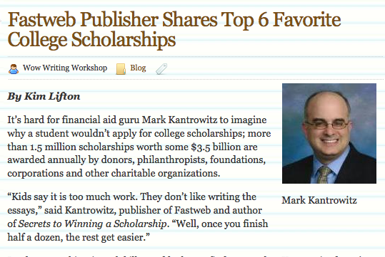
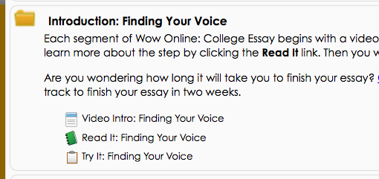
Resources wowwritingworkshop.com/resources
Notes:
We’ve assembled some of our best resources – articles, tips and activities to help you make the most of your limited time together. This link (http://wowwritingworkshop.com/resources/for-counselors-teachers/) will take you to a variety of resources:
Essay Advice from University Admission Officers: Quotes from admissions officers around the country, from schools both large and small. Share this page with students and parents to help take the pressure off and help them understand what a college essay is – and is not.
Morning Writing: Finding Your Voice: One of our most versatile and successful writing exercises. Because it has nothing to do with college essays, this activity frees students to listen to their writing voices without judgment or expectations.
From the Wow Blog: Reprints of articles that first appeared on the Wow Writing Workshop website, and were included in our e-newsletter. Please share them with students, parents and colleagues. We only ask that you attribute them to Wow.
Wow Online – College Essay flyer: Information to share with parents and students.

Slide 21
Q&A

