Slide 1
STEM- It’s Where the Jobs Are and Will Be!
Moderator: Amy Thompson, York High School
Presenters: Kelli Allen, Iowa State University
Rachel O’Connell, Missouri University of Science and Technology
Christine Grotzke, Michigan Technological University

Slide 2
Why is STEM all the buzz?
Many STEM areas have high starting salaries
Average for 2013 graduates by discipline*:
Engineering $62,535 (up 4.0% from 2012)
Computer Science $59,977 (up 4.3% from 2012)
Business $54,234 (up 7.1% from 2012)
Health Sciences $49,713 (up 9.4% from 2012)
Communications $43,145 (up 3.8% from 2012)
Math & Sciences $42,724 (up 3.1% from 2012)
Education $40,480 (up 5.1% from 2012)
Humanities & Social Sciences $37,058 (up 9.4% from 2012)
Overall $44,928 (up 5.3% from 2012)
Highly-skilled areas looking for high-qualified applicants
Pressure to make sure students are exposed early and often to subject areas.
Pressure to graduate students that are college ready.
*Source: April 2013 Salary Survey, National Association of Colleges and Employers

Slide 3
The 15 Most Valuable College Majors*
Biomedical Engineering
Biochemistry
Computer Science
Software Engineering
Environmental Engineering
Civil Engineering
Geology
Management Information Systems
Petroleum Engineering
Applied Mathematics
Mathematics
Construction Management
Finance
Physics
Statistics
* Source: Goudreau, Jenna, “The 15 Most Valuable College Majors,” Forbes, May 15, 2012. http://www.forbes.com/sites/jennagoudreau/2012/05/15/best-top-most-valuable-college-majors-degrees/
Notes:
Results based off of potential growth in salaries from starting to mid-career (at least 10 years in) and projected job growth between 2010-2020. Salary data was taken from PayScale.com and Projected Job growth from US Bureau of Labor Statistics.

Slide 4
What students should be looking at STEM fields?
Strong analytical and computational skills
Creative and likes to think outside the box
Strong team player
Natural curiosity
Self-starter

Slide 5
What do colleges look for in students going into STEM majors?
Academically…preference for AP or advanced courses
4 years of English
4 years of mathematics (Calculus preferred if going into engineering.)
3-4 years of science (Including at least one year each of biology, chemistry, and physics)
3 years of social science
2 years of foreign language
Solid math scores on the ACT or SAT
Other
Summer program, job shadowed, interned
Has worked, played a sport, been active in a student organization
Has taken on some leadership role
Shows initiative and creativity
Notes:
Per the National Science Foundation’s Science and Engineering Indicators 2012, advanced mathematics and science course taking is a strong predictor of students’ educational success. Recommended are a sequence of mathematics before high school graduation would be Algebra I, Geometry, Algebra II, Precalculus/analysis, trigonometry, statistics and probability, and calculus. In science advanced science courses beyond the standard science survey, biology I and introduction to physics would include advanced biology, chemistry, and physics.
From 1990 to 2009, the percentage of students taking advanced mathematics courses increased. The overall percentage of students earning credit for Calculus was 17% and other AP/IB mathematics courses was 15% in 2009 which is up from 1990 when only 7% if students took calculus and 4% took other AP/IB math. From 1990 to 2009, the percentage of students taking advanced science courses increased from 11% to 14%.
Black/African American and Hispanic/Latino populations are taking less advance coursework of that of white and Asian/Pacific Islander students.
However, even though the gender divide still exists, females are well prepared taking more advanced courses than their male counterparts, except when it comes to physics. 42% of males took physics compared to 36% of females. Males were 6 times more likely to take an engineering class than females.

Slide 6
How do I encourage students to look at STEM fields?
Get teachers and other staff involved in the encouragement process (not all up to the guidance office)
Provide pathways for students who come in under achieving with ways to “catch-up” through summer school, community college classes, etc.
Expose students to different job opportunities through guest speakers, summer opportunities, etc.
Give them resources to explore different job fields

Slide 7
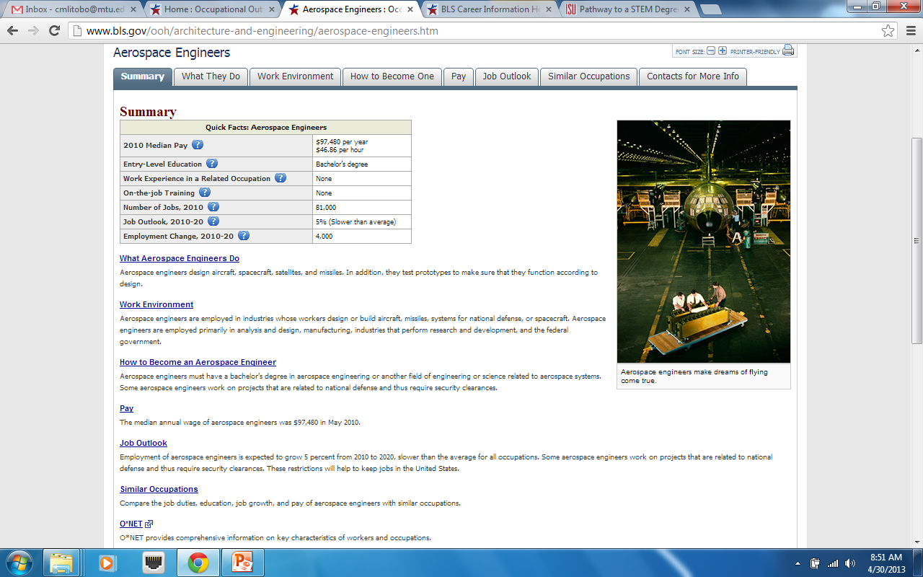
US Bureau of Labor Statistics’ Occupational Outlook Handbook http://www.bls.gov/ooh/
Notes:
Students can look at 2010-2020 job growth projections, median pay, what training or education is required, what do they do, what is the work environment like, etc.

Slide 8
How do I encourage my female students and minority students to look at the STEM fields?
Talk about the helping nature of the fields with your female students
Connect them with role models in the local area
Summer programs are often cheap or free for women and minorities that are interested in the STEM fields

Slide 9
How do you identify resources within your school?
What is already occurring, possibly under the radar?
Are there student organizations in these areas that you could partner with?
What resources do your faculty have access to?
Are there parents or school board members who have connections that you could use?

Slide 10
How do you identify resources in your community?
Are there companies in the area that could sponsor a visit, job shadow or talk to a group of students interested in their area?
Are there any research facilities that they could tour?
Are there any alum who have returned to the area and are doing great things?
Are there any STEM events that occur in the area?
Are there any colleges or other education facilities who might be able to offer support?

Slide 11
What are ways to get your whole school involved?
Excite the faculty- often they have lots of ideas that they just do not have time for in a normal class setting.
Get the school board, parent organizations, etc. involved- even if it is just as an extra set of hands. They may also have connections in industry or for sponsorship.
Create a student committee (NHS??) to help give input and encourage participation.

Slide 12
Example: York High School STEM Day
All school and community collaboration
Faculty
Students
Parents
Community Members
College Members

Slide 13
What have you tried in your schools with your students?

Slide 14
Any Questions?
Kelli Allen
Rachel O’Connell
Christine Grotzke
Amy Thompson

Slide 15
Source Material
National Association for College and Employers Average Starting Salary Data- http://www.naceweb.org/s04172013/average-starting-salary.aspx
Forbes Article- www.forbes.com/sites/jennagoudreau/2012/05/15/best-top-most-valuable-college-majors-degrees/
National Science Foundation Statistics-http://www.nsf.gov/statistics/seind12/c0/c0i.htm
US Bureau of Labor Statistics- www.bls.gov/ooh/
York Stem Day- http://york.elmhurst205.org/ABSTEM

