Slide 1
“Choosing a College from Diverse Options”:
Choosing Students at Highly Selective Institutions

Slide 2
First, A note on hookS
Are there factors that are outside
the applicant’s control?

Slide 3
Hooks
Colleges want diversity in every sense
Reading in context
Everyone has a hook
Institutional priorities

Slide 4
ACADEMICS
The jumping-off point

Slide 5
Holistic Evaluation
Every element is taken into consideration . . .
. . . But academics (testing, GPA) still matter
Strong academics are a solid starting point for a competitive application
Schools want to feel confident that the student can handle the work
The application should be well-balanced

Slide 6
FIT
Delving deeper

Slide 7
Fit & Reciprocal Interest
Common Application has made it easier than ever to apply to highly selective institutions, which means . . .
. . . Students must do their research & work harder to distinguish themselves
Students choose colleges months before colleges start to choose them; schools expect students to have been thoughtful and deliberate
What about us do they identify with?
Demonstrated interest

Slide 8
supplements
Two-way windows

Slide 9
Supplements
Supplements tell colleges
about students . . .
. . . and students
about colleges.
What kinds of questions do they ask?
What do they highlight?

Slide 10
Supplements
The student should:
Be him- or herself
Be original
Avoid the obvious response
Remember that (within reason) there are no wrong answers
Colleges want to see the student’s voice and personality. What does he value? What will she contribute? Is he/she a good fit?

Slide 11
Supplements
Some examples . . .

Slide 12
In Closing . . .

Slide 13
Thank you!

Slide 14
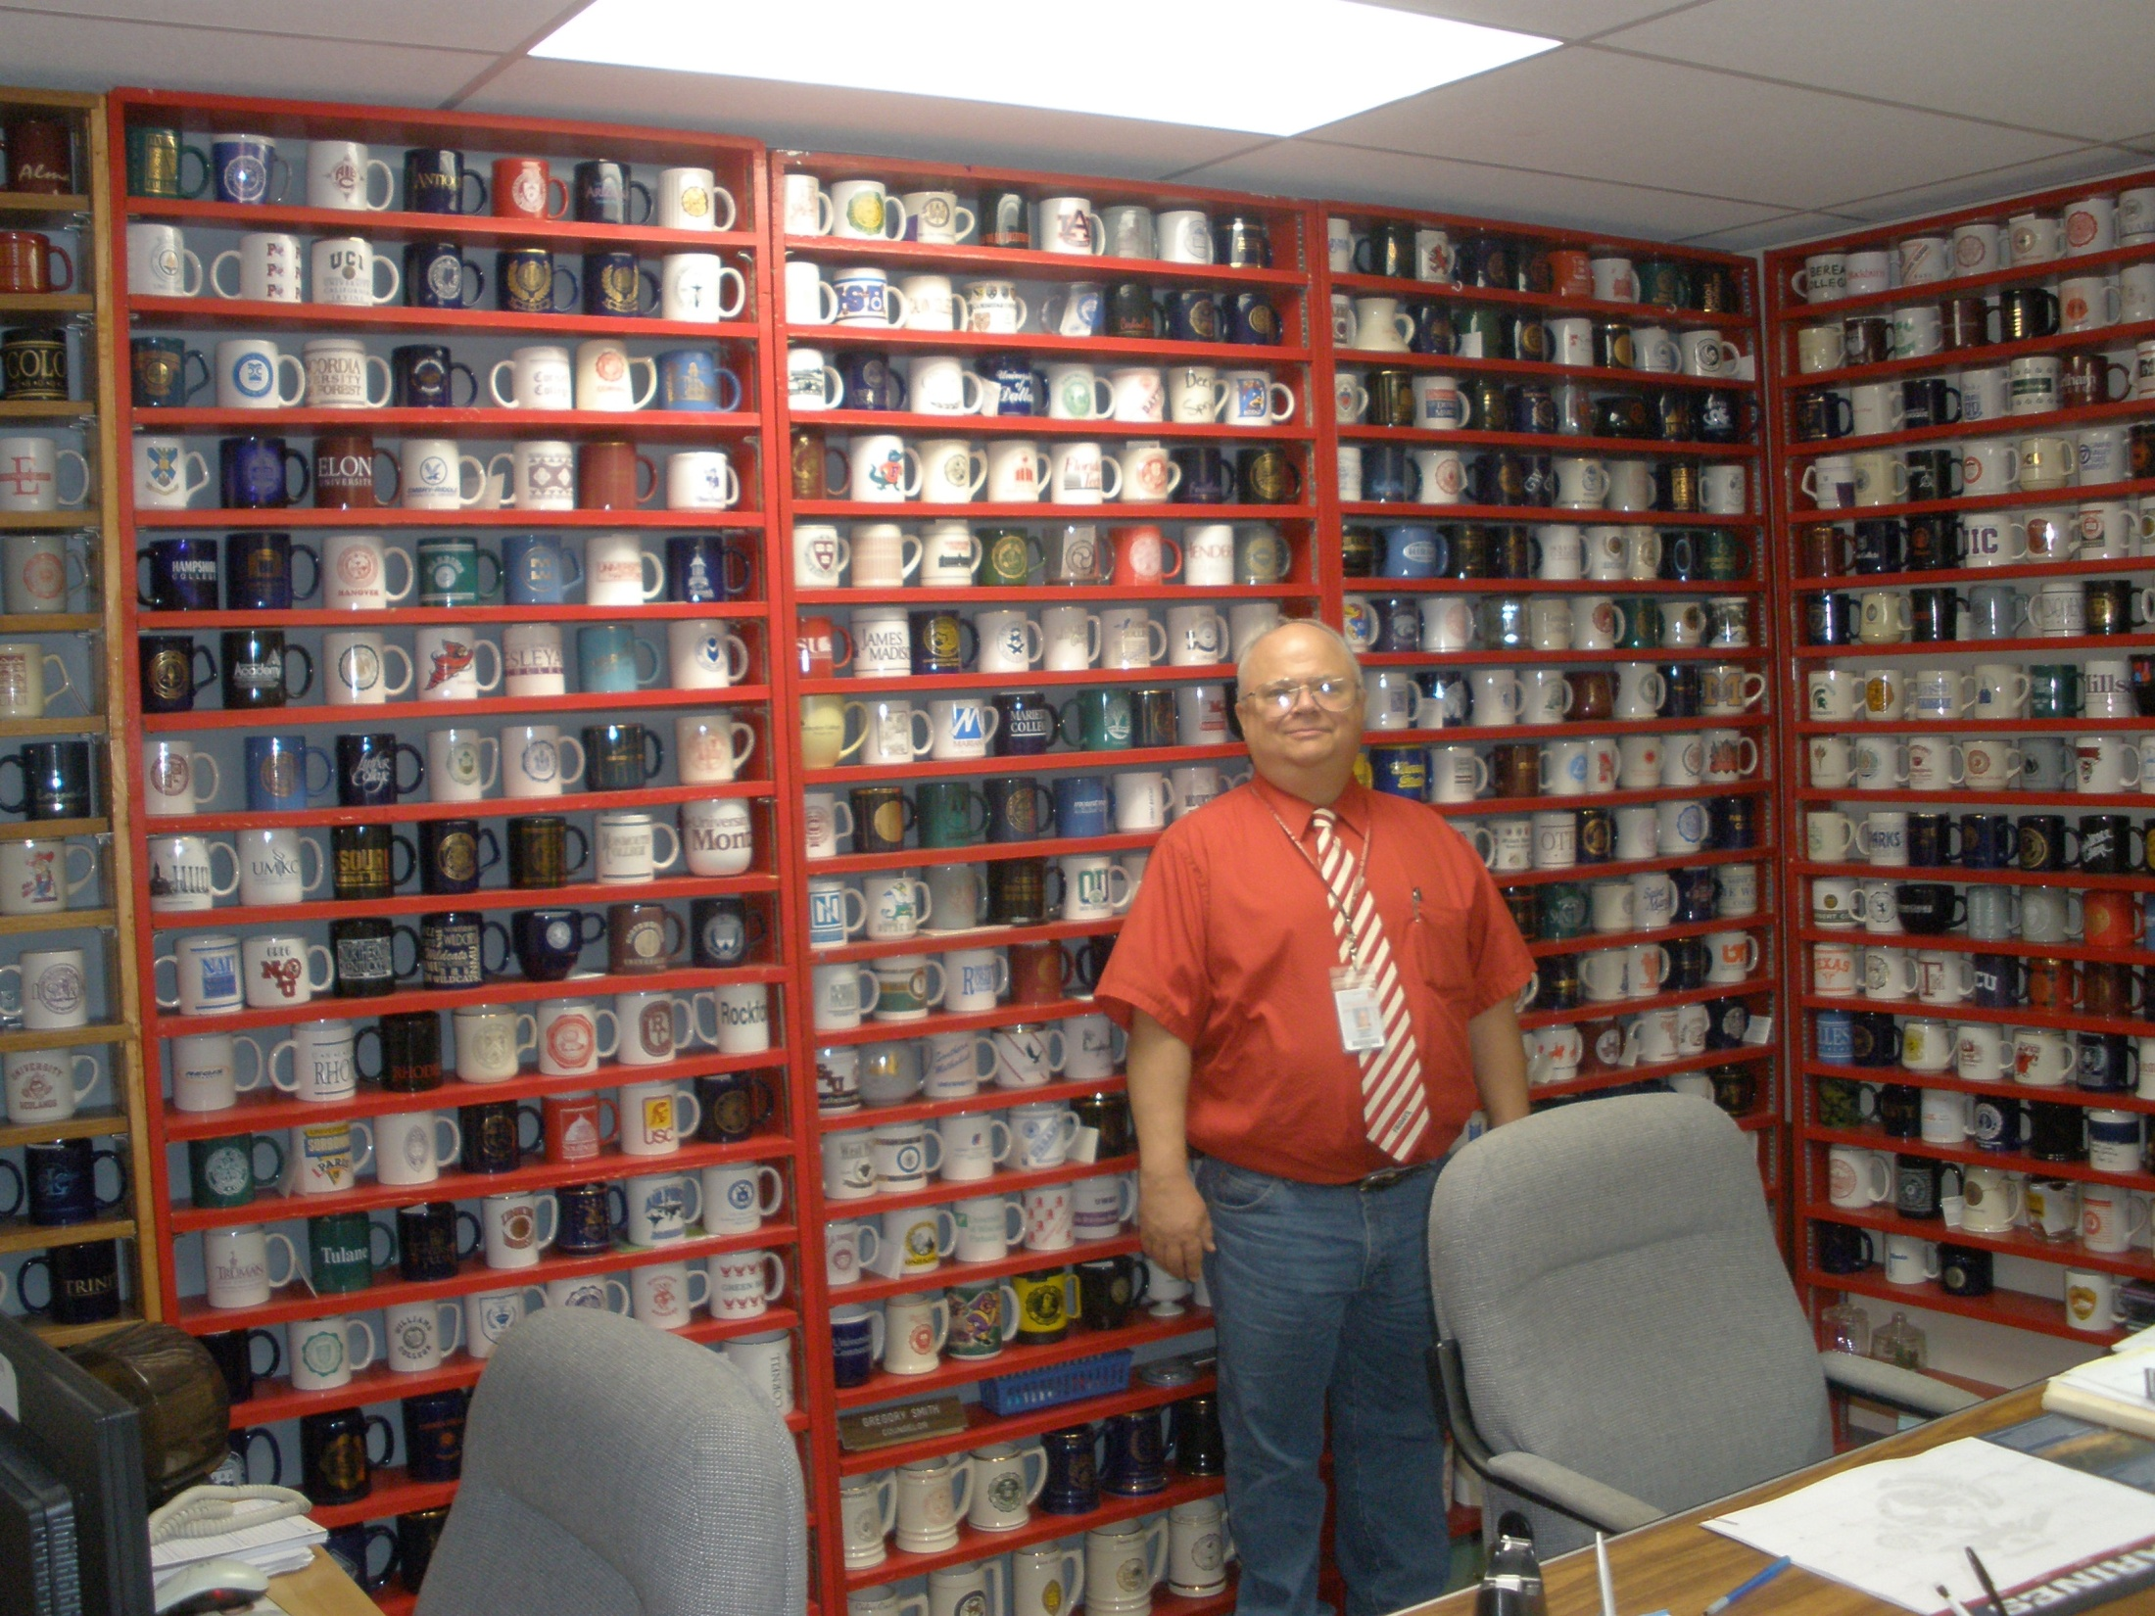
Picture of Greg Smith’s Mugs – Announce retirement
Gregory Smith 36 Years! High School Counselor
QUESTIONS??

