Slide 1
Choosing a College from Diverse Options

Slide 2
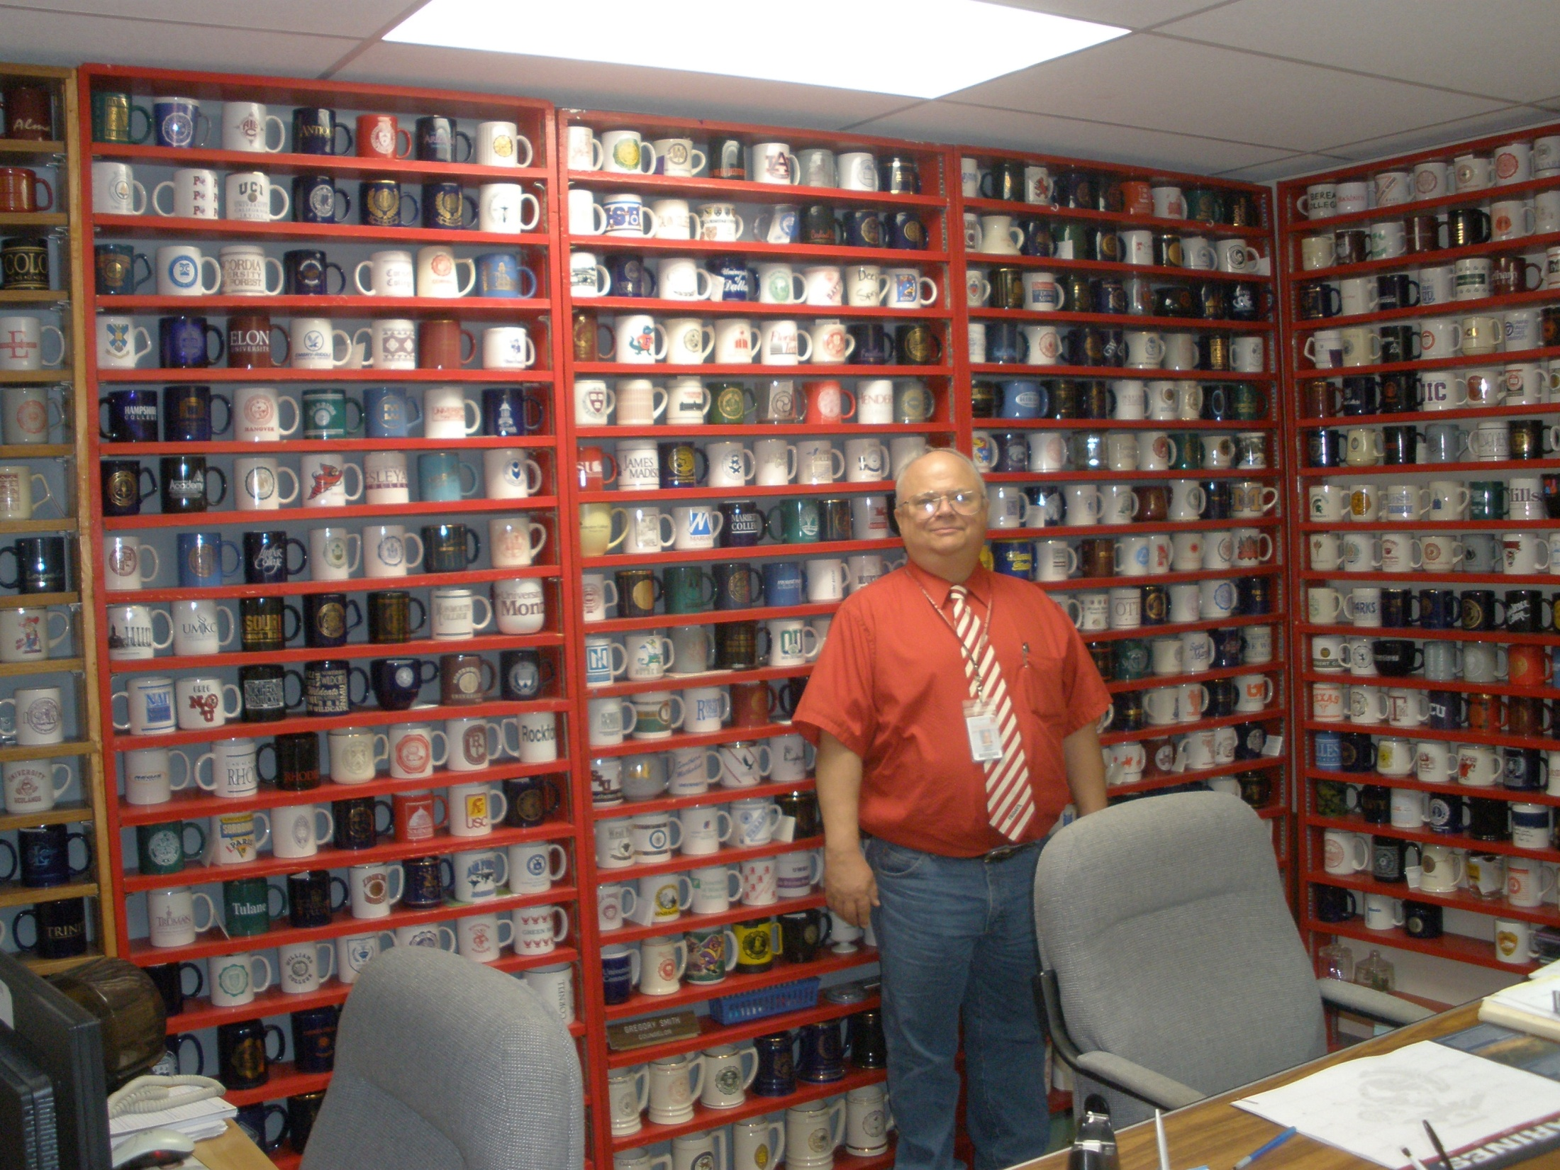
Picture of Greg Smith’s Mugs – Announce retirement

Slide 3
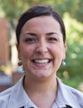
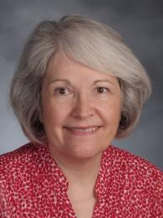
Presenters
Choosing a College
from Diverse Options
Moderator: Gregory Smith, Counselor, Naperville Central High School
Hayley Schueneman Admissions Counselor
Knox College
Sarah Idzik Assistant Director of Admissions
University of Chicago
Jean Childers College & Career Coordinator Naperville Central High School

Slide 4
Jean Childers
Naperville Central HS

Slide 5
Students - Stress
What if no one likes me – on my application
Not getting into my first choice college
Indecision of major/career
Time/deadlines
Strained parent relationships
Fear of the future

Slide 6
College Selection
gather information…..research….. viewbooks …..call friends…..college websites…..overnight visits….. ask counselor …… college visits …… rankings …… top 10 lists ….. Facebook ..…college website….. parent’s opinions….. admission counselor calls….. emails…..newspaper article
“A wealth of information creates a poverty of attention.”
Herbert Simon
 | Location | Enrollment | Major | Social | Cost | Male/Female | Rank | Weather | Career Ser
College #1
College #2
College #3

Slide 7
Criteria for College Selection
RANK IMPORTANCE
Major
Affordability
Location
Ranking and Prestige
Social Scene and Friends
Student Survey - NCHS Junior Survey 2013

Slide 8
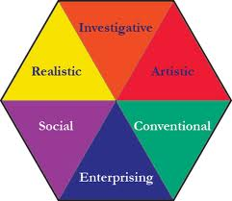
Selecting a Major
Career Interest surveys – pick career 1st
Top majors for most popular colleges
High & Low Demand Jobs
Rugg’s Recommendations

Slide 9
Majors with High Demand
Business – Finance, Accounting, Marketing, Management, Inter. Business
Science – Life & Physical Science, nanotechnology, biochemistry
Technology – computer science, software eng., cyber security, new media
Engineering – biomedical, civil, computer, electrical, mechanical, nuclear
Health Science – physical therapy, nursing, pre-med, pre-vet, audiology
Social Services – social work, counseling & therapy, family therapy
Education – early childhood, elementary, post-secondary
Source: Bureau of Labor Statistics 2012

Slide 10
New Majors – Illinois Colleges
Biomedical Engineering
Information security
Logistics
Social media/new media
Physical Therapy
Physician Assistant
International Business
Ice College Fair Survey COD Fall 2011

Slide 11
Affordability
Accepted academically, denied financially
Choose best college and pay full price or scholarship at less desirable college.
Delaying decisions – FAFSA
More negotiating
Save $ for graduate school

Slide 12
Where you go to college often determines where you will live an work in future.
Illinois is a highly populated state
91%-99% in-state students at all IL publics
Illinois publics higher than average cost
Adjacent states lure IL students

Slide 13
Location
ACT
35 33 31 29 27 25 23 21 19 17 15 13 11
COMMUNITY COLLEGE
0 2.0 2.5 3.0 3.5 4.0
GPA

Slide 14
Migration

Slide 15
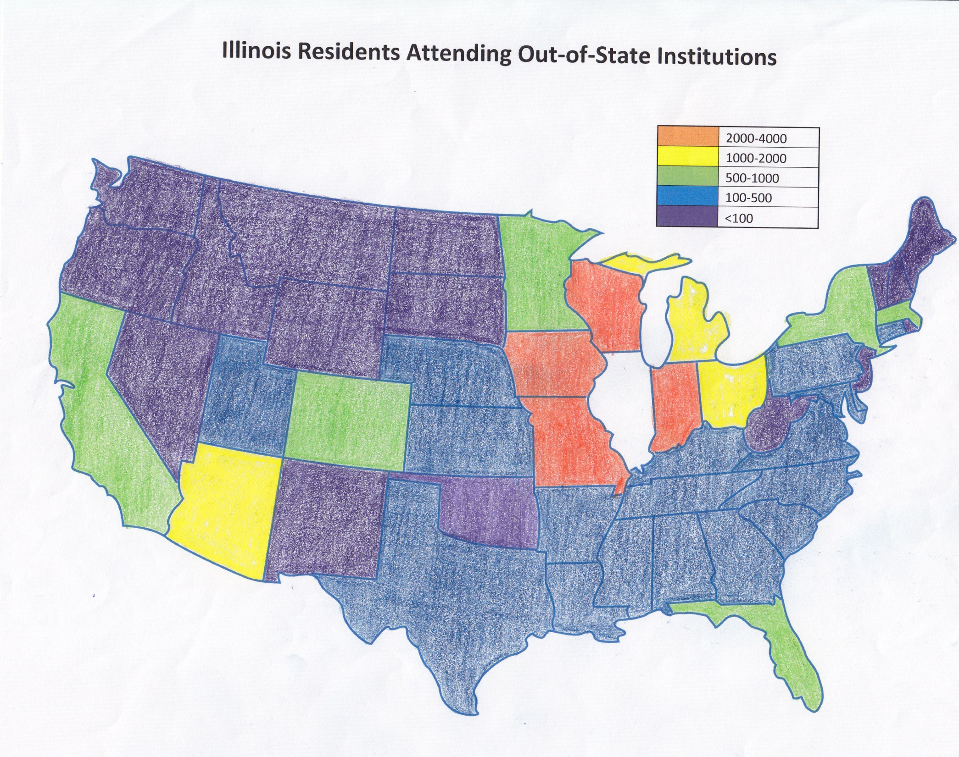
Source: National Center for Educational Statistics

Slide 16
Rankings / Prestige
Many colleges options – use rank to cull list
Ranking is like the College’s ACT score
Statistics are safer than trusting opinions
College rank does not define you
College experience is what you make it
Source: NCHS Student Editorial Central Times Newspaper 2013
D. Trivedi, R.Shanholtz

Slide 17
Resources for College Selection
Internet Research – College Websites 82.4 %
Campus Visits 80.7%
NCHS College and Career Center/Counselor 48.3%
College Visits at NCHS 47.5%
College Fairs 32.4%
Friends /Facebook 24.4%
Student Survey - NCHS Junior Survey 2013

Slide 18
Eighty Percent
Location – > 7 hours from here
Enrollment – < 5,000 students
Admission – accept >50% of applicants
Residency – enroll >75% in-state residents
Gender – enroll >50% female students
Minority Background – <50% minority students
Religious Affiliation – none

Slide 19
Campus Visits
30% don’t go on campus to choose colleges
Application is their first contact with college
Campus tour after admission
The Journal of College Admission NACAC Spring 2012 Sarah Cox, “The Stealth Applicant Search for Higher Education”

Slide 20
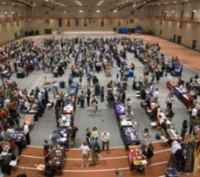
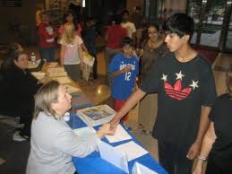
College & Career Fairs

Slide 21
College Visits Target Market
Affluent community Full Pay
College educated parents High Expectations
High ACT/GPA Academic potential
College Bound High # Prospects

Slide 23
High School Counselor’s Role
Advising
Junior conferences
Evening & classroom presentations
Provide resources, insight & tools
Guide students to appropriate colleges

Slide 24
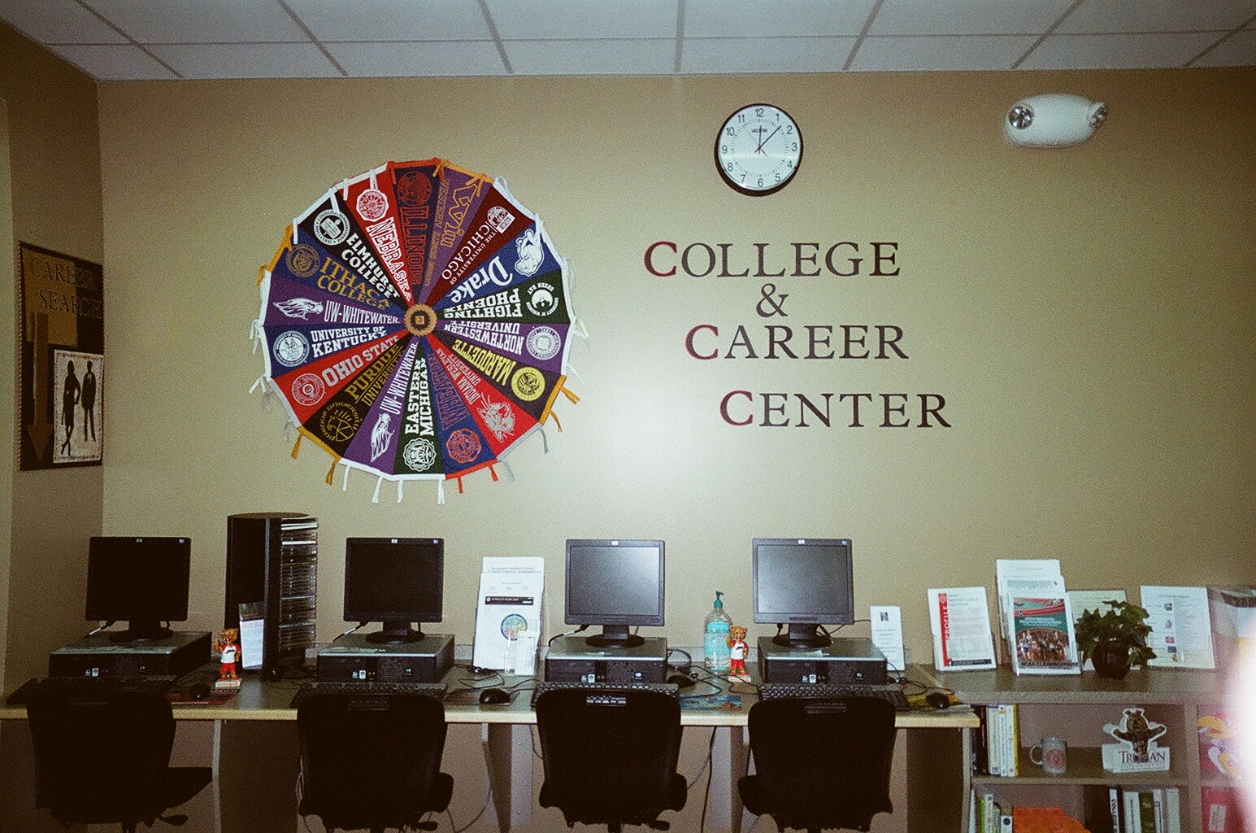
College Selection Advising – School Days & Thursday Nights

Slide 25
Counselor Knowledge
Broad knowledge of many colleges
Depth of knowledge of Top 50 colleges
Aware of special requirements for selectives
Know where to find information requested
NCHS Parent Focus Group
Things Counselors Should Know

Slide 26
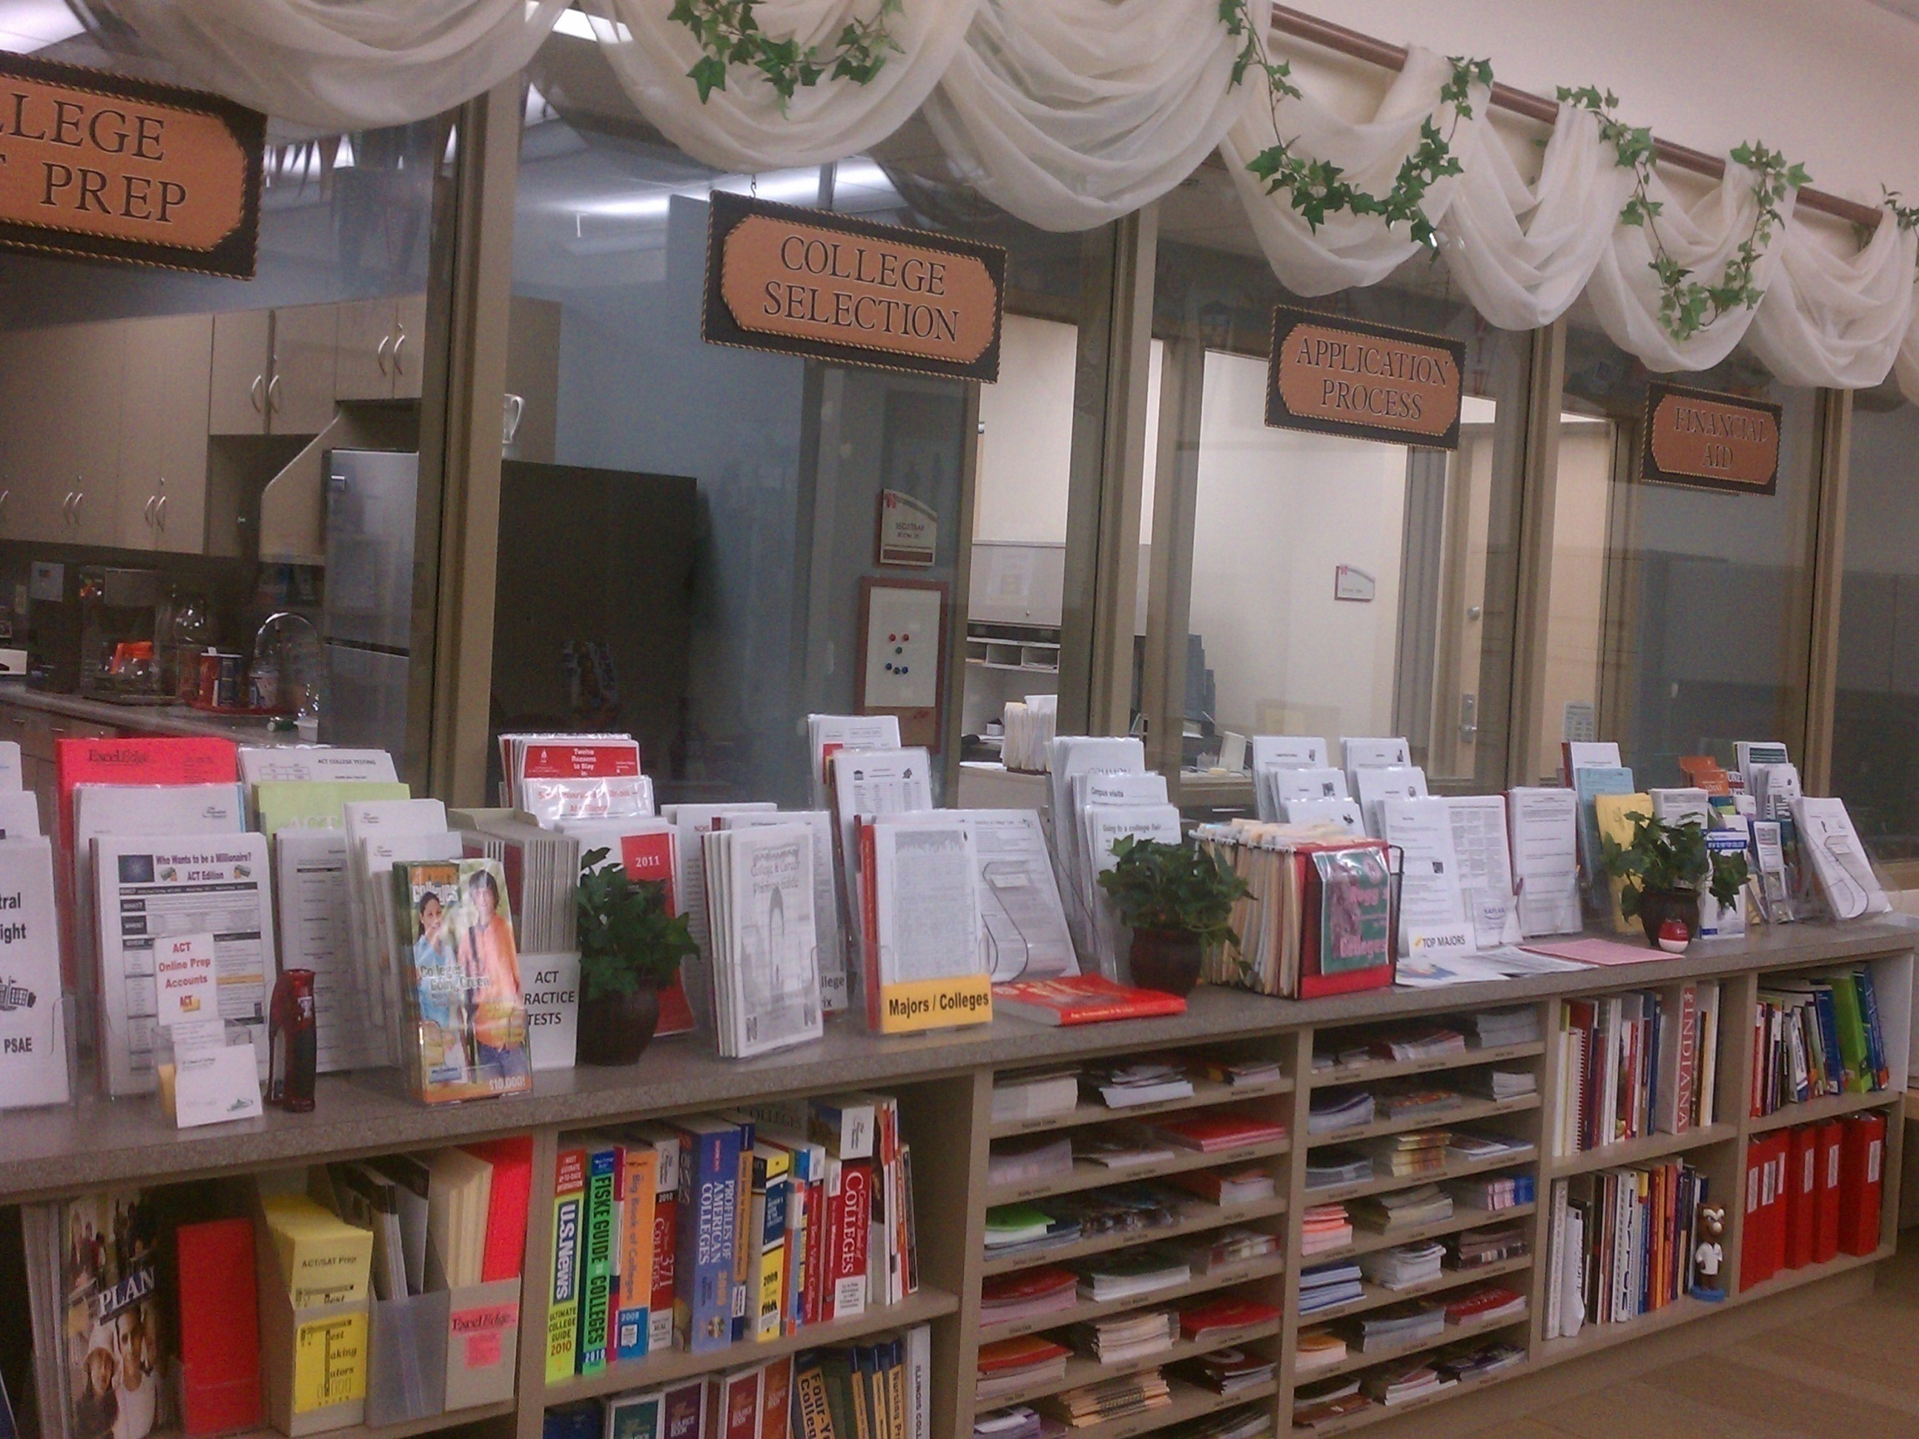
College Selection Resources - Paper & Digital on School Website

Slide 27
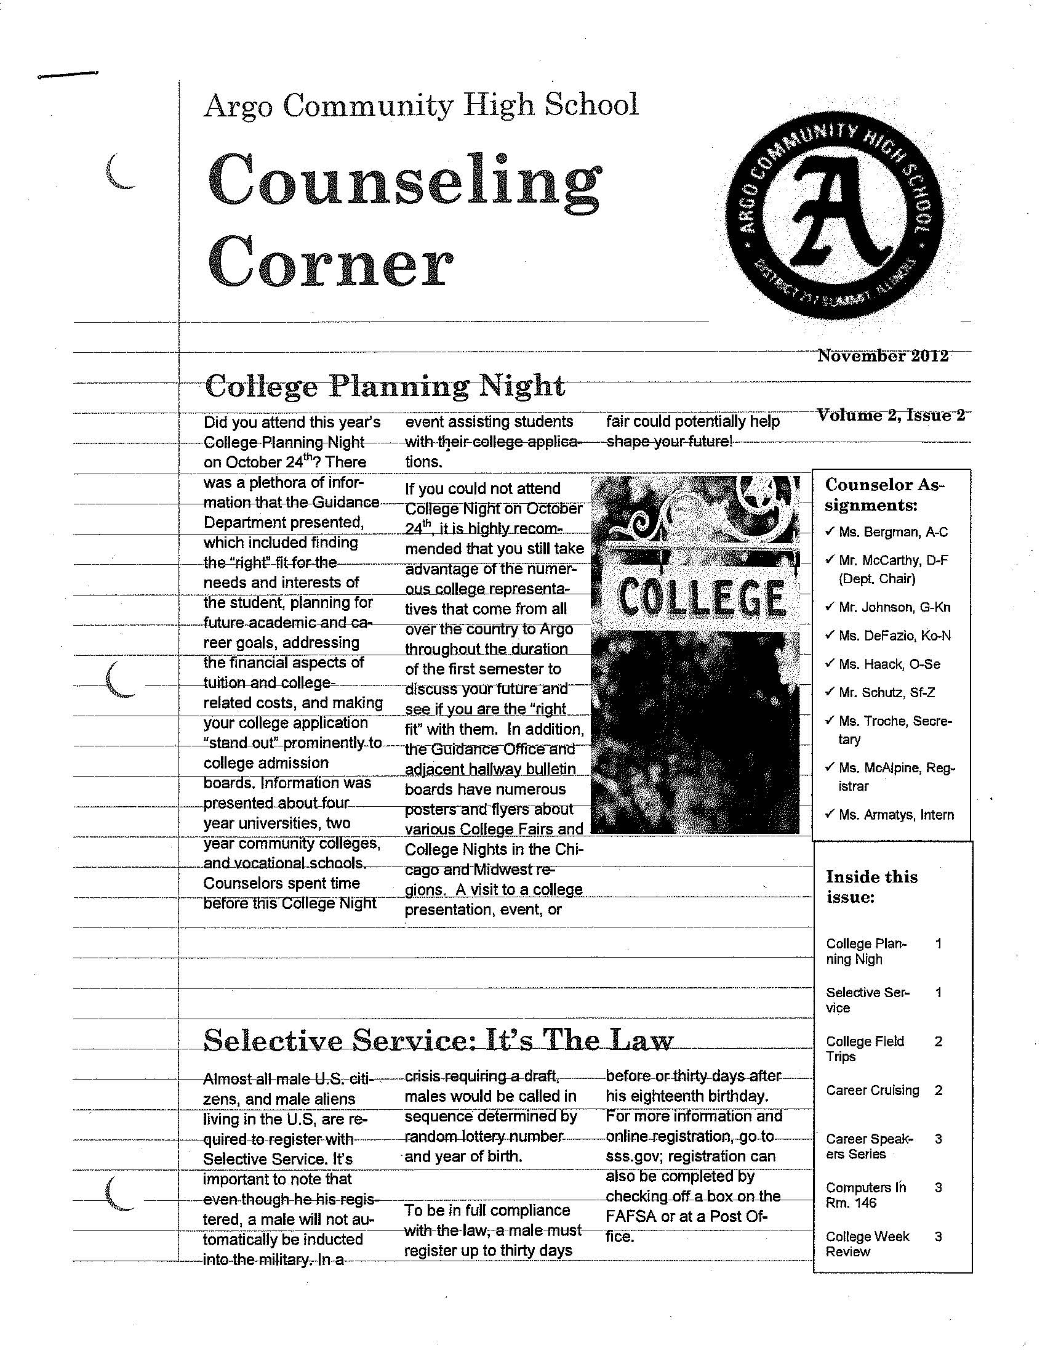
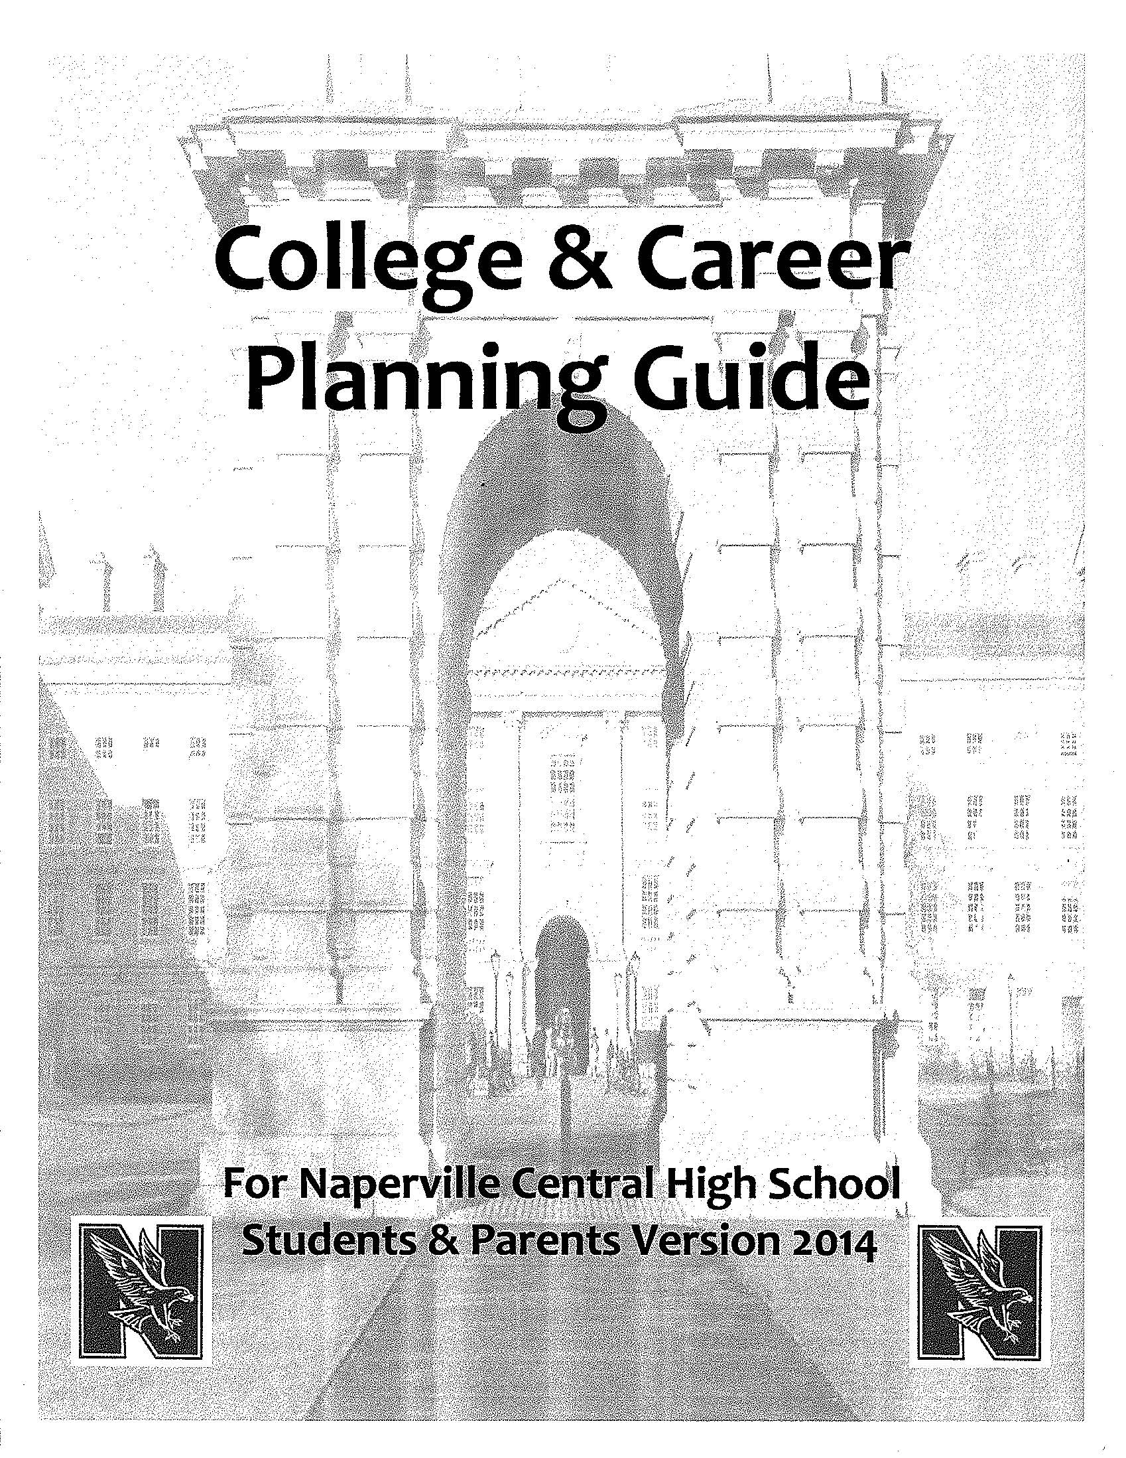
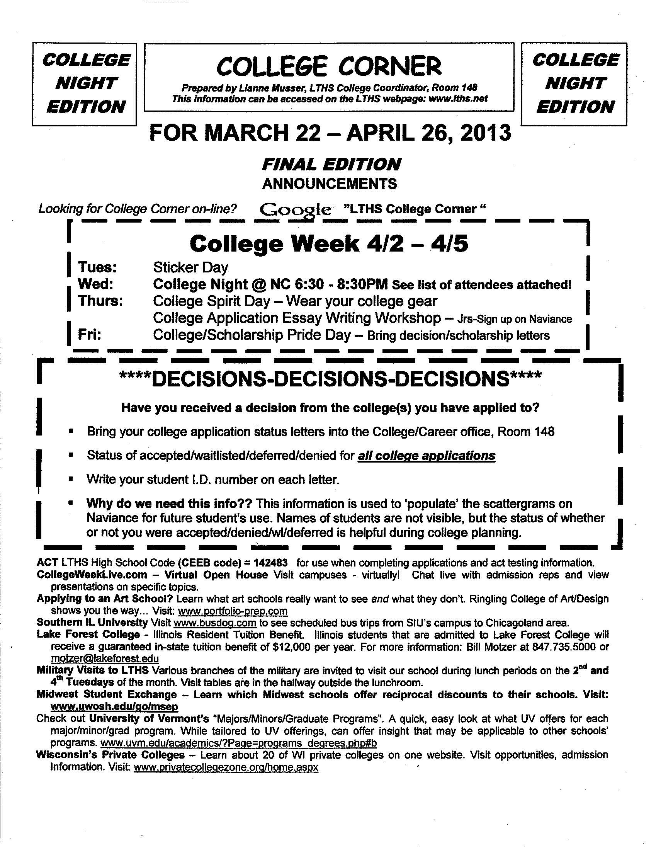
Resources – Counselor Communications
COUNSELOR NEWS C&C BOOKLETS CCC NEWSLETTER
Argo Community HS Naperville Central HS Lyons Township HS

Slide 28
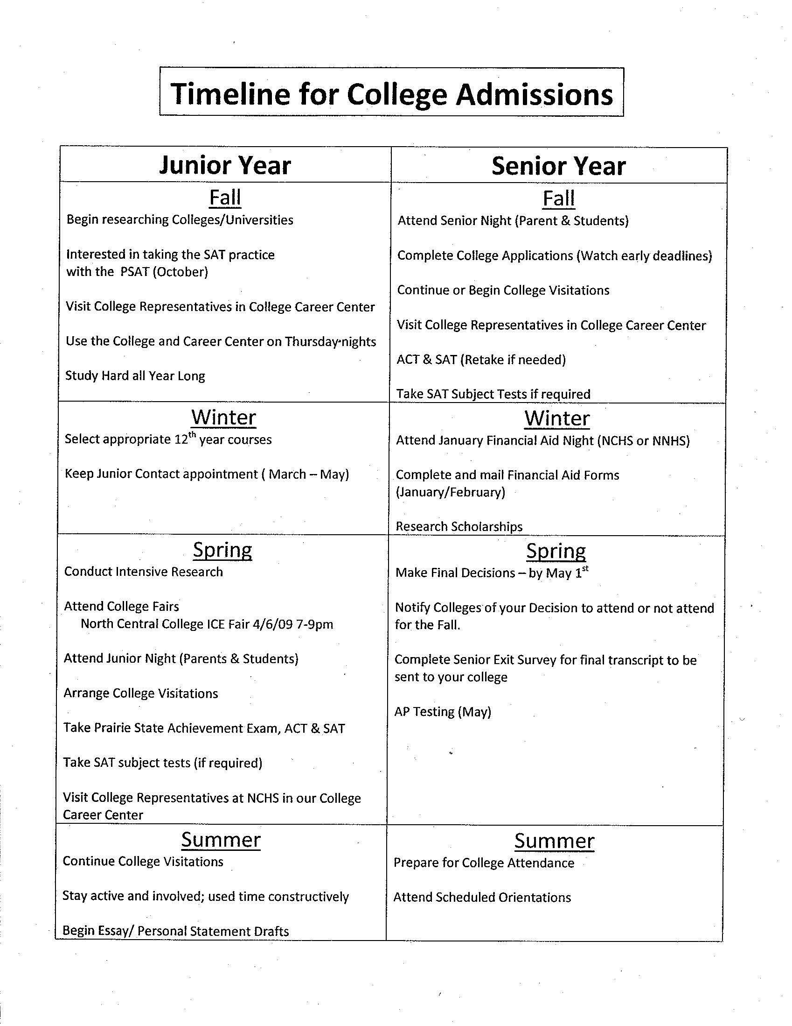
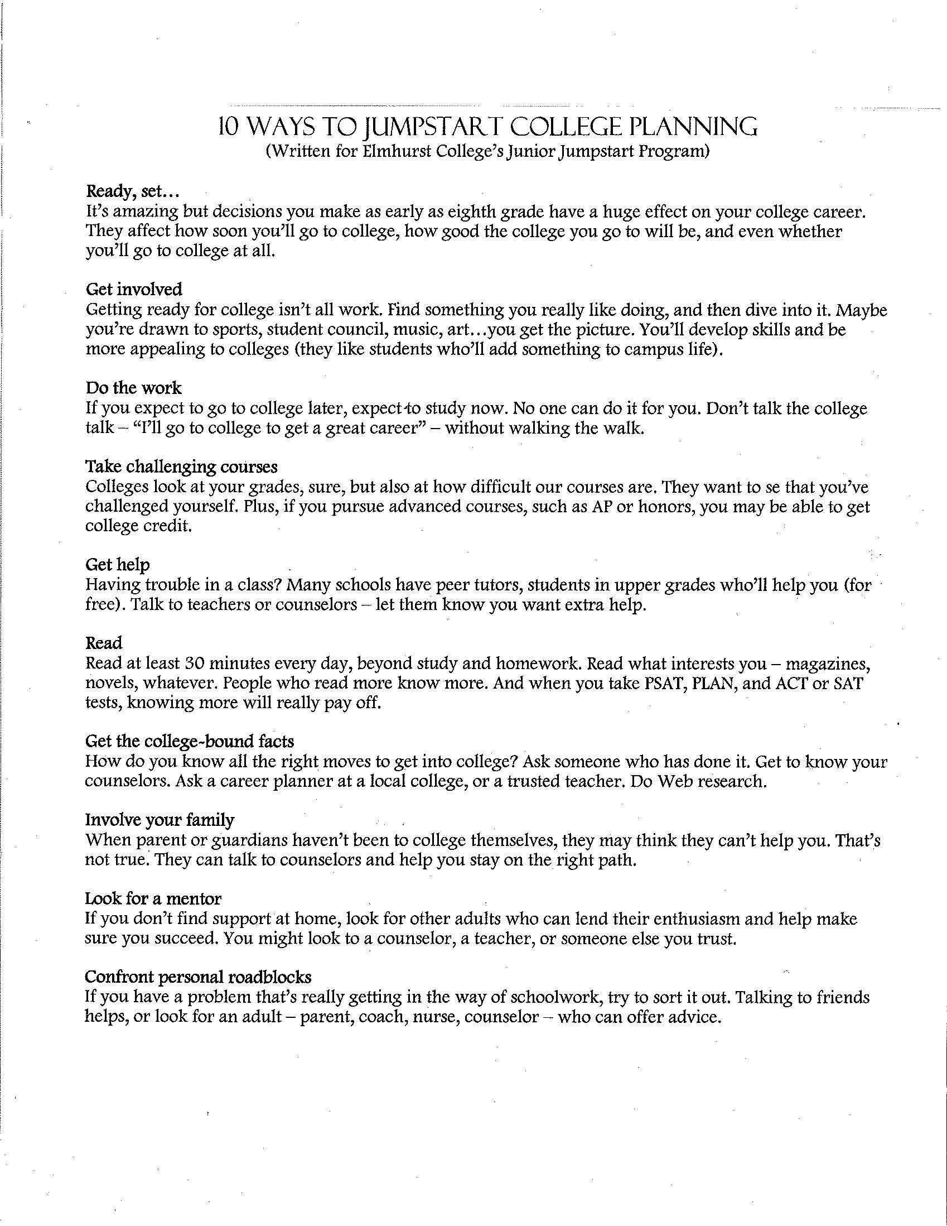
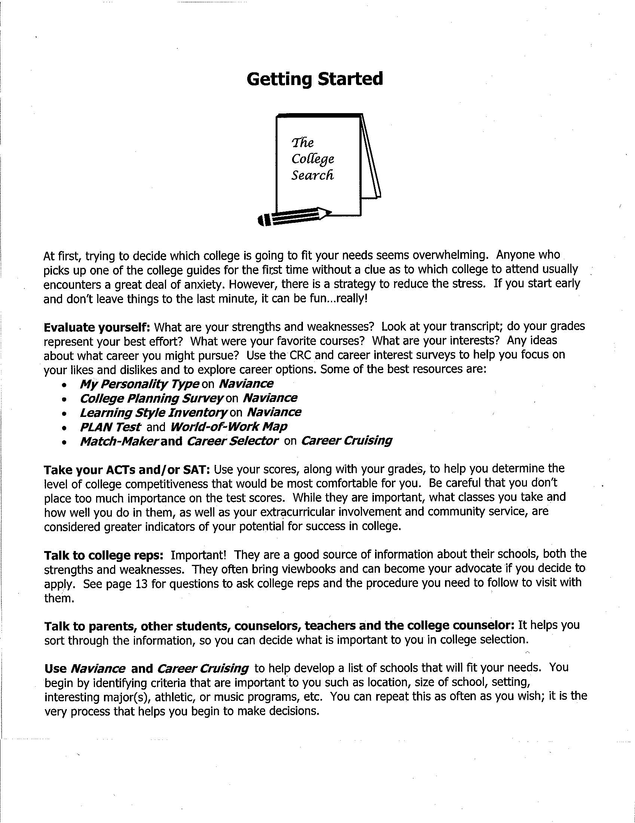
Resources – Starting Out
TIMELINE JUMPSTART GETTING STARTED
Naperville Central HS York Comm. HS /Elmhurst Libertyville HS

Slide 29
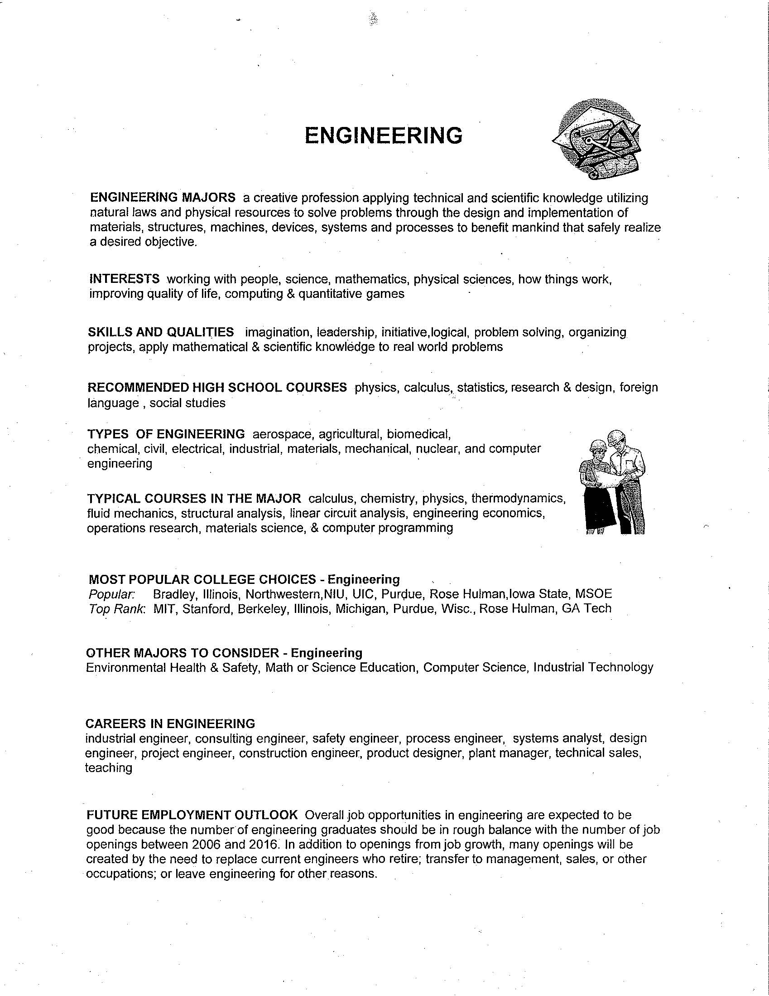
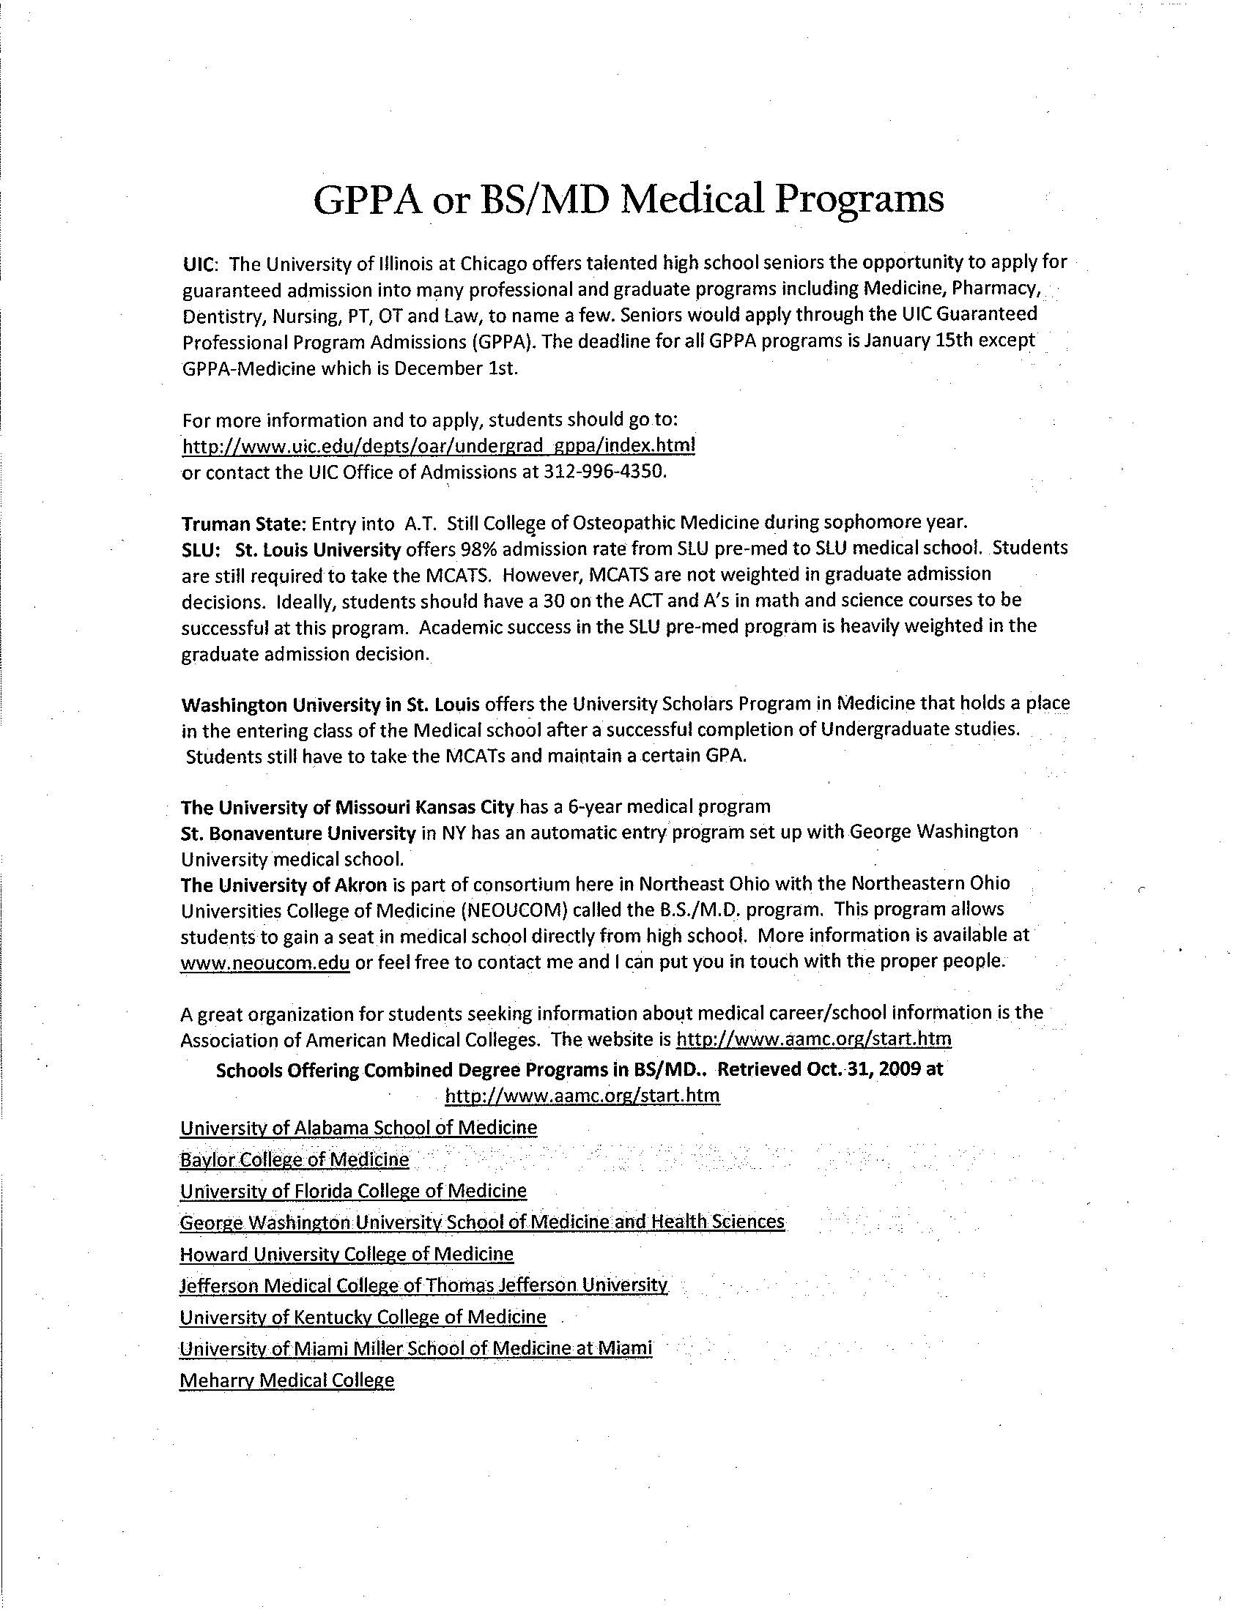
Resources – Major by College
MOST POPULAR RECOMMENDATIONS MEDICAL PROGRAMS
College & Career Planning Guide
Naperville Central HS ruggsrecommendations.com aamc.org

Slide 30
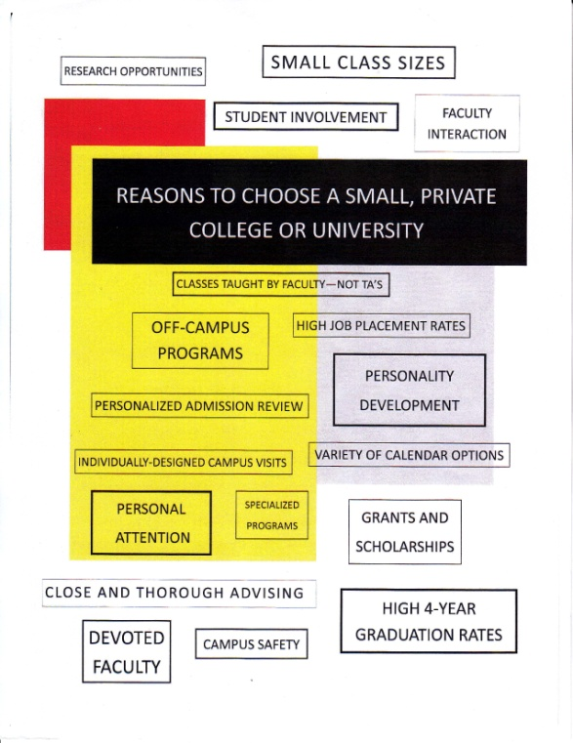
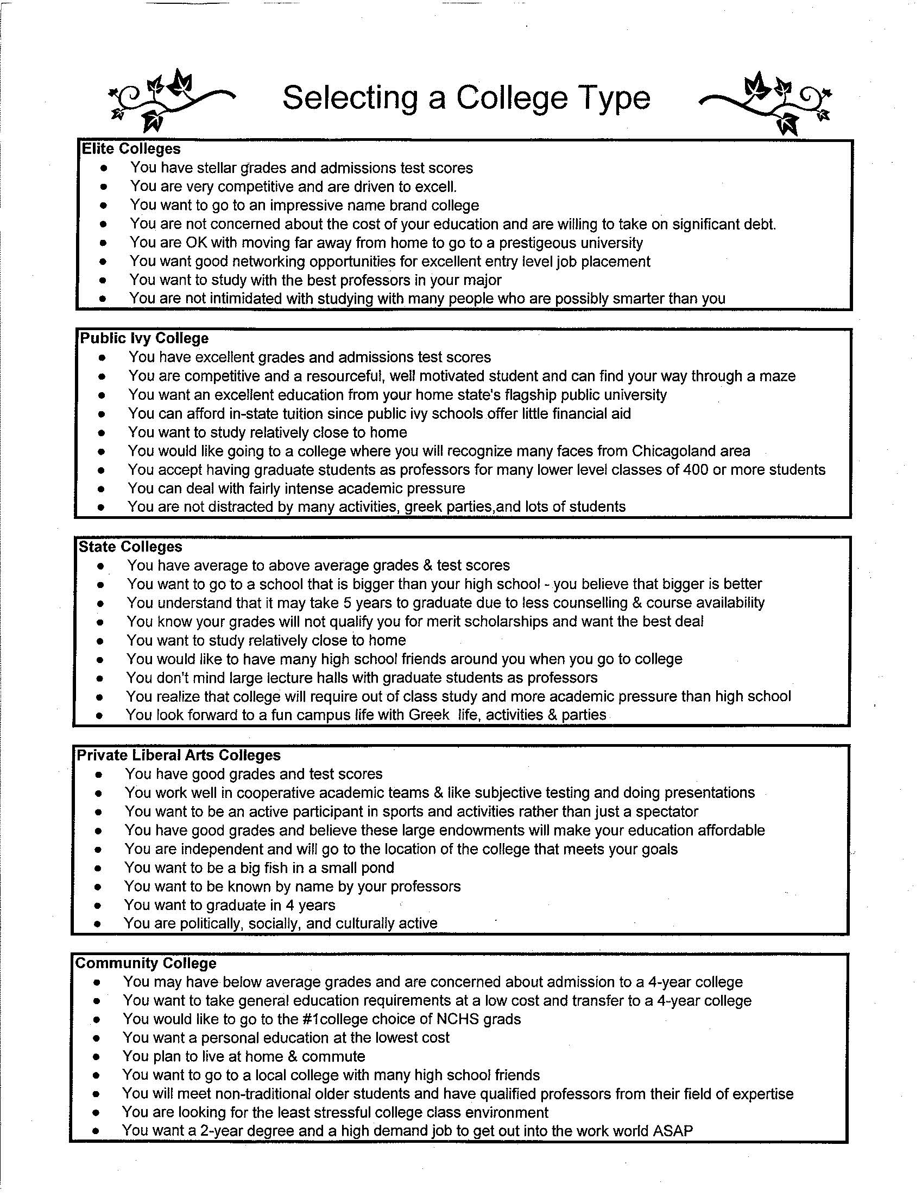
Resources – College Type
PRIVATE PICK COLLEGE TYPE RELIGIOUS
Naperville Central HS Naperville Central HS Wheaton North HS

Slide 31
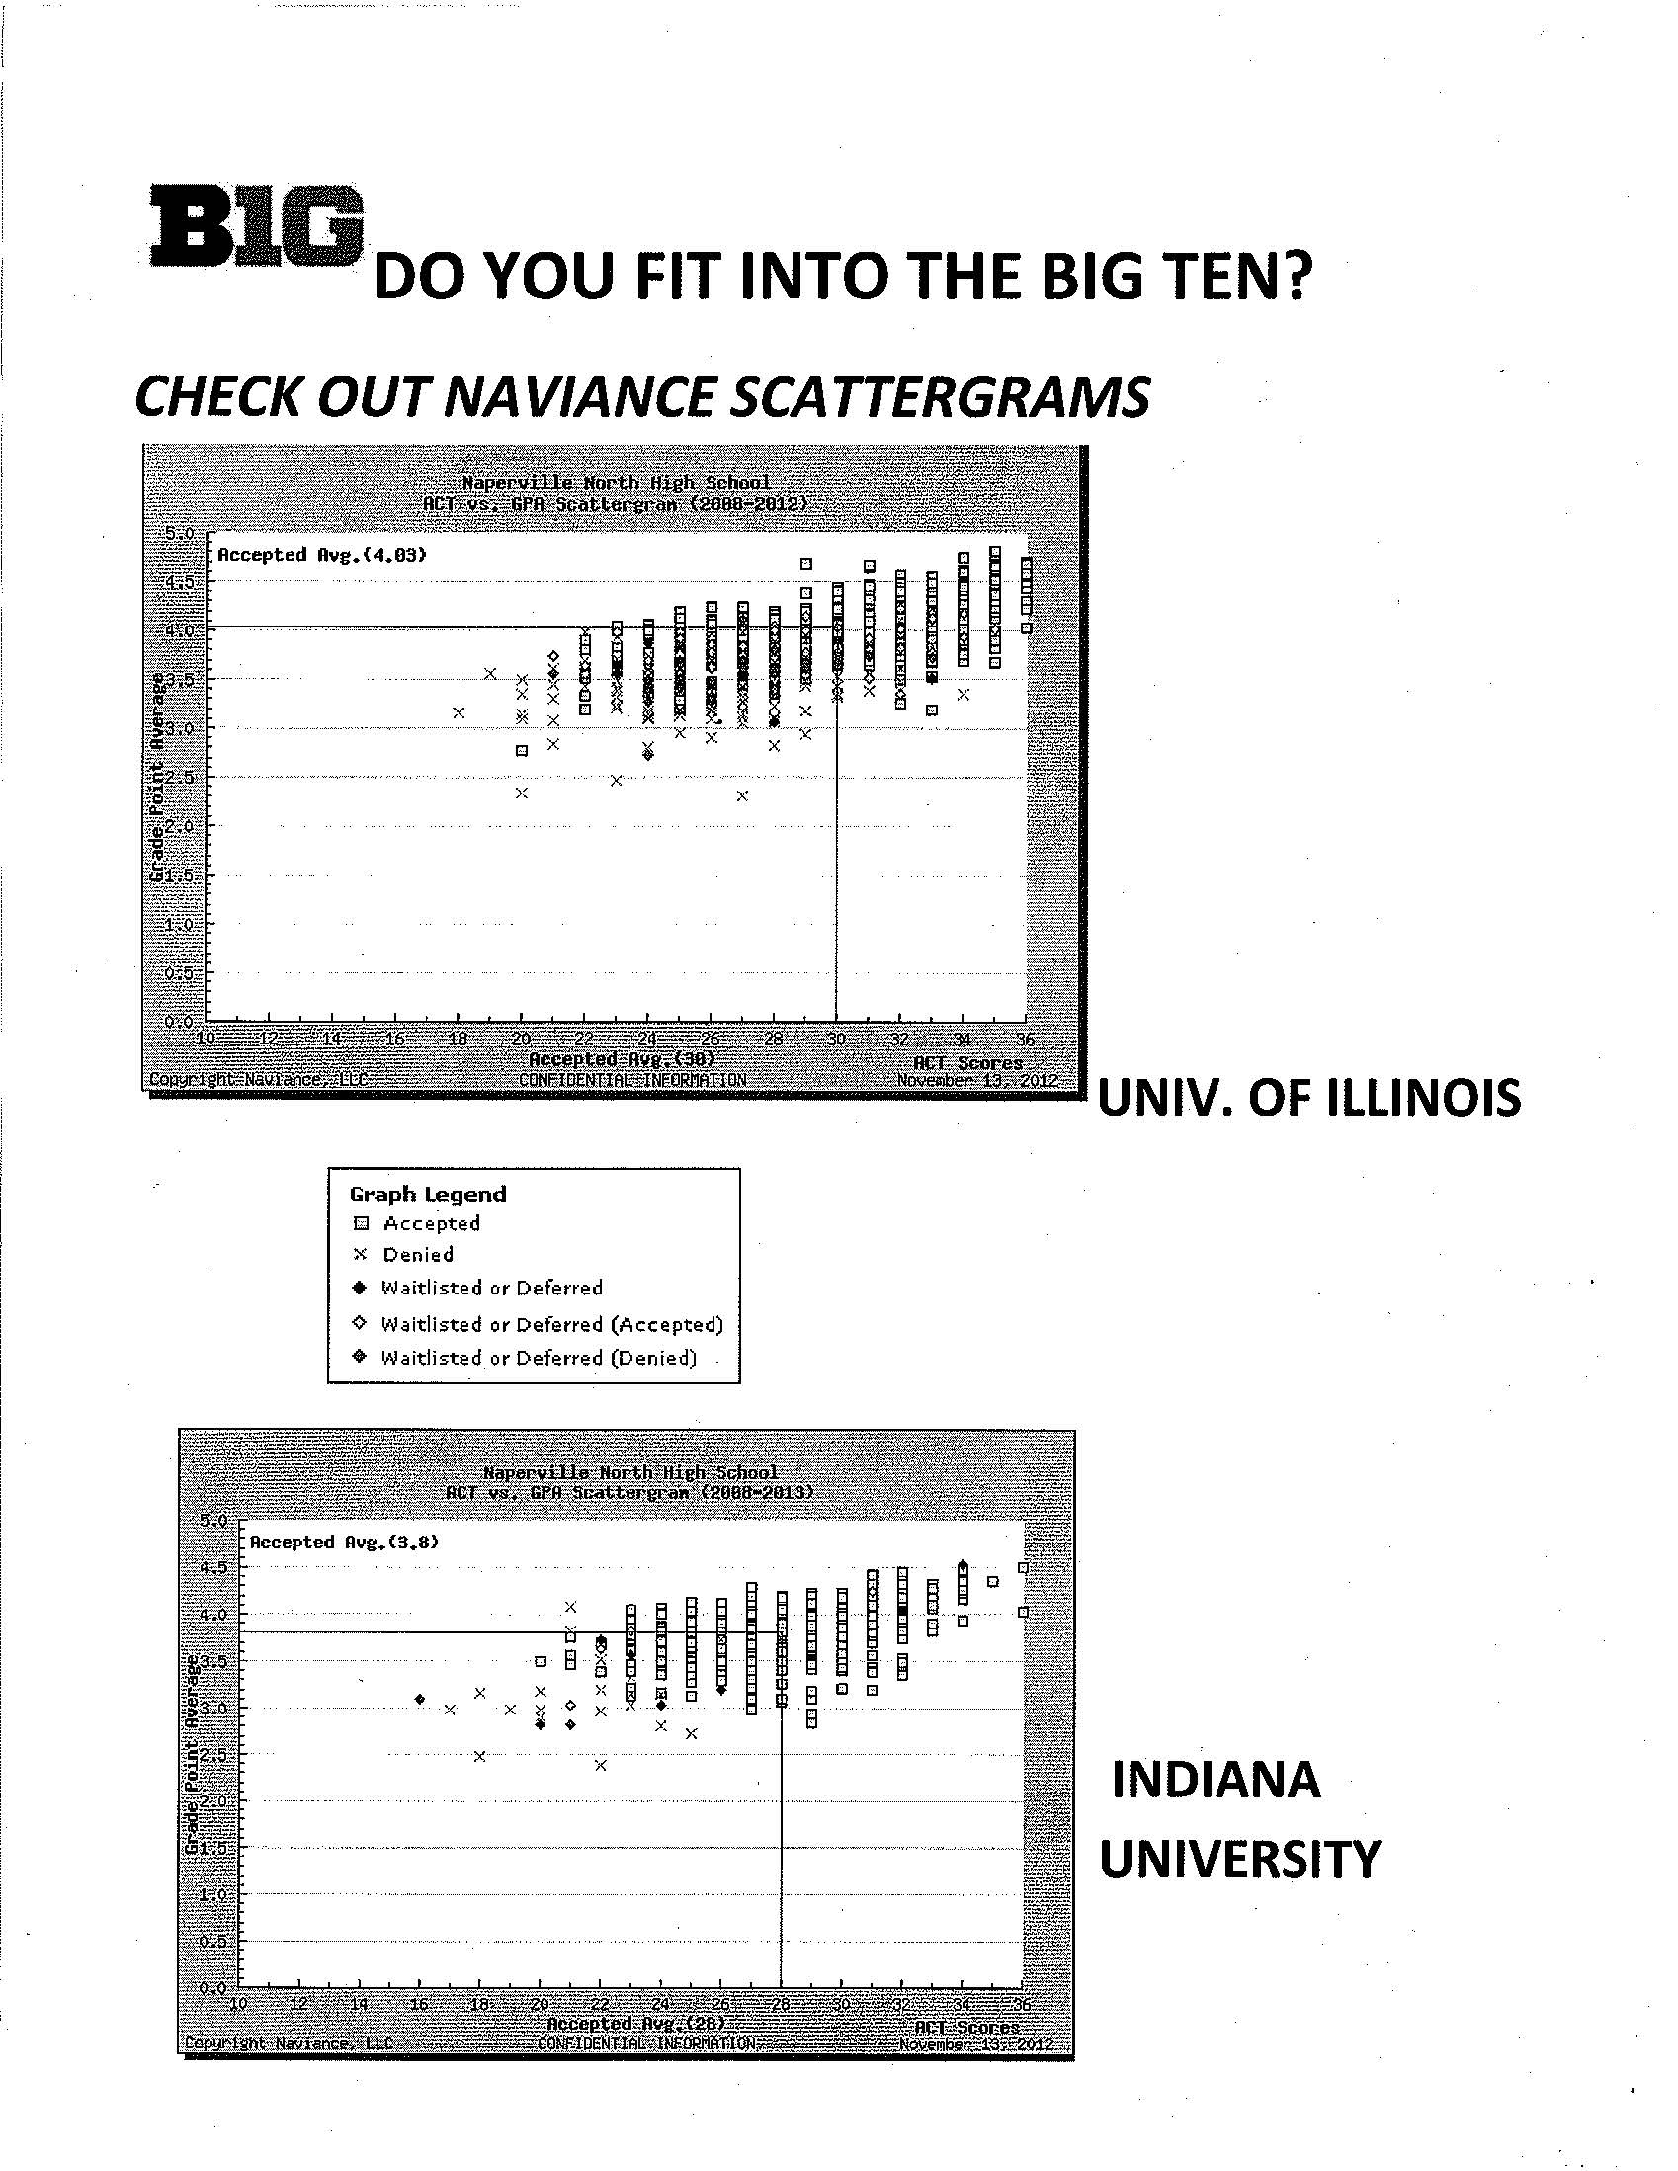
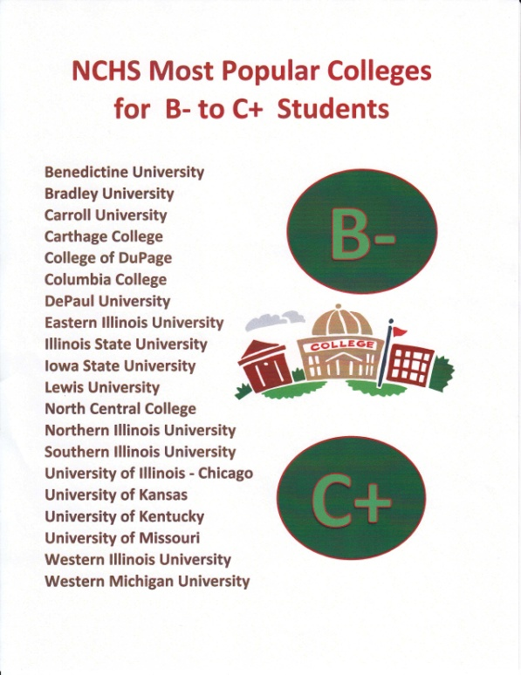
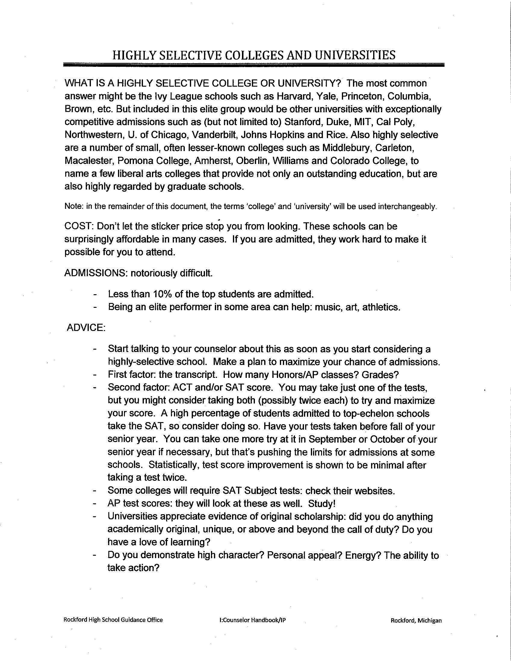
Resources – College Fit
BIG TEN FIT B- TO C+ STUDENTS HIGHLY SELECTIVE
Naperville North HS Naperville Central HS Rockford HS

Slide 32
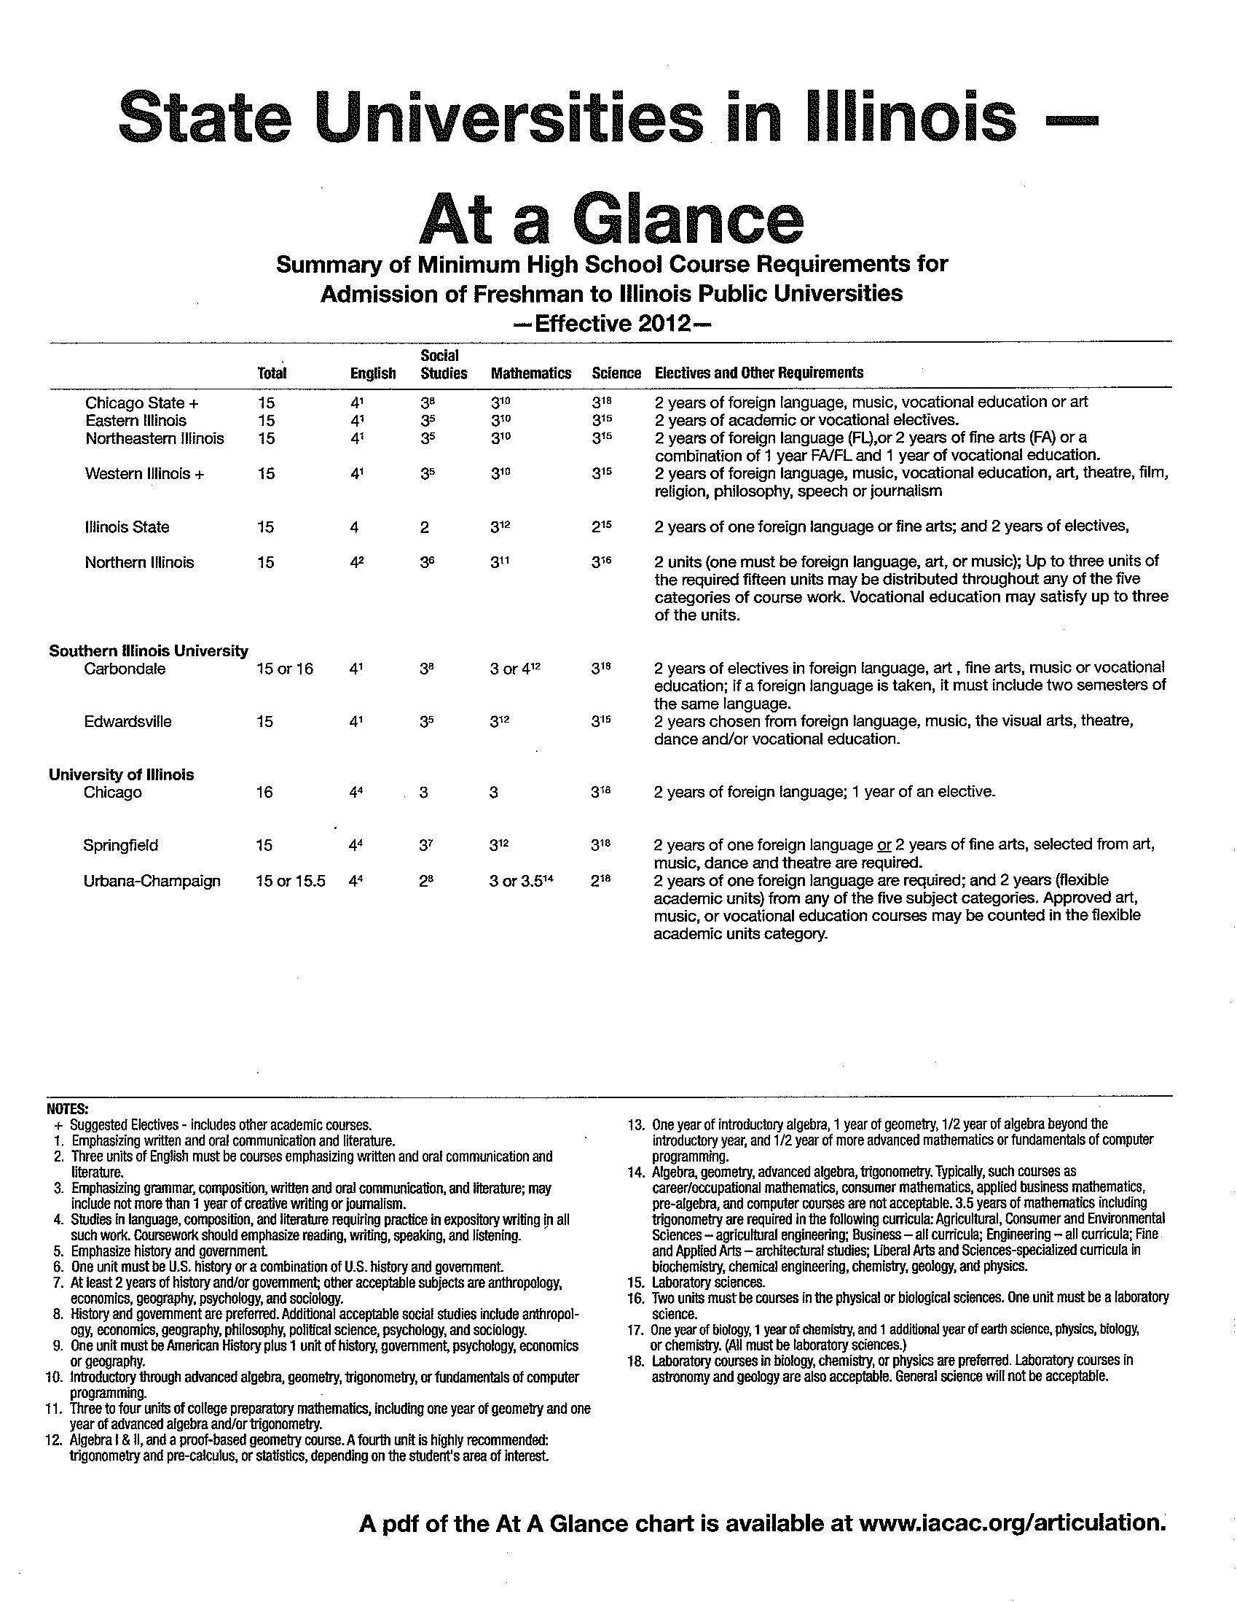
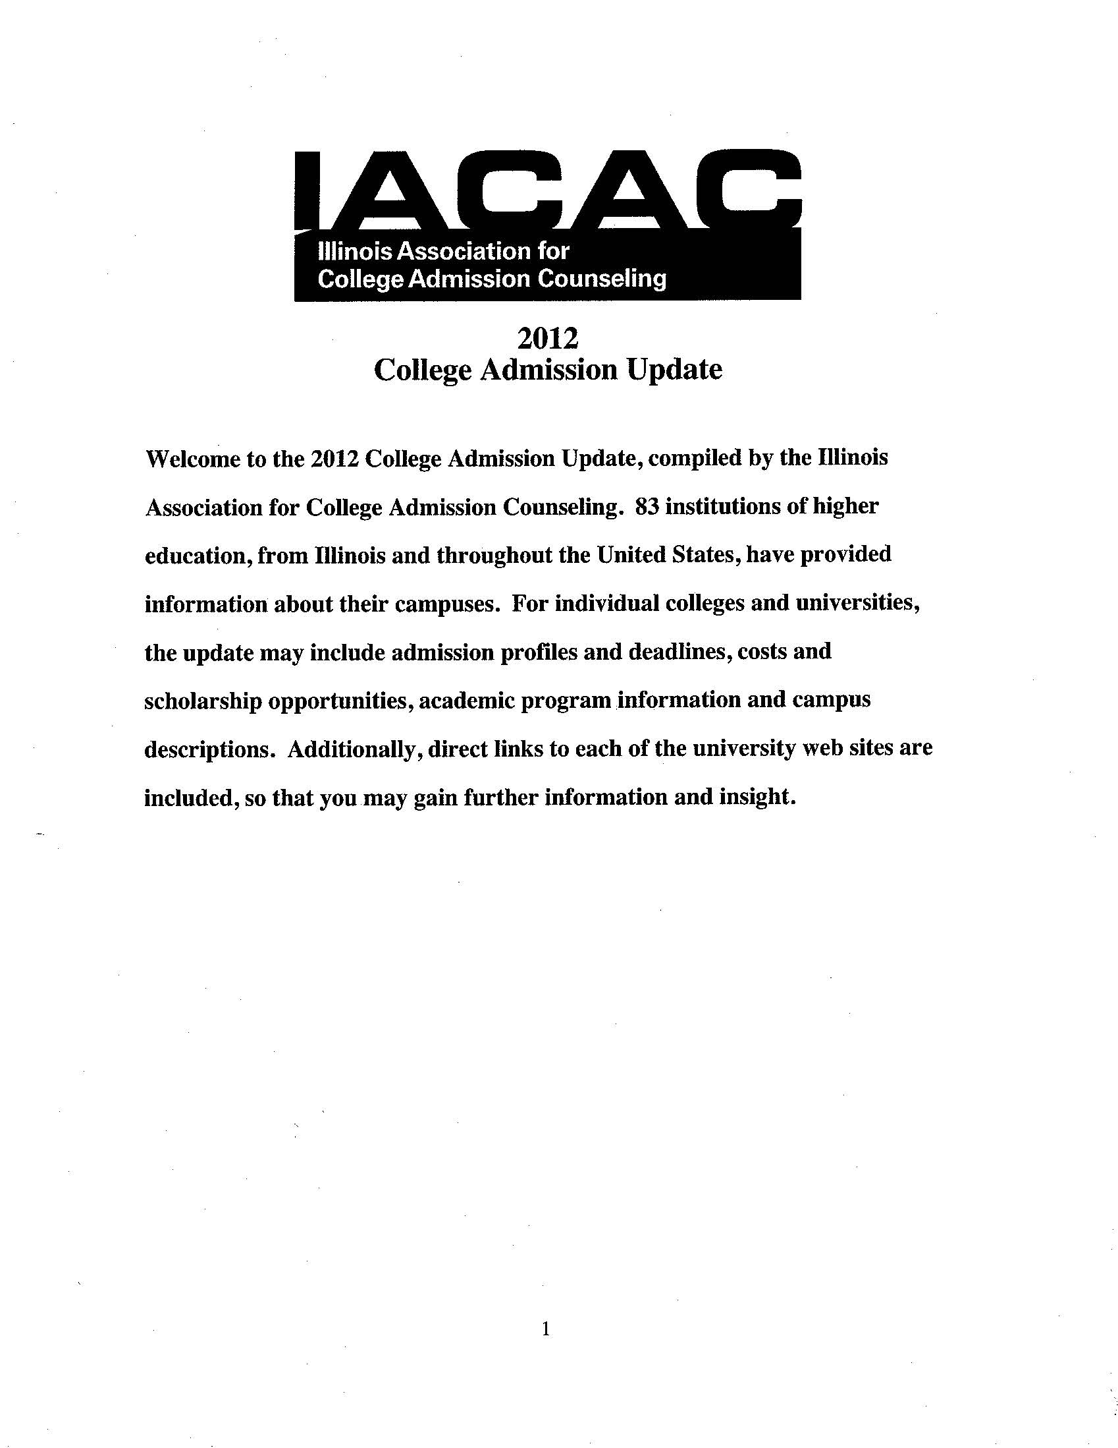
Resources – IACAC
STATE UNIVERSITIES IN ILLINOIS – ARTICULATION
IACAC – Illinois Association for College Admissions Counseling

Slide 33
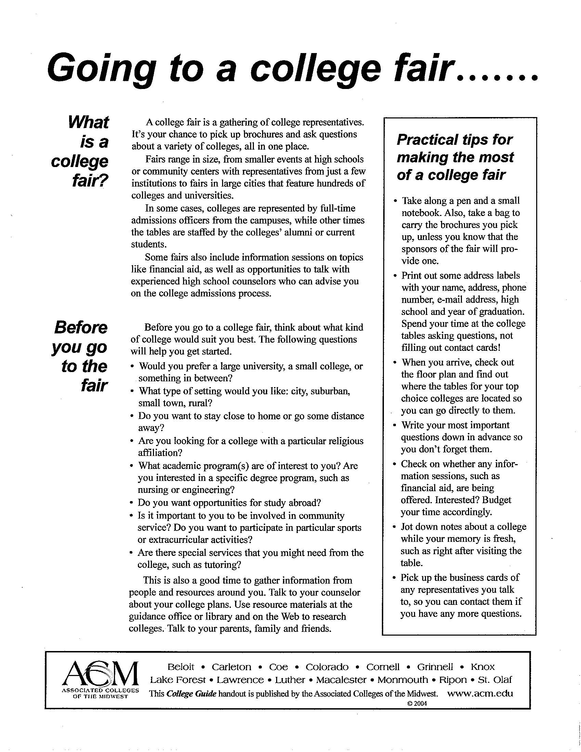
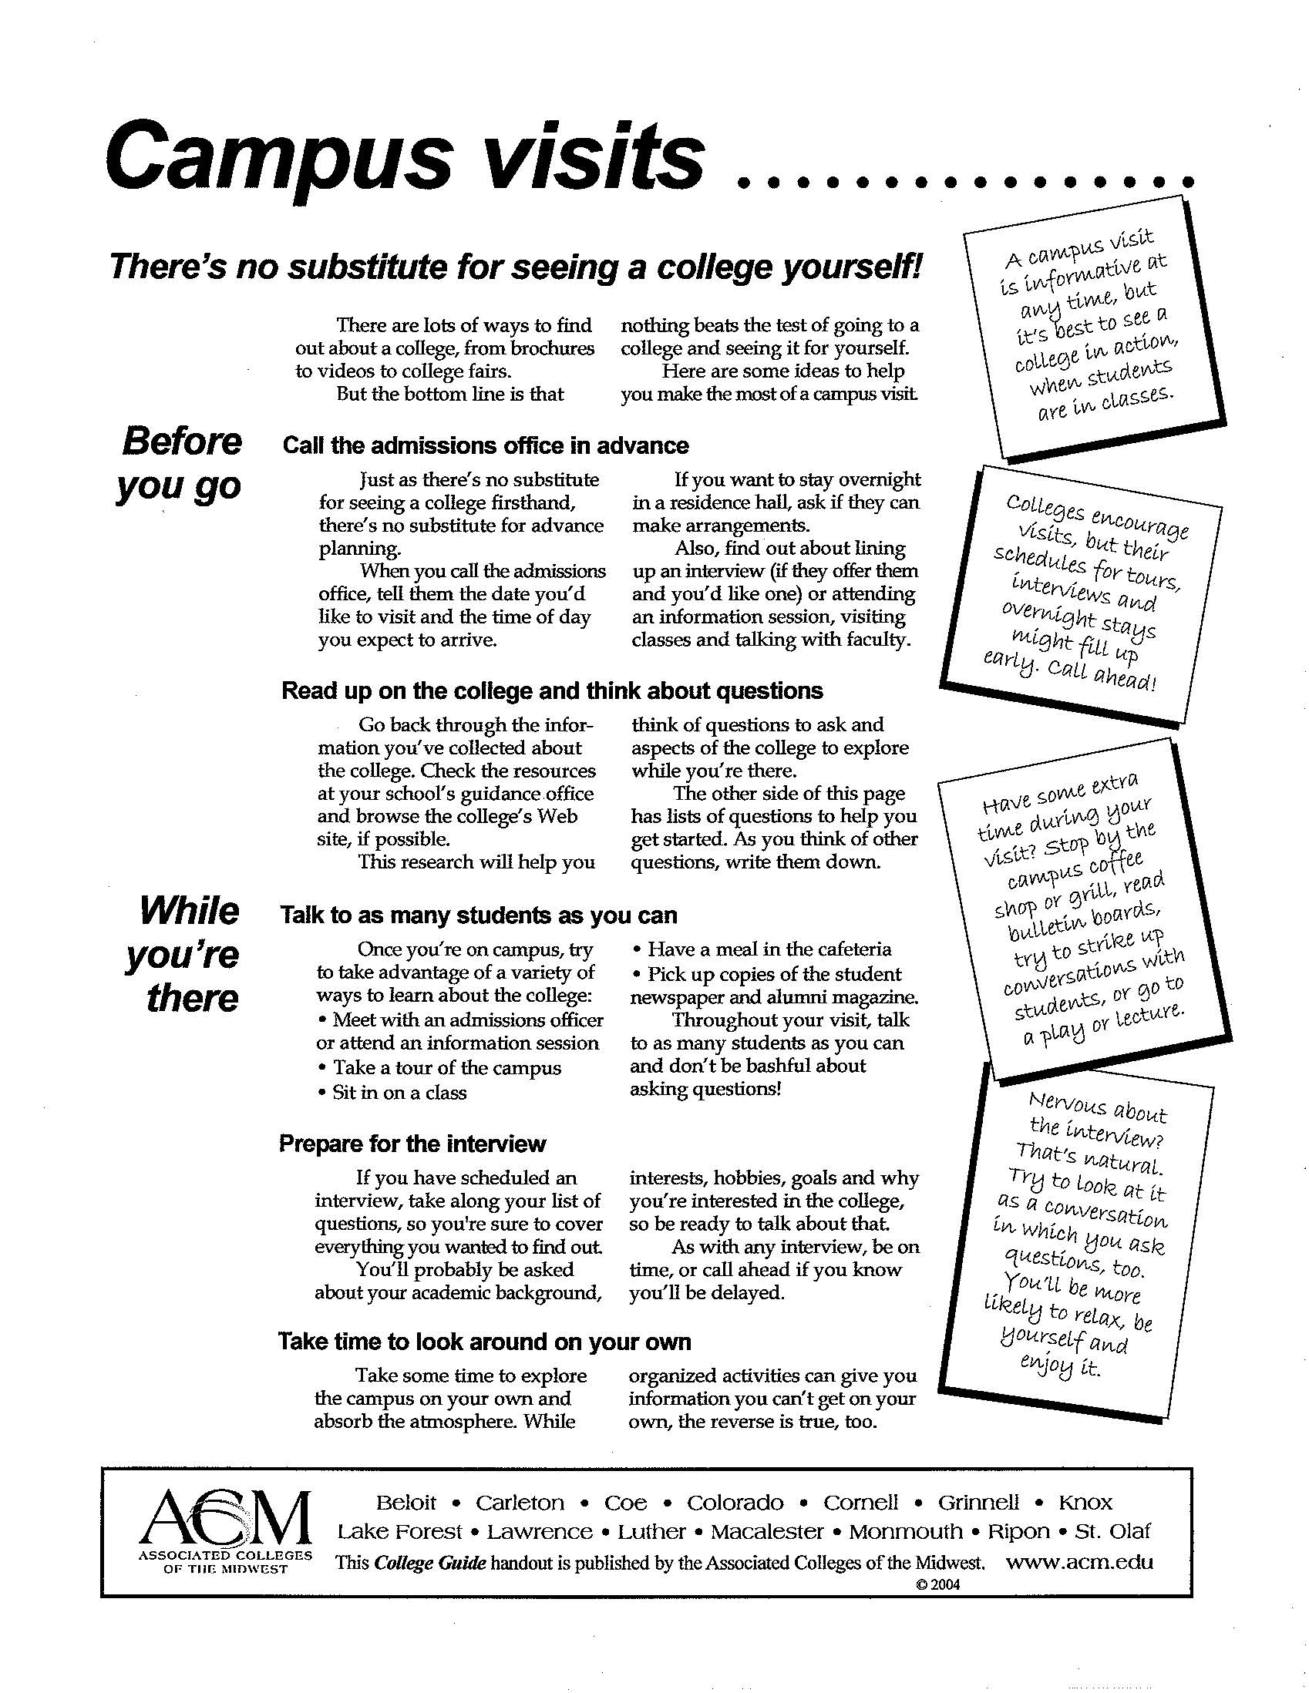
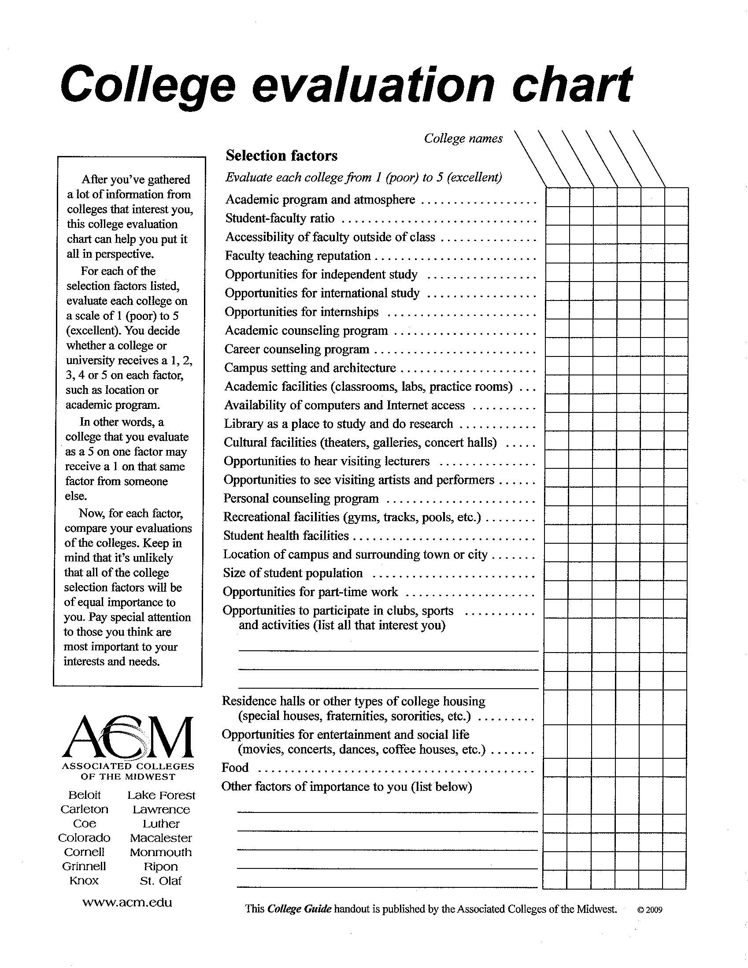
Resources – Assoc. Colleges of Midwest
COLLEGE FAIRS CAMPUS VISITS COLLEGE EVALUATION
Going to a College Fair…
Campus Visits
College Evaluation Chart
Associated Colleges of the Midwest - www.acm.edu

Slide 34
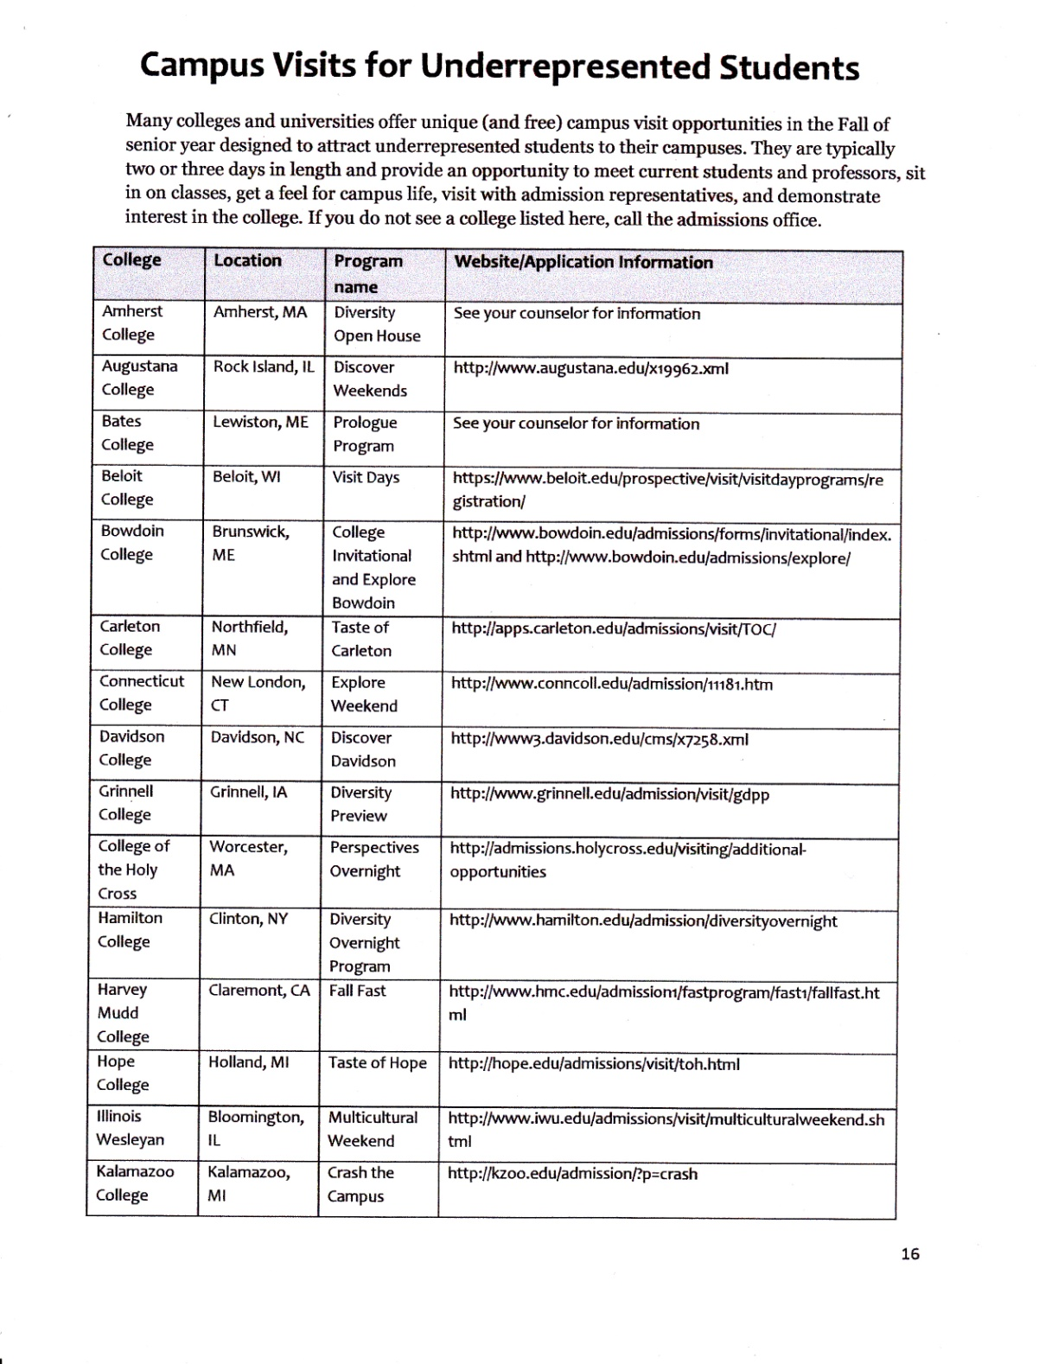
Resources – Diverse Students
UNDOCUMENTED STUDENTS UNDERREPRESENTED STUDENTS
College Evaluation Chart
IACAC College Advising Guide Walter Payton HS

Slide 35
Diversity
Intellect
Economy
Race
Culture
Gender
Geography

Slide 36
Diverse Students’ College Selection Criteria
Cost
Prestige/Reputation
Media & Sports attract
Trade or professional programs
Diversity – acceptance
Parental influence
Location – family ties, religion, safety, gender

Slide 37
US NEWS DIVERSITY | INDEX
University of Illinois - Chicago | 0.70
Northeastern Illinois University | 0.67
Roosevelt University | 0.65
Dominican University | 0.61
Illinois Institute of Technology | 0.57
University of Chicago | 0.57
St. Xavier | 0.57
DePaul | 0.55
Northwestern University | 0.54
Northern Illinois | 0.51
Benedictine University | 0.50
Loyola University | 0.50
University of Illinois - Urbana | 0.50
2013 US News & World Report – excludes international students. 1.0 most diverse

Slide 38
INTERNATIONAL STUDENTS | %
Illinois Institute of Technology | 21%
University of Illinois - Urbana | 13%
Lake Forest | 12%
University of Chicago | 9%
Knox College | 9%
Northwestern University | 6%
Northeastern Illinois | 4%
Illinois Wesleyan | 4%
Roosevelt | 2%
DePaul | 2%
Southern Illinois - Carbondale | 2%
Millikin | 2%
University of Illinois - Chicago | 1%
2013 US News & World Report rankings & reviews

Slide 39
Source: US census.gov – higher education

Slide 40
Finding a Good Fit
World of possibilities
Many hands in college selection
Some delayed decision
Today is decision day!
Help me make a decision!

Slide 41
Making Decisions
Six most important criteria
Extra news is distracting
Don’t focus on small details
Consciously contemplate options…..
Then, let the unconscious brain choose
Better decision – better outcomes
Source: How We Decide, Jonah Lehrer, 2009

Slide 42
COLLEGE MAP
Empower students to make better college decisions!

Slide 43
Hayley Schueneman Knox College

Slide 44
The College Admissions Continuum
Recruit
Evaluate
There are schools that lie on each point of the continuum, and they look at different factors. It’s important to engage in the process so that you can be as savvy as possible as to what different schools are looking for – that way, you can find the right fit for you.

Slide 45
Admission at a small liberal arts school
What we’re looking for:
students who like learning for the sake of learning: passionate
students who are willing to explore and don’t always take things at surface value: curious
students who are leaders and agents of change, in their school and community: dedicated
students who are willing to address their strengths, weaknesses, and limitations: self-aware
Notice anything missing?

Slide 46
Empowering students to be advocates for their own education
Entreat guidance from others, but ultimately students should follow their own path
Use action words as a starting point for self-evaluation (“Choosing a College”)
Take research beyond the basics (“9 Myths”)

Slide 47
What can we do to assist students?
Get students excited about the process, encourage them to take charge
Try to show instead of tell
Be responsive
Be aware of their tone and personality
Help them remember that this is fun
A lot of stress is placed on these students from a variety of sources

Slide 48
Final Thoughts
A student who is taking charge of their college search is a student that admission counselors love working with:
They ask insightful questions
They’re engaged in the visit/interview
They’re the students who we look forward the most to checking in with, and get excited when they make their decision - whether they attend our school or not
They remind us why we do this job

Slide 49
Sarah Idzik University of Chicago

